Slide 1
KeyKit
Musical Fun with Windows, Tasks, and Objects
Tim Thompson
tjt@nosuch.com

Slide 2
What is it?
Programming language - interpreted, multi-tasking, graphics, object-oriented
Specialized for MIDI algorithmic and realtime manipulation, “phrase” data type, realtime scheduling
Multi-window graphical user interface, pull-off menus and buttons, tools include multi-track editor, drum pattern editor
Entire user interface and all tools written in KeyKit and provided as source code in library, easily customized and extended

Slide 3
Reason for Being
Hacking - fun, programming, normal music composition, algorithmic music
learning - OS’s, device drivers, graphics, user interface design, OO
personal and programmer-centric, not commercial, although current version is complete enough for non-programmers

Slide 4
Development History
1.0 - BASIC-like
2.0 - realtime
3.0 - grammer, rewrite, fast enough to avoid built-ins
4.0 - graphics
5.0 - first multi-window attempts, multi-tasking, fifos, tools using tasks/fifos
6.0 - object-oriented, multi-window interface rewritten, pull-off menus/buttons

Slide 5
Development machines
Atari ST, PC (286), UNIX (386, X11), Windows NT, Win95
Ported at various times to: Atari ST, DOS, UNIX PC, Mac, Amiga, SVR3, SVR4, SunOS, NeXT, X Windows, SGI, Amdahl, VAX, 5620, Plan 9, Windows 3.1/NT/95

Slide 6
Language Features
Inspired by awk
Variables need not be declared
No semicolons
#define, #include
The usual control structures and expressions

Slide 7
Phrase data type
Time-ordered list of MIDI “notes” - can be system-exclusives, isolated note-on, isolated note-off, or full note with duration
Constant value syntax
ph = ‘c e g’ # ph is a c major triad
ph = ‘dc2,e,f’ # ph is an arpeggio, channel 2
Structure-like manipulation of attributes :
ph.dur = 1b # all note durations = 1 beat
ph.pitch += 12 # transposed up an octave

Slide 8
Phrase and Note Attributes
pitch (0-127)
vol(0-127)
chan (1-16)
dur (in clicks)
time (in clicks, relative to beginning of phrase)
type (NOTE, NOTEON, NOTEOFF, MIDIBYTES, PROGRAM, PRESSURE, etc.)
length (of phrase, independent of notes in it)
attrib (string, arbitrary meaning)
flags (integer, arbitrary meaning, bit 1 == picked)

Slide 9
Phrase Operations
Serial concatenation
ph = ph1 + ph2
Parallel merging
ph = ph1 | ph2
Removing notes
ph = ph1 - ph2
Matching notes
ph = ph1 & ph2
Nth note
ph = ph1 % n

Slide 10
Phrase Operations - the “select”
ph = ph1 { ??.pitch > 60 }
ph = ph1 { ??.dur > 1b }
ph = ph1 { isonbeat(??,4b) }
ph = ph1 { ??.number < 4 }
ph = ph1 { rand(3)==0 }
ph = ph1 { isinscale(??,scale) }
ph = ph - ph { ??.type == MIDIBYTES }

Slide 11
Phrase Operations - Looping
# randomize volume of each note and
# construct a new phrase with the result
r = ‘‘
for ( nt in ph ) {
nt.vol += rand(10)
r = r | nt # or r |= nt
}
# randomize volume of each note, in-place
for ( n=0; n<sizeof(ph); n++ )
ph%n.vol += rand(10)

Slide 12
Function values, In-line Functions
function major(k) {return(k|transpose(k,4)|transpose(k,7));}
function minor(k) { return(k|transpose(k,3)|transpose(k,7));}
function randchordtype() {
if ( rand(2) == 0 ) return(major) else return(minor)
}
f = randchordtype()
f(‘c’)
randchordtype()(‘c’)
Instead of return(major), you could use an in-line function:
return (function ? (k){return(k|transpose(k,4)|transpose(k,7));})

Slide 13
Other Language Features
Variable arguments - … , nargs(), argv(), varg()
Fifos
Objects
Graphics - primitive elements are:
lines, rectangles, text, windows,
phrase windows, menus

Slide 14
Variable Arguments
function savecall(f,...){
# save a function and argument list
Callfunc = f
Callargs = argv(1,nargs())
}
function docall(phr) {
Callfunc(phr,varg(Callargs));
}
savecall(quantize,1b)
docall(‘a,b,c’)
savecall(repeat,4,2b,5b)
docall(‘a,b,c’)

Slide 15
Tasks and I/O
All tasks are time-shared evenly, interleaved at the interpreted instruction level
Scheduled MIDI output events are tasks as well, but performance can’t be degraded by other tasks
MIDI input is always being recorded, available in a global variable for easy and immediate processing
MIDI, mouse, and console input events can be read from special fifos
Reading a fifo (with no data waiting) blocks a task
lock() and unlock() used for exclusion and synchronization

Slide 16
KeyKit - the GUI
Completely implemented with Keykit code, even pull-off menus, dragging of windows, etc.
Tools framework allows all tools to be manipulated consistently for resizing, saving/restoring state, copying

Slide 17
The GUI Tools
Bang, Blocks, Bounce, Chord Palette, Console, Controller, Echo, Group, Kboom, Loopy, Markov Maker, Mouse Matrix, Parameters, Peer, Prog Change, Riff, RiffRaff, Sectionalize, Tempo, Volume, and others

Slide 18
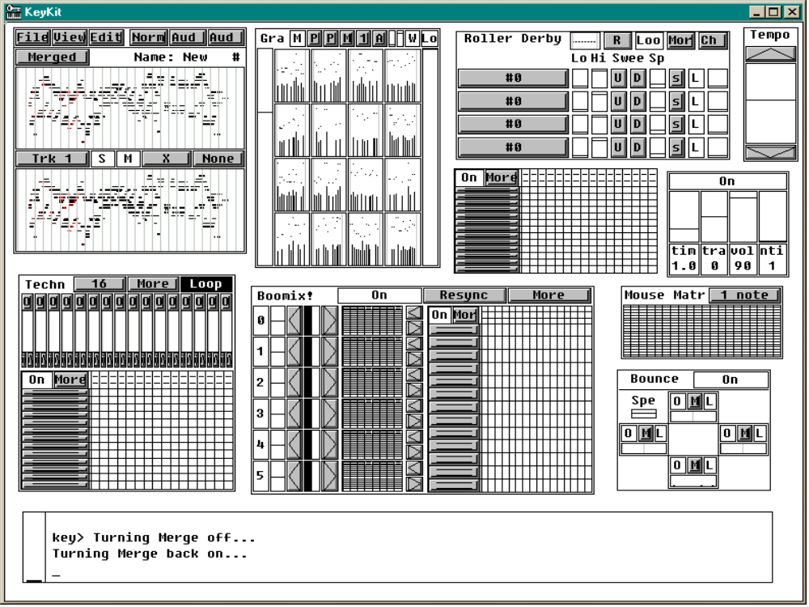

Slide 19
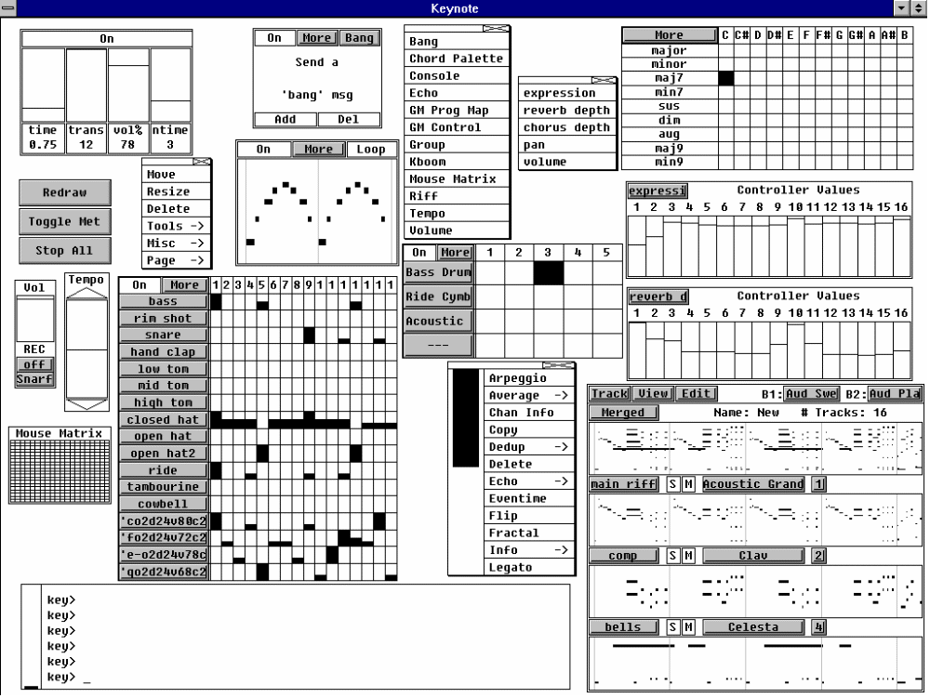

Slide 20
KeyKit’s Unique Strengths
Phrase (as opposed to note) manipulation supported directly by the language syntax
Interpreted language makes iterative development a breeze - immediate feedback
Robust - syntax and execution errors do not bring the system (or even other tasks) down
Associative arrays - simple but powerful
Finely-grained multi-tasking gives graceful sharing of CPU, no degradation in realtime scheduling

Slide 21
KeyKit’s Unique Strengths
Textual language allows concise expression of:
  Reusable parameterized utility functions
  Time-ordered layout of composition
  Data-driven algorithms
  Independent algorithms running in parallel
GUI framework encourages “tool-oriented” approach to building music
Same language used to implement GUI and all tools, no need to escape to (or learn) C

Slide 22
Availability and Resources
Freely available, with complete source code
Win95/98/NT and Linux executables
Mac port exists, but needs MIDI I/O work
Download site and mailing list:
  http://www.nosuch.com/keykit
Documentation
  Tutorial
  Tools reference manual
  Hacking the user interface
  Language reference manual

