Slide 1
Happy Feet and other recent adventures with KeyKit
Tim Thompson
tjt@nosuch.com

Slide 2
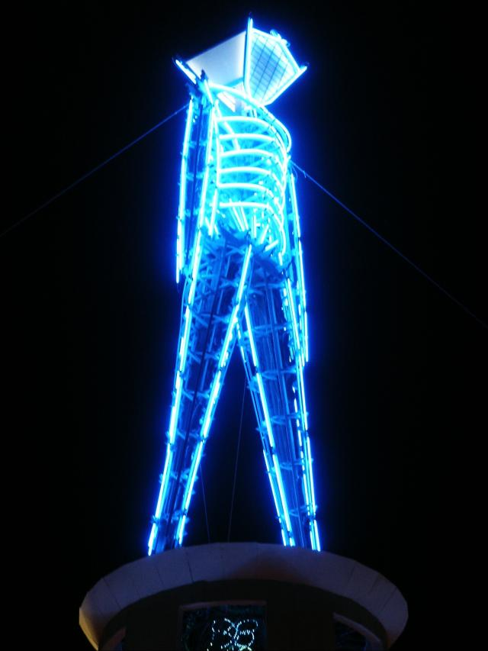
Burning Man Rules!

Slide 3
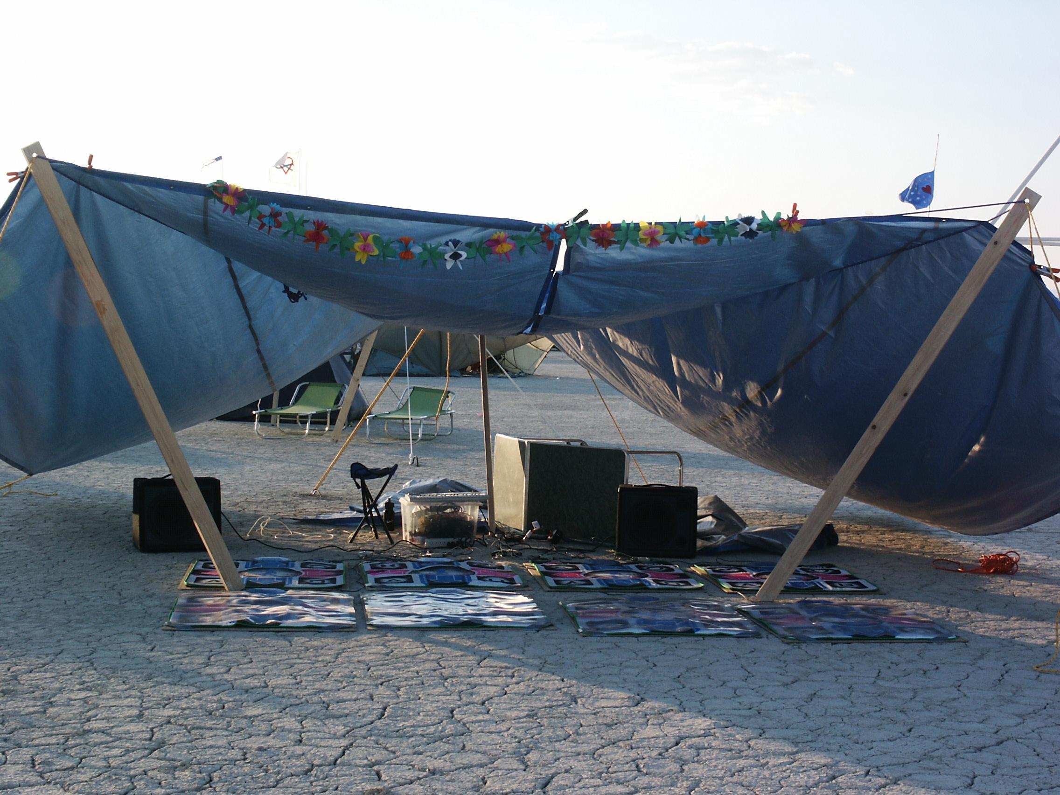
Dance Pads at Burning Man

Slide 4
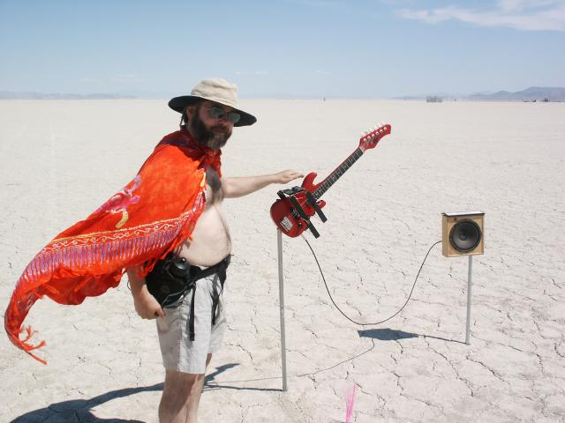
Tim at Burning Man

Slide 5
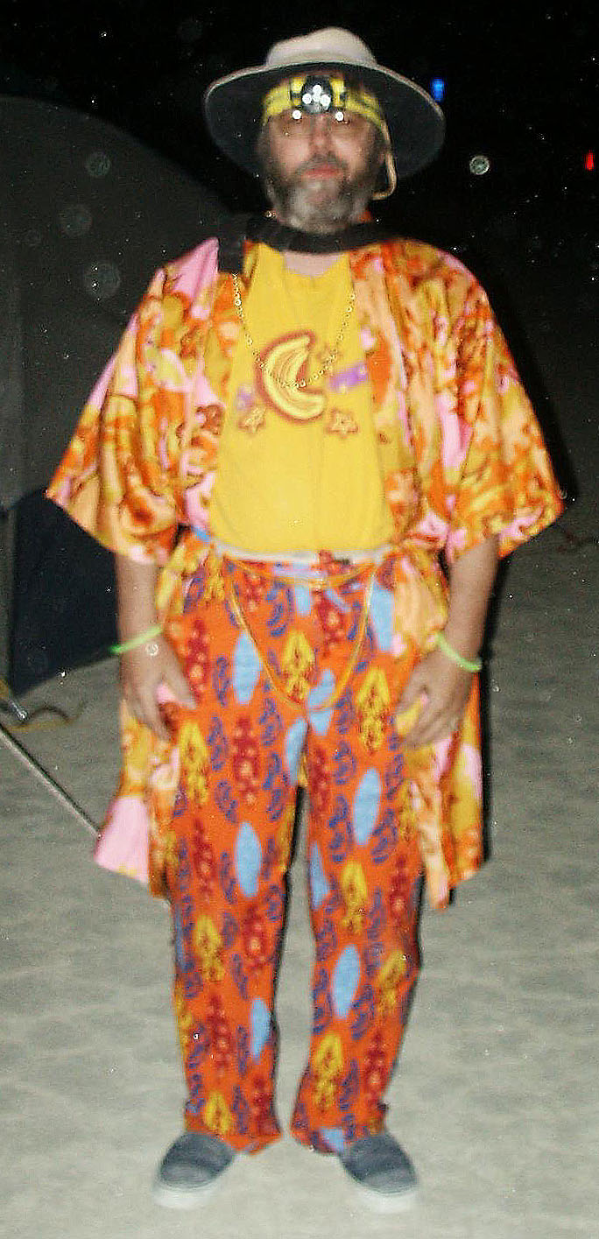
Dork at Burning Man

Slide 6
Outline
History
Features
  Language
  GUI
  Realtime
Recent Adventures
  Expresso
  Typo
  Gene Pool
  Dance Pad interfacing
  Happy Feet

Slide 7
What is it?
Programming language - interpreted, multi-tasking, graphics, object-oriented
Specialized for MIDI algorithmic and realtime manipulation, “phrase” data type, realtime scheduling
Multi-window graphical user interface, pull-off menus and buttons, tools include multi-track editor, drum pattern editor
Entire user interface and all tools written in KeyKit and provided as source code in library, easily customized and extended

Slide 8
Reason for Being
Hacking - fun, programming, normal music composition, algorithmic music
learning - OS’s, device drivers, graphics, user interface design, OO
personal and programmer-centric, not commercial, although current version is complete enough for non-programmers

Slide 9
Development History
1.0 - BASIC-like
2.0 - realtime
3.0 - grammer, rewrite, fast enough to avoid built-ins
4.0 - graphics
5.0 - first multi-window attempts, multi-tasking, fifos, tools using tasks/fifos
6.0 - object-oriented, multi-window interface rewritten, pull-off menus/buttons
7.0 – support for multiple MIDI ports

Slide 10
Development machines
Atari ST, PC (286), UNIX (386, X11), Windows NT, Win95, Win98
Ported at various times to: Atari ST, DOS, UNIX PC, Mac, Amiga, SVR3, SVR4, SunOS, NeXT, X Windows, SGI, Amdahl, VAX, 5620, Plan 9, Windows 3.1/NT/95/98/XP

Slide 11
Language Features
Inspired by awk
Variables need not be declared
Semicolons not required
#define, #include
The usual control structures and expressions (except no switch)

Slide 12
Phrase data type
Time-ordered list of MIDI “notes” - can be system-exclusives, isolated note-on, isolated note-off, or full note with duration
Constant value syntax
ph = ‘c e g’ # ph is a c major triad
ph = ‘dc2,e,f’ # ph is an arpeggio, channel 2
Structure-like manipulation of attributes :
ph.dur = 1b # all note durations = 1 beat
ph.pitch += 12 # transposed up an octave

Slide 13
Phrase and Note Attributes
pitch (0-127)
vol(0-127)
chan (1-16)
dur (in clicks)
time (in clicks, relative to beginning of phrase)
type (NOTE, NOTEON, NOTEOFF, MIDIBYTES, PROGRAM, PRESSURE, etc.)
length (of phrase, independent of notes in it)
attrib (string, arbitrary meaning)
flags (integer, arbitrary meaning, bit 1 == picked)

Slide 14
Phrase Operations
Serial concatenation
ph = ph1 + ph2
Parallel merging
ph = ph1 | ph2
Removing notes
ph = ph1 - ph2
Matching notes
ph = ph1 & ph2
Nth note
ph = ph1 % n

Slide 15
Phrase Operations - the “select”
ph = ph1 { ??.pitch > 60 }
ph = ph1 { ??.dur > 1b }
ph = ph1 { isonbeat(??,4b) }
ph = ph1 { ??.number < 4 }
ph = ph1 { rand(3)==0 }
ph = ph1 { isinscale(??,scale) }
ph = ph - ph { ??.type == MIDIBYTES }

Slide 16
Phrase Operations - Looping
# randomize volume of each note and
# construct a new phrase with the result
r = ‘‘
for ( nt in ph ) {
nt.vol += rand(10)
r = r | nt # or r |= nt
}
# randomize volume of each note, in-place
for ( n=0; n<sizeof(ph); n++ )
ph%n.vol += rand(10)

Slide 17
Function values, In-line Functions
function major(k) {return(k|transpose(k,4)|transpose(k,7));}
function minor(k) { return(k|transpose(k,3)|transpose(k,7));}
function randchordtype() {
if ( rand(2) == 0 ) return(major) else return(minor)
}
f = randchordtype()
f(‘c’)
randchordtype()(‘c’)
Instead of return(major), you could use an in-line function:
return (function ?(k){return(k|transpose(k,4)|transpose(k,7));})

Slide 18
Other Language Features
Variable arguments - … , nargs(), argv(), varg()
Fifos
Objects
Graphics - primitive elements are:
lines, rectangles, text, windows,
phrase windows, menus

Slide 19
Variable Arguments
function calleither(f1,f2,...){
if (rand(2) == 0) {
f1(...)
} else {
f2(...)
}
P = calleither(flip,reverse,p)
P = calleither(scadjust,scafilt,p,scale1)

Slide 20
Variable Arguments
function savecall(f,...){
# save a function and argument list
Callfunc = f
Callargs = argv(1,nargs())
}
function docall(phr) {
Callfunc(phr,varg(Callargs));
}
savecall(quantize,1b)
docall(‘a,b,c’)
savecall(repeat,4,2b,5b)
docall(‘a,b,c’)

Slide 21
Tasks and I/O
All tasks are time-shared evenly, interleaved at the interpreted instruction level
Scheduled MIDI output events are tasks as well, but performance can’t be degraded by other tasks
MIDI input is always being recorded, available in a global variable for easy and immediate processing
MIDI, mouse, and console input events can be read from special fifos
Reading a fifo (with no data waiting) blocks a task
lock() and unlock() used for exclusion and synchronization

Slide 22
KeyKit - the GUI
Completely implemented with Keykit code, even pull-off menus, dragging of windows, etc.
Tools framework allows all tools to be manipulated consistently for resizing, saving/restoring state, copying

Slide 23
The GUI Tools
Bang, Blocks, Bounce, Chord Palette, Console, Controller, Echo, Group, Kboom, Loopy, Markov Maker, Mouse Matrix, Parameters, Peer, Prog Change, Riff, RiffRaff, Sectionalize, Tempo, Volume, and many others

Slide 24
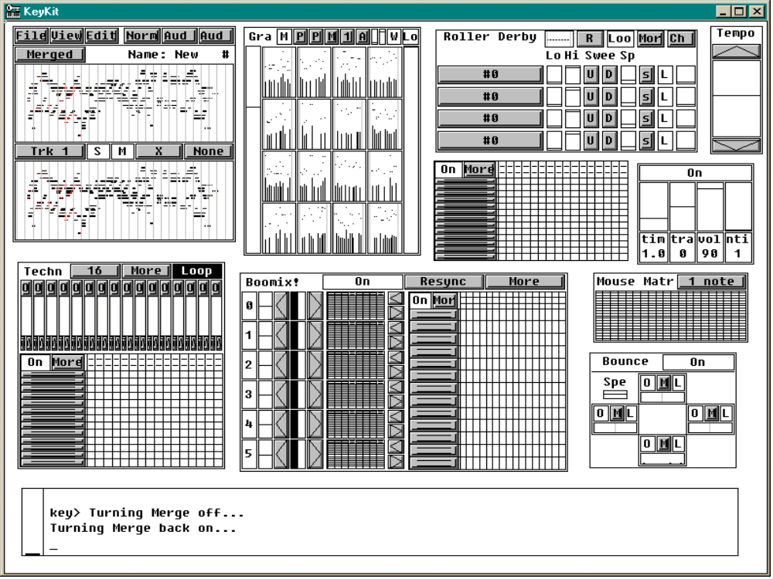

Slide 25
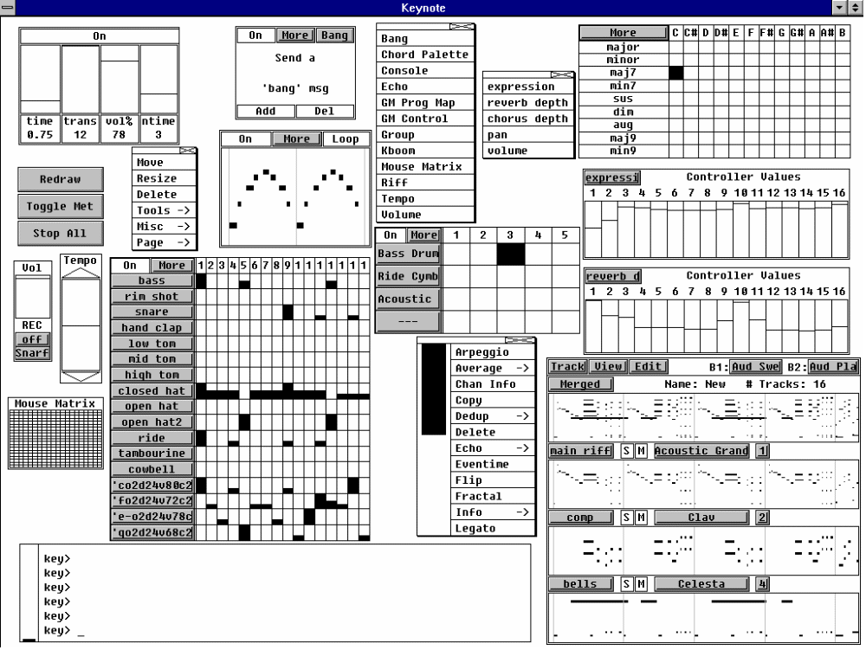

Slide 26
Summary of Unique Strengths
Phrase (as opposed to note) manipulation supported directly by the language syntax
Interpreted language makes iterative development a breeze - immediate feedback
Robust - syntax and execution errors do not bring the system (or even other tasks) down
Associative arrays - simple but powerful
Finely-grained multi-tasking gives graceful sharing of CPU, no degradation in realtime scheduling

Slide 27
Summary of Unique Strengths (continued)
Textual language allows concise expression of:
  Reusable parameterized utility functions
  Time-ordered layout of composition
  Data-driven algorithms
  Independent algorithms running in parallel
GUI framework encourages “tool-oriented” approach to building music
Same language used to implement GUI and all tools, no need to escape to (or learn) C

Slide 28
Availability and Resources
Freely available, with complete source code
Win95/98/NT/XP and Linux executables
Mac port exists, but needs MIDI I/O work
Download site:
  http://nosuch.com/keykit
Documentation
  Tutorial, tools reference, language reference, hacking guide
Mailing list

Slide 29
Recent adventures in KeyKit
Expresso
Typo
Gene Pool
Dance Pad interfacing
Happy Feet

Slide 30
Expresso
L-systems fractal generation
Driven from file of expression transformations
Starting expression is “X”
After 10-20 generations, expression is huge
Substituting note or small phrase for X produces wide variety of results
Used interactively for Woodstockhausen 2000 performance
Basis of several Tune Toys on nosuch.com

Slide 31
Expresso – default transformations
# This is a set of transformations for expresso
A = A+A
A = A|A
A = transpose(A,4)
A = transpose(A,-5)
A = transpose(A,-7)
A = A+transpose(A,12)
A = A+transpose(A,7)
A = A+transpose(A,4)+transpose(A,7)
A = echo(A,4,6)
A = step(A,12)
A = arpeggio(A)
A = shuffle(A)

Slide 32
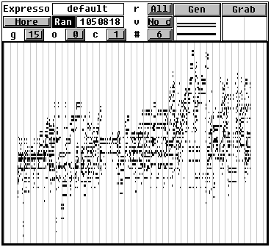
Expresso – GUI tool
Generates new result
Phrase to use for value of X
# of generations
# of tracks
to generate

Slide 33
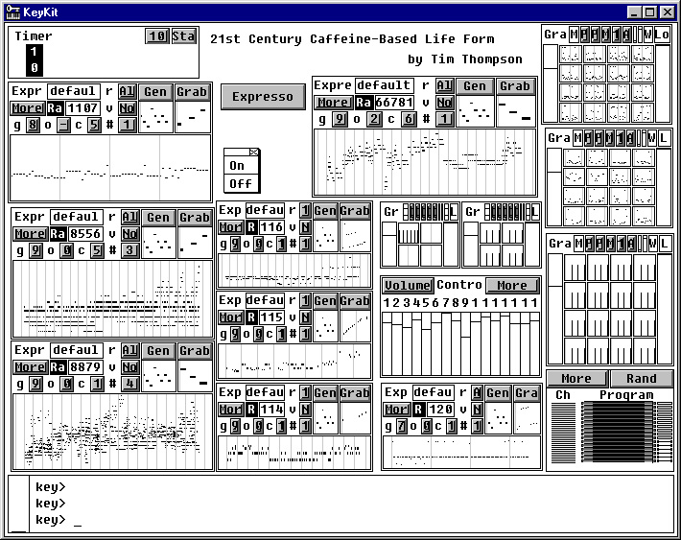
8 instances ( ) of Expresso tool used interactively in
“21st Century Caffeine-based Life Form” at Woodstockhausen 2000

Slide 34
Typo
Typing keyboard used as musical controller
Based on ability to receive console up/down events (Windows-specific addition to keykit)
Most keys used to play notes; holding down control key used to access other functions
Holding down shift key causes notes to be recorded and looped
Number keys 0-9 control “sections” – each section retains sound choices and looped notes
Used for Woodstockhausen 2001 performance

Slide 35
Gene Pool – musical mating
Uses small instruction set of musical opcodes
Each opcode does one thing:
  Adjust pitch (or time, velocity, duration) of current note
  Set pitch (or time, velocity, duration) of current note
  Trigger note (i.e. add current note to the generated result)
Any phrase can be disassembled into a sequence of musical opcodes that generates it
Mating of these sequences produces new generations
  Take half of one, half of the other
  Shuffle them
  Etc.

Slide 36
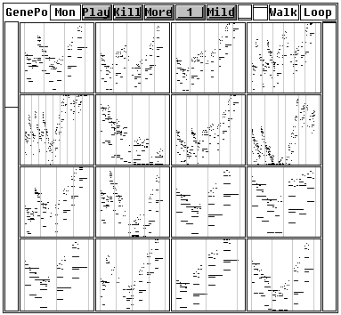
Gene Pool – GUI
Left-click
plays
Right-click
kills and fills
by mating
survivors

Slide 37
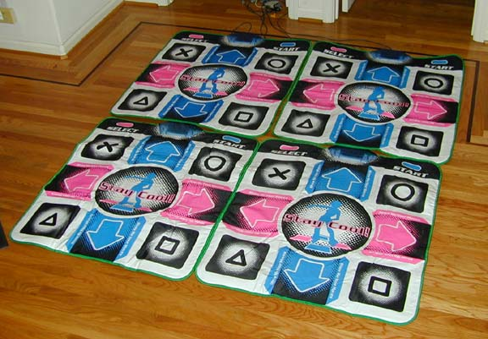
Dance Pads

Slide 38
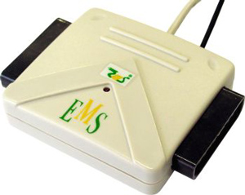
Dance Pad Interfacing
PS2-to-USB interfaces, not all created equal
EMS USB 2-port interface works well
(available at www.levelsix.com
or www.gocybershop.net)
Windows driver makes dance pad look like buttons on a joystick, works with standard multimedia API
Able to connect 4 interfaces (8 pads) simultaneously
Pads and interfaces have been surprisingly reliable

Slide 39
KeyKit interface to Dance Pad
Windows events (and/or polling) generate keykit events
Appears as a fifo, just like mouse/console/midi
Order of pads is non-deterministic, need to establish order (by pressing in sequence) at startup, if order is important
Good responsiveness

Slide 40
Happy Feet
Bach’s “Jesu, Joy of Man’s Desiring” provides notes
Music broken into snippets by time or attacks
Snippets assigned across all 4 dance pads, in sets
Advancing through sets is controlled by select button
4 sections in performance
Performed at Woodstockhausen 2002

Slide 41
Dance Pad UI
8 main buttons play notes or snippets
Select and Start buttons, followed by a main button, perform control functions
Pressing Select or Start multiple times (2 or 4) is used to perform less-common functions
Each of 4 pads is independent and usually identical, some functions affect one pad, some affect all pads
People try the Select and Start buttons without knowing what they do – need to “hide” functions more

Slide 42
Dance Pad Controls
Fourth section of “Happy Feet” is most open-ended
Select-UP: transpose an octave up
Select-DOWN: transpose an octave down
Select-UPRIGHT: change patch
Start-UPRIGHT: toggle looping
Start*2-UPRIGHT: toggle fading
Select*2-LEFT: toggle drums
Etc…

Slide 43
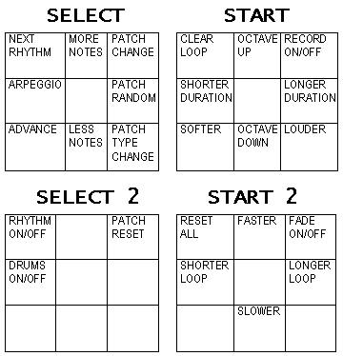
Dance Pad Controls

Slide 44
Tim looking cool at Burning Man

