Slide 1
KeyKit
Tim Thompson
tjt@nosuch.com
http://nosuch.com

Slide 2
Outline
History
Language and GUI
Algorithmic Tools
Interactive Tools
Realtime Tools
Hardware Interfacing
Combinations thereof

Slide 3
What is it?
Textual programming language – procedural, interpreted, multi-tasking, graphics, object-oriented
Specialized for MIDI algorithmic and realtime manipulation, first-class “phrase” data type, realtime scheduling
Multi-window graphical user interface, pull-off menus and buttons, tools include multi-track editor, drum pattern editor
Entire user interface and all tools written in the language and provided as source code in library, easily customized and extended

Slide 4
Reason for Being
Hacking - fun, programming, normal music composition, algorithmic music
learning - OS’s, device drivers, graphics, user interface design, OO
personal and programmer-centric, not commercial, although current version is complete enough for non-programmers

Slide 5
Development History
1.0 - BASIC-like
2.0 - realtime
3.0 - grammer, rewrite, fast enough to avoid built-ins
4.0 - graphics
5.0 - first multi-window attempts, multi-tasking, fifos, tools using tasks/fifos
6.0 - object-oriented, multi-window interface completely rewritten, pull-off menus/buttons
7.0 – support for multiple MIDI ports

Slide 6
Development machines
Atari ST, PC (286), UNIX (386, X11),
Windows NT, Win95/98/XP
Ported at various times to: Atari ST, DOS, UNIX PC, Mac, Amiga, SVR3, SVR4, SunOS, NeXT, X Windows, SGI, Amdahl, VAX, 5620, Plan 9, Windows 3.1/NT/95/98/XP

Slide 7
Language Features
Inspired by awk
Variables need not be declared
Semicolons not required
#define, #include
The usual control structures and expressions (although no switch)

Slide 8
MIDI Phrase is a first-class data type
Time-ordered list of MIDI “notes” - can be system-exclusives, isolated note-on, isolated note-off, or full note with duration
Constant value syntax
ph = ‘c e g’ # ph is a c major triad
ph = ‘dc2,e,f’ # ph is an arpeggio, channel 2
Structure-like manipulation of attributes :
ph.dur = 1b # all note durations = 1 beat
ph.pitch += 12 # transposed up an octave

Slide 9
Phrase/Note Attributes
pitch (0-127)
vol(0-127)
chan (1-16)
dur (in clicks)
time (in clicks, relative to beginning of phrase)
type (NOTE, NOTEON, NOTEOFF, MIDIBYTES, PROGRAM, PRESSURE, etc.)
length (of phrase, independent of notes in it)
attrib (string, arbitrary meaning)
flags (integer, arbitrary meaning, bit 1 == picked)

Slide 10
Phrase Operations
Serial concatenation
ph = ph1 + ph2
Parallel merging
ph = ph1 | ph2
Removing notes
ph = ph1 - ph2
Matching notes
ph = ph1 & ph2
Nth note
ph = ph1 % n

Slide 11
Phrase Operations - the “select”
ph = ph1 { ??.pitch > 60 }
ph = ph1 { ??.dur > 1b }
ph = ph1 { isonbeat(??,4b) }
ph = ph1 { ??.number < 4 }
ph = ph1 { rand(3)==0 }
ph = ph1 { isinscale(??,scale) }
ph = ph - ph { ??.type == MIDIBYTES }

Slide 12
Phrase Operations - Looping
# randomize volume of each note and
# construct a new phrase with the result
r = ‘‘
for ( nt in ph ) {
nt.vol += rand(10)
r = r | nt # or r |= nt
}
# randomize volume of each note, in-place
for ( n=0; n<sizeof(ph); n++ )
ph%n.vol += rand(10)

Slide 13
Function values
function major(k) {
return(k|transpose(k,4)|transpose(k,7));
}
function minor(k) {
return(k|transpose(k,3)|transpose(k,7));
}
function randchordtype() {
if ( rand(2) == 0 )
return(major)
else
return(minor)
}
f = randchordtype() # value of f is a function
f(‘c’)
randchordtype()(‘c’)

Slide 14
Other Language Features
Variable arguments - … , nargs(), argv(), varg()
Fifos and locking
Objects
Graphics - primitive elements are:
lines, rectangles, text, windows,
phrase windows, menus
Machine-dependent hook – mdep() – used to add/expose non-portable features
TCP/IP hooks available for Windows and Linux, network interaction

Slide 15
Variable Arguments
function calleither(f1,f2,...){
if (rand(2) == 0) {
f1(...)
} else {
f2(...)
}
P = calleither(flip,reverse,p)
P = calleither(scadjust,scafilt,p,scale1)

Slide 16
Tasks and I/O
All tasks are time-shared evenly, interleaved at the interpreted instruction level
Scheduled MIDI output events are tasks as well, but performance can’t be degraded by other tasks
MIDI input is always being recorded, available in a global variable for easy and immediate processing
MIDI, mouse, and console input events can be read from special fifos
Reading a fifo (with no data waiting) blocks a task
lock() and unlock() used for exclusion and synchronization

Slide 17
KeyKit - the GUI
Completely implemented with Keykit code, even pull-off menus, dragging of windows, window-manager-like operations, etc.
Each tool is independent, with consistent methods for resizing and inter-tool communication
Consistent saving/restoring mechanism of individual tools is highly leveraged, used for:
  Copying between like tools
  Copy/paste of entire tools
  Moving tools between “pages”
  Manipulating of tools within tools
  Broadcasting of a tool and its contents across a network

Slide 18
Variety of Tools
Why so many?
  Improvisational interactive programming
Ball Maze, Bang, Blocks, Boomix, Bounce, Chords, Console, Controller, Echo, Expresso, FourPlay, Fractal, Gene Pool, Ginsu, Grab Bag, Grind, Group, Kboom, Konnect, Loopy, Markov Maker, Monitor, Mouse Matrix, Mousey, Parameters, Party, Peer, Picture This, Prog Change, Quix, Remapper, Riff, RiffRaff, Roller, Sectionalize, Techno, Tempo, Video Decay, Volume, Woolls Bargen, and others

Slide 19
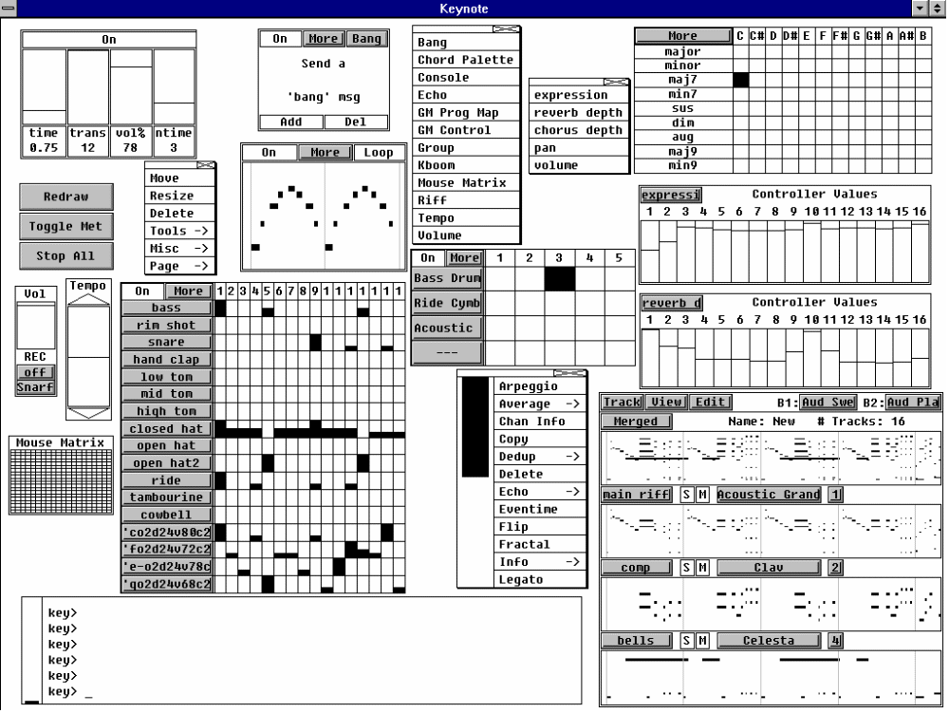
Echo
Chords
Riff
Controller
Kboom
Kboom (drum patts)
Group (multi-track seq)
BASIC TOOLS

Slide 20
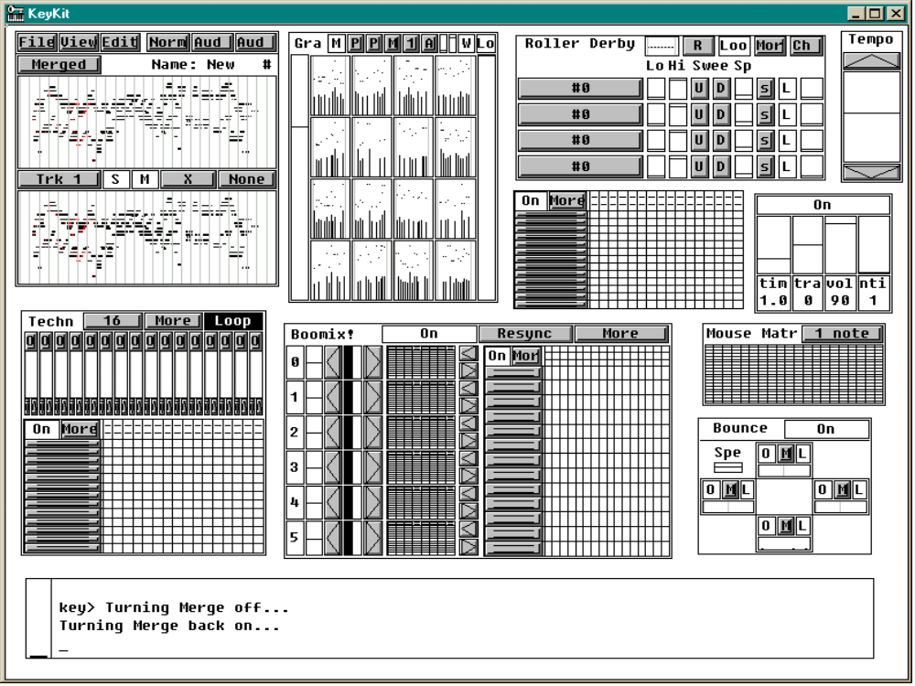
Roller Derby
Grab Bag
Mouse Matrix
Boomix
Techno
Bounce
TOOL VARIETY

Slide 21
Summary of Unique Strengths
Phrase (as opposed to note) manipulation supported directly by the language syntax
Interpreted language makes iterative development a breeze - immediate feedback
Robust - syntax and execution errors do not bring the system (or even other tasks) down
Associative arrays - simple but powerful
Finely-grained multi-tasking gives graceful sharing of CPU, no degradation in realtime scheduling

Slide 22
Summary of Unique Strengths (continued)
Textual language allows concise expression of:
  Reusable parameterized utility functions
  Time-ordered layout of composition
  Data-driven algorithms
  Independent algorithms running in parallel
GUI framework encourages “tool-oriented” approach
Same language used to implement GUI and all tools, no need to escape to (or learn) C

Slide 23
Availability and Resources
Freely available, with complete source code
Win95/98/NT/XP and Linux executables
Mac port exists, but needs lots of polishing
Download site:
  http://nosuch.com/keykit
Documentation
  Tutorial, tools reference, language reference, hacking guide
Mailing list

Slide 24
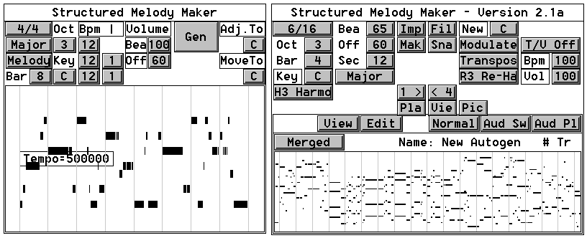
What are other people doing with it?
Mailing list has 3000 people, little visible activity, but evidence of lots of experimentation
Burton Beerman – composition with BodySynth
David Wooll’s “Bargen” tools
Version 1
Version N
Re-used
Group tool

Slide 25
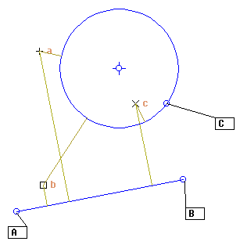
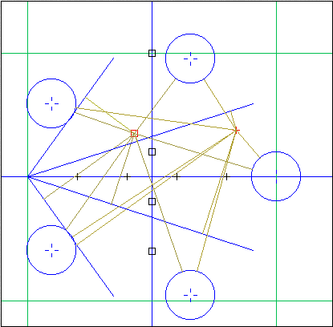
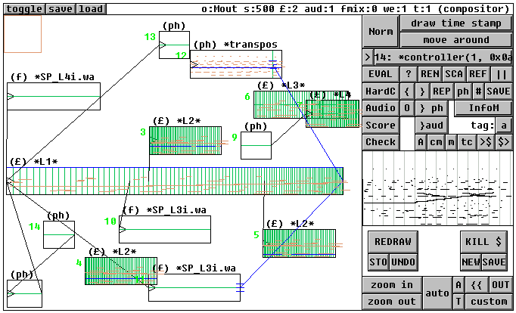
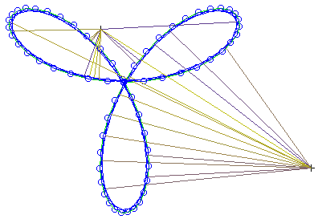
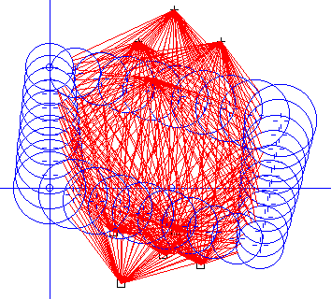
Geomaestro – WOW!
By Stephane Rollandin, well documented:
http://www.zogotounga.net/GM/paper1.html
Chosen (along with KeyKit) in recent Art.Bit collection in Japan: http://www.art-bit.jp

Slide 26
What is Tim doing with it?
Algorithmic - Expresso
Interactive - Gene Pool, Picture This
Realtime – Typo
Network - Konnect
Hardware Controllers
  Playstation (dance pads, wireless joysticks)
  Video

Slide 27
Algorithmic Tools - Expresso
L-systems fractal generation
Driven from file of expression transformations
Starting expression is “X”
After 10-20 generations, expression is huge
Substituting note or small phrase for X produces wide variety of results
Used interactively for Woodstockhausen 2000 performance
Basis of several Tune Toys on nosuch.com

Slide 28
Expresso – default transformations
# This is a set of transformations for expresso
A = A+A
A = A|A
A = transpose(A,4)
A = transpose(A,-5)
A = transpose(A,-7)
A = A+transpose(A,12)
A = A+transpose(A,7)
A = A+transpose(A,4)+transpose(A,7)
A = echo(A,4,6)
A = step(A,12)
A = arpeggio(A)
A = shuffle(A)

Slide 29
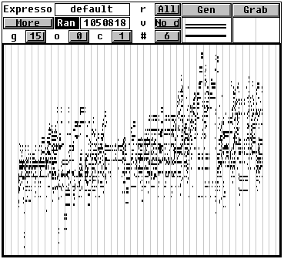
Expresso – GUI interface
Generates new result
Phrase to use for value of X
# of generations
# of tracks
to generate

Slide 30
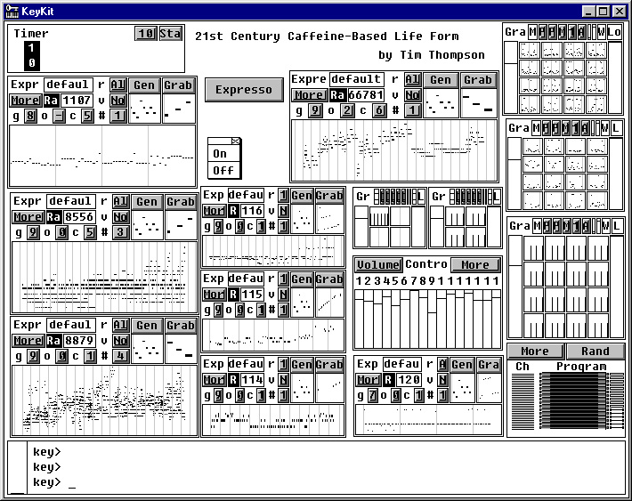
8 instances ( ) of Expresso tool used interactively in
“21st Century Caffeine-based Life Form” at Woodstockhausen 2000

Slide 31
Interactive Tool - Gene Pool
Uses small instruction set of musical opcodes
Each opcode does one thing:
  Adjust pitch (or time, velocity, duration) of current note
  Set pitch (or time, velocity, duration) of current note
  Trigger note (i.e. add current note to the generated result)
Any phrase can be disassembled into a sequence of musical opcodes that generates it
Mating of these sequences produces new generations
  Take half of one, half of the other
  Shuffle them
  Etc.

Slide 32
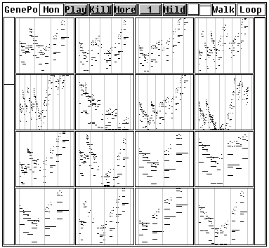
Gene Pool – GUI
Left-click
plays
Right-click
kills and fills
by mating
survivors

Slide 33
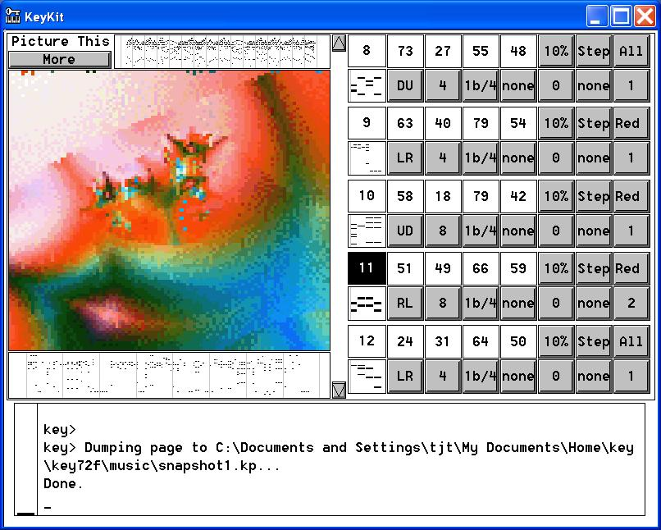
Interactive Tool - Picture This
Use RGB
values of an
image in
various ways

Slide 34
Realtime Tool - Typo
Typing keyboard used as musical controller
Based on ability to receive console up/down events (Windows-specific addition to keykit)
Most keys used to play notes; holding down control key used to access other functions
Holding down shift key causes notes to be recorded and looped
Number keys 0-9 control “sections” – each section retains sound choices and looped notes
Used for Woodstockhausen 2001 performance

Slide 35
Network Tool - Konnect
Uses Linux and Windows-specific hooks
Broadcast of MIDI data in realtime
Simple text-chat
Two-way synchronization with 4-beat delay
  Each side continuously transmits and receives
  Received data is resynchronized to local timing
  What you hear during a given 4 beats is what the other side played in response to the 4 beats you just finished several beats ago.
Linux server runs KeyKit process that serves as proxy/broadcaster, >2 clients can connect and jam simultaneously

Slide 36
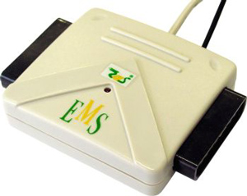
Playstation Controller Interfacing
PS2-to-USB interfaces, not all created equal
EMS USB 2-port interface works well
(available at www.levelsix.com
or www.gocybershop.net)
Windows driver makes dance pad look like buttons on a joystick, works with standard multimedia API
Able to connect 4 interfaces (8 pads) simultaneously
Pads and interfaces have been surprisingly reliable

Slide 37
KeyKit hooks for joystick/Playstation devices
It’s a generic joystick interface – anything with a Windows driver that looks like a joystick will work
Windows events (and/or polling) generate keykit events
Looks like a fifo in the KeyKit language, just like mouse/console/midi/network inputs
Good responsiveness
Order of devices is non-deterministic, need to establish order interactively, if order is important

Slide 38
Wireless joysticks
Anything that looks like a joystick becomes a music controller
Logitech wireless joysticks for the Playstation work well (with EMS USB2 interface), and have natural layout of buttons for performance
10 buttons + 4-button joypad + 4 axis of analog joystick control
Both button-down and button-up events can be used

Slide 39
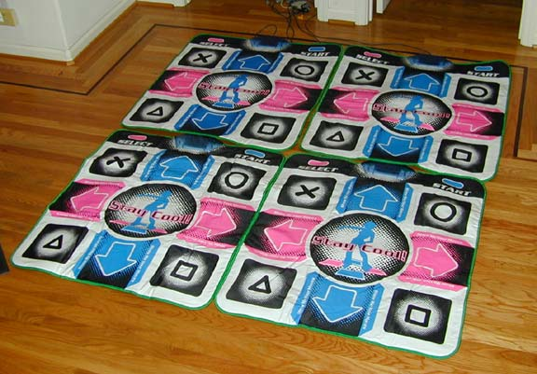
Dance Pads

Slide 40
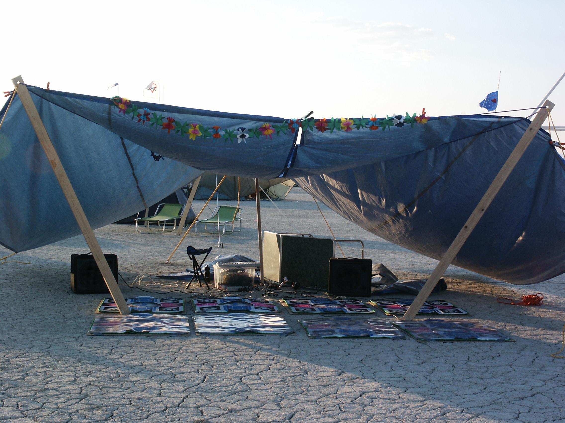
Dance Pads at Burning Man 2002

Slide 41
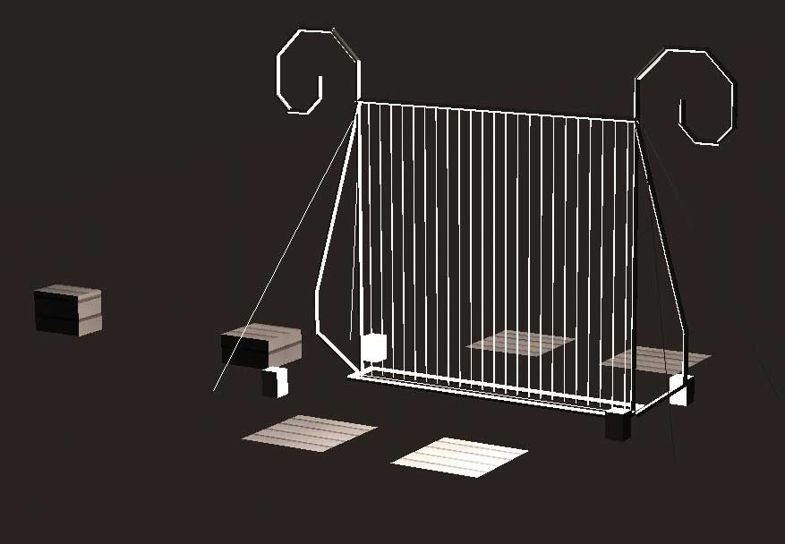
Dance Pads at Burning Man 2003

Slide 42
Happy Feet – a composition for the Dance Pads
Performance at Woodstockhausen 2002
Bach’s “Jesu, Joy of Man’s Desiring” provides notes
Music broken into snippets by time or attacks
Snippets assigned across all 4 dance pads, in sets
Advancing through sets is controlled by select button
4 sections in performance

Slide 43
Dance Pad UI
8 main buttons play notes or snippets
Select and Start buttons, followed by a main button, perform control functions
Pressing Select or Start multiple times (2 or 4) is used to perform less-common functions
Each of 4 pads is independent and usually identical, some functions affect one pad, some affect all pads
People try the Select and Start buttons without knowing what they do – need to “hide” functions more

Slide 44
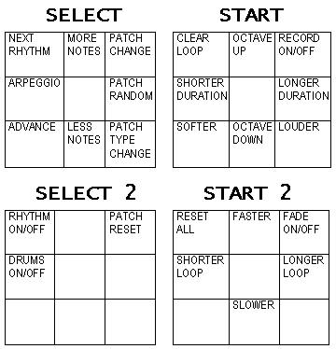
Dance Pad Controls

Slide 45
Video input
Windows-specific feature, uses DirectShow API
Grabs samples of video, provides averaged low-res (adjustable) grid of RGB values

Slide 46
Combining things in performance
Ball Maze
  Mouse
  Wireless Joystick
  Video

Slide 47
Availability and Resources
Freely available, with complete source code
Win95/98/NT/XP and Linux executables
Mac port exists, but needs lots of polishing
Documentation
  Tutorial, tools reference, language reference, hacking guide
Mailing list
Download site: http://nosuch.com/keykit
Questions: tjt@nosuch.com

