Slide 1
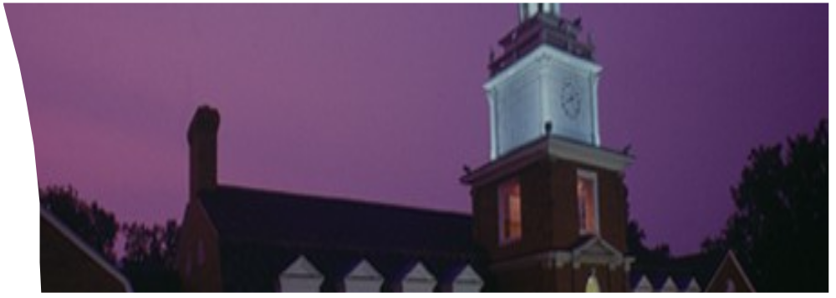
Dialog Systems
Mika Chen
Notes:
If you’re not familiar with how to use PowerPoint templates, do a “save as” when downloading the template and use it as a foundation for your presentation. You can re-create right over the top of it. If you are comfortable using PowerPoint templates, save the file as a PowerPoint template (.pot) and pull it into a new presentation, using it in place of your previous templates.
Title Slide
Title is 28 pt. Frutiger. Frutiger and Galliard are the university’s two official fonts. To obtain them, visit Computer Network Services at http://www.ohiou.edu/software/ and look for “Adobe Fonts.” The default font for this presentation is Arial. Do not use another font.
Subtitle and speaker’s name are 20 pt. Frutiger.
Photo may be customized for your purpose. Avoid clip art.
Make sure photo dimensions don’t get distorted.
Illustrative photos should be documentary style (for example, where the subject is being observed), or still-life (for example, university scenes or technology objects).
Photos should be saved as JPGs, then inserted.
Obtain photos from the Microsoft Clip Art and Media Web site at http://office.microsoft.com/ clipart/default.aspx/. Under “search,” select “photos,” then type in a photo topic such as “technology.” Avoid clip art and illustrations as graphic elements in your presentation.
Obtain photos from google.com’s “Images” search using key words. Use only rights-free images.
Obtain photos from a Web page. “Right-click” on the photo, then select “copy.” Once copied, go to your slide and “paste” onto the slide.
Or, “right-click” on photo. Choose “Save Target As” and save the photo onto your hard drive.
Go to presentation slide, choose “Insert.”
Choose “Picture”, “From file” and select the photo you just saved. This will insert the photo onto your slide.
For university brand guidelines, go to http://www.ohiou.edu/ucm/styleguide/.

Slide 2
Why Dialog Systems
The consulting sizes problem aligns with the
task-oriented dialog system
Determine the intent
Fill in two slots: height and weight

Slide 3
Dialog Systems: Types and Definition
Task-oriented dialog agents
Designed for a particular task and set up to have short conversations
Get information from the user to help complete the task
Examples: digital assistants such as Siri, Cortana, Alexa, Google Now/Home, etc.

Slide 4
Dialog Systems : Types and Definition
Chatbots
Designed for extended conversations, set up to mimic the unstructured conversational or “chats” characteristic of human-human interaction
Do not focus on a particular task
Examples: Little Bing, etc.

Slide 5
Chatbot: Rule-based
ELIZA: pattern/transform rules (Weizenbaum, 1966)
Example rule:
(0 YOU 0 ME) [pattern]
->
(WHAT MAKES YOU THINK I 3 YOU) [transform]
***3 is the index of the word in the pattern)
This rule would transfer
You hate me
Into:
WHAT MAKES YOU THINK I HATE YOU

Slide 6
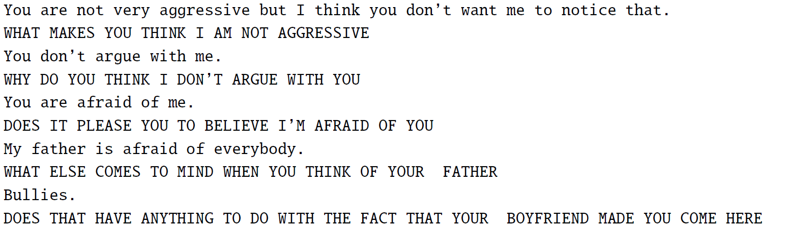
Chatbot: Rule-based
Excerpted ELIZA conversation
Other rule-based chatbots:
PARRY, (Colby et al., 1972) in addition to regular expressions, also include a model of its own mental state, with affect variables for the agent’s levels of fear and anger; certain topics might lead PARRY to become more angry or mistrustful.

Slide 7
Corpus-based: IR-based or Sequence-to-Sequence
IR-based: the principle behind IR-based approach is to
respond to a user’s turn X by repeating some appropriate
turn Y from a corpus of natural text.
Return the response to the most similar turn (Jafarpour et al.
2009, Leuski and Traum 2011)
Return the most similar turn (Ritter et al. 2011, Wang et al.
2013)

Slide 8
IR-based Approach
Similarity function: tf-idf, word embeddings, etc.
Include more features in similarity functions: words in prior turns, information about user, etc
Use full IR ranking approach
Examples: Cleverbot, XiaoIce

Slide 9
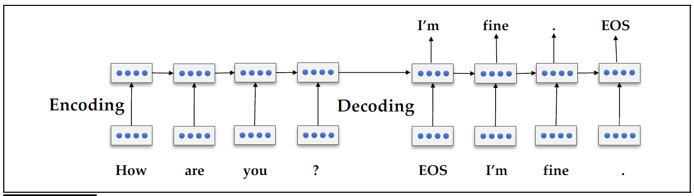
Sequence to Sequence Chatbots
Transduce from the user’s prior turn to the system’s turn

Slide 10
Sequence to Sequence Chatbots
Phrase-based machine translation (Ritter et al 2011) to
translate a user turn to a system response
Sequence-to-sequence models (Shang et al. 2015, Vinyals
and Le 2015, Sordoni et al. 2015)
To address the problem of producing predictable and
repetitive responses, change the objective function to mutual
information objective, or modify a beam decoder to keep more
diverse responses in the beam (Li et al., 2016a)
To address the inability to model the longer prior context of
the conversation, use a hierarchical model that summarizes
Information over multiple prior turns (Lowe et al. 2017b)

Slide 11
Sequence to Sequence Chatbots
To address the problem that don’t tend to generate responses
cohere across multiple turns, use reinforcement learning,
adversial networks (Li et al. 2016b, Li et al. 2017)

Slide 12
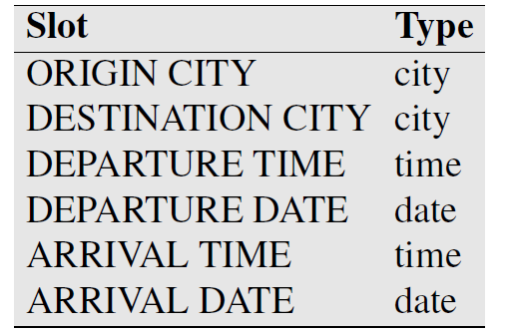
Task-Oriented Dialog Agents
Frame-based Dialog Agents
Based on domain ontology: a knowledge structure representing
the kinds of intentions the system can extract from user sentences
Frames: the ontology defines one or more frames
Slots: each frame is a collection of slots, and defines the values
that each slot can take
The set of slots in a frame specifies what the system needs to
know, and the filler of each slot is constrained to values of a
particular semantic type

Slide 13
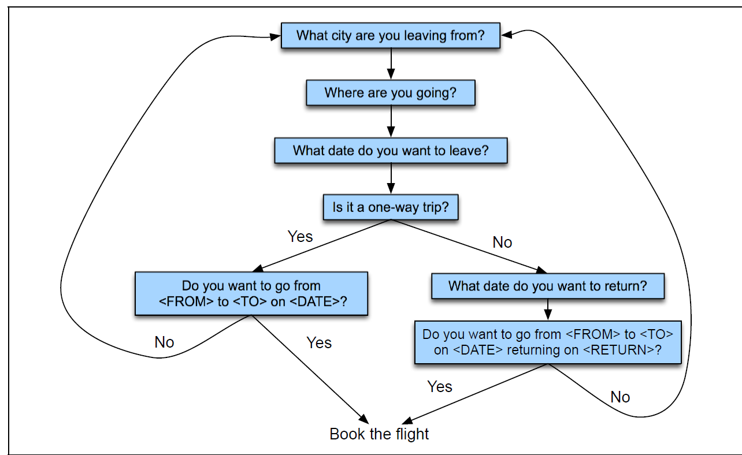
Frame-based Dialog Agents
Control structure for frame-based dialog: most frame-based
dialog systems are based on finite-state automata that are hand-
designed for the task by a dialog designer

Slide 14
Frame-based Dialog Agents
Modern task-oriented dialog agents need to dynamically
switch control between frames, the architecture is usually a
production rule system:
Different types of inputs cause different productions to fire
Different productions can fill in different frames

Slide 15
Frame-based Dialog Agents
Natural language understanding for filling slots
Domain Classification: for example, is the user talking about
airlines, or programming an alarm clock, etc.
Intent Determination: what general task or goal is the user
trying to accomplish, e.g. find a movie or show a flight, etc.
Slot filling: extract the particular slots and fillers that the user
intends the system to understand from their utterance

Slide 16
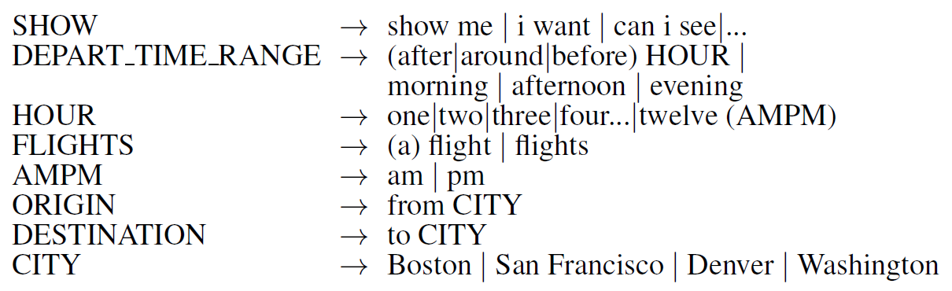
Hand-written Rules
Still common in industrial applications
Regular expressions, e.g. define a regular expression that map to the SET-ALARM intent:
wake me (up) | set (the|an) alarm | get me up
Hand-designed semantic grammars, for example:

Slide 17
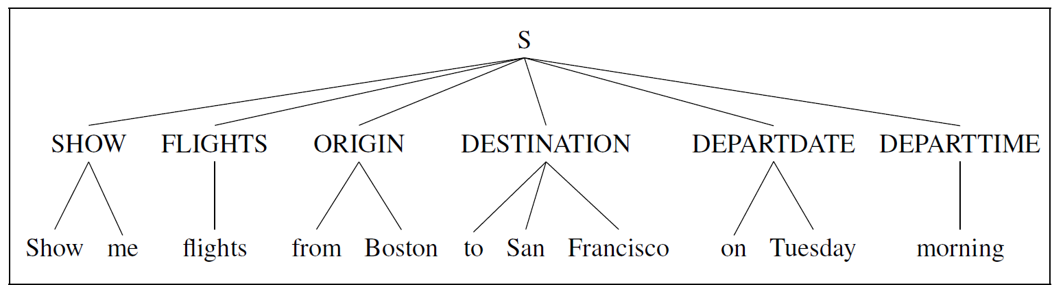
Hand-written Rules
Resulting semantic parsing trees, for example:
Issues have to be dealt with:
Negation
Speech recognition errors

Slide 18
Hand-written Rules
Pros and Cons
High precision
Expensive and slow to create
Suffer from recall problems

Slide 19
Supervised Machine Learning
Classifier: map from sentences to intents and domains
A simple 1-of-N classifier: logistic regression, neural network, etc.
Features: N-grams, etc.
Sequence Model: map from sentences to slot fillers
Strategy I:
Classifier I: predict which slot the user wants to fill
Features: unigram, bigram, trigram, named entity features, etc.
Classifier II: determine the filler of the named slot
Features: N-grams, lexicon features, etc.

Slide 20
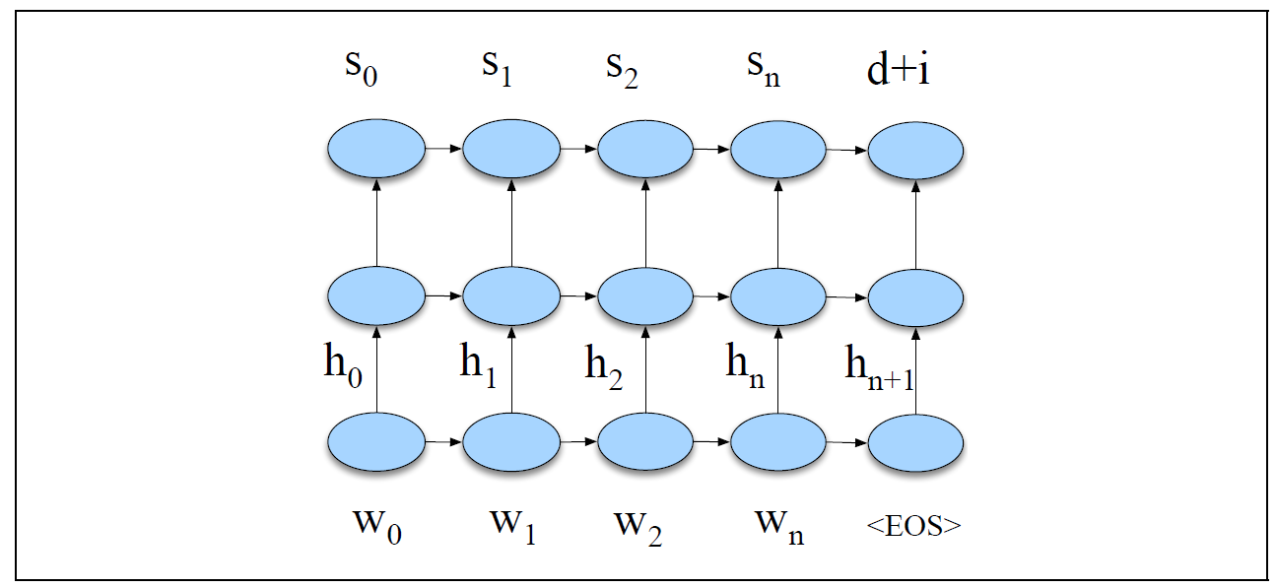
Sequence Model for Slot Filling
Strategy II: use a sequence model (MEMMs, CRFs, RNNs) to directly
Assign a slot label to each word in the sequence.
Features: word embeddings, word unigrams, bigrams, lexicons, etc.
Strategy III: neural network architectures
Don’t generally make use of an explicit feature extraction step
Input: a series of words, represented as word embeddings
Output: a series of IOB tags plus domain and intent

Slide 21
Supervised Machine Learning
Industrial contexts:
Often bootstrapped from rule-based systems in a semi-supervised
learning manner
A rule-based system is first built for the domain, and a test-set is labeled
As new user utterances come in, they are paired with the labeling
provided by the rule-based system to create training tuples
A classifier can be trained on these tuples
Pros and Cons:
Often outperform the rule-based system
The rule-based systems may still remain higher precision for dealing with complex cases like negation

Slide 22
References
Vinyals, O. and Le, Q. (2015). A neural conversational model
Weizenbaum, J. (1966). ELIZA – A computer program for the study of natural language
Communication between man and machine
Ritter, A., Cherry, C., and Dolan, W. B. (2011). Data-driven response generation in
social media
Colby, K. M., Weber, S., and Hilf, F.D. (1971). Artificial paranoia
Jafarpour, S., Burges, C., and Ritter, A. (2009). Filter, rank and transfer the knowledge:
Learning to chat
Leuski, A. and Traum, D. (2011). NPCEditor: Creating virtual human dialogue using
information retrieval techniques
Wang, H., Lu, Z., Li, H., and Chen, E. (2013). A dataset for research on short-text
conversations
Shang, L., Lu, Z., and Li, H. (2015). Neural responding machine for short-text
conversation
Sordoni, A., Galley, M., Auli, M., Brockett, C., Ji, Y., Mitchell, M., Nie, J. –Y, Gao, J., and
Dolan, B. (2015). A neural network approach to context-sensitive generation of
conversational responses

Slide 23
References
Li, J., Galley, M., Brockett, C., Gao, J., and Dolan, B. (2016a). A diversity-promoting
objective function for neural conversation models
Li, J., Monroe, W., Ritter, A., Galley, M. Gao, J., and Jurafsky, D. (2016b). Deep
reinforcement learning for dialogue generation
Li, J., Monroe, W., Shi, T., Ritter, A., and Jurafsky, D. (2017). Adversial learning for
neural dialogue generation
Lowe, R. T., Pow, N., Serban, I. V., Charlin, L., Liu, C.-W., and Pineau, J. (2017b).
Training end-to-end dialogue systems with the ubuntu dialogue corpus

