Slide 1
Computer System Engineering
Lab3: Banker’s Algorithm
Contact:
benjamin_kang@mymail.sutd.edu.sg

Slide 2
Objectives
Understand deadlock and implement Banker’s algorithm
Picture from: http://career.guru99.com/top-50-operating-system-interview-questions/

Slide 3
Deadlock and Banker’s algorithm
Reference: ch7-2017-release.pdf
What is Deadlock?
slides 7.5 – 7.16
What is Banker’s algorithm?
slides 7.33 – 7.37

Slide 4
Tasks:
1 . Implement a basic Bank system
2 . Implement safety check algorithm
3 . Analyse the complexity of banker’s algorithm

Slide 5
Task 1: Bank System
1 . Customers can request resources, while system can grant the request or deny it.
2 . Customers can release resources
3 . System can print its states by invoke special function

Slide 6
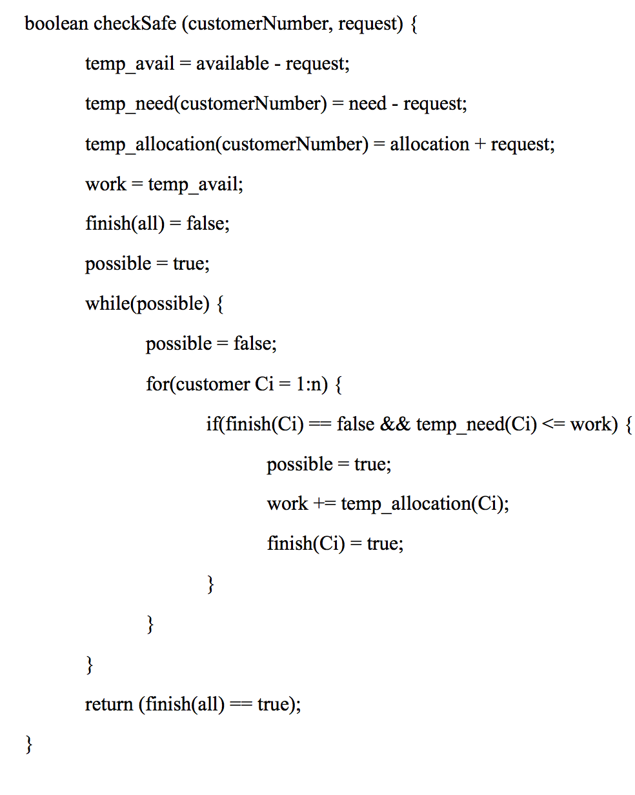
Task 2: Safety Check Algorithm
Safety Check:
when a process requests an available resource, system must decide if granting the request will leave the system in a safe state.
The psuedocode is also available in the handout

Slide 7
Task 3: Complexity analysis
Please analyze the time complexity of Banker’s algorithm if:
1. there is n customers in total
2. There is m resources in total

Slide 8
Code: data structure
Java Version
private int numberOfCustomers; // the number of customers private int numberOfResources; // the number of resources private int[] available; // the available amount of each resource private int[][] maximum; // the maximum demand of each customer private int[][] allocation; // the amount currently allocated private int[][] need; // the remaining needs of each customer
C Version
int numberOfCustomers; // the number of customers int numberOfResources; // the number of resources int *available; // the available amount of each resource int **maximum; // the maximum demand of each customer int **allocation; // the amount currently allocated int **need; // the remaining needs of each customer

Slide 9
Code: Q1-Bank System (Java)
You need to implement following functions:
/** * Constructor for the Banker class. * @param resources An array of the available count for each resource. * @param numberOfCustomers The number of customers. */ public Banker (int[] resources, int numberOfCustomers); /** * Sets the maximum number of demand of each resource for a customer. * @param customerIndex The customer's index (0-indexed). * @param maximumDemand An array of the maximum demanded count for each resource. */ public void setMaximumDemand(int customerIndex, int[] maximumDemand); /** * Prints the current state of the bank. */ public void printState();
Assume customerIndex will be in a valid range for simplicity.
Please refer to the starter code for more details.
Notes:
----- Meeting Notes (14/2/18 13:33) -----
Specify explicity the bounds check.

Slide 10
Code: Q1-Bank System (Java)
You need to implement following functions:
/** * Requests resources for a customer loan. * If the request leave the bank in a safe state, it is carried out. * @param customerIndex The customer's index (0-indexed). * @param request An array of the requested count for each resource. * @return true if the requested resources can be loaned, else false. */ public synchronized boolean requestResources(int customerIndex, int[] request); /** * Checks if the request will leave the bank in a safe state. * @param customerIndex The customer's index (0-indexed). * @param request An array of the requested count for each resource. * @return true if the requested resources will leave the bank in a * safe state, else false */ private synchronized boolean checkSafe(int customerIndex, int[] request); /** * Releases resources borrowed by a customer. Assume release is valid for simplicity. * @param customerIndex The customer's index (0-indexed). * @param release An array of the release count for each resource. */ public synchronized void releaseResources(int customerIndex, int[] release);
Please refer to the starter code for more details.
Notes:
----- Meeting Notes (14/2/18 13:33) -----
Say that: "for simplicity, you can assume that the

Slide 11
Code: Q1-Bank System (C)
You need to implement following functions:
/** * Initializes the state of the bank. * @param resources An array of the available count for each resource. * @param m The number of resources. * @param n The number of customers. */ void initBank(int *resources, int m, int n); /** * Sets the maximum number of demand of each resource for a customer. * @param customerIndex The customer's index (0-indexed). * @param maximumDemand An array of the maximum demanded count for each resource. */ void setMaximumDemand(int customerIndex, int *maximumDemand); /** * Prints the state of the bank. */ void printState();
Assume customerIndex will be in a valid range for simplicity.
Please refer to the starter code for more details.

Slide 12
Code: Q1-Bank System (C)
You need to implement following functions:
/** * Requests resources for a customer loan. * If the request leave the bank in a safe state, it is carried out. * @param customerIndex The customer's index (0-indexed). * @param request An array of the requested count for each resource. * @return 1 if the requested resources can be loaned, else 0. */ int requestResources(int customerIndex, int *request); /** * Checks if the request will leave the bank in a safe state. * @param customerIndex The customer's index (0-indexed). * @param request An array of the requested count for each resource. * @return 1 if the requested resources will leave the bank in a * safe state, else 0 */ int checkSafe(int customerIndex, int *request); /** * Releases resources borrowed by a customer. Assume release is valid for simplicity. * @param customerIndex The customer's index (0-indexed). * @param release An array of the release count for each resource. */ void releaseResources(int customerIndex, int *release);
Please refer to the starter code for more details.

Slide 13
Test Cases
There are two test cases provided. (q1.txt, q2.txt)
To help you focus on implementing the algorithm, we have provided a function in the starter code that parses and runs the test cases.

Slide 14
Test Case 1 (q1.txt)
Customer 0 requesting
0 1 0
Customer 1 requesting
2 0 0
Customer 2 requesting
3 0 2
Customer 3 requesting
2 1 1
Customer 4 requesting
0 0 2
Customer 1 releasing
1 0 0
Current state:
Available:
4 3 2
Maximum:
7 5 3
3 2 2
9 0 2
2 2 2
4 3 3
Allocation:
0 1 0
1 0 0
3 0 2
2 1 1
0 0 2
Need:
7 4 3
1 2 2
6 0 0
0 1 1
4 3 1
n,5
m,3
a,10 5 7
c,0,7 5 3
c,1,3 2 2
c,2,9 0 2
c,3,2 2 2
c,4,4 3 3
r,0,0 1 0
r,1,2 0 0
r,2,3 0 2
r,3,2 1 1
r,4,0 0 2 f,1,2 0 0
p
(n) Number of customers: 5
(m) Number of resources: 3
(a) Available resources: 10 5 7
(c) Maximum resources needed by the 0th customer: 7 5 3
(c) Maximum resources needed by the 4th customer: 7 5 3
(r) Request for resources by the 0th customer: 0 1 0
(r) Request for resources by the 4th customer: 0 0 2
(f) Release of resources by the 1st customer: 1 0 0
(p) Print the current state of the bank

Slide 15
Test Case 2 (q2.txt)
Current state:
Available:
2 3 0
Maximum:
7 5 3
3 2 2
9 0 2
2 2 2
4 3 3
Allocation:
0 1 0
3 0 2
3 0 2
2 1 1
0 0 2
Need:
7 4 3
0 2 0
6 0 0
0 1 1
4 3 1
n,5
m,3
a,10 5 7
c,0,7 5 3
c,1,3 2 2
c,2,9 0 2
c,3,2 2 2
c,4,4 3 3
r,0,0 1 0
r,1,2 0 0
r,2,3 0 2
r,3,2 1 1
r,4,0 0 2
r,1,1 0 2
p
r,0,0 2 0
p
Testing the checkSafe function.
We attempt to make an loan that can leave the bank in unsafe state:
(r) Request for resources by the 0th customer: 0 2 0
(p) This should print the same result as the previous print.

Slide 16
Requirement
Put your screenshots and analysis in a pdf file. Your submission should contain: one pdf report; source code. Please zip them up and submit before 12:00 PM, 22nd Feb, 2018.
Good luck!

