Slide 1
Error Channels

Slide 2
.
depolarizing channel
amplitude damping channel
phase damping channel
amplitude & phase damping channel
thermal relaxation

Slide 3






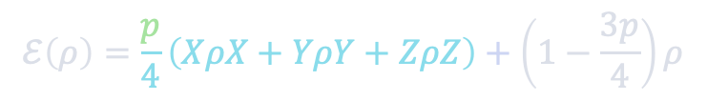

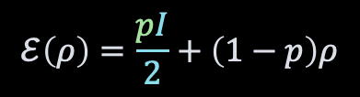





❯ Depolarizing channel
depolarized – replaced by a completely mixed state $\frac{I}{2}$
$$= \frac{ρ+XρX+YρY+ZρZ}{4}$$
$$ℰ\left(ρ\right)=\frac{pI}{2}+\left(1−p\right)ρ$$
$$ℰ\left(ρ\right)=\frac{p}{4}\left(XρX+YρY+ZρZ\right)+\left(1−\frac{3p}{4}\right)ρ$$
$$z$$
$$z$$
$$|0⟩$$
$$|0⟩$$
$$p$$
$$x$$
$$x$$
$$y$$
$$y$$
$$|1⟩$$
$$|1⟩$$

Slide 4
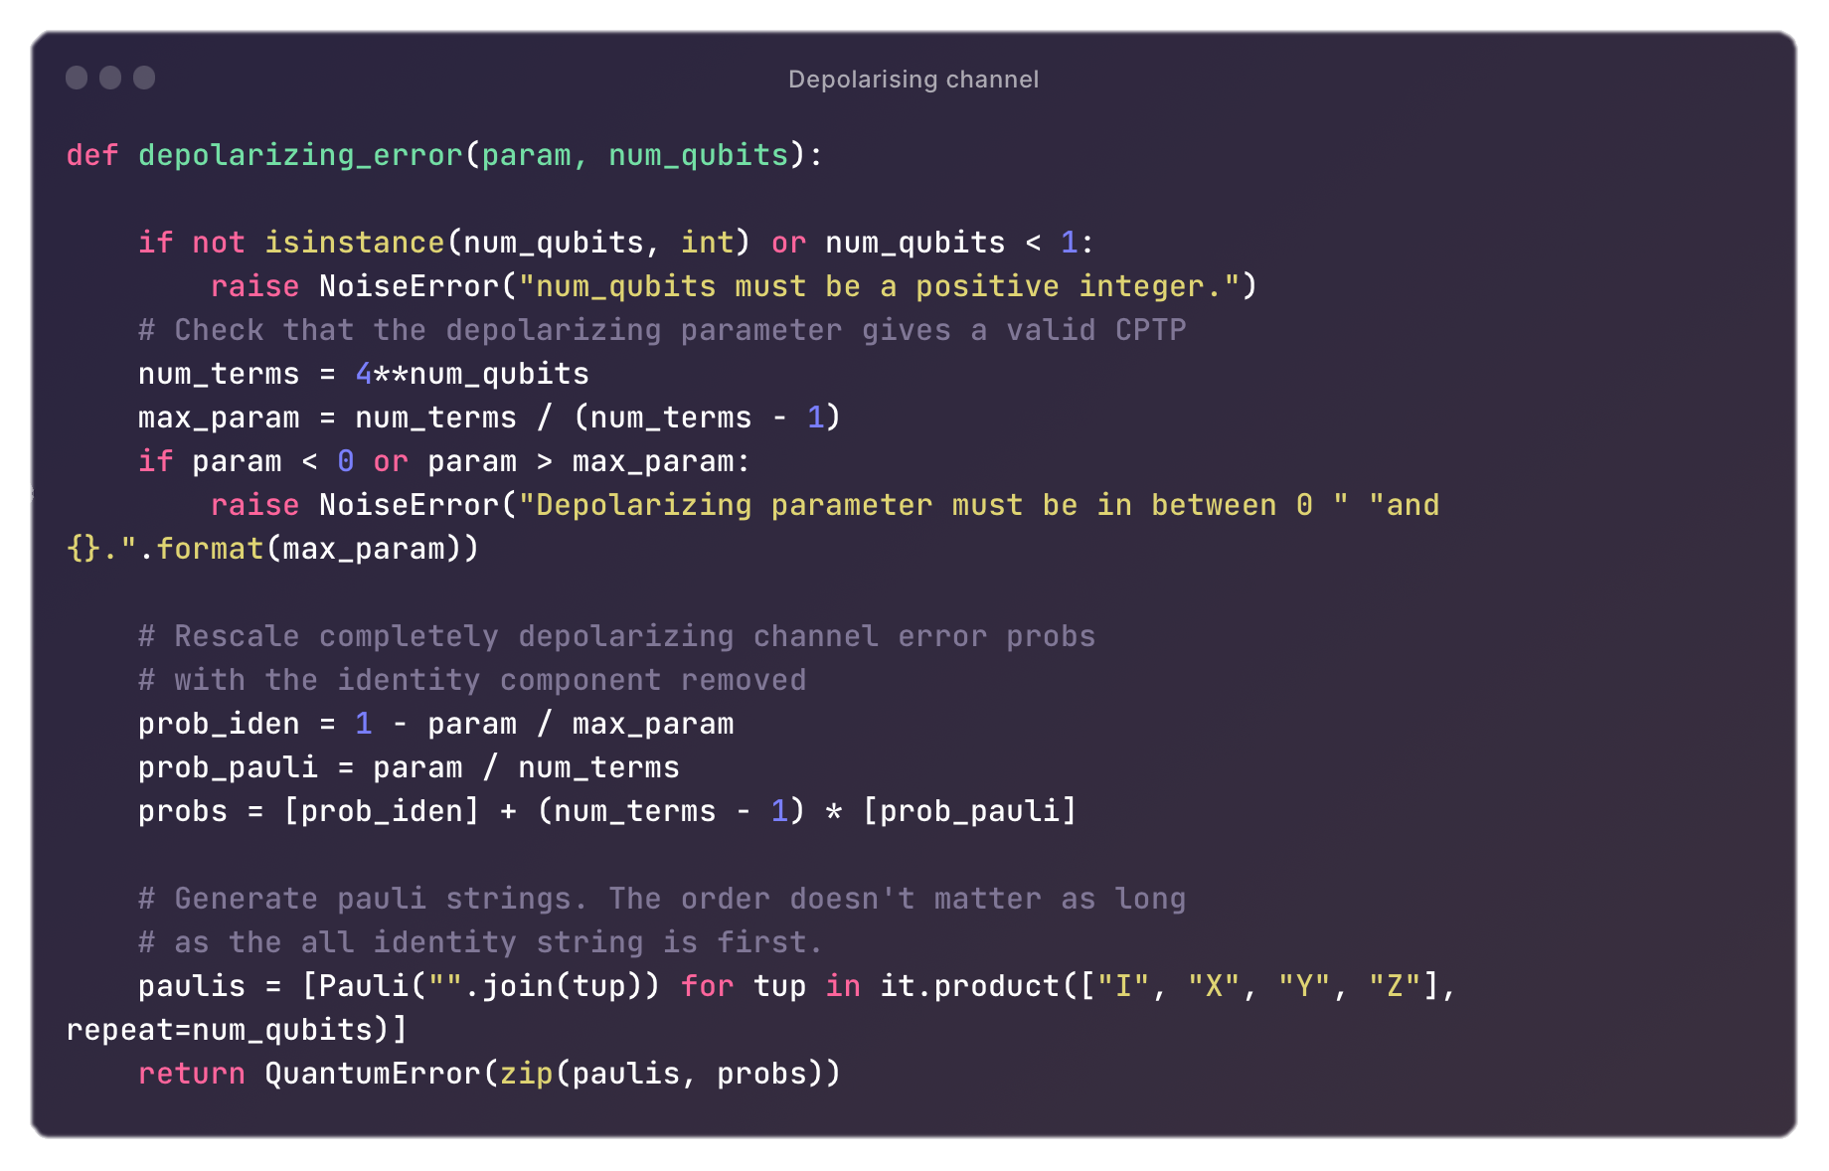

Slide 5








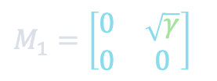




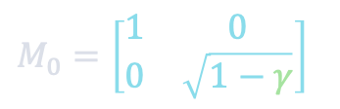
❯ Amplitude damping channel
$$\left|1\right\rangle →|0⟩$$
energy dissipation:
$$\left|0\right\rangle →\left|0\right\rangle , \left|1\right\rangle →γ|1⟩$$
$M_{0}=\left[\begin{matrix}1 & 0 \\ 0 & \sqrt{1−γ}\end{matrix}\right]$
$M_{1}=\left[\begin{matrix}0 & \sqrt{γ} \\ 0 & 0\end{matrix}\right]$
$$γ=\sin^{2}{θ}$$
$$z$$
$$z$$
$$|0⟩$$
$$|0⟩$$
$$γ$$
$$x$$
$$x$$
$$y$$
$$y$$
$$|1⟩$$

Slide 6











❯ Dephasing channel
alias: phase damping channel
E.g.: electronic states are perturbed in an atom by distant electrical charges.
eigenstates DO NOT change
NO loss of energy
relative phase DOES
for a qubit: $R_{Z}(θ)$
LOSS of quantum information
$$M_{0}=\sqrt{α}I$$
$$M_{1}=\sqrt{1−α}Z$$
$$α=\left(1+\sqrt{1−λ}\right)/2$$
$$z$$
$$z$$
$$|0⟩$$
$$|0⟩$$
$$α$$
$$x$$
$$x$$
$$y$$
$$y$$
$$|1⟩$$
$$|1⟩$$

Slide 7
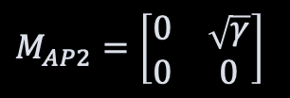
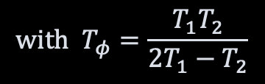
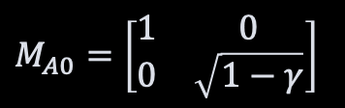
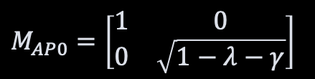


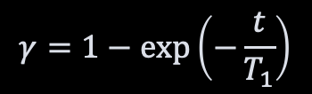
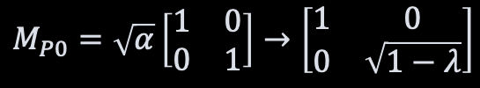

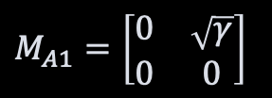

❯ Amplitude & Phase damping channel - Thermal relaxation
$$M_{P0}=\sqrt{α}\left[\begin{matrix}1 & 0 \\ 0 & 1\end{matrix}\right]→\left[\begin{matrix}1 & 0 \\ 0 & \sqrt{1−λ}\end{matrix}\right]$$
$$M_{P1}=\sqrt{1−α}\left[\begin{matrix}1 & 0 \\ 0 & −1\end{matrix}\right]→\left[\begin{matrix}0 & 0 \\ 0 & \sqrt{α}\end{matrix}\right]$$
$M_{A0}=\left[\begin{matrix}1 & 0 \\ 0 & \sqrt{1−γ}\end{matrix}\right]$
$M_{A1}=\left[\begin{matrix}0 & \sqrt{γ} \\ 0 & 0\end{matrix}\right]$
$$+$$
$M_{AP0}=\left[\begin{matrix}1 & 0 \\ 0 & \sqrt{1−λ−γ}\end{matrix}\right]$
$$M_{AP1}=\left[\begin{matrix}0 & 0 \\ 0 & \sqrt{α}\end{matrix}\right]$$
$M_{AP2}=\left[\begin{matrix}0 & \sqrt{γ} \\ 0 & 0\end{matrix}\right]$
$$γ=1−\exp\left(−\frac{t}{T_{1}}\right)$$
Thermal relaxation:
$$λ=1−\exp\left(−\frac{t}{T_{φ}}\right)$$
$$\text{with} T_{φ}=\frac{T_{1}T_{2}}{2T_{1}−T_{2}}$$
https://physics.stackexchange.com/questions/720139/what-is-the-connection-between-quantum-thermal-relaxation-and-phase-and-amplitud/722327#722327
https://quantumcomputing.stackexchange.com/questions/27017/what-is-the-concrete-difference-between-qiskit-thermal-relaxation-error-and-phas

Slide 8
