Slide 1
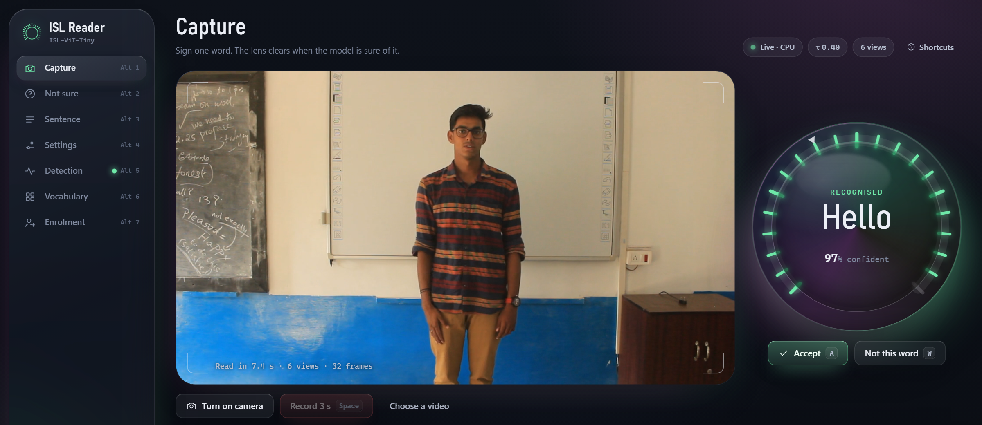
ISL Reader
A 2 MB Vision Transformer, a super-resolution GAN front end and an integrated interface for Indian Sign Language
Yalamanchi Kushal · Nethi Kushala Kumar · Dhruseek Rishi Menon
Guide: Dr. T. Bagyammal · 23CSE473 NNDL · Group 03 · Review 3
Notes:
ISL Reader recognises isolated Indian Sign Language words from short video. This review covers the full system: the classifier, the super-resolution GAN we added in front of the hand detector, and the web interface that ties them together. The screenshot on the right is the live app reading a held-out clip of 'Hello' at 97 % confidence.

Slide 2
What we set out to build
A model of about 2 MB
≥ 75 % on unseen people
A working app
It has to run on smart glasses, so the classifier must fit in roughly two megabytes.
Measured only on recording sessions the model never saw, on the 50 deployed words.
Camera or video in, word out, with a confidence check and a way to correct mistakes.
Why it is hard
Signs are two-handed: handshape, motion and location together decide the word.
Little labelled data: about 15 clips per word in INCLUDE.
A wearable camera gives smaller, compressed video than the 1080p studio data.
Random splits leak recording sessions, so published accuracies overstate real use.
Notes:
Three targets: about 2 MB, at least 75 % top-1 on recording sessions held out from training, and a working app. Four difficulties: two-handed signs, scarce data, low-resolution wearable video, and leaky evaluation in the literature.

Slide 3
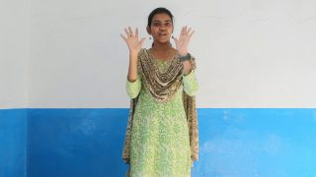
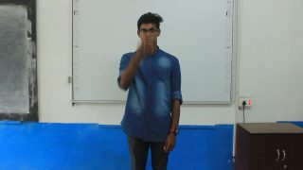
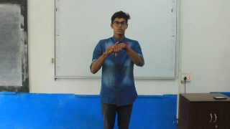
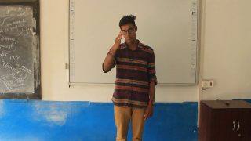
Dataset details
4,257
262
1080p
13
INCLUDE clips used
words, 15 categories
25 fps, one studio
recording sessions
Split | Clips | Use
Training sessions | 2,845 | Classifier and GAN training
Held-out test sessions | 1,010 | 472 of them = the 50 deployed words
Excluded | 402 | Words with < 6 training clips
Validation sessions | 888 | GAN development only
iSign (unlabelled) | 18,000 | Self-supervised pretraining
CISLR (300 x 300 px) | 609 | Cross-corpus test
Frames from held-out INCLUDE clips (Sridhar et al., ACM MM 2020, CC-BY-4.0)
We train on all 262 words and answer from the 50 deployed words: per-word data is fixed, so a smaller training vocabulary only removes data.
Notes:
INCLUDE is the labelled corpus: 4,257 usable clips of 262 words, recorded at 1080p in one studio. We rebuilt 13 recording sessions from the camera's clip numbers because the dataset has no signer labels. 2,845 clips train the model; 1,010 clips from held-out sessions test it, and 472 of those are the 50 deployed words used in every result. iSign gives 18,000 unlabelled clips for pretraining; CISLR is a second corpus for a transfer test.

Slide 4
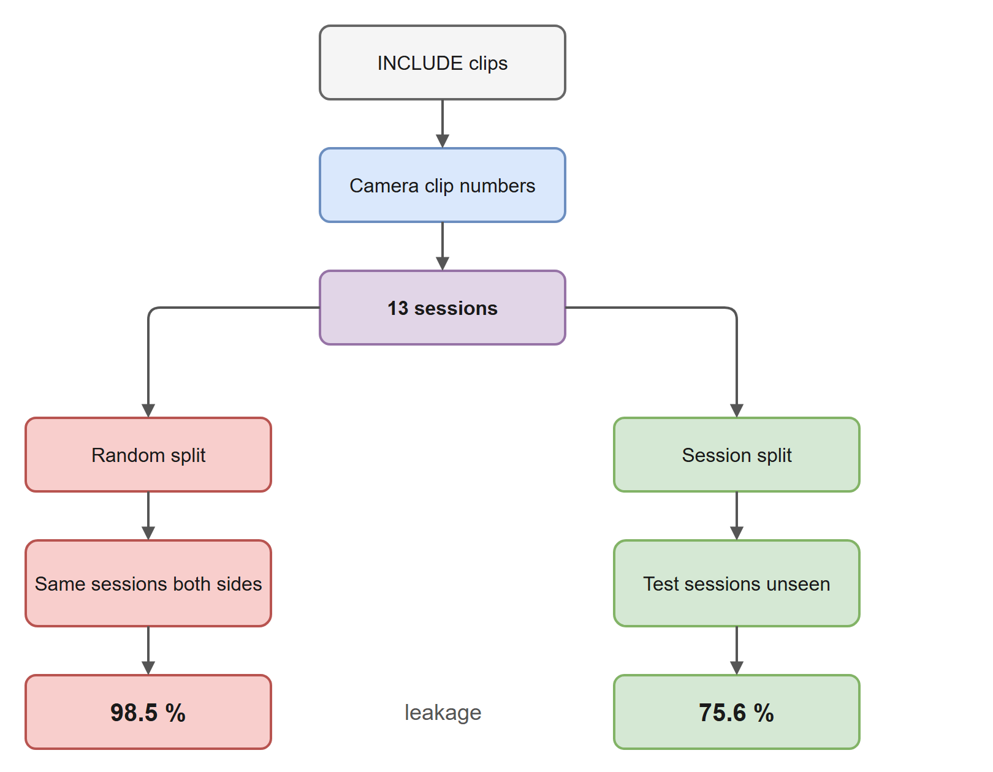
Evaluation: hold out whole recording sessions
Camera clip numbers run in sequence; big jumps mark a new session.
Whole sessions are held out; a check refuses any overlap.
The 22.9-point gap is what the model gains from seeing the same person and room.
Notes:
INCLUDE was recorded as back-to-back takes. A random split puts near-identical takes on both sides, so the same pixel-only model scores 98.5 % there and 75.6 % on unseen sessions. Every result after this slide is on unseen sessions, with three seeds and paired McNemar tests.

Slide 5
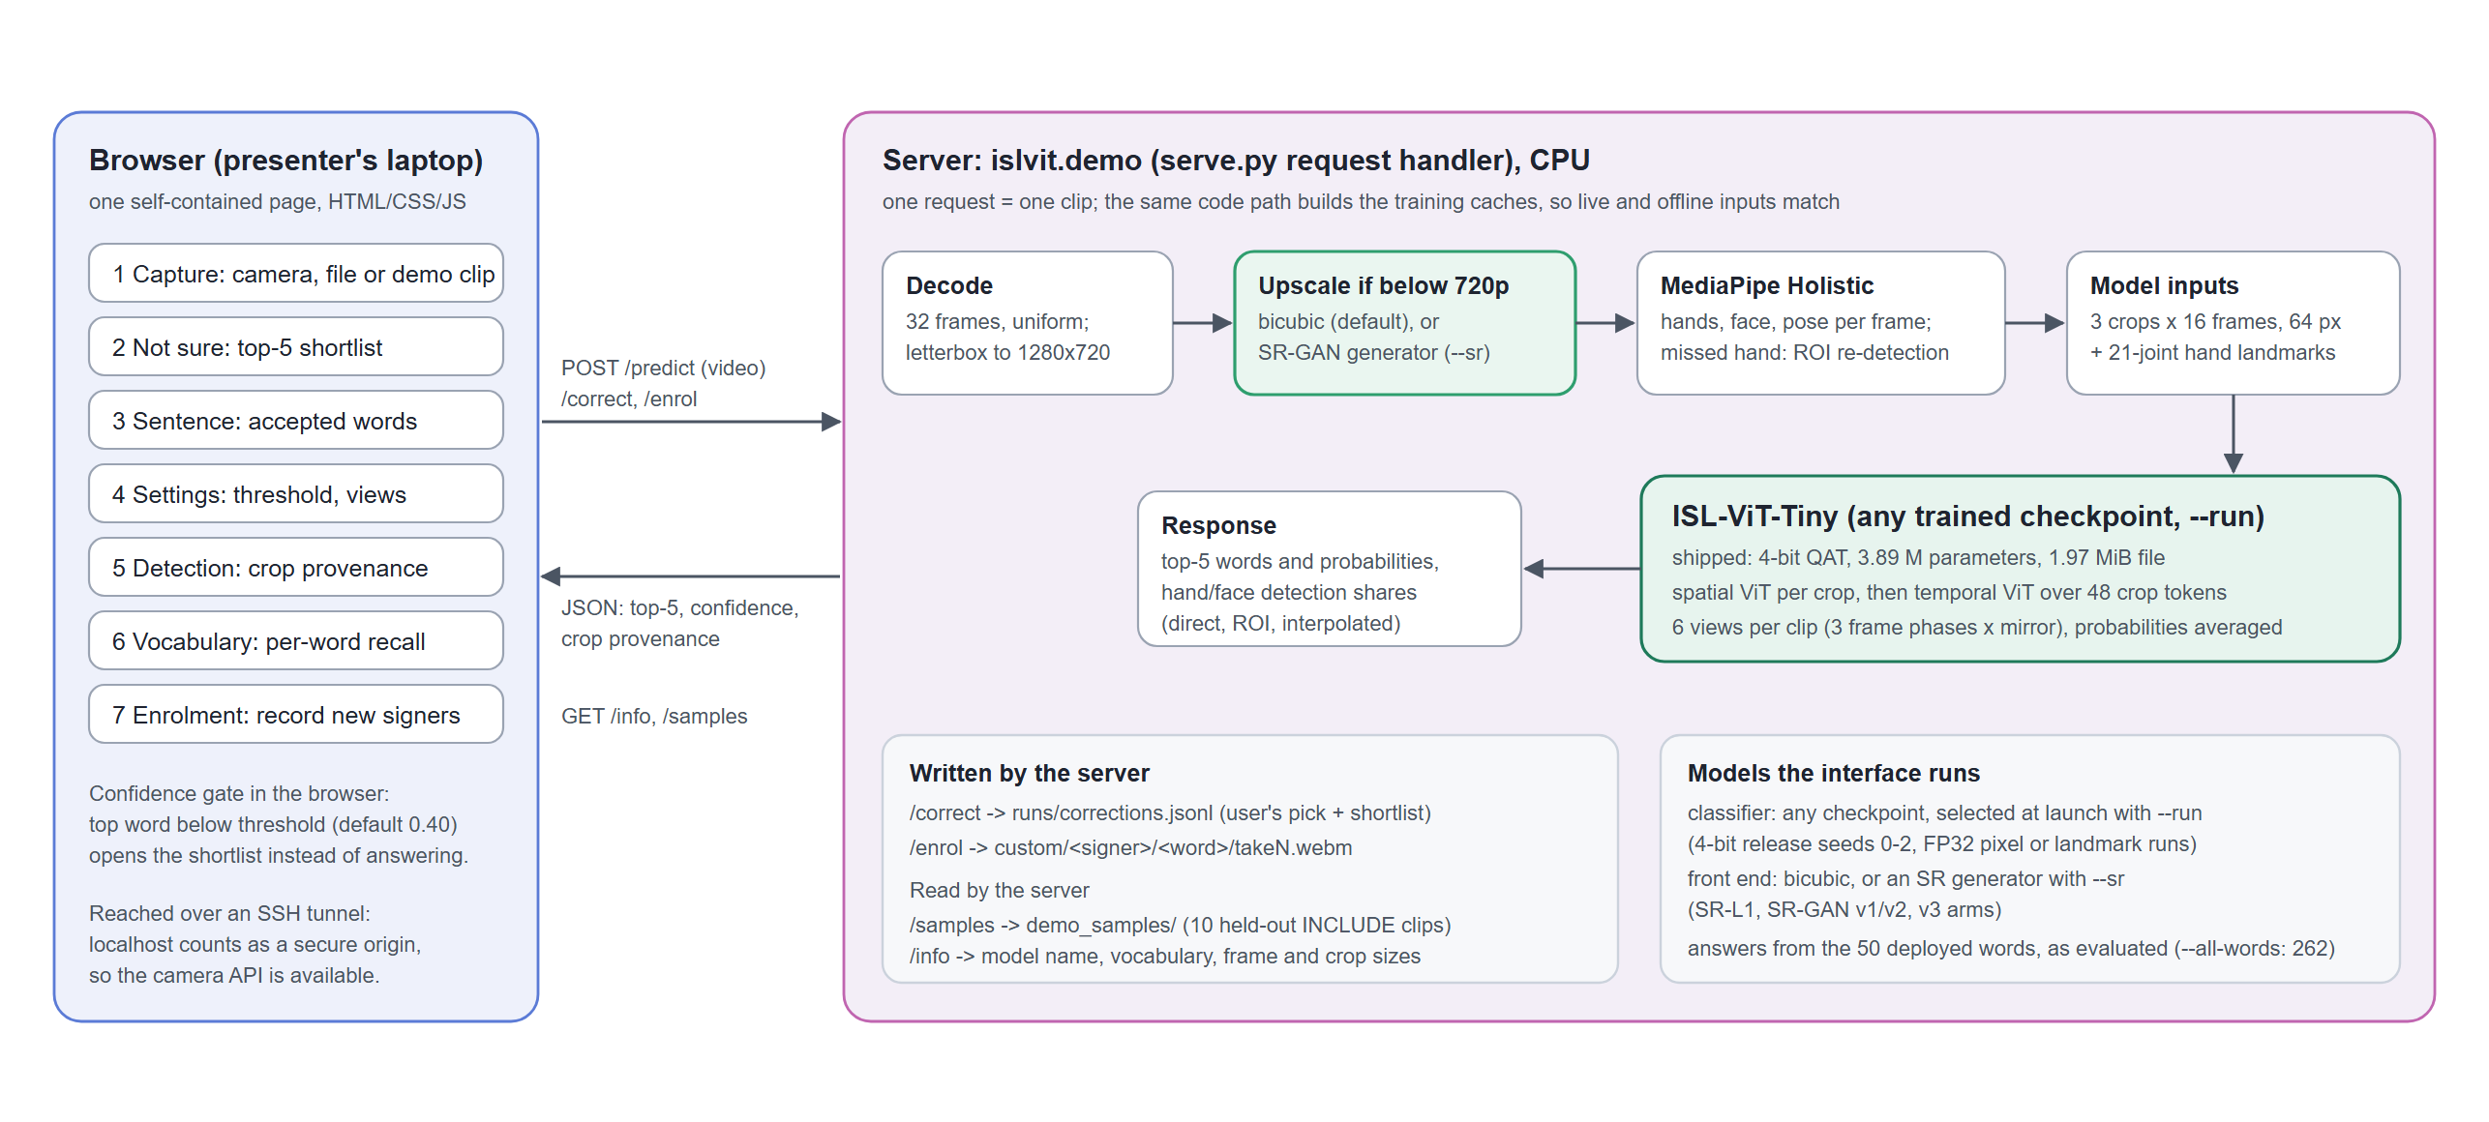
System architecture of the integrated app
Notes:
The browser posts a clip to the Python server. The server decodes 32 frames, upscales low-resolution video with either bicubic or the SR-GAN, runs MediaPipe Holistic, builds three crops and hand landmarks, and runs the classifier on six views. The answer goes back with the top five words and how each crop was found. The server can load any trained checkpoint and either front end at start-up, and it restricts answers to the 50 deployed words exactly as the evaluation does.

Slide 6
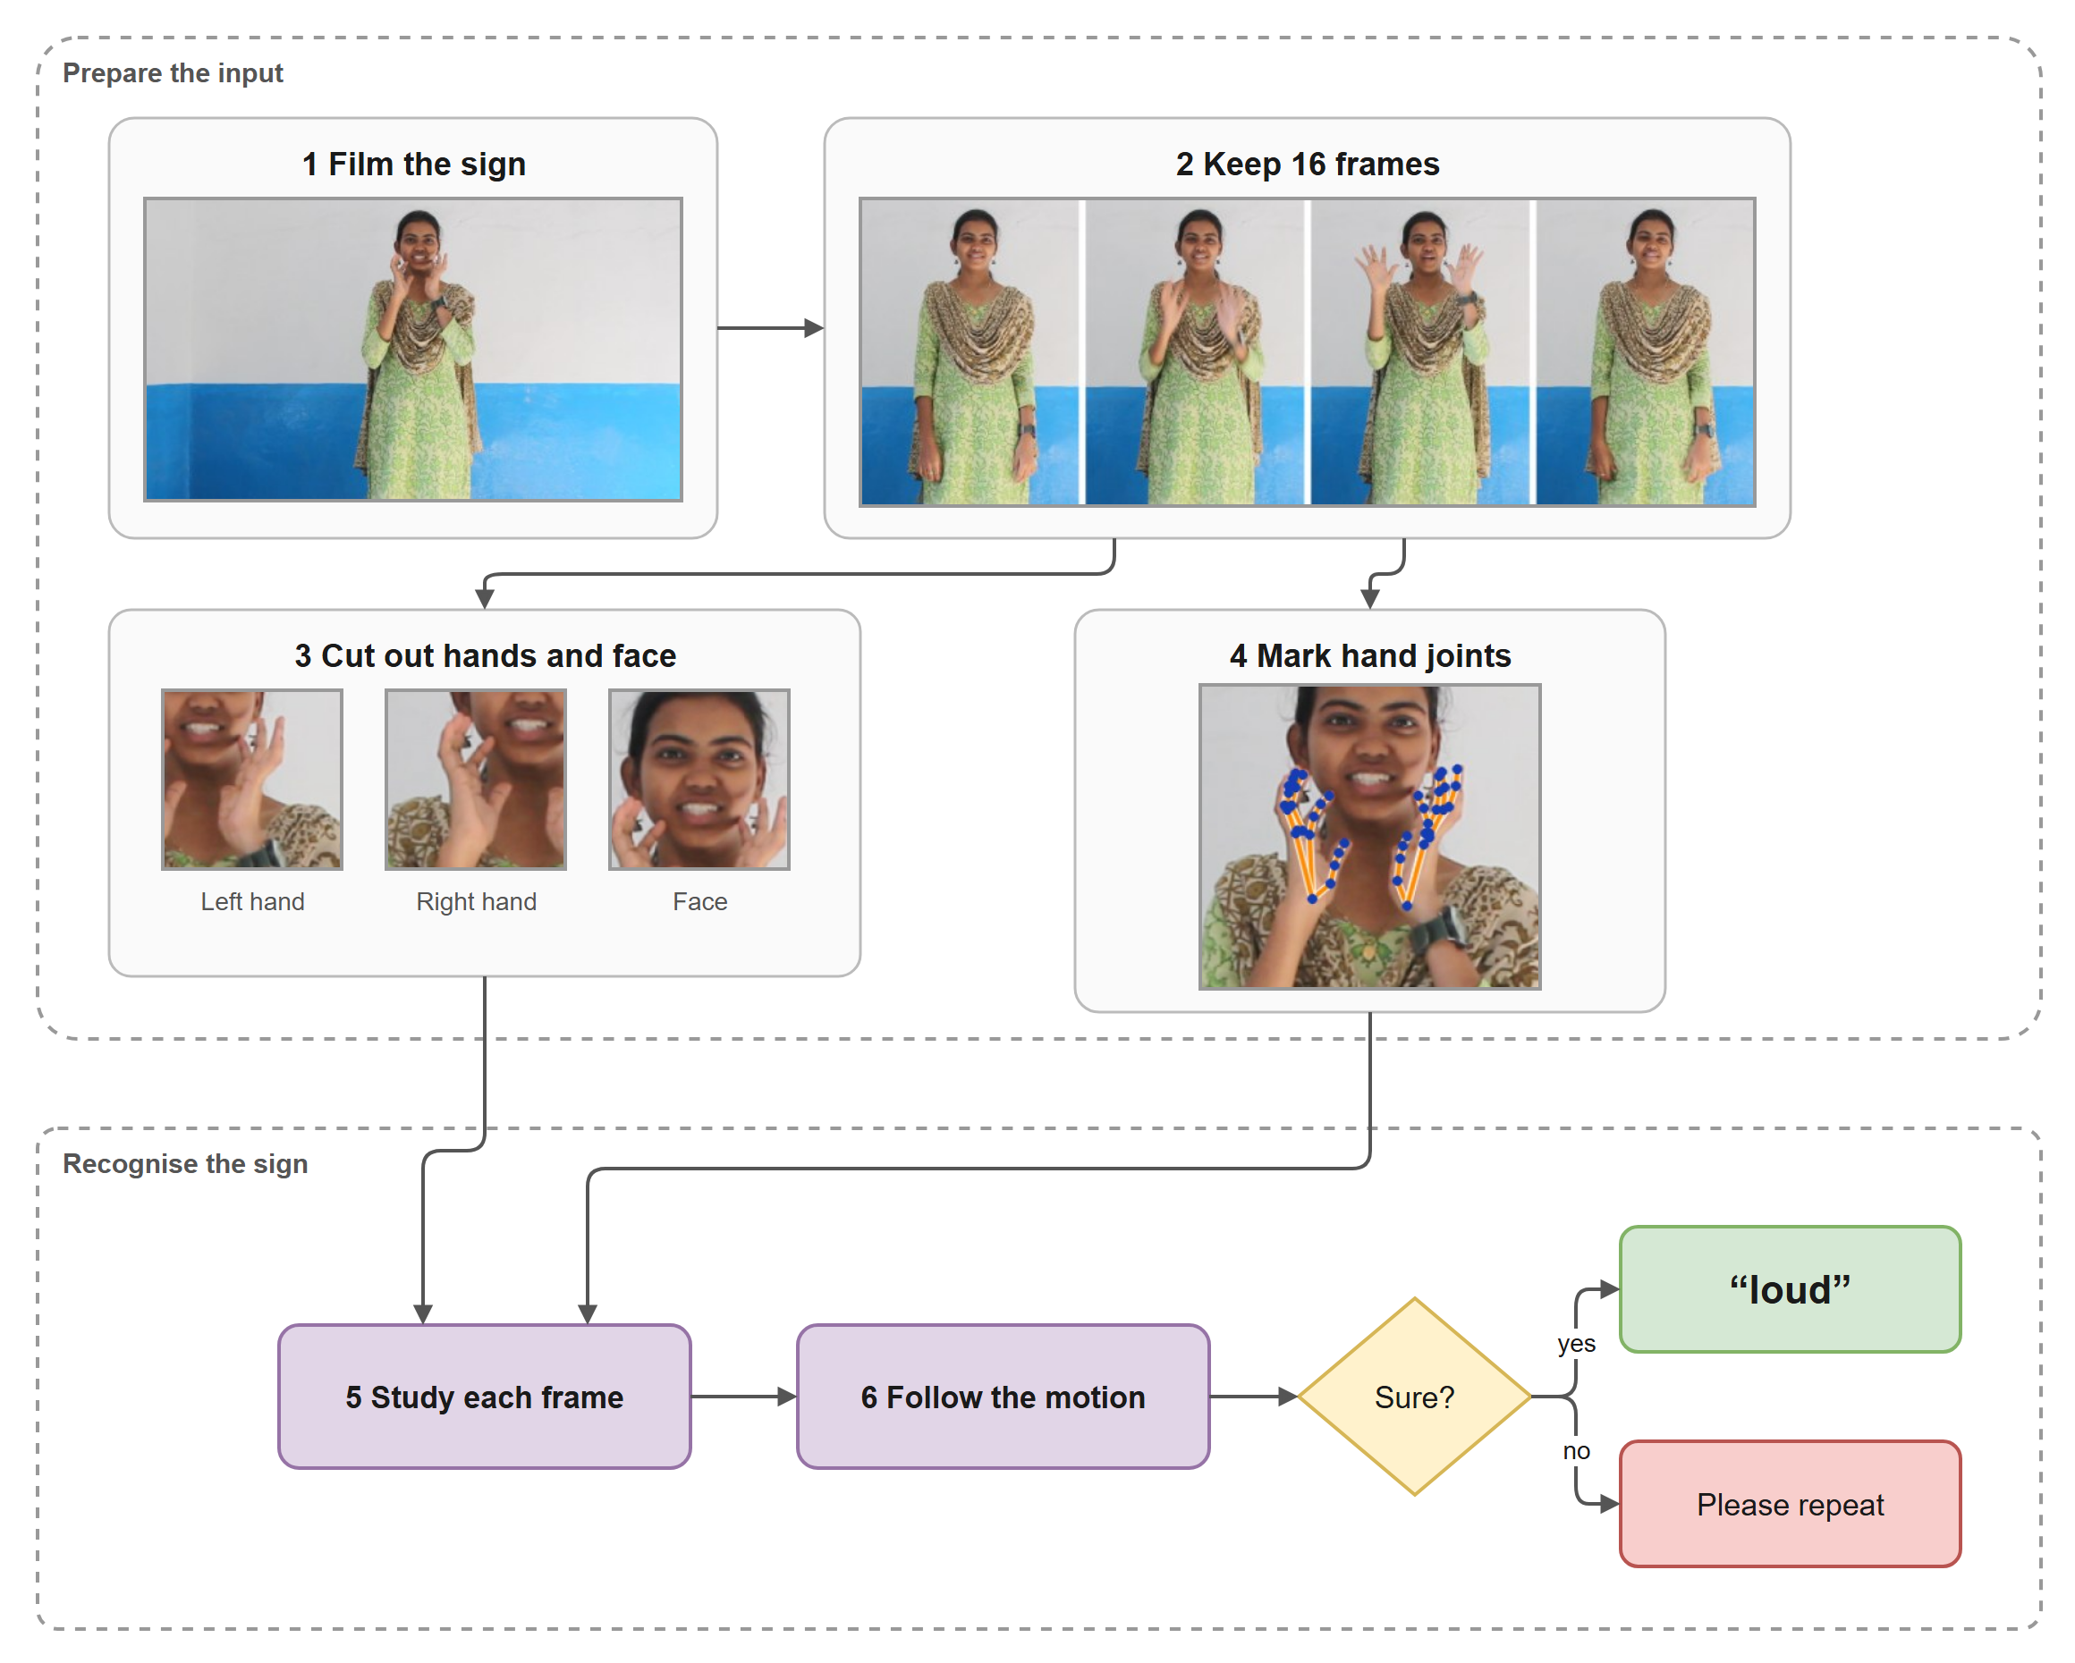
From video to model inputs
32 frames sampled uniformly, letterboxed to 1280 x 720.
MediaPipe Holistic finds hands, face and pose; a missed hand gets a second search in an upscaled forearm region, else the nearest box is reused and flagged.
Three crops per frame (left hand, right hand, face), 64 px.
21 joints per hand: shape relative to the wrist, location relative to the shoulders.
Detectors are rebuilt for every video; otherwise repeated runs disagreed on 3–6 % of frames.
Notes:
This is the input pipeline with real frames from a held-out clip. The landmark features are the biggest single lever in the project: the detector was already computing them, and adding them raised accuracy from 73.7 to 86.5 percent.

Slide 7
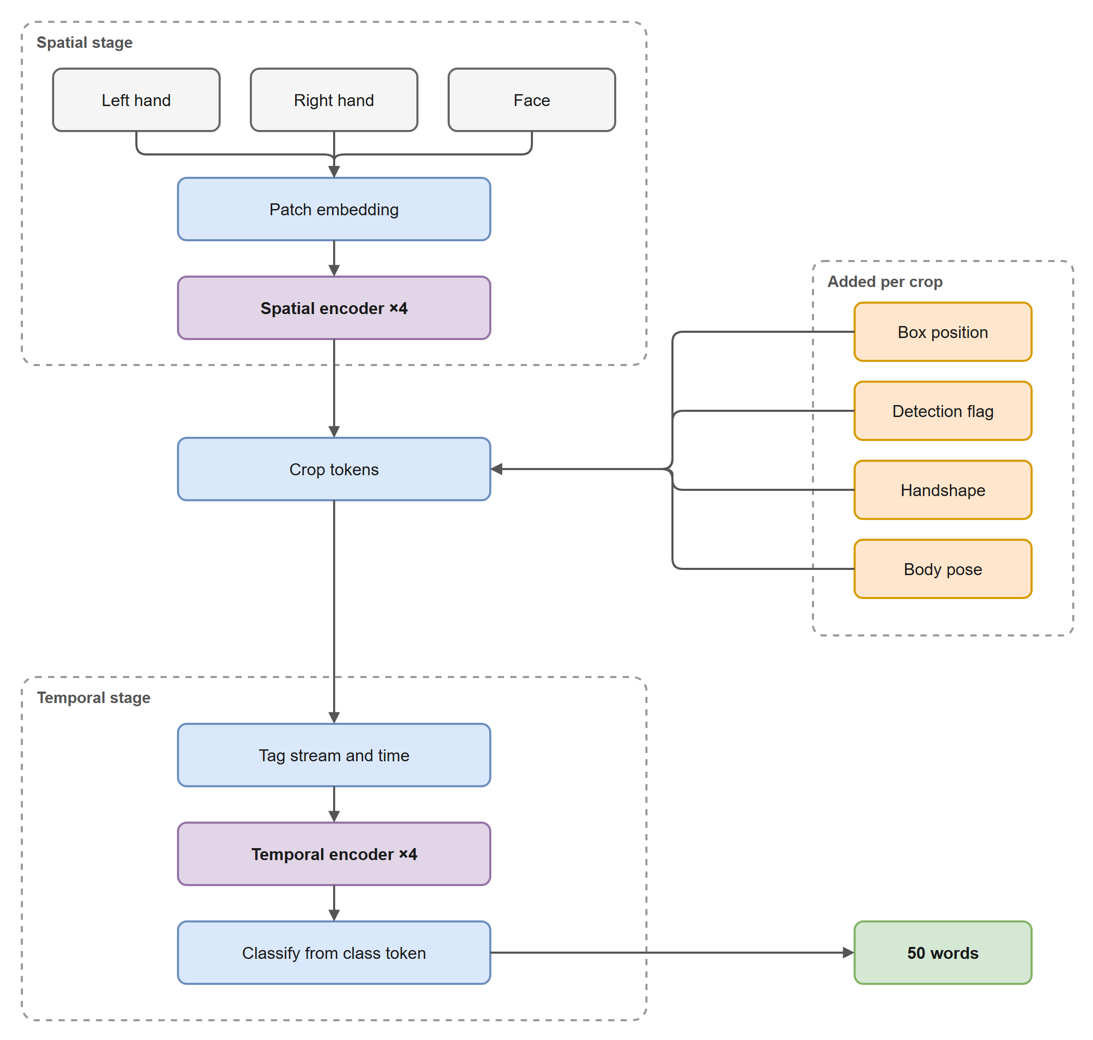
Classifier: ISL-ViT-Tiny
Component | Setting
Input | 16 frames x 3 crops x 64 x 64, box geometry, detection flags, landmarks
Spatial stage | 4 blocks, width 192, 3 heads, shared over 48 crops
Temporal stage | 4 blocks over 48 crop tokens + class token
Output | 262 words, restricted to the 50 deployed
Parameters | 3,894,214 (91 k for landmarks)
Why factorised: joint attention over every patch would be 816 tokens; the model attends over 17 tokens per crop, then 49 across the clip. Box geometry puts back the location that cropping removes.
Notes:
A spatial ViT reads each crop on its own with shared weights; each crop's token is tagged with its stream, frame, box position, a reliability flag and the landmark features; a temporal transformer then attends across all 48 crop tokens. Width 192 and three heads match DeiT-Tiny so pretrained weights load directly.

Slide 8
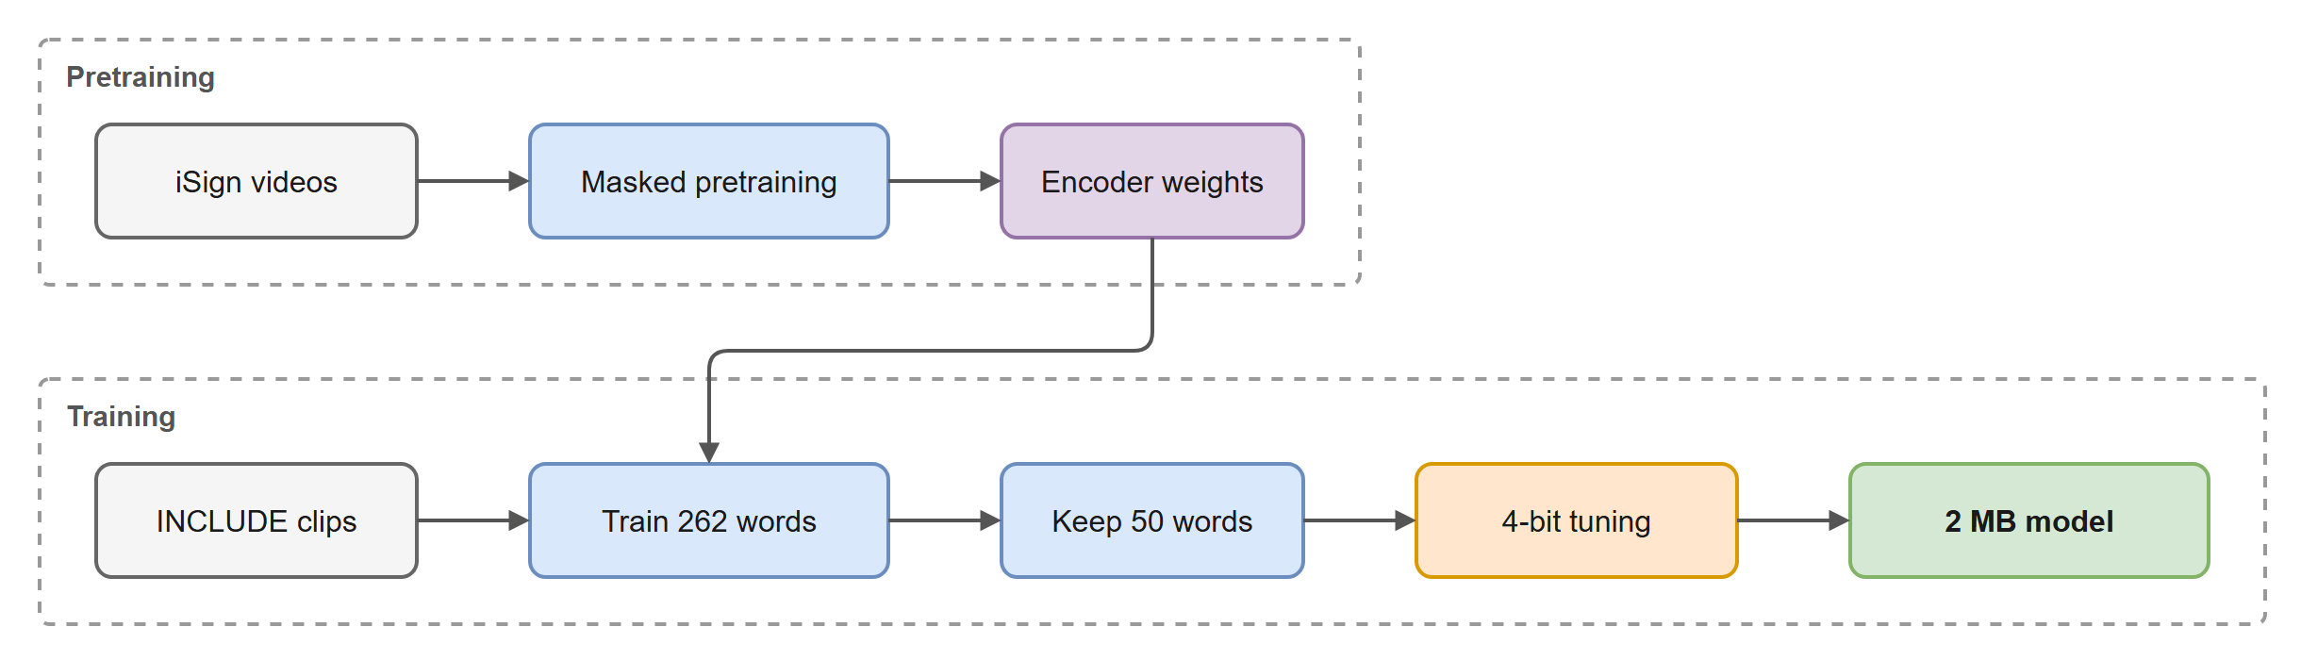
Training algorithm and compression
1. Self-supervised pretraining
2. Supervised training
3. 4-bit quantisation-aware
Masked image modelling (SimMIM) on 18,000 unlabelled iSign clips: 75 % of patches hidden and reconstructed.
1,000 epochs on 2,845 clips, AdamW 5e-4, mixup, stream dropout, resolution jitter, EMA. The final epoch is kept: no selection on test.
Weights at 4 bits in groups of 128 with 16-bit scales; straight-through estimator; 300 epochs. Post-training rounding lost 3.1 points, QAT only 0.6.
Notes:
Pretraining by masked image modelling on unlabelled iSign video, then supervised training for a fixed 1,000 epochs keeping the final weights, then 300 epochs of quantisation-aware training. Rounding after training cost 3.1 points; training with the rounding in the loop cost 0.6, at a seventh of the file size.

Slide 9
Comparing the classifier variants
85.9 %
top-1, shipped 4-bit model (seeds 84.5 / 87.5 / 85.8)
96.4 %
top-5: the right word is usually in the shortlist
1.97 MiB
3.89 M parameters, 4-bit
Answering from all 262 words instead of the 50 gives 72.0 %, so the app restricts answers exactly as the evaluation does.
Notes:
Landmarks are the big step: 73.7 to 86.5 percent. Post-training 4-bit rounding drops to 83.4; quantisation-aware training holds 85.9 at 1.97 MiB, 10.9 points above the 75 percent target. The same model answering from all 262 words scores 72.0, which is why the app restricts to the 50 deployed words.

Slide 10
Where a GAN can help: low-resolution video
Camera video
Below 720p?
Bicubic | SR-GAN
MediaPipe hands
ISL-ViT-Tiny
Why here
How we tested it
Every clip reaches the hand detector through one resize to 720p, which was bicubic. A wearable camera would send small, compressed video through exactly this step. The GAN replaces only that resize; 1080p video never passes through it, so clean results cannot change.
472 test clips degraded to 360p, 240p, 180p with JPEG. Front ends: bicubic, SR-L1 (same generator, no adversarial loss), SR-GAN v1, v2 and two v3 arms. Frozen 4-bit and 32-bit models, plus models fine-tuned on 360p. Paired McNemar tests; a rule fixed before the runs.
3
6
472
p < 0.05
levels: 360p, 240p, 180p, each with JPEG
front ends: bicubic, SR-L1, SR-GAN v1, v2, two v3 arms
test clips, identical in every run
and all 3 seeds agree, fixed in advance
Notes:
We looked for the place where a GAN can make a measurable difference. The only upscaling step in the pipeline is the resize to 720p before hand detection, and it is exactly where low-resolution wearable video would go. SR-L1 is the key control: same network, no adversarial loss, so it separates what learned upscaling gives from what the GAN adds.

Slide 11
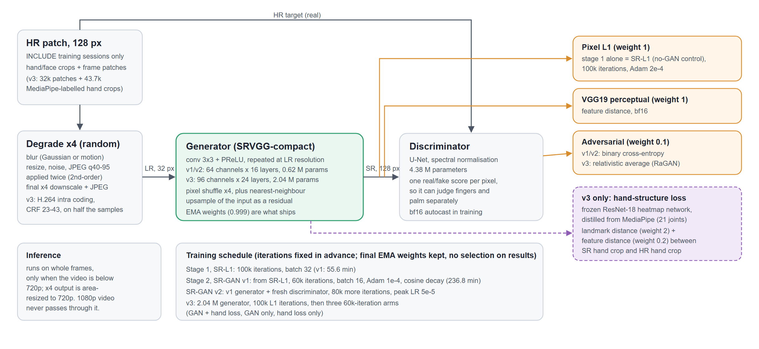
The super-resolution GAN
Notes:
Real-ESRGAN-style design. Generator: compact VGG-style network working at low resolution with a pixel shuffle and a residual upsample. Discriminator: U-Net with spectral normalisation, scoring each pixel. Training patches come only from training sessions and are degraded by random blur, resize, noise and JPEG applied twice. Losses: L1, VGG perceptual and adversarial. Version 3 adds a hand-landmark loss from a network we distilled from MediaPipe.

Slide 12
GAN results on degraded test video
+14.5
points at 180p, SR-GAN v2 vs bicubic (p = 7 × 10⁻³²)
+1.5
the adversarial loss's own gain over SR-L1, at 240p only
0
reliable gains for v3 over v2 or SR-L1, at any level
Fine-tuned on 360p: +5.2 at 240p, +12.5 at 180p over bicubic.
Notes:
Learned super-resolution helps at every degraded level: up to 14.5 points at 180p, and it still helps after the classifier is fine-tuned. But the adversarial part adds little: SR-GAN beats the non-adversarial SR-L1 only at 240p. More GAN training (v2) and the task-aware v3 did not improve on that.

Slide 13
Where the remaining loss sits
Landmarks, not pixels
With SR-GAN, 10.4 points are still missing at 180p: about 7.7 from the landmarks and 2.8 from the pixels.
Detector tuning fails
Lower thresholds and wider searches found up to 99 % of hand frames, but accuracy moved at most 0.8 points: misplaced hands rose to 14 %.
No invented hands
Hands found only in degraded video: 1.9 % with bicubic, 2.6 % with SR-GAN, at 180p.
Notes:
We swapped clean and degraded inputs. With clean pixels and degraded landmarks the model scores 78.2; with degraded pixels and clean landmarks 83.1. So after super-resolution the problem is where the detector places the joints. Tuning the detector finds more hands but more of them are misplaced.

Slide 14
A task-aware GAN (v3): what it changed
Hand-landmark proxy
ResNet-18 with heatmap head, trained on 43,682 verified hand crops to read MediaPipe's 21 joints.
Error on validation crops: 0.0215 of the crop, 91.4 % of points within 0.05 (MediaPipe vs itself: 0.041).
The generator is penalised when the proxy reads different joints from its output than from the original.
−3.1
On validation it found more hands (73.3 % vs 63.3 % for v2 at 180p). On the test set it was not reliably better than v2 or SR-L1, and the version without the adversarial loss was 3.1 points worse at 240p. Better detection did not become better classification.
points: v3 without the adversarial loss vs v2 at 240p (p = 5 × 10⁻⁶)
Notes:
Because the loss is in the landmarks, version 3 trains the generator against a differentiable stand-in for the hand detector. It did what it was designed to do at detection level on validation sessions, but not at the classifier on the test set. One untested explanation: the frozen classifier was trained on clean-video landmarks; fine-tuning it on the v3 front end would test that.

Slide 15
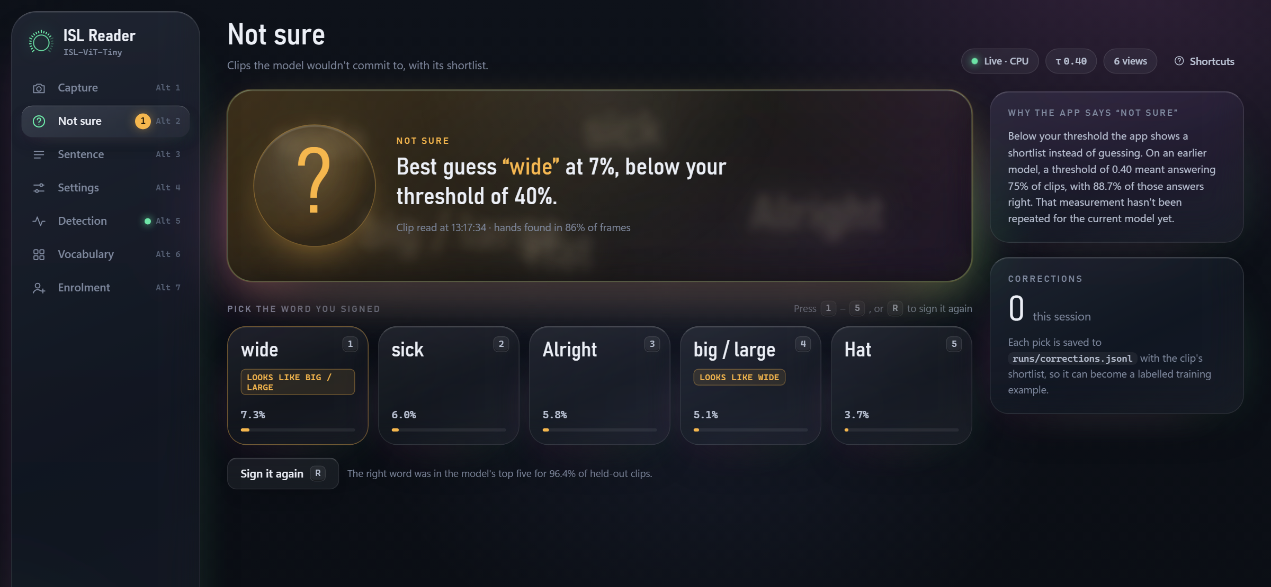
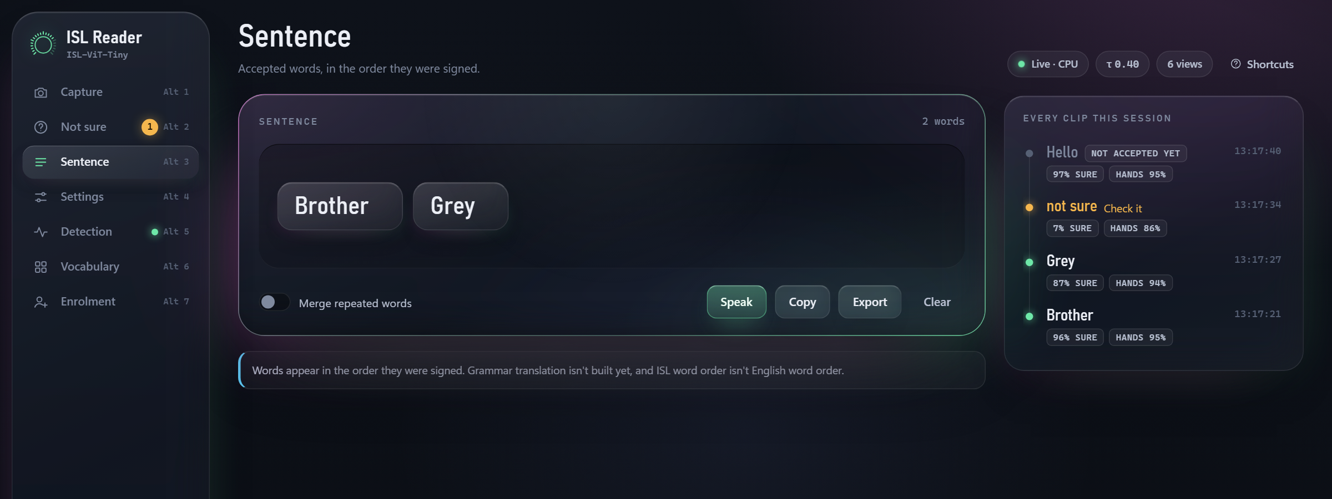
The interface, connected to the models
Seven screens
Capture: camera, video file or one of 10 held-out demo clips
Not sure: shortlist when confidence < threshold
Sentence: accepted words, speak, copy, export
Settings: threshold and views
Detection: where each crop came from
Vocabulary: per-word recall on unseen sessions
Enrolment: record new signers for training
Runs any trained checkpoint and either upscaling front end; reached over an SSH tunnel, which also enables the camera.
Notes:
The interface is one web page served by the recognition server. These are live screenshots: Capture reading a held-out clip, the Not-sure shortlist for a look-alike word, and the sentence built from accepted words. Corrections are logged as labelled examples, and the Enrolment screen records new signers into the training folder.

Slide 16
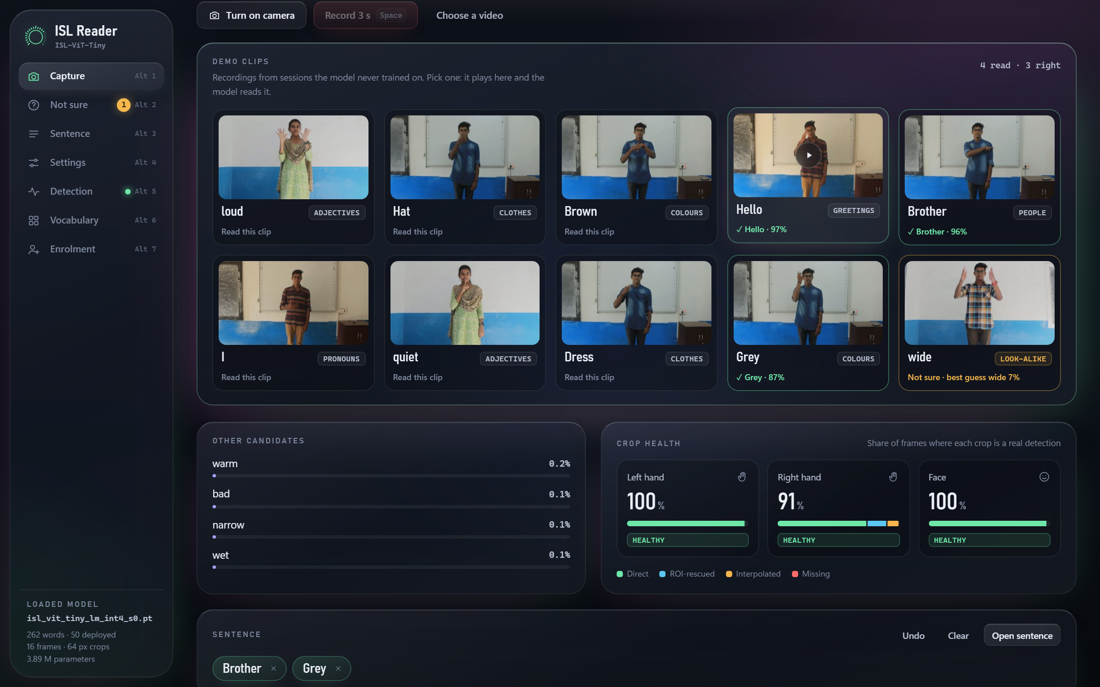
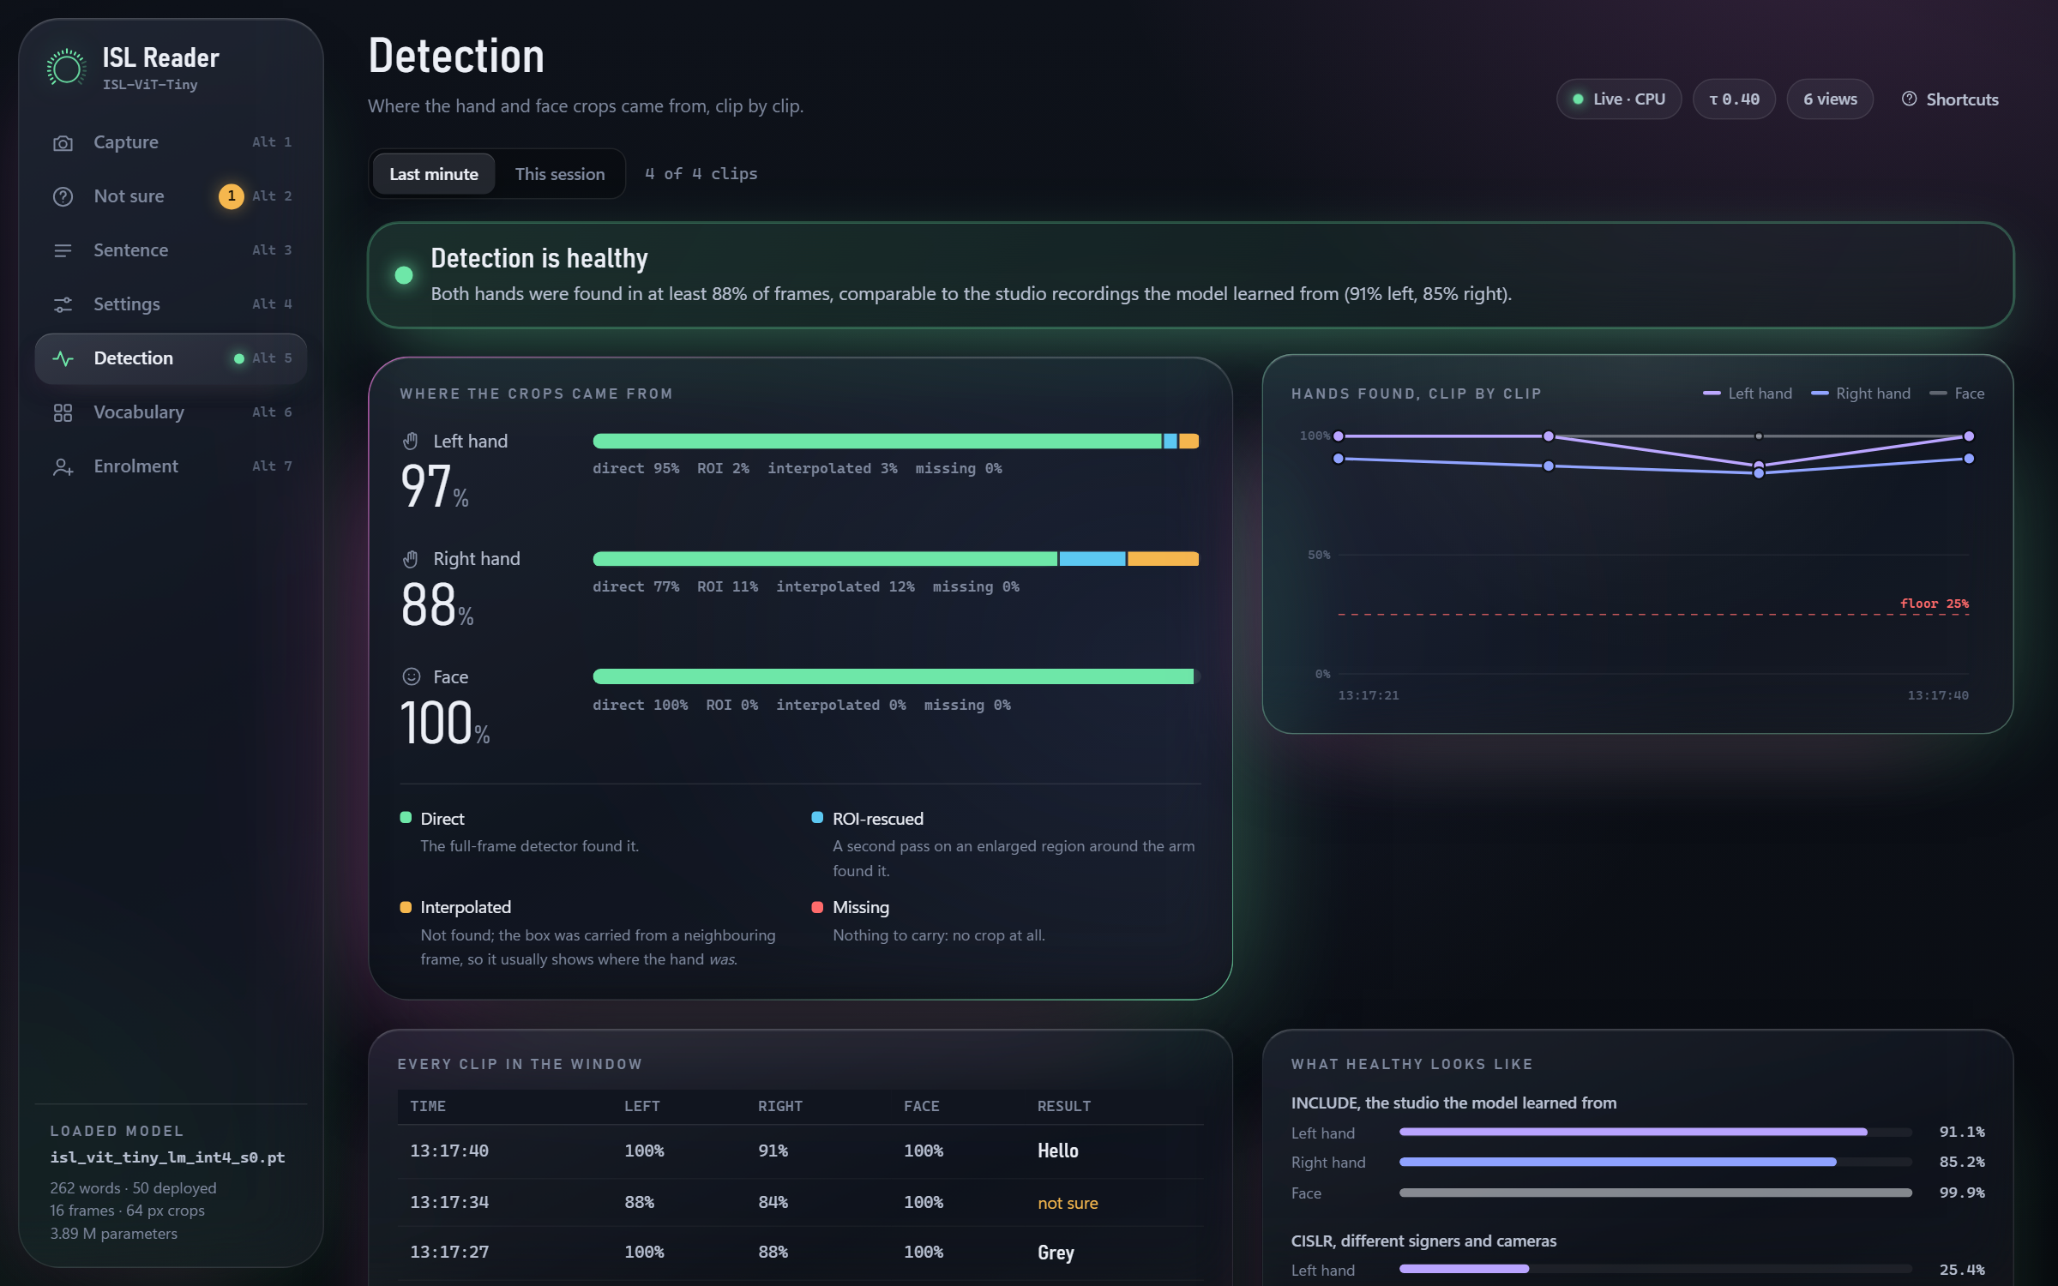
Testing the interface with the models
Test | Method | Result
Screens render | Chromium, 7 screens at 1366 and 1920 px | No console errors
Live answers | 10 demo clips on the live server; 4 also via the Capture screen | 9/9 reliable clips correct (66–97 %); look-alike → Not sure
Same answers as the evaluation | App vs offline result, same clips and model | 8 of 8 clips agree
Vocabulary restriction | 50-word vs 262-word answers | Matches the 85.9 % setting (262 words: 72.0 %)
GAN front end in the app | 180p copy of a demo clip, SR-GAN on | Read correctly
Latency | Desktop CPU, 6 views, end to end | 5–9 s per clip
Notes:
Browser tests: Playwright driving Chromium. Live tests: the running server on held-out clips. Consistency test: the server's classification code against the offline evaluation's per-clip results. We tested at three levels: automated browser tests on every screen, live end-to-end tests through the running server, and a consistency test that the app gives the same answer as the offline evaluation for the same clip and model. It matched on all 8 clips, including the 2 the model gets wrong.

Slide 17
What we found
Next steps
Fine-tune the classifier on the task-aware front end
Re-measure the confidence curve for the shipped model
Fix hand detection for tightly framed video (CISLR)
Record new signers through Enrolment; test on wearable hardware
85.9 % top-1 on unseen sessions from a 1.97 MiB model; random splits overstate accuracy by over 20 points.
Learned super-resolution recovers up to 14.5 points on 180p video; the adversarial loss adds little beyond it.
After upscaling, the remaining error is in landmark placement, not pixels.
The app reproduces the evaluation's answers clip for clip.
Notes:
Limitations: one studio, inferred sessions, no successful cross-corpus transfer yet, synthetic degradation, latency measured on a desktop CPU, isolated words only. Thank you; we can run the live demo now.

