Slide 1

Academia
Discriminations
?
Harassment
Unwell
being
-
Understand
Prevent
React
Introduction5

Slide 2
BUT...
We are researchers !
Be wrong, do better !
A problem ?
Hypothesis
Solution
Introduction5

Slide 3
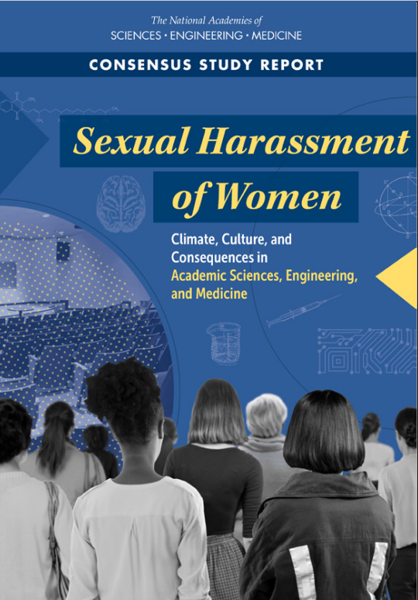





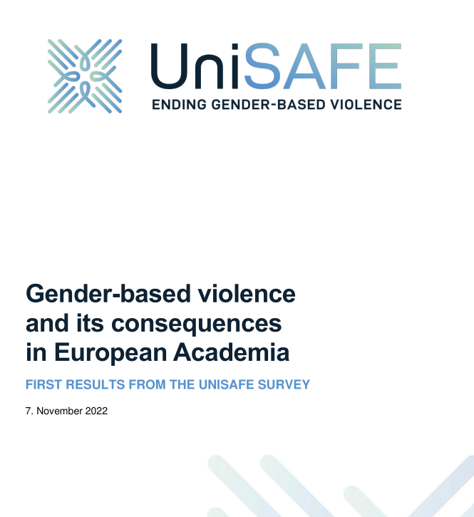

BUT...
We are researchers ?
Introduction5

Slide 4
BUT...
Lots of sources, from reports and research papers:
  https://not-in-our-labs.github.io/ressources.html
  Https://not-in-our-labs.github.io/presentation.html
Feedback welcome !
Introduction5

Slide 5
BUT...
Investigation - part I
Parity in computer science ?

Slide 6
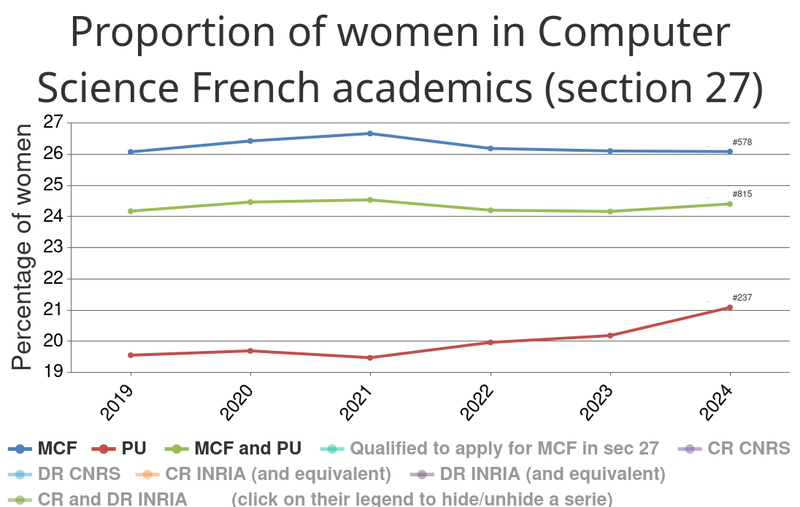
Evidence 1: a stable lack of women in CS
BUT...
Parity in computer science ?

Slide 7
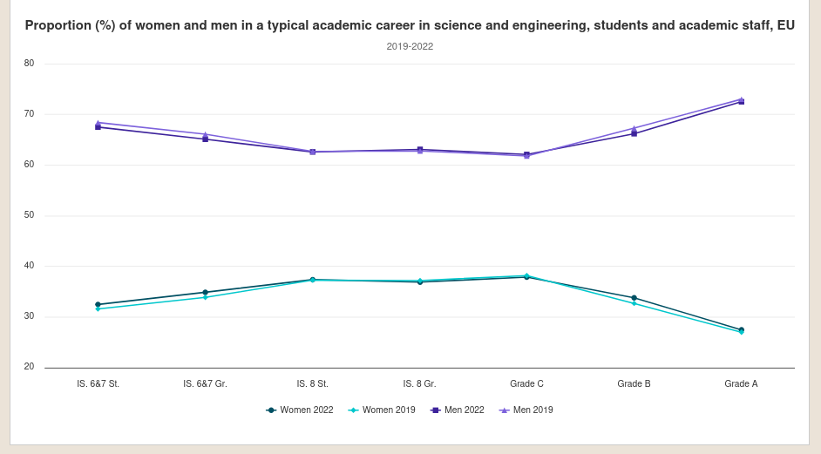
Evidence 2: a leaky pipeline the higher we go
BUT...
Bachelor
Master
PhD St
PhD Gr
Parity in computer science ?

Slide 8
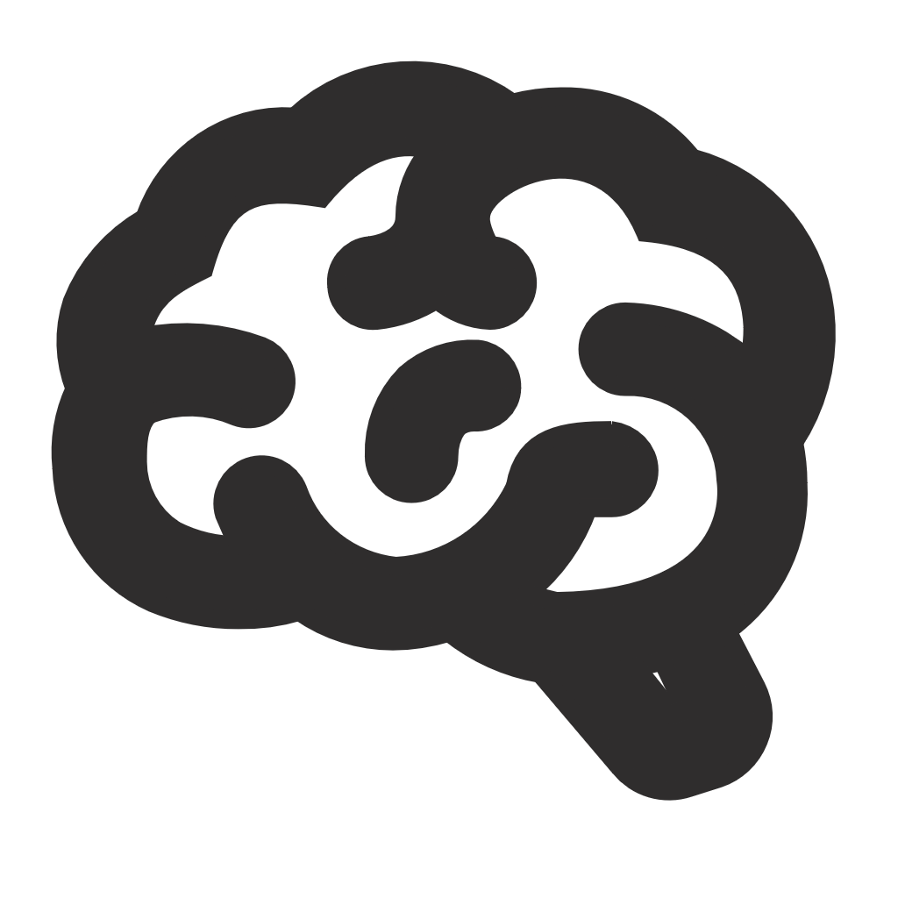
Hypothesis 1: stereotypes and biases ?
BUT...
Big lying belief sponge !
Creates a « coherent »
view of the world
from incomplete facts
Parity in computer science ?

Slide 9
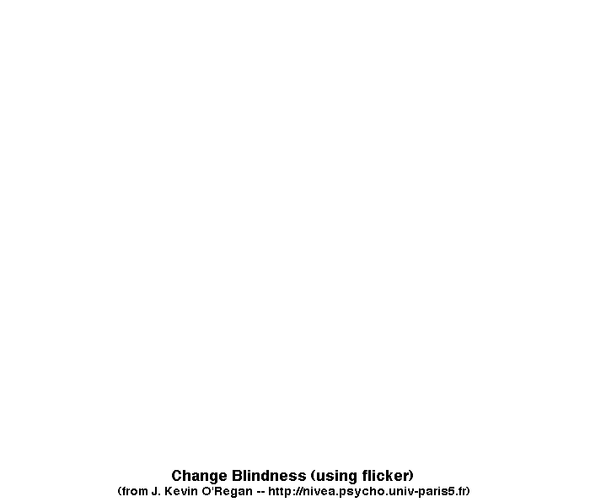
Hypothesis 1: stereotypes and biases ?
BUT...
Parity in computer science ?

Slide 10



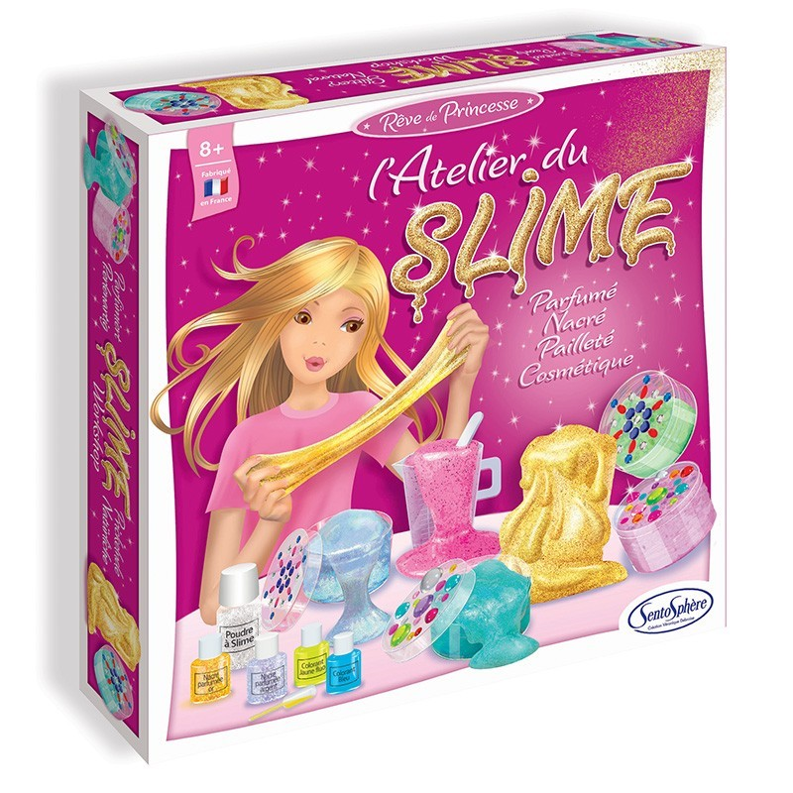
Hypothesis 1: stereotypes and biases ?
BUT...
“by age 6, children already think that boys are better than girls
at computer science and engineering” (Miller et al. 2024)
Parity in computer science ?

Slide 11


Hypothesis 1: stereotypes and biases ?
BUT...
So, let’s just solve the gendered stereotype of science. Job’s done.
Parity in computer science ?

Slide 12
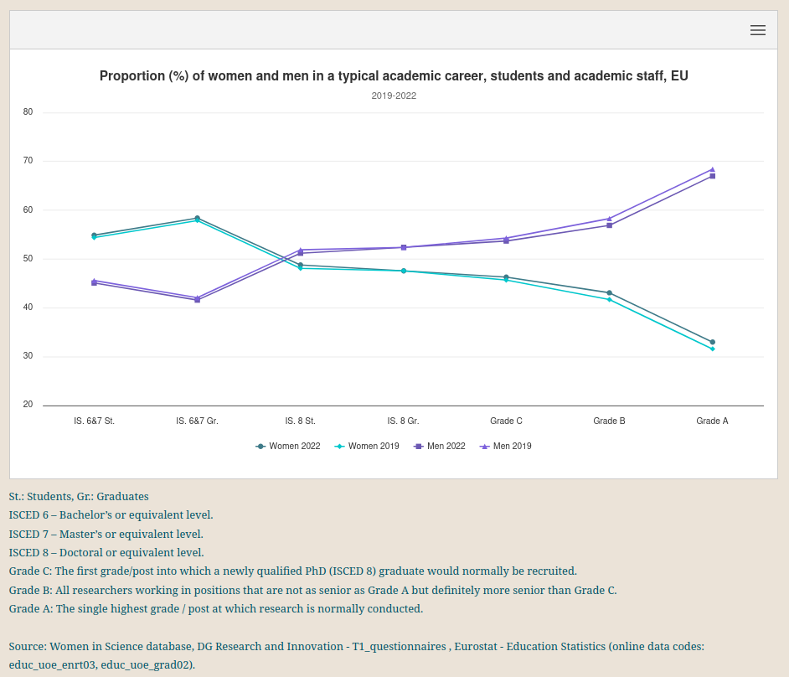
Counter-evidence: the leaky pipeline is everywhere, not just CS
BUT...
Parity in computer science ?

Slide 13
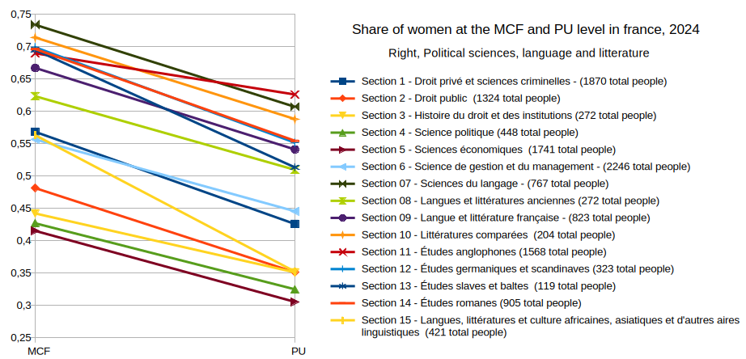
Counter-evidence: the leaky pipeline is everywhere, not just CS
BUT...
Parity in computer science ?

Slide 14

BUT...
We need
more facts !
Parity in computer science ?

Slide 15
BUT...
Investigation - part 2
Unwell-being in academia ?

Slide 16
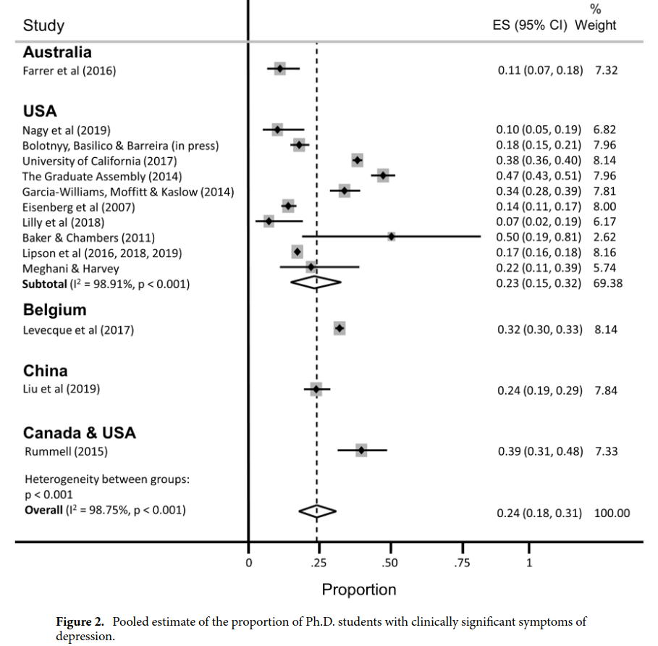
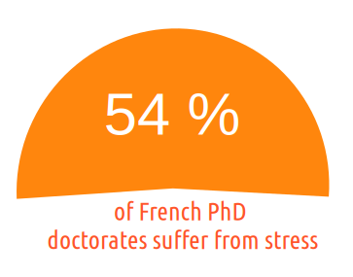
Evidence 3: PhD students are way too depressed
BUT...
Wordwide, we have 24% of depression
among PhD students (Satinsky et al. 2021)
Consistenly above :
general population (~5%)
young adults (~15%)
Unwell-being in academia ?

Slide 17
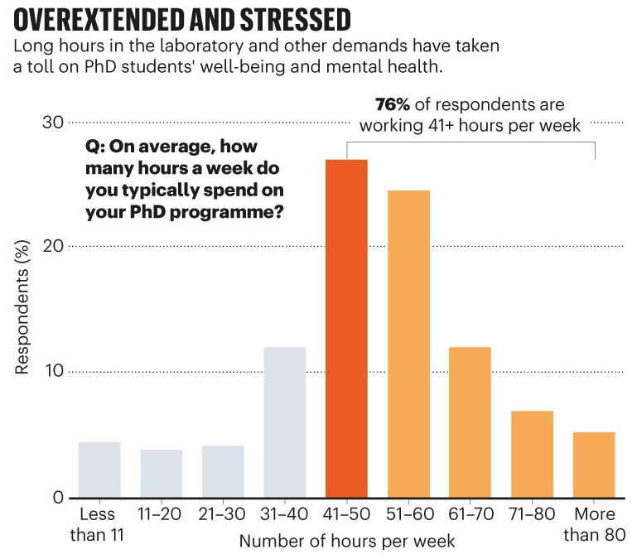
Evidence 4: PhD students are overworked
BUT...
From a 6000 PhD student survey by nature. (Woolston 2019)
Unwell-being in academia ?

Slide 18
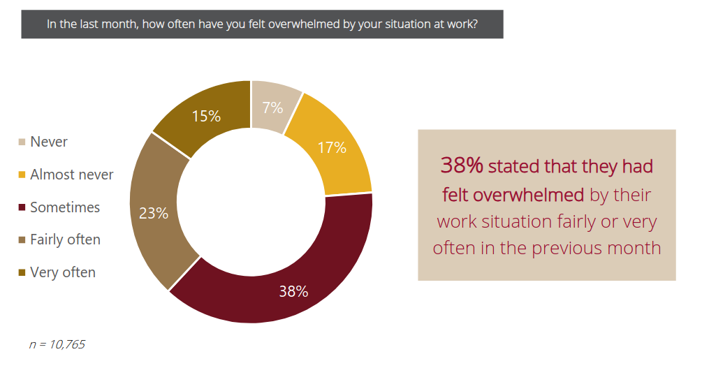
Evidence 5: everybody is overwhelmed
From a wordwide survey (Cerejo, Awati, and Hayward 2020)
BUT...
Unwell-being in academia ?

Slide 19





Hypothesis 2: research is by essence hard
IMPOSTOR SYNDROM
NO TICK BOXES
UNCLIMBED MOUNTAIN
FIRST TIME FAILING
Unwell-being in academia ?

Slide 20



Hypothesis 2: research is by essence hard
Harder than most
other jobs????
Ok, fair point, but...
Unwell-being in academia ?

Slide 21
The missing link
Worse at the bottom
of the power ladder
In all academia:
  too much unwell being
  a leaky pipeline
Less women the
higher we go in
the power ladder
Starting to tie things up ?

Slide 22
BUT...
We need
more facts !
Parity in computer science ?

Slide 23
BUT...
Investigation - part 3
Omnipresent discriminations

Slide 24
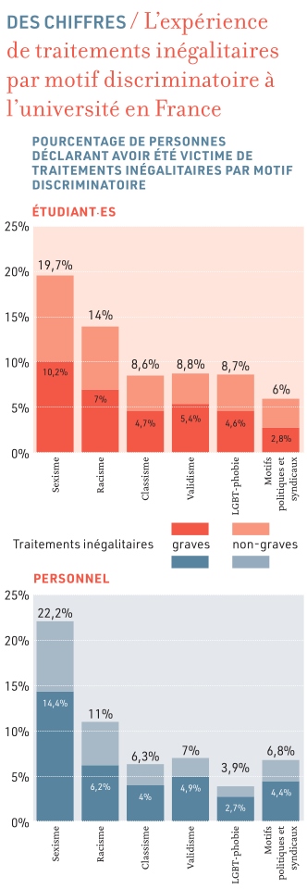
Evidence 6: strong inequalities in the access to a higher status
BUT...
+ Weight-related discrimination
2.4x
to get a PhD if a close
relative has one
6.2x
+ LGBTQIA+ related discrimination
to become a professor if
white-skinned instead of black
It is
+ Beliefs related discrimination
more likely*
+ Money based discrimination
+ ......
2.6x
to become a
professor if male
4.6x
to become uni staff without
a declared disability
Omnipresent discriminations
*pure statistical single-variable analysis

Slide 25
Evidence 7: men are not competing fairly
BUT...
Men spend more time doing research, and leave
  the less rewarding work to women. (Winslow 2010, O’Meara et al. 2017)
Men self-cite 70 percent more than women (King et al. 2017)
Female authored papers are less cited (Bendels et al. 2018),
  and notably less likely to be cited by men (Koffi 2021)
Parenthood leads to a significant decline in the number of publications
  by women, while not for men. (Lutter and Schröder 2020)
Omnipresent discriminations

Slide 26
Evidence 8: evaluations are highly biased
BUT...
A women name on a CV implies evaluation bias
  (Steinpreis, Anders, and Ritzke 1999)
The “two-body” problem is only used to refuse women not seen as movable
  (Rivera 2017)
Women don’t get credit for group collaborations, while men do. (Sarsons 2017)
Underr-epresented minorities faculty received are 44% less likely to receive unanimous votes from P&T committees (Masters-Waage et al. 2024)
Career breaks are discriminated against in CVs. (Kristal et al. 2023)
Omnipresent discriminations

Slide 27

PAUSE !
It is only getting
worse from here :(
Omnipresent discriminations

Slide 28
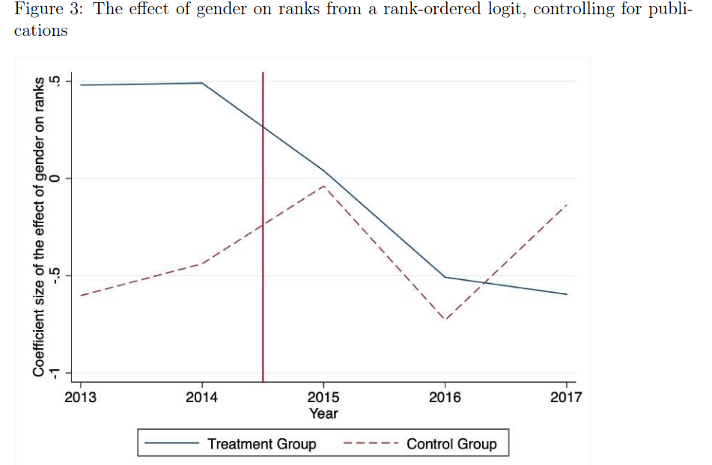
Evidence 9: men are ACTIVELY gate keeping
BUT...
Consequences of the french 2015 reform « 40 % ratio » in committes on STEM fields
« the negative effect of the reform is concentrated in committees headed by men, this result seems driven by the reaction of men to the reform »
(Deschamps 2024)
« male evaluators become less favorable toward female candidates as soon as a female evaluator joins the committee »
(Bagues, Sylos-Labini, and Zinovyeva 2017)
Omnipresent discriminations

Slide 29
Fun (?) Fact 1:
BUT...
you are more likely to disbelieve
facts demonstrating biases if you are a man!
(Handley et al. 2015)
In fact, it is often that our brains don't see some things (remember the previous illusion), and it can be very hard to finally see them. But, we need to see more things to unlock the final piece of the puzzle.
Omnipresent discriminations

Slide 30
BUT...
Investigation - part 4
The final piece of the puzzle

Slide 31


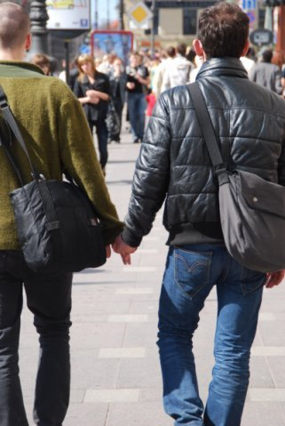
The magical hiding glasses ? (by Privileged Inc TM)
If we are not the target of a
discriminating or harassing behaviour
we will probably not even see it
The final piece of the puzzle

Slide 32
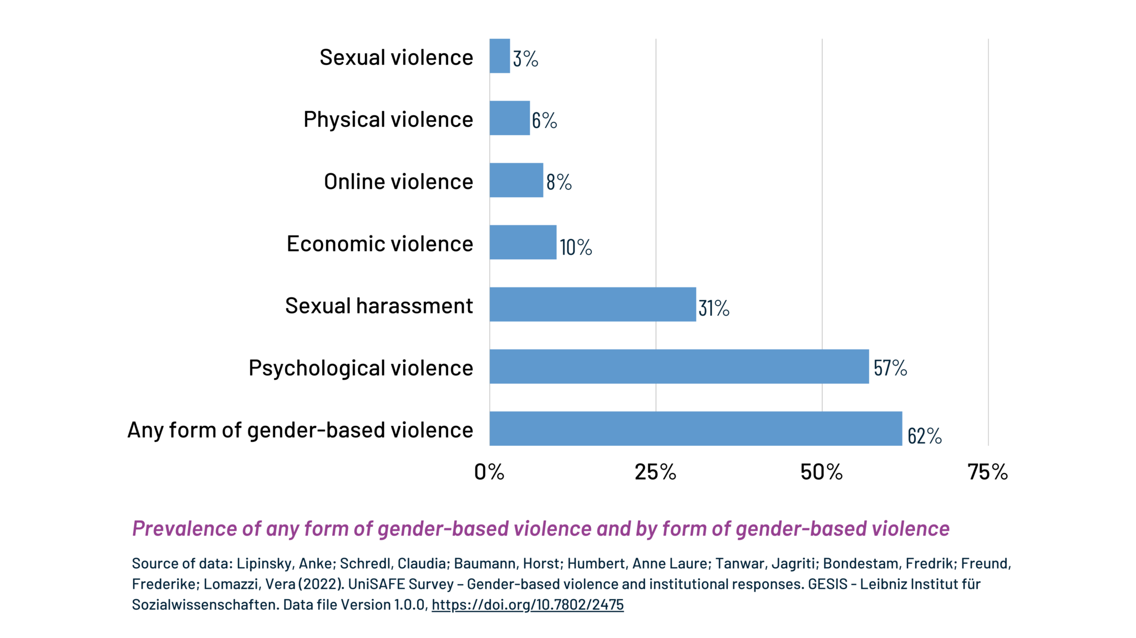
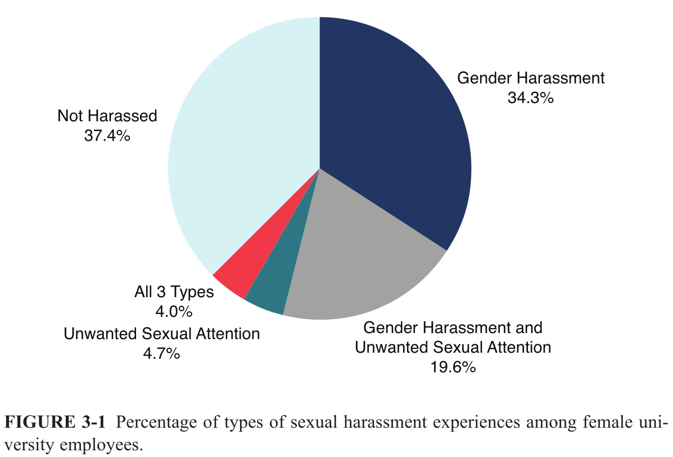
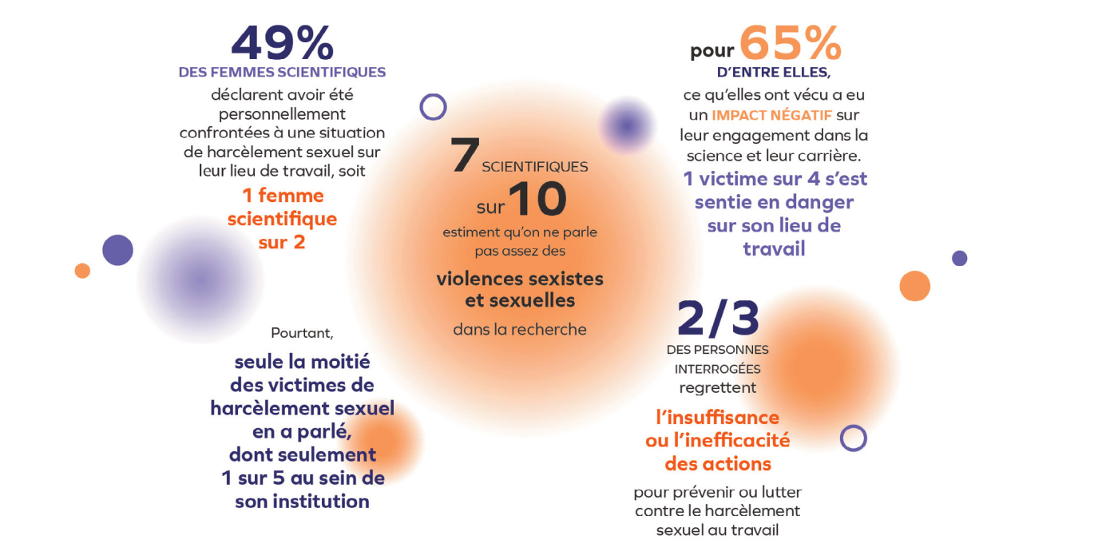
Evidence 10: the omnipresent « invisible » phenomenom
The final piece of the puzzle

Slide 33
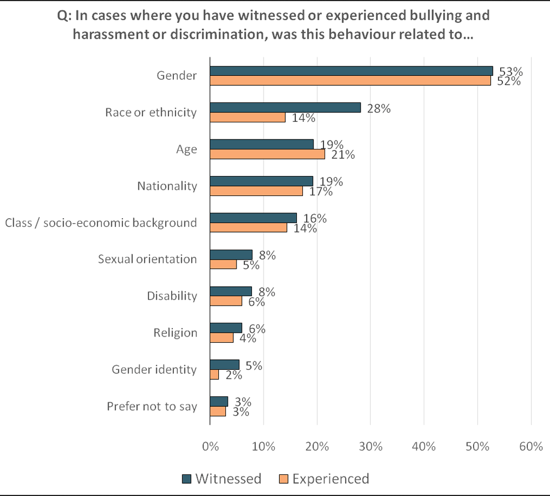
Evidence 11: it targets many groups at all levels
Since their arrivals in french higher education, the share of students target of a sexual assault or rape, often reiterated, is :
24% of women
9% of men
33% of transgenders/non binaries/queers
UK researchers
The final piece of the puzzle

Slide 34
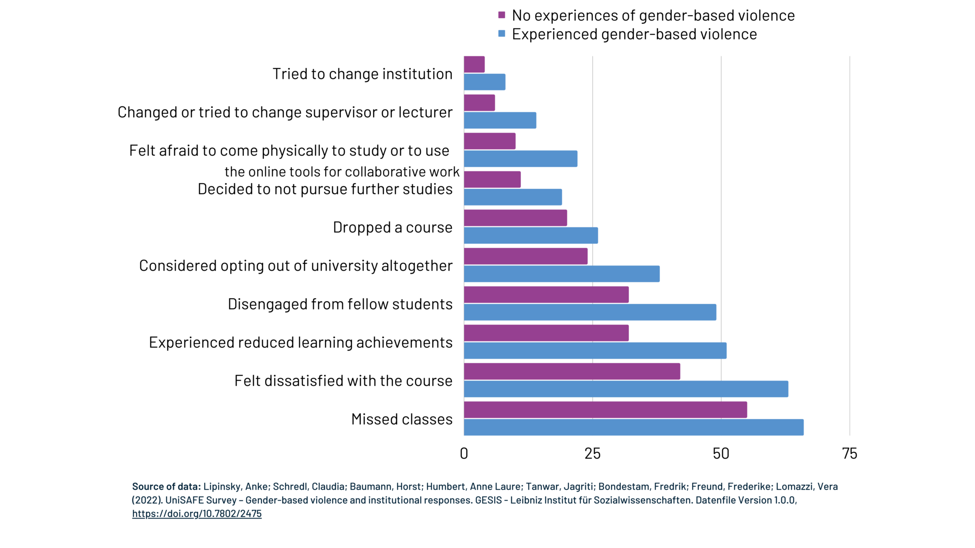
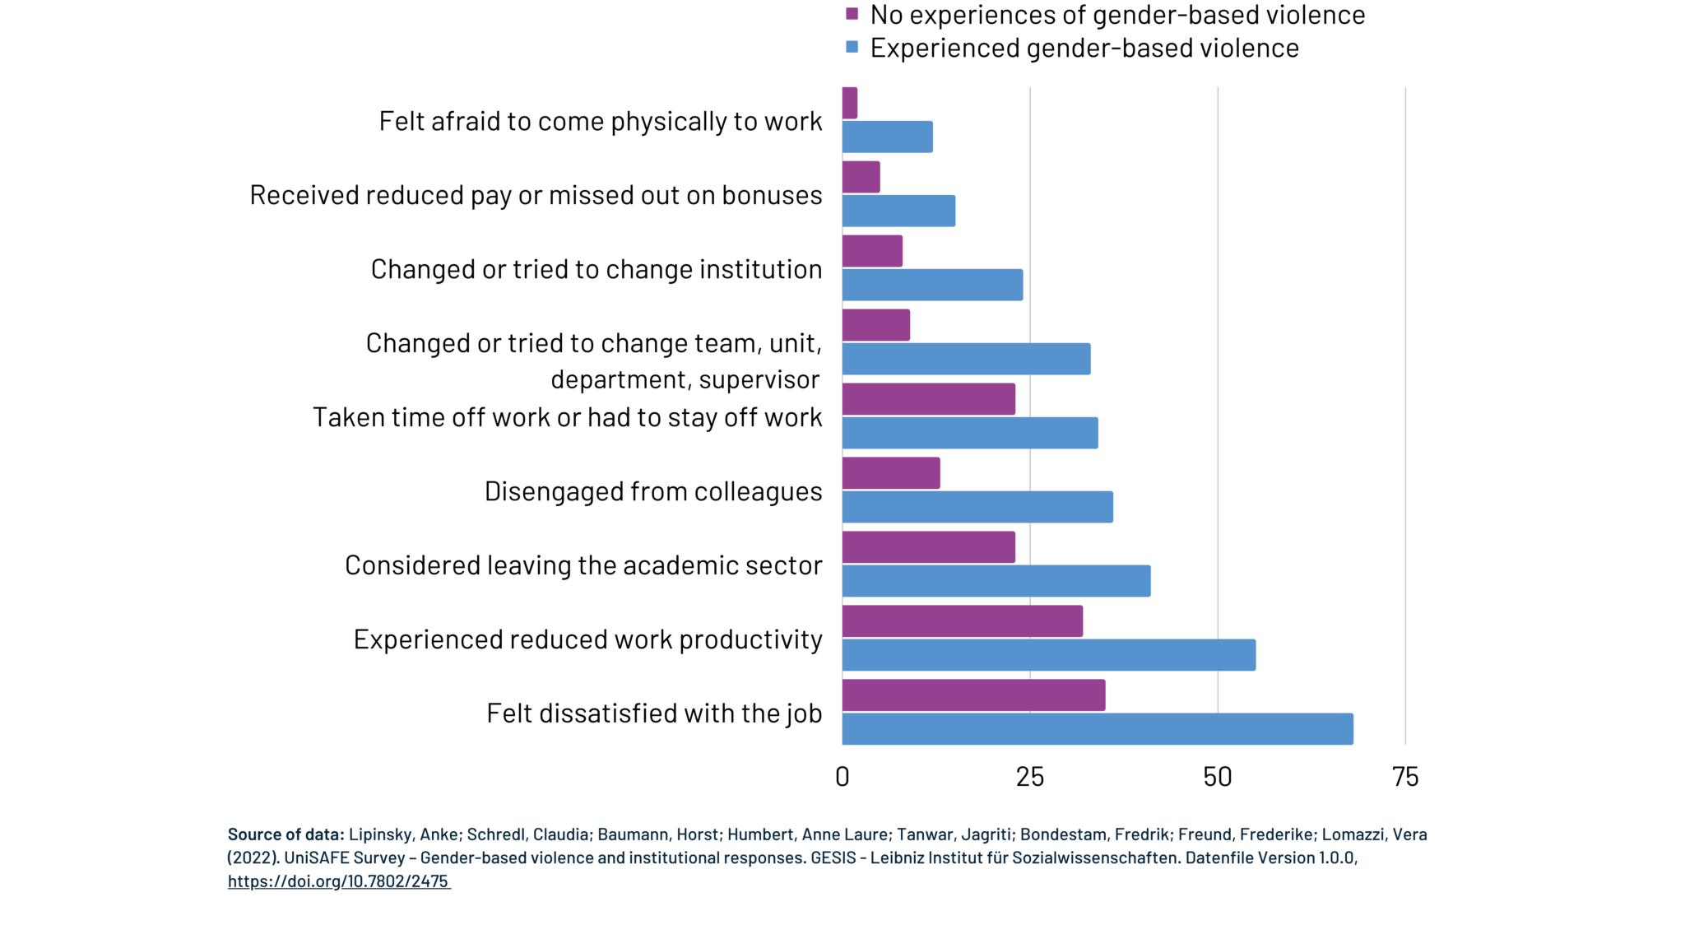
Evidence 12: it has consequences
The final piece of the puzzle

Slide 35
The missing link (part 2)
Harassment and bullying is widespread
against women and URM
It actively makes them run away
It actively depresses them
Worse at the bottom
of the power ladder
The final piece of the puzzle

Slide 36
The missing link
Power imbalances foster and sustain sexual-harassment (Benya, Widnall, and Johnson 2018) (Zara et al. 2024) (Bergeron et al. 2025), and in fact other form of harassments and discriminations (Dhume and Roberti-Lintermans 2024)
« The academic workplace has the second highest rate of sexual harassment at 58 percent (the military has the high-est rate at 69 percent) when comparing it with military, private sector, and the government »(Benya, Widnall, and Johnson 2018)
The final piece of the puzzle

Slide 37



empowers
Harassment
Bullying
Exploitation
justifies
Strong
Competion
Star culture
Medals
Merit
power imbalance
defended by
Gate-keeping and
discriminations
Depressed
Overworked
Overwhelmed
Overstressed
causes
The final piece of the puzzle

Slide 38
Ok, all this sounds bad...
but it is only individual consequences,
and maybe « SCIENCE » and « PROGRESS » needs all this!
First off, I find you morally diubious if you believe this, but ok, let’s still be thorough.
Is it an issue ?

Slide 39
Moral answer:
It is widely accepted that science with experiments
that involve misstreating human beings is
unethical and should not be done.
Is it an issue ?

Slide 40
Practical answer:
A lack of diversity leads to biased and dangerous science :
airbags systems have been designed historically for men body shapes, leading to less chances for women to survive car crashes
medicine is dosed for men, with few women in cohorts (19% for antiviral, 38% for vaccins, 11% for aids)
women have distinct symptoms sometimes – e.g. yentl syndrom for cardiovascular diseases, women with such conditions have 10% more chances of dying when arriving at the hospital.
LLM with racist or sexist bias, now deployed in companies to filter CVs.
Is it an issue ?

Slide 41
An answer accepting the bad « progress » premise:
Diversity breads inovation!
  publications by mixed-gender teams are more cited (Campbell et al. 2013)
  science by mixed-gender teams is significantly more novel and impactfull (Yang et al. 2022)
  diversity in inputs by author ethnicity, location, and references leads to greater contributions to science as measured by impact factors and citations. (Freeman and Huang 2015)
  piverse scholars are more innovative, but their work is taken up by others less than it should be (Hofstra et al. 2020)
Is it an issue ?

Slide 42
We have many issues and we understand them and their roots.
TIME TO ACT
Act

Slide 43



What exists and what beliefs are behind it
Individual
Societal
Institutional/Cultural
Mentoring
Networking
Child-care
Part-time
Bias training
Fight harassment
Train employees
Improve the culture
Act

Slide 44
Are institutions doing enough ?
often focus on solutions from the individual or societal point of view,
it is either women who are missing something or society to blame,
but never our academic culture which is blamed.
They do not address the most common form of harassment (gender-harassment), provide opaque and inefficient report procedures (He et al. 2024) leading to a feeling of betrayal (Bergeron et al. 2025).
They often focus on protecting the image of the institution (Faniko et al. 2021), and on just aiming for legal compliance, which had little impact on harassment, (Benya, Widnall, and Johnson 2018), notably as most targets of harassment don’t report issues. (Lipinsky et al. 2022)
Act

Slide 45

A fourth point of view ?
We do the research, we are part of this toxic culture, and we have power over it.
« A systemwide change to the culture and climate in higher education is required to prevent and effectively address all three forms of sexual harassment. » (Benya, Widnall, and Johnson 2018)
« We need to focus on broad cultural change » (Johnson and Hoover 2015)
Us
Act

Slide 46
Step 1: be the bare minimal of reasonable human beings
The basics:
As a general rule, don’t touch or be very close to people at the workplace
Don’t comment on the physical appearance of people
Avoid one on one meetings with subordinates outside of the worplace
Don’t try to date your students
Don’t ever say somebody does not belong here because of X or Y
Don’t make general comments about some group X having some supposed characteristics
...
Act

Slide 47
Step 2: question the toxic culture, spread a better mentality
42% of PhD students think it’s
normal to suffer mentally.
Relieve the pressure :
It's normal to not work outside of the office.
It's normal if research is not my whole life.
It's ok if I don't publish one more paper this year.
It's ok if I go on long vacations.
It's ok if I don't want to pursue research after my PhD.
It's ok if I am not doing a permanent crunch.
It’s especially important not to be « brillant »
50% don’t feel they can talk about not pursuing academia
Act

Slide 48
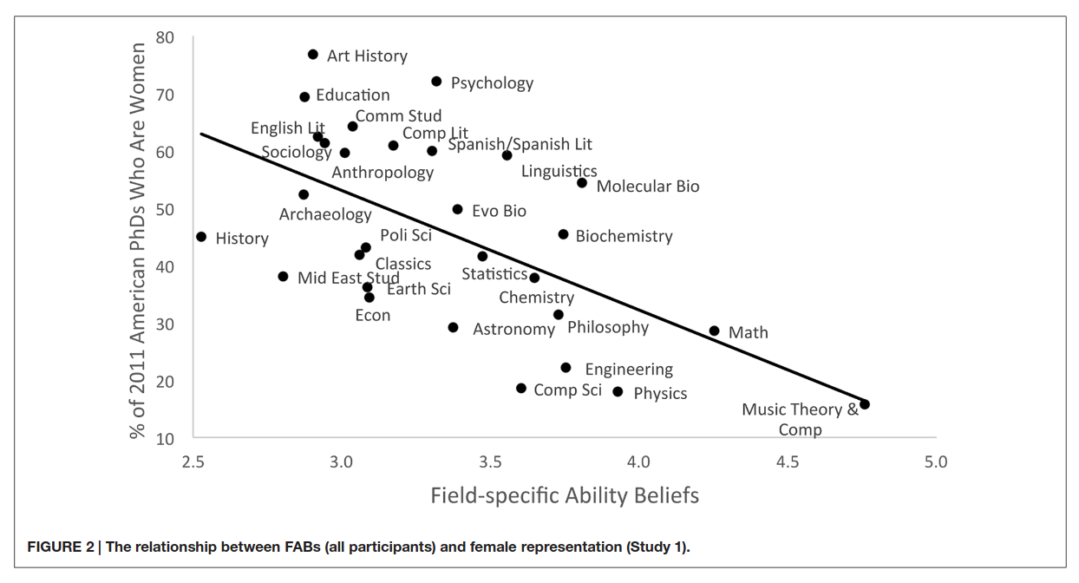
Step 3: don’t be « brillant », don’t create superstars, research is a collective
Bellman-Ford
Cantor set
Chernoff Bound
Currying
De Morgan's law
Floyd-Warshall
Gauss' theorem
Gaussian elimination
Grobner basis
Moore's law
Russel paradox
Von Neuman Archi
Merit is
not the main factor of academic success
often missattributed (unvoluntarily, but also voluntarily...)
a belief which triggers resistance against egalitarian action (Faniko et al. 2021)
protecting harassers: the behavior of male colleagues perceived as “superstars” is often minimized or ignored (Benya, Widnall, and Johnson 2018)
a belief which discriminates against women in our society
Act

Slide 49
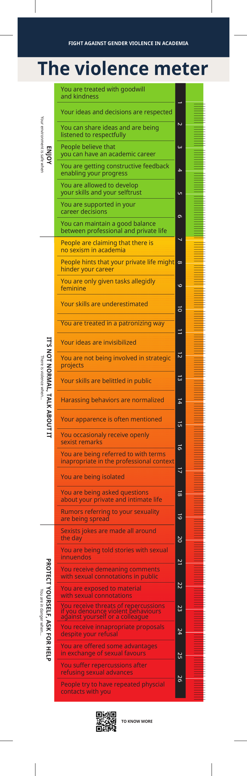
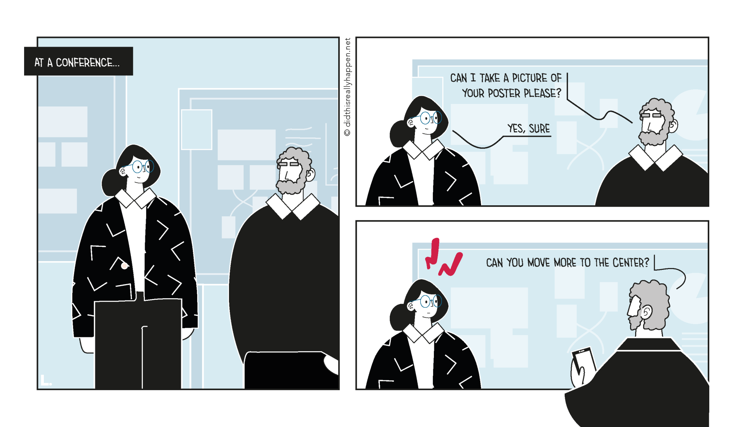
Step 4: recognize what is not acceptable
https://didthisreallyhappen.net/
Act

Slide 50
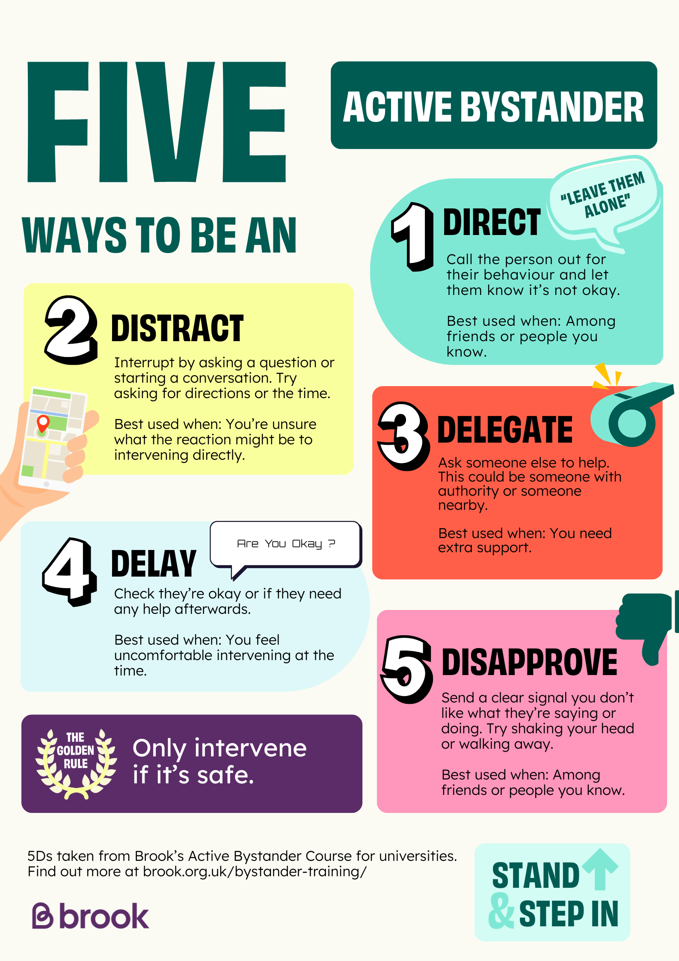
Step 5: don’t be a passive bystander
Act

Slide 51
Step 7: break the myths
« There is risk of false accusations »
« We are discriminating white men »
2 to 10 % at the most most
vs
60 % of gender-harassment?
No, we are making things fair!
(did the french revolution
« discriminate » noblemen?)
« We can’t say anything anymore »
« Quotas are unfair and break merit based hiring »
It is the converse.
Most of « we » were never
able to say anything,
and can finally speak.
There is not merit currently...
(yeah, I won a race against people
carrying a 50kg backpack...)
Act

Slide 52
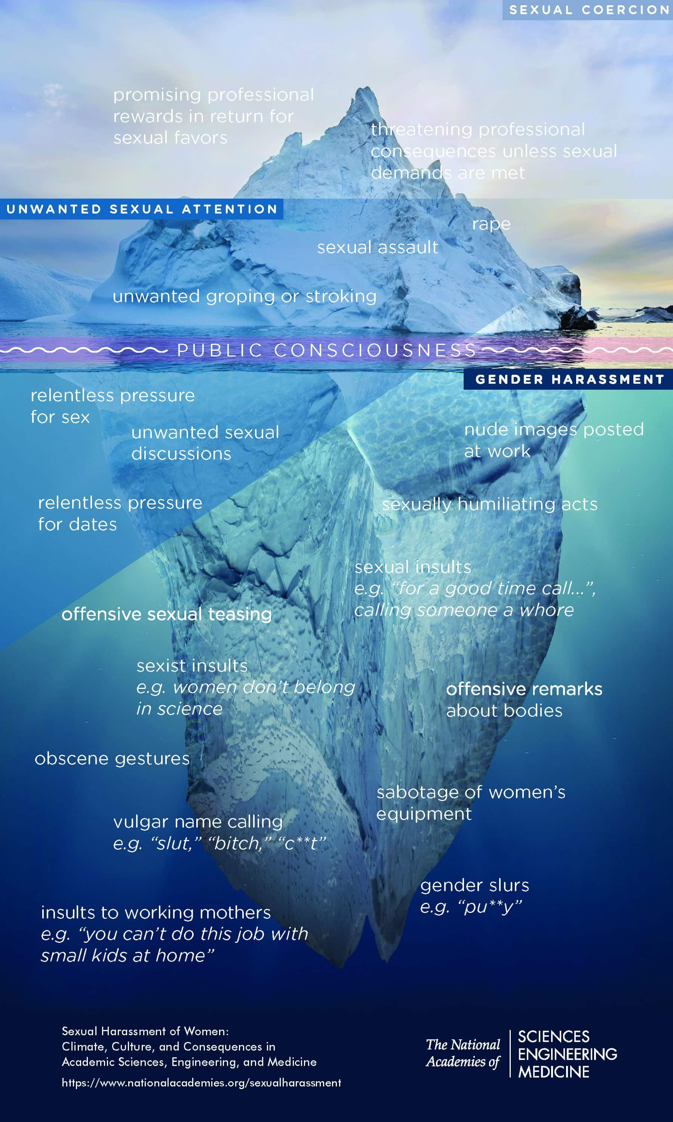
Step 7: break the myths
It is NEVER just a joke :
« sexual coercion never took place without unwanted sexual attention and gender harassment. »
(Benya, Widnall, and Johnson 2018)
« It is just a joke »
Each layer enables the people
doing worse at the next level.
Who are you laughing with???
Act

Slide 53
Going further
at all levels, we can act, question, investigate, and do better
Move things forward

Slide 54
When advising
Follow mentoring trainings, that do take into account power imbalance.
Favor co-supervision rather than one-to-one.
Give ressources to your students, on possible careers, local listeners.
Be early on feedback and don't impose any crunch.
Feel responsible (wich you often legally are) for the wellbeing of your students.
Emancipate students, don't exploit them.
Never forget the factual and huge power imbalance
→ read the booklet from https://not-in-our-labs.github.io/
Move things forward

Slide 55
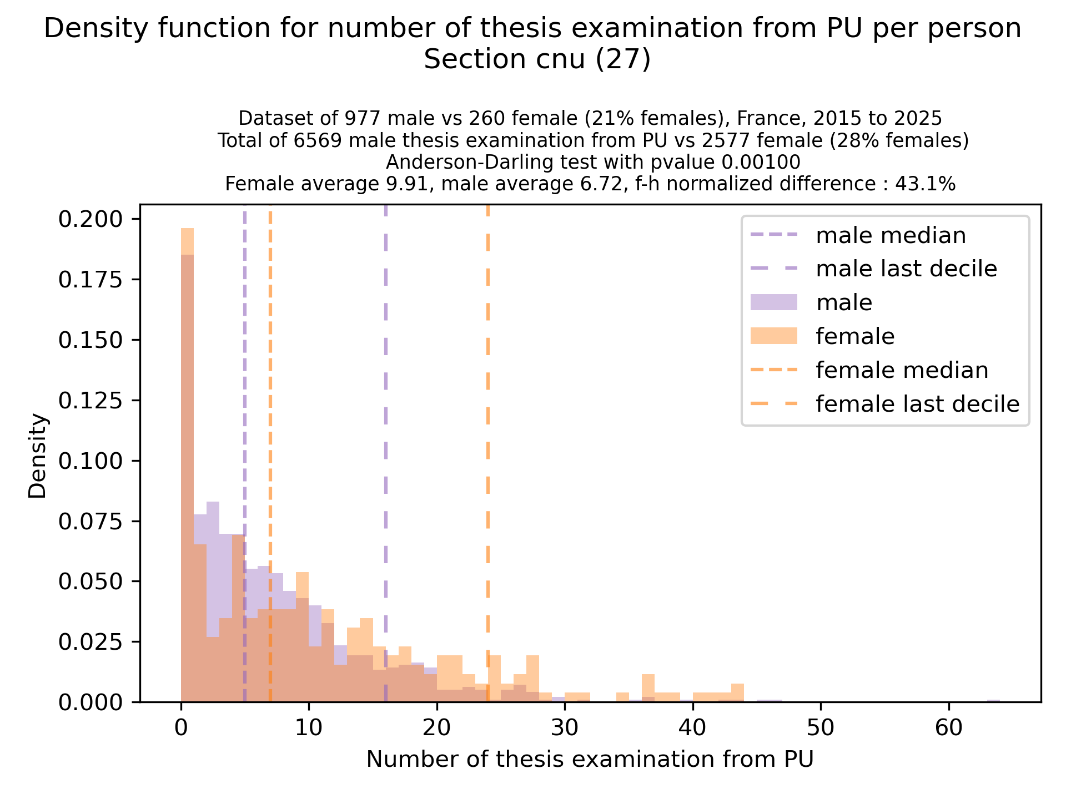
When advising
When it is time to make a
PhD thesis committe
Move things forward

Slide 56
When advising
Don’t pressure women, see mails to avoid:
https://egalite-fh.irisa.fr/presentation-recommandations/comites-de-selection-combien-dinvitations-accepter/
When it is time to make a
PhD thesis committe
Idea? - always include in your invitation mails for women : « If you have more than 2 or 3 thesis committees already planned this year, please decline this invitation. »
Move things forward

Slide 57
When having responsabilities - department/lab heads
Frequent climate surveys update
Include whithin the usual scientific seminar talks on this
    (if in need of inspiration https://egalite-fh.irisa.fr/animation/seminaire-fifty-fifty/)
Impose mentoring training, diversity workshop, bystander training
Reduce hierarchical structures, diffuse power
Encourage dedicated discussion groups (women-only, LGBT groups,...)
Move things forward

Slide 58
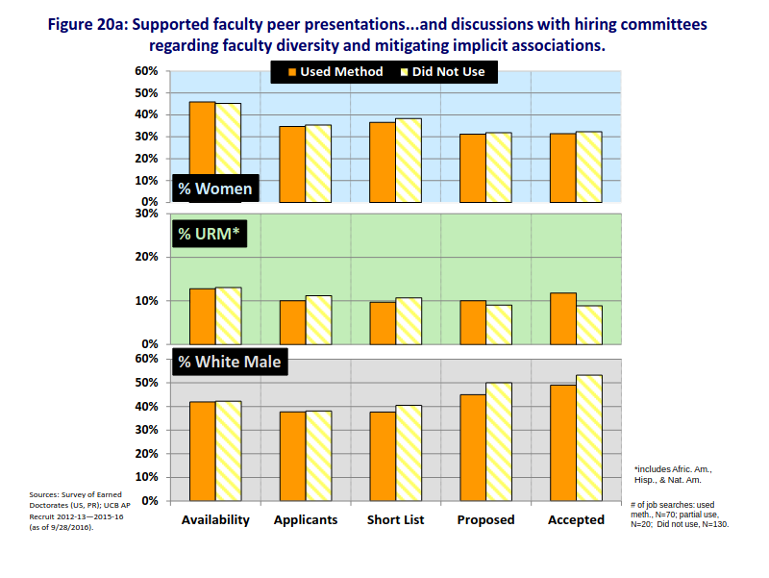
When hiring
Basic bias training with implicit-association training impact is not enough!
Move things forward

Slide 59
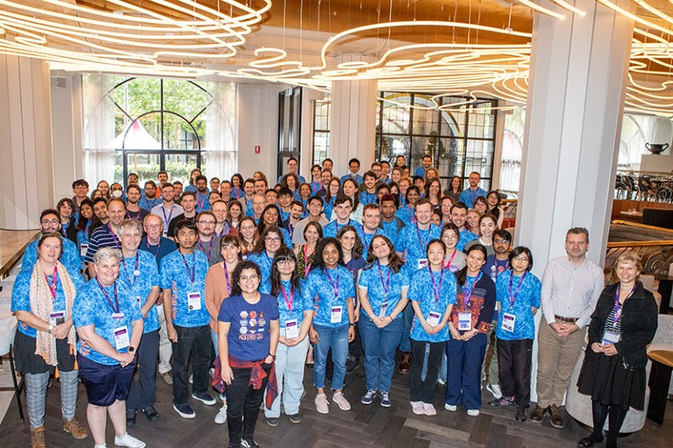
When hiring
A cascading effect :
Astro3D Australian Center
Recruitement measures:
  clear goals in terms of diversity
  diversifiction of team leaders
  2 day training on diversity for everybody, every year.
  minimal quota of 50% of women in postdoc hiring committees
  minimal quota of 50% of women on final postdoc listings
more PhD women
more leader women
more postdoc women
It is important to recruit AND keep people, and women stay more in women lead teams.
Toxic culture vs inclusive culture
2017
38%
2022
50%
Move things forward

Slide 60
When hiring – so many things to try and explore !
have a women for president, but a men for the administrative part (to fight against Deschamps 2024)
have clear goals and general agreement on diversity and discriminations. (Goulden et al. 2019)
when possible, shape the job description to target diversity (Goulden et al. 2019)
ask for CVs without dates, only experience lengths (Kristal et al. 2023) (Behavioural Insights Team 2021)
agree before hands on criterion and use rubrics (but be careful, a rubric can in itself discriminate, if based on something unequally easy to do) (Culpepper et al. 2023) (Behavioural Insights Team 2021)
have a jury member be responsible for highlightings whenever a new criterion appears or disappear.
evaluate speech time repartition in jurys? (http://arementalkingtoomuch.com/) It is an objective feedback that everybody can take home and reflect on, but also a lacking data point.
for people who will be teaching, include a question on what they would do in front of a discrimination: ‘A bachelor male student does not want to do a group project with a female, stating that women are bad at computer science, how do you answer them?’ (aiming for skill-based evaluation and awareness of those issue (Behavioural Insights Team 2021))
Move things forward

Slide 61
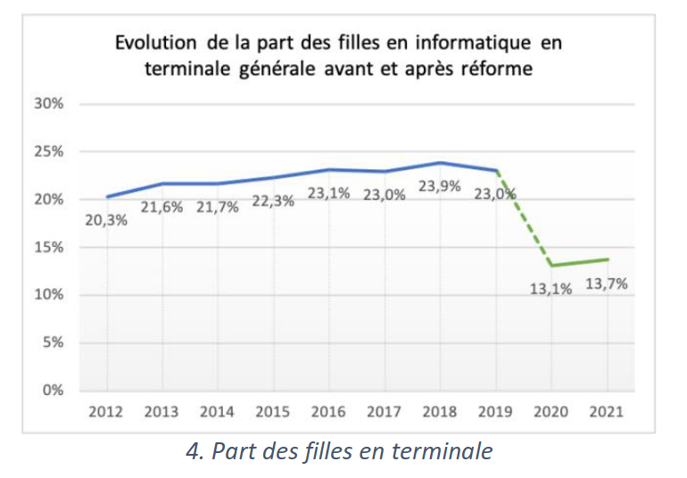
Time to conclude
It will probably worsen if we don’t act
Terrible things are here, all around us.
Competition, Star Culture, Power imbalance
Masculinist culture
Harassment, Unwell-being, Discriminations
But, we are researchers. So, let’s be researchers. Let’s solve this problem!
Move things forward

