Slide 1

Academia
Discriminations
?
Harassment
Unwell
being
-
Understand
Prevent
React
Introduction5

Slide 2

Discomfort
ahead
This talk may
evoke bad experiences
reveal uncomfortable facts
Introduction5

Slide 3
BUT...
We are researchers !
Be wrong, do better !
A problem ?
Hypothesis
Solution
Introduction5

Slide 4
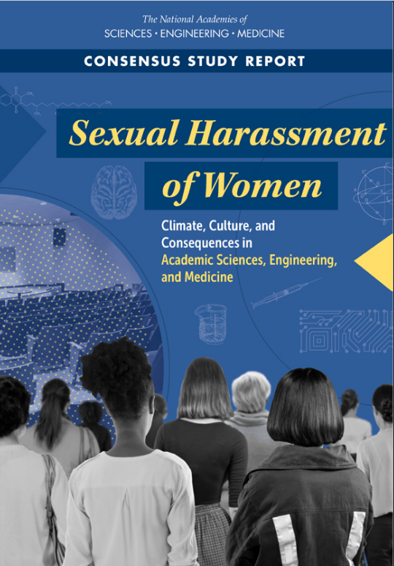





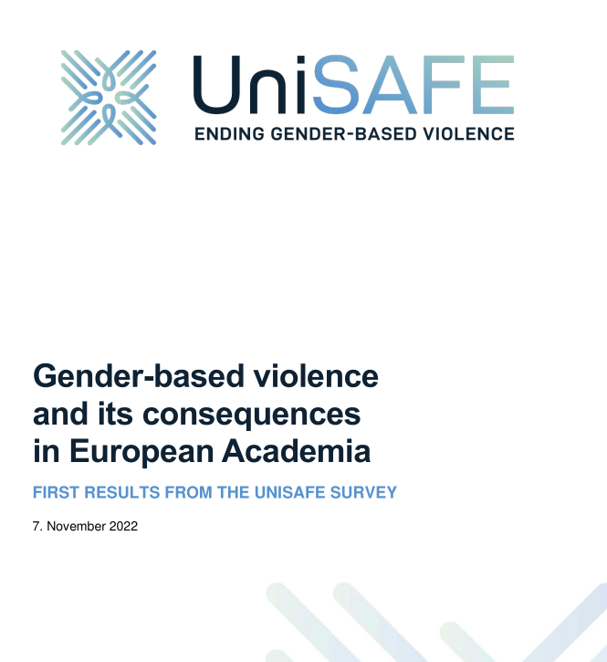

BUT...
We are researchers ?
Introduction5

Slide 5
BUT...
Lots of sources, from reports and research papers:
  https://not-in-our-labs.github.io/ressources.html
  Https://not-in-our-labs.github.io/presentation.html
Feedback welcome !
Introduction5

Slide 6
BUT...
Investigation - part I
Parity in computer science ?

Slide 7
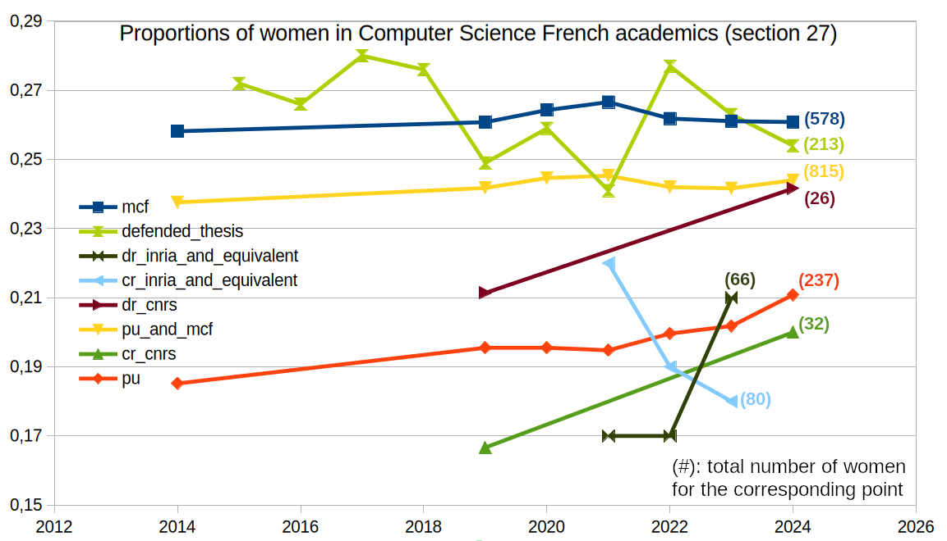
Evidence 1: a stable lack of women in CS
BUT...
Parity in computer science ?

Slide 8
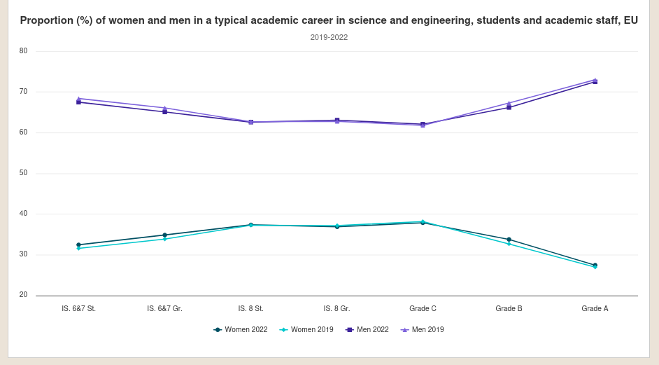
Evidence 2: a leaky pipeline the higher we go
BUT...
Bachelor
Master
PhD St
PhD Gr
Parity in computer science ?

Slide 9

Hypothesis 1: stereotypes and biases ?
BUT...
Big lying belief sponge !
Creates a « coherent »
view of the world
from incomplete facts
Parity in computer science ?

Slide 10
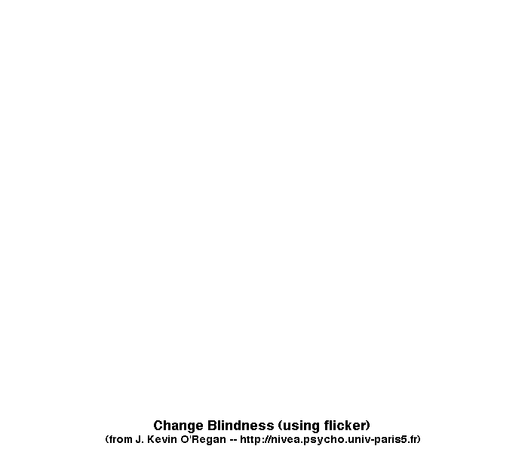
Hypothesis 1: stereotypes and biases ?
BUT...
Parity in computer science ?

Slide 11




Hypothesis 1: stereotypes and biases ?
BUT...
“by age 6, children already think that boys are better than girls
at computer science and engineering” (Miller et al. 2024)
Parity in computer science ?

Slide 12


Hypothesis 1: stereotypes and biases ?
BUT...
So, let’s just solve the gendered stereotype of science. Job’s done.
Parity in computer science ?

Slide 13
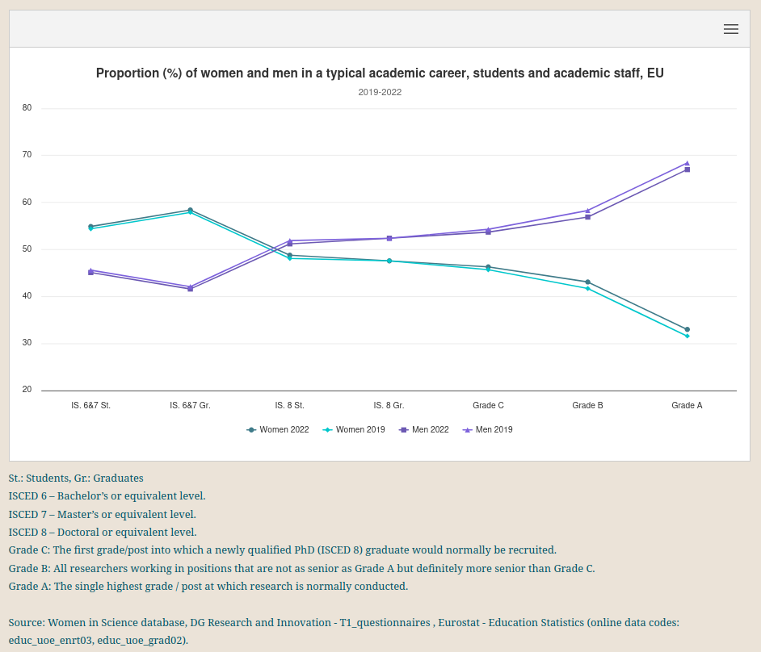
Counter-evidence: the leaky pipeline is everywhere, not just CS
BUT...
Parity in computer science ?

Slide 14
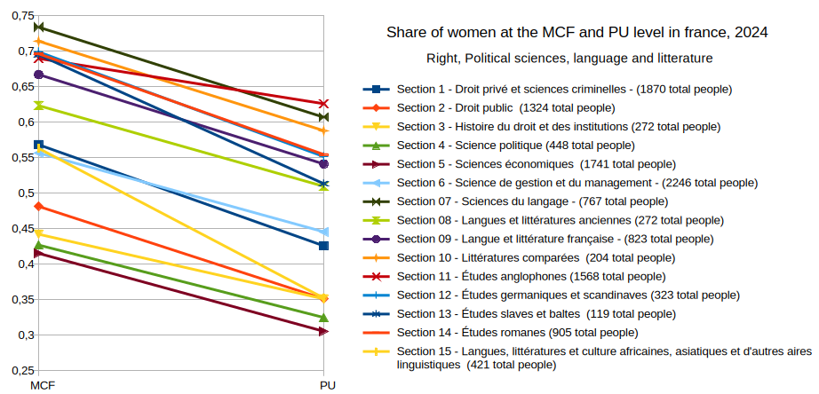
Counter-evidence: the leaky pipeline is everywhere, not just CS
BUT...
Parity in computer science ?

Slide 15
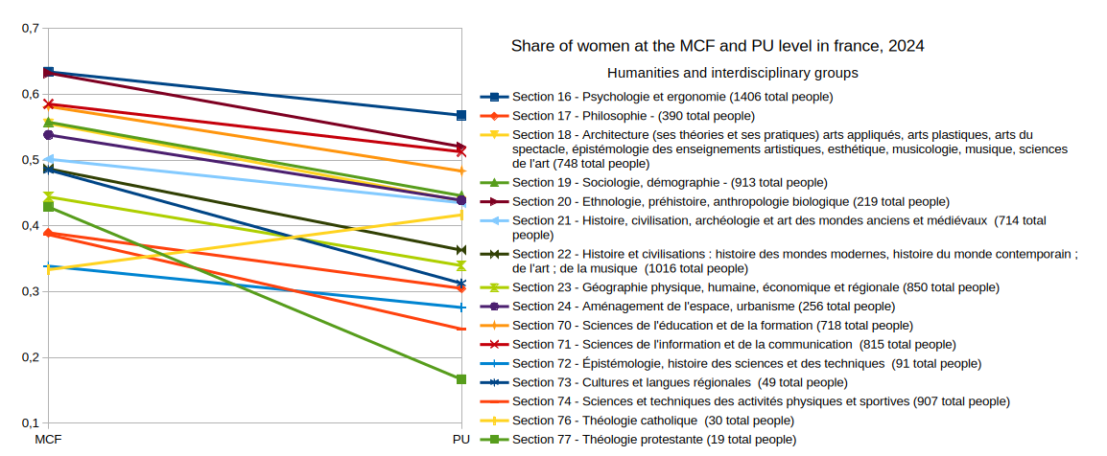
Counter-evidence: the leaky pipeline is everywhere, not just CS
BUT...
Parity in computer science ?

Slide 16

BUT...
We need
more facts !
Parity in computer science ?

Slide 17
BUT...
Investigation - part 2
Unwell-being in academia ?

Slide 18
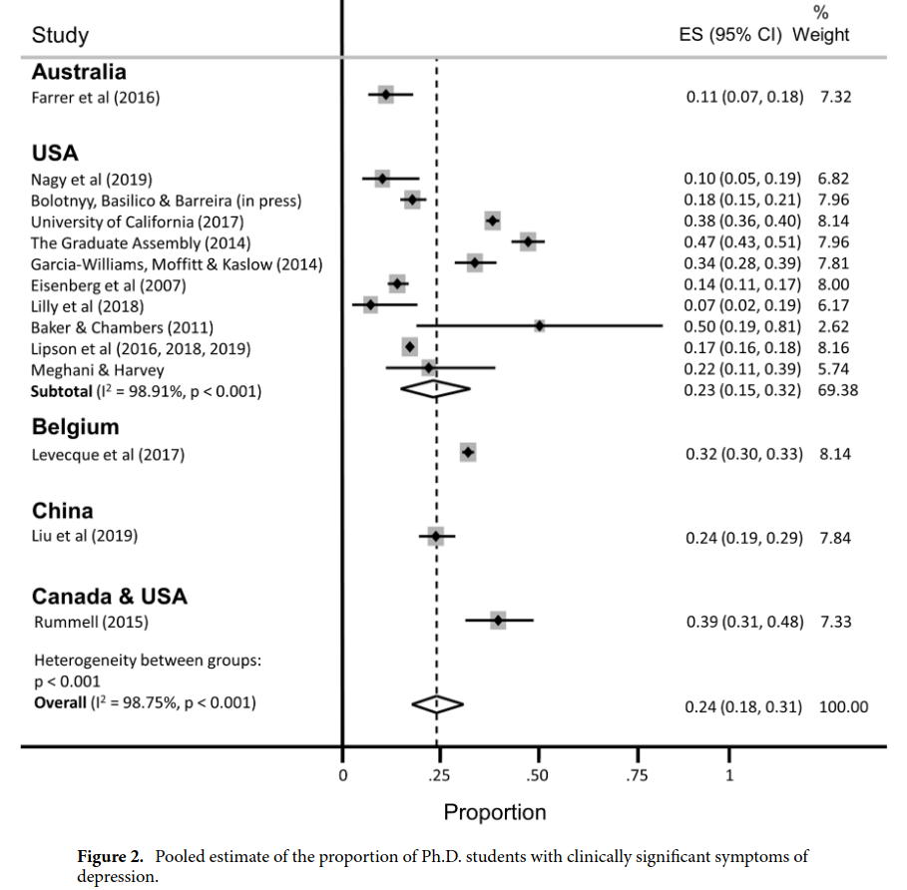
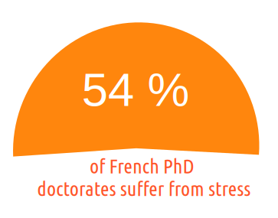
Evidence 3: PhD students are way too sad
BUT...
Wordwide, we have 24% of depression
among PhD students (Satinsky et al. 2021)
Consistenly above :
general population (~5%)
young adults (~15%)
Unwell-being in academia ?

Slide 19
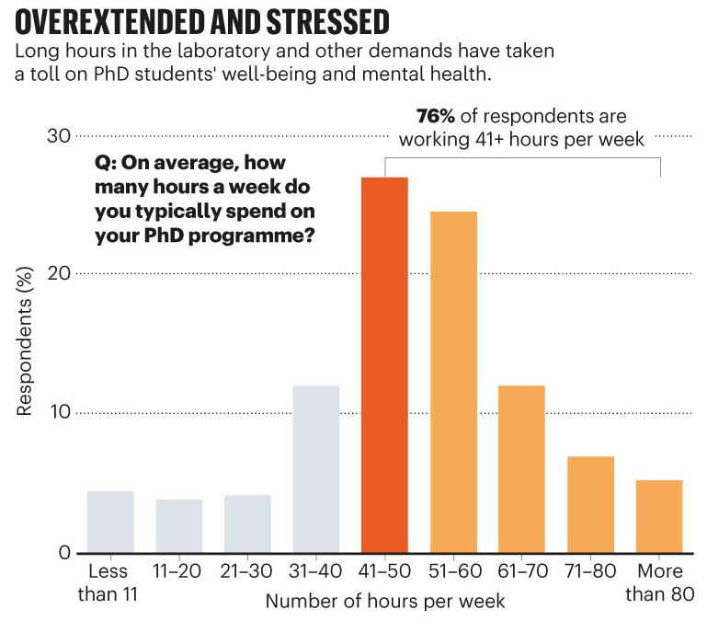
Evidence 4: PhD students are overworked
BUT...
From a 6000 phd student survey by nature. (Woolston 2019)
Unwell-being in academia ?

Slide 20
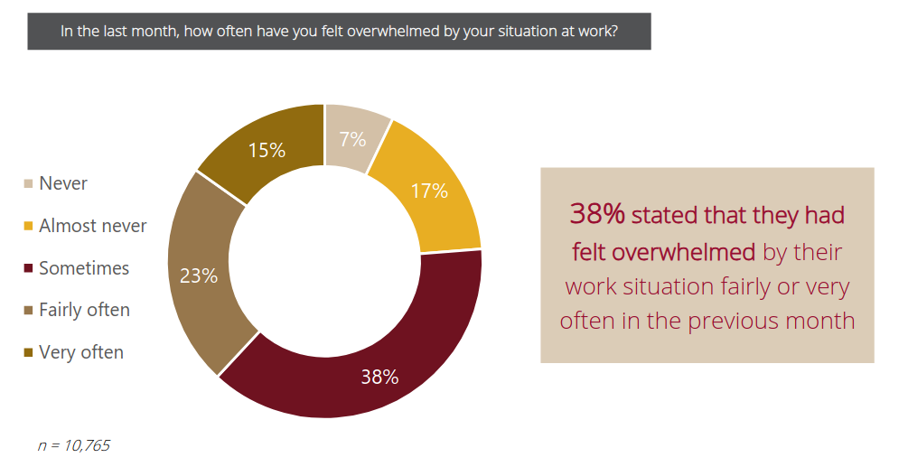
Evidence 5: everybody is overwhelmed
From a wordwide survey (Cerejo, Awati, and Hayward 2020)
BUT...
Unwell-being in academia ?

Slide 21





Hypothesis 2: research is by essence hard
IMPOSTOR SYNDROM
NO TICK BOXES
UNCLIMBED MOUNTAIN
FIRST TIME FAILING
Unwell-being in academia ?

Slide 22



Hypothesis 2: research is by essence hard
Harder than most
other jobs ????
Ok, fair point, but...
Unwell-being in academia ?

Slide 23
The missing link
Worse at the bottom
of the power ladder
In all academia:
  too much unwell being
  a leaky pipeline
Less women the
higher we go in
the power ladder
Starting to tie things up ?

Slide 24
BUT...
We need
more facts !
Parity in computer science ?

Slide 25
BUT...
Investigation - part 3
Omnipresent discriminations

Slide 26
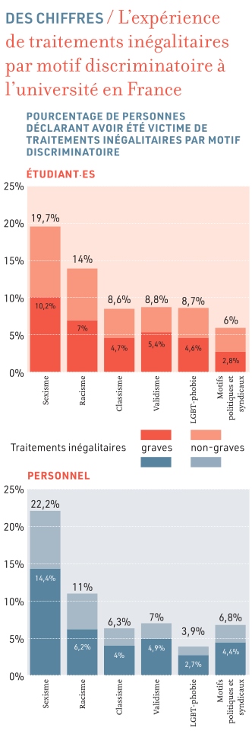
Evidence 6: strong inequalities in the access to a higher status
BUT...
2.4x
to get a PhD if a close
relative has one
+ Weight-related discrimination
6.2x
to become a professor if
white-skinned instead of black
+ LGBTQIA+ related discrimination
It is
more likely
+ Beliefs related discrimination
+ ...
to become a
professor if male
2.6x
4.6x
to become uni staff without
a declared disability
Omnipresent discriminations

Slide 27
Evidence 7: men are not competing fairly
BUT...
Men spend more time doing research, and leave
  the less rewarding work to women. (Winslow 2010, O’Meara et al. 2017)
Men self-cite 70 percent more than women (King et al. 2017)
Female authored papers are less cited (Bendels et al. 2018),
  and notably less likely to be cited by men (Koffi 2021)
Omnipresent discriminations

Slide 28
Evidence 8: evaluations are highly biased
BUT...
A women name on a CV implies evaluation bias
  (Steinpreis, Anders, and Ritzke 1999)
The “two-body” problem is only used to refuse women not seen as movable
  (Rivera 2017)
Women don’t get credit for group collaborations, while men do. (Sarsons 2017)
URM faculty received 7% more negative votes and were 44% less likely to receive unanimous votes from P&T committees (Masters-Waage et al. 2024)
Omnipresent discriminations

Slide 29

PAUSE !
It is only getting
worse from here :(
Omnipresent discriminations

Slide 30
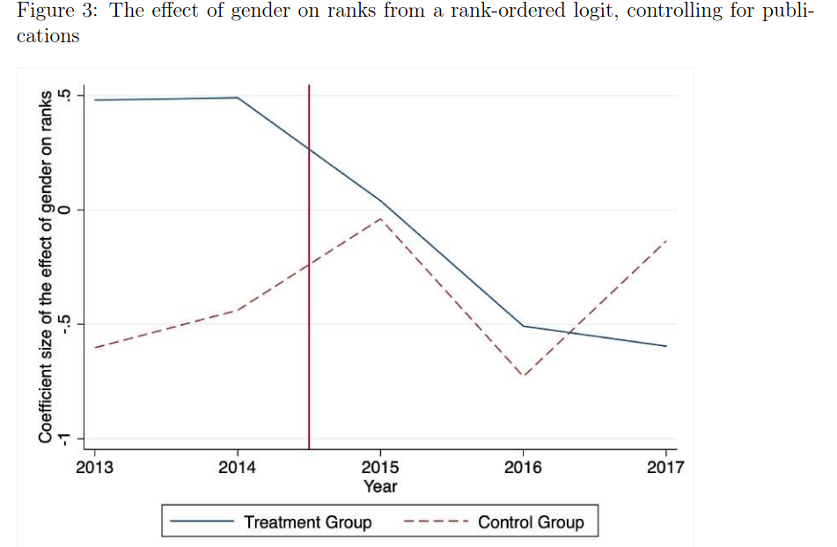
Evidence 9: men are ACTIVELY gate keeping
BUT...
Consequences of the french 2015 reform « 40 % ratio » in committes on STEM fields
« the negative effect of the reform is concentrated in committees headed by men, this result seems driven by the reaction of men to the reform »
(Deschamps 2024)
« male evaluators become less favorable toward female candidates as soon as a female evaluator joins the committee »
(Bagues, Sylos-Labini, and Zinovyeva 2017)
Omnipresent discriminations

Slide 31
Fun (?) Fact 1:
BUT...
you are more likely to disbelieve
the previous facts if you are a man!
(Handley et al. 2015)
We need to take off our magical hiding glasses, and look even deeper, for the
final piece of the puzzle, tiying unwell being and active discriminations all together.
Omnipresent discriminations

Slide 32
BUT...
Investigation - part 4
The final piece of the puzzle

Slide 33


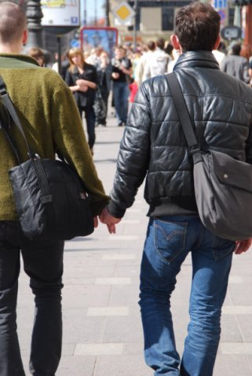
The magical hiding glasses ? (by Privileged Inc TM)
If we are not the target of a
discriminating or harassing behaviour
we will probably not even see it
The final piece of the puzzle

Slide 34
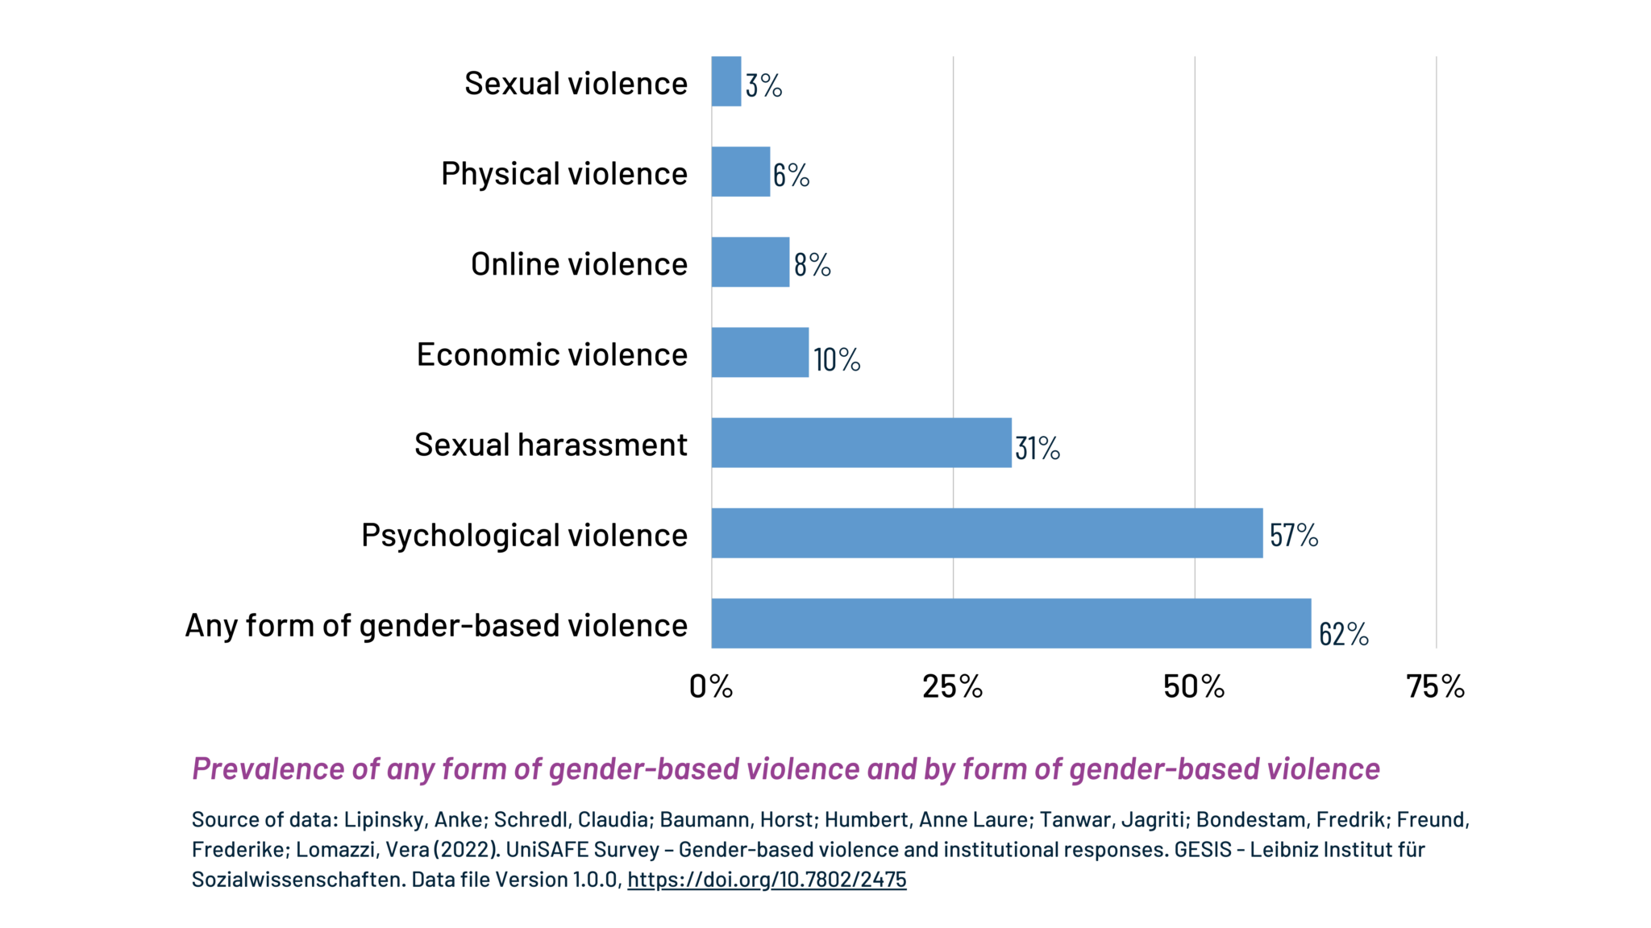
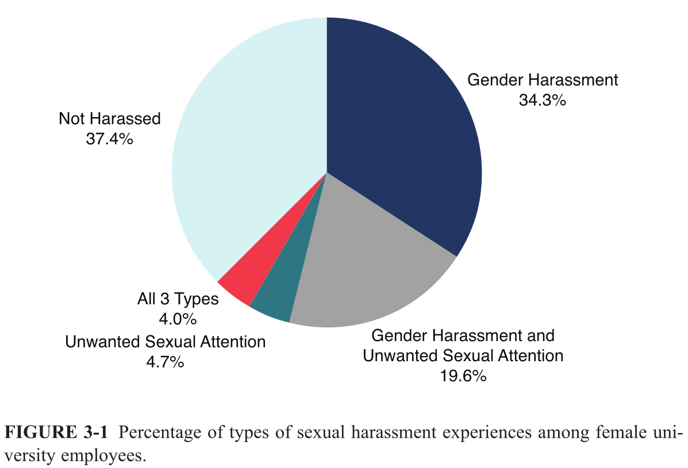
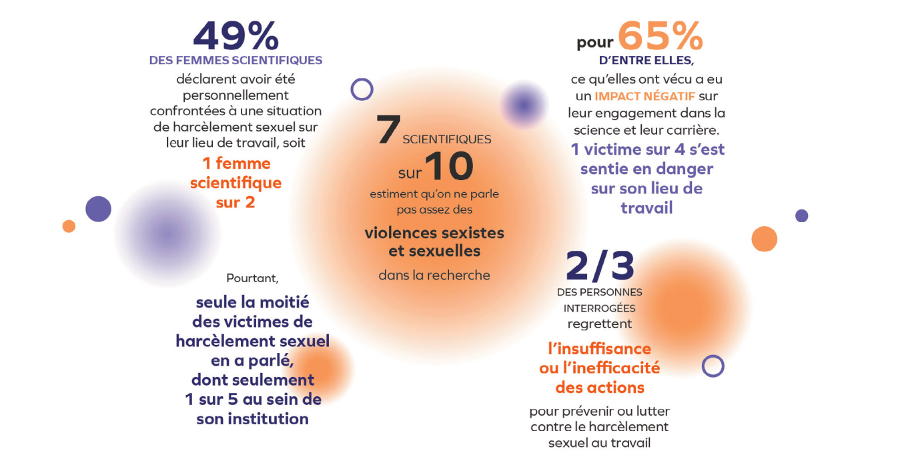
Evidence 10: the omnipresent « invisible » phenomenom
The final piece of the puzzle

Slide 35
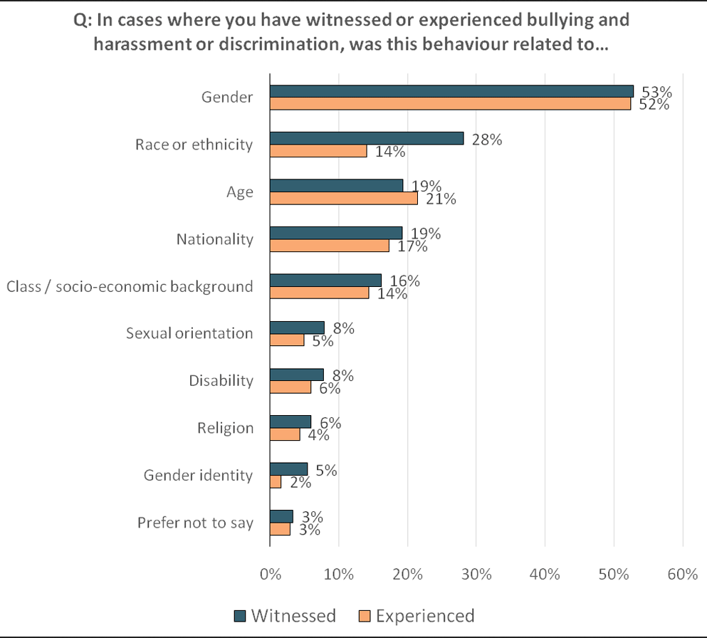
Evidence 11: it targets many groups at all levels
Since their arrivals in french higher education, the share of students target of a sexual assault or rape, often reiterated, is :
24% of women
9% of men
33% of transgenders/non binaries/queers
UK researchers
The final piece of the puzzle

Slide 36
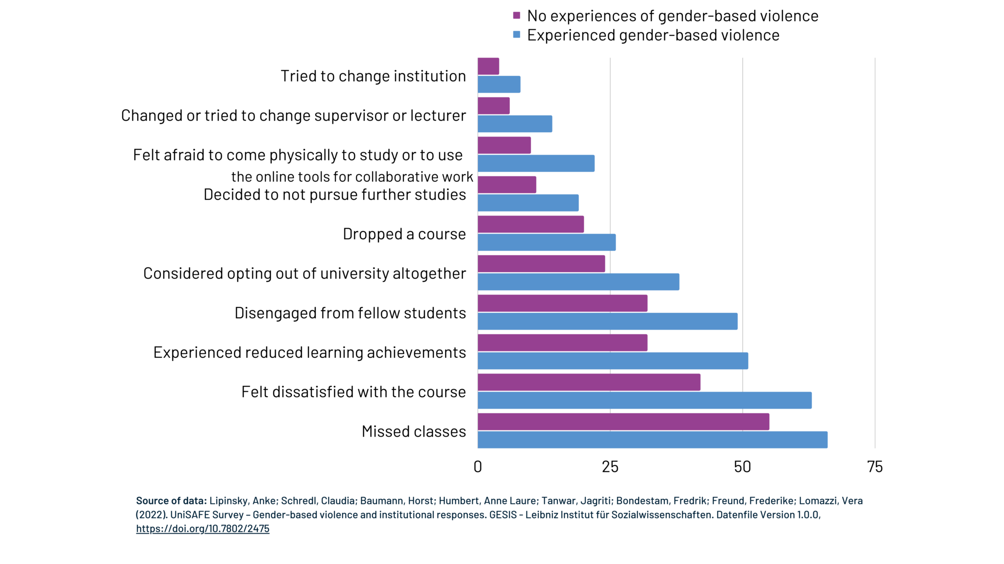
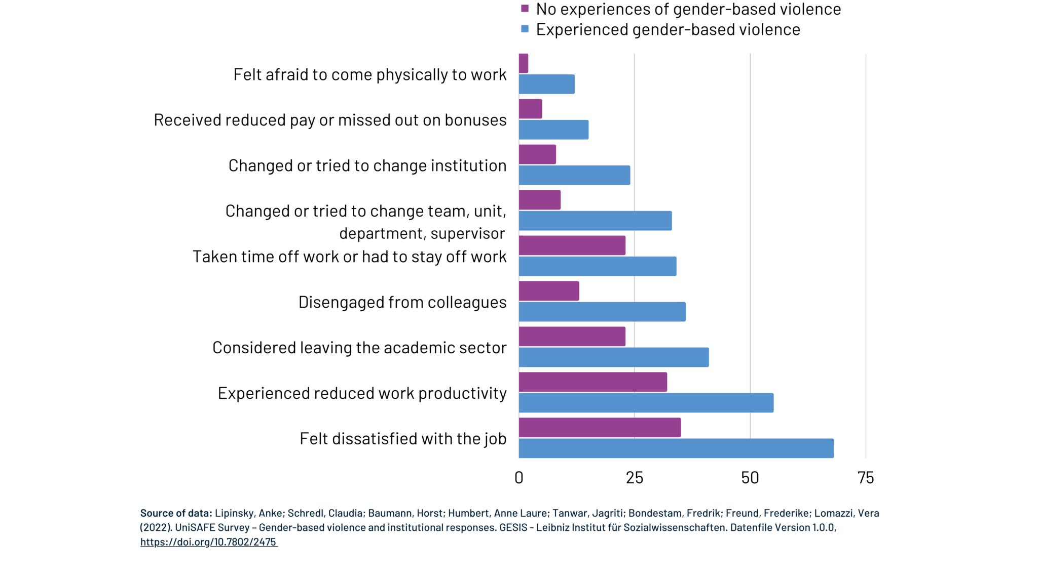
Evidence 12: it has consequences
The final piece of the puzzle

Slide 37
The missing link (part 2)
Harassment and bullying is widespread
against women and UMR
It actively makes them run away
It actively depresses them
Worse at the bottom
of the power ladder
The final piece of the puzzle

Slide 38
The missing link
Power imbalances foster and sustain sexual-harassment (Benya, Widnall, and Johnson 2018) (Zara et al. 2024) (Bergeron et al. 2025), and in fact other form of harassments and discriminations (Dhume and Roberti-Lintermans 2024)
« The academic workplace has the second highest rate of sexual harassment at 58 percent (the military has the high-est rate at 69 percent) when comparing it with military, private sector, and the government »(Benya, Widnall, and Johnson 2018)
The final piece of the puzzle

Slide 39



empowers
Harassment
Bullying
Exploitation
justifies
Strong
Competion
Star culture
Medals
Merit
power imbalance
defended by
Gate-keeping and
discriminations
Depressed
Overworked
Overwhelmed
Overstressed
causes
The final piece of the puzzle

Slide 40
Ok, all this sounds bad...
but it is only individual consequences,
and maybe « SCIENCE » and « PROGRESS » needs all this!
First off, I find you morally diubious if you believe this, but ok, let’s still be thorough.
Is it an issue ?

Slide 41
Moral answer:
It is widely accepted that science experiments
that involve misstreating human beings is
unethical and should not be done.
Is it an issue ?

Slide 42
Practical answer:
A lack of diversity leads to biased and dangerous science :
airbags systems have been designed historically for men body shapes, leading to less chances for women to survive car crashes
medicine is dosed for men, with few womens in cohorts (19% for antiviral, 38% for vaccins, 11% for aids)
women have distinct symptoms sometimes – e.g. yentl syndrom for cardiovascular diceases, women with such conditions have 10% more chances of dying when arriving at the hospital.
LLM with racist or sexist bias, now deployed in companies to filter CVs.
Is it an issue ?

Slide 43
An answer accepting the bad « progress » premise:
Diversity breads inovation!
  publications by mixed-gender teams are more cited (Campbell et al. 2013)
  science by mixed-gender teams is significantly more novel and impactfull (Yang et al. 2022)
  diversity in inputs by author ethnicity, location, and references leads to greater contributions to science as measured by impact factors and citations. (Freeman and Huang 2015)
  piverse scholars are more innovative, but their work is taken up by others less than it should be (Hofstra et al. 2020)
Is it an issue ?

Slide 44
We have many issues and we understand them and their roots.
TIME TO ACT
Act

Slide 45



What exists and what beliefs are behind it
Individual
Societal
Institutional/Cultural
Mentoring
Networking
Child-care
Part-time
Fight harassment
Train employees
Act

Slide 46
Are institutions doing enough ?
often focus on actions from the individual or societal point of view,
it is either women who are missing something or society to blame,
but never our academic culture which is blamed.
They do not address the most common form of harassment (gender-harassment), provide opaque and inefficient report procedure (He et al. 2024) leading to a feeling of betrayal (Bergeron et al. 2025), and
They often focus on protecting the image of the institution (Faniko et al. 2021), and on just aiming for legal compliance, which had little impact on harassment. (Benya, Widnall, and Johnson 2018), notably as most targets of harassment don’t report issues. (Lipinsky et al. 2022)
Act

Slide 47

A fourth point of view ?
We do the research, we are part of this toxic culture, and we have power over it.
« A systemwide change to the culture and climate in higher education is required to prevent and effectively address all three forms of sexual harassment. » (Benya, Widnall, and Johnson 2018)
« We need to focus on broad cultural change » (Johnson and Hoover 2015)
Us
Act

Slide 48
Step 1: be the bare minimal of reasonable human beings
The basics:
As a general rule, don’t touch or be very close to people at the workplace
Don’t comment on the physical appearance of people
Avoid one on one meetings with subordinates outside of the worplace
Don’t try to date your students
Don’t ever say somebody does not belong here because of X or Y
Don’t make general comments about some group X having some suposed characteristics
...
Act

Slide 49
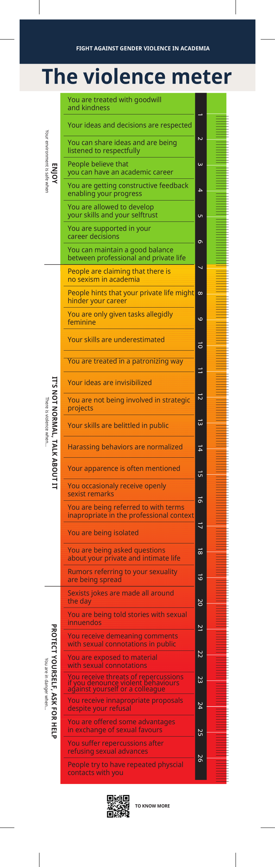
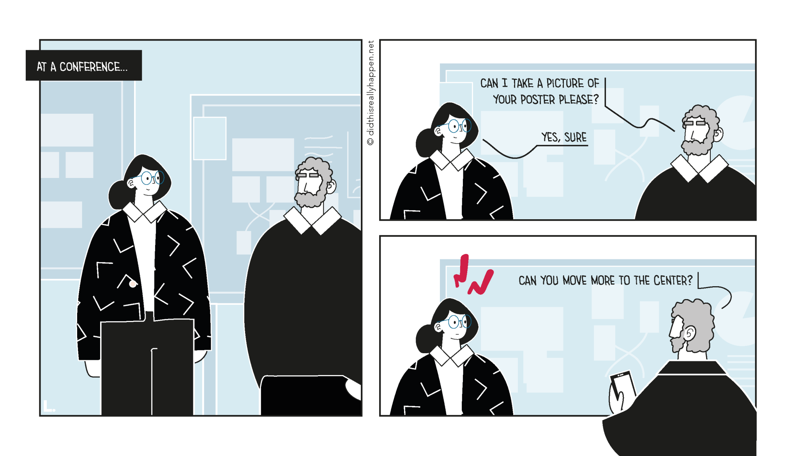
Step 2: recognize what is not acceptable
https://didthisreallyhappen.net/
Act

Slide 50
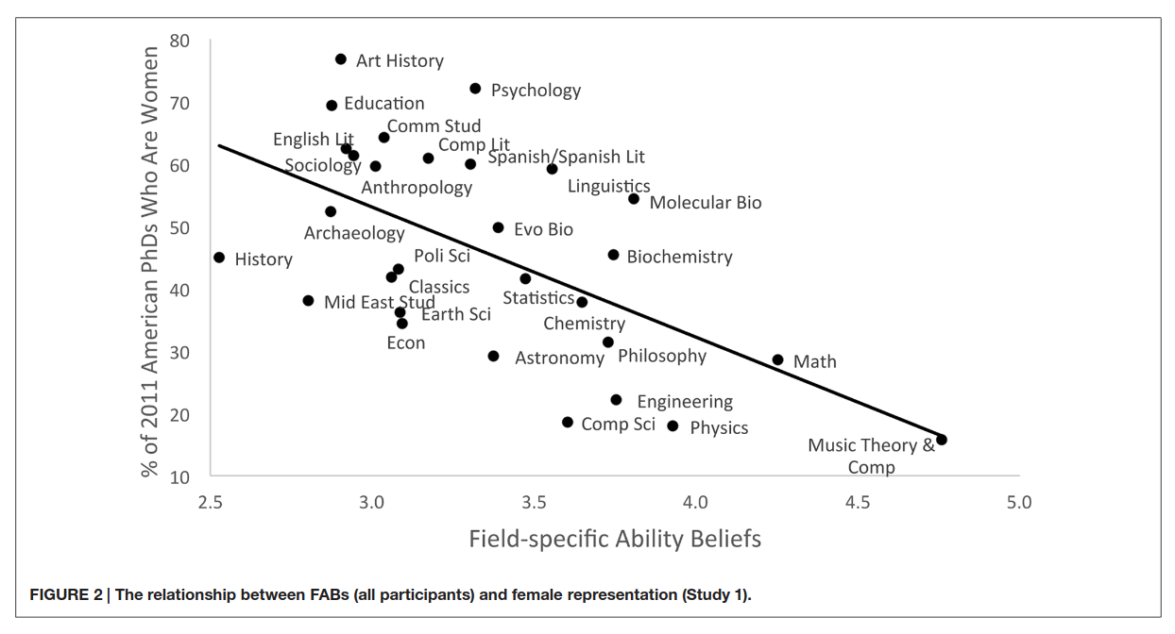
Step 3: question the toxic culture, spread a better mentality
42% of PhD students think it’s
normal to suffer mentally.
Relieve the pressure :
It's normal to not work outside of the office.
It's normal if research is not my whole life.
It's ok if I don't publish one more paper this year.
It's ok if I go on long vacations.
It's ok if I don't want to pursue research after my PhD.
It's ok if I am not doing a permanent crunch.
It’s especially important not to be « brillant »
50% don’t feel they can talk about not pursuing academia
Act

Slide 51
Step 4: face the facts, see what’s happening
“The interview responses demonstrate that the behavior of male colleagues, whom higher-ranking faculty or administrators perceived as “superstars” in their particular substantive area, was often minimized or ignored.” (Benya, Widnall, and Johnson 2018)
Act

Slide 52
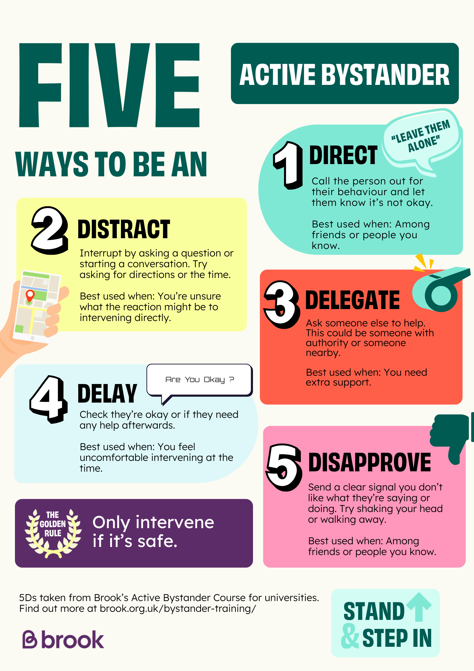
Step 5: don’t be a passive bystander
Act

Slide 53
Step 7: break the myths
« There is risk of false accusations »
« We are discriminating white men »
2 to 10 % at the most most
vs
60 % of gender-harassment ?
No, we are making things fair !
(did the french revolution
« discriminate » noblemen?)
« We can’t say anything anymore »
« Quotas are unfair and breaks merit based hiring »
It is the converse.
Most of « we » were never
able to say anything,
and can finally speak.
There is not merit currently...
(yeah, I won a race against people
carrying a 50kg backpack...)
Act

Slide 54
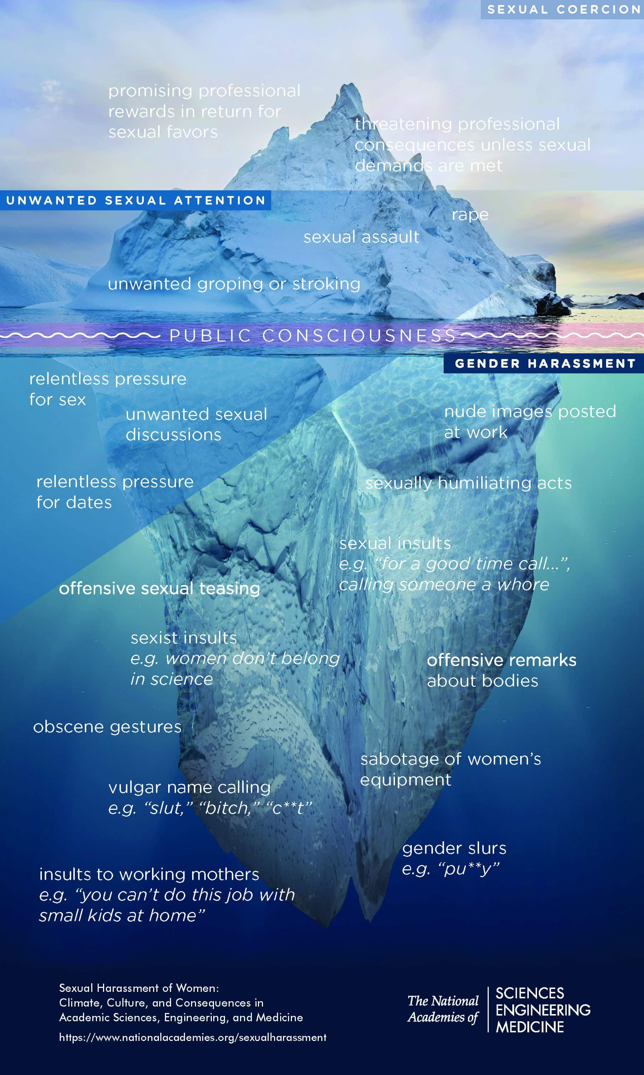
Step 7: break the myths
It is NEVER just a joke :
« sexual coercion never took place without unwanted sexual attention and gender harassment. »
(Benya, Widnall, and Johnson 2018)
« It is just a joke »
Each layer enables the people
doing worse at the next level.
Who are you laughing with???
Act

Slide 55
How to answer: « It’s just a joke »
« sexual coercion never took place without unwanted sexual attention and gender harassment. » (Benya, Widnall, and Johnson 2018)
Act

Slide 56
Going further
at all levels, we can act, question, investigate, and do better
Move things forward

Slide 57
When advising
Follow mentoring trainings, that do take into account power imbalance.
Favor co-supervision rather than one-to-one.
Give ressources to your students, on possible careers, local listeners.
Be early on feedback and don't impose any crunch.
Feel responsible (wich you legally are) for the wellbeing of your students.
Emancipate students, don't exploit them.
Never forget the factual and huge power imbalance
→ read the booklet from https://not-in-our-labs.github.io/
Move things forward

Slide 58
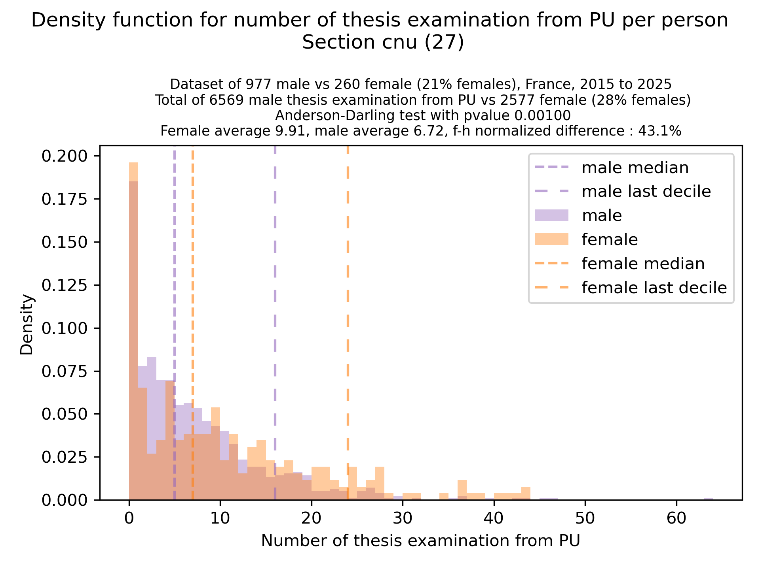
When advising
When it is time to make a
PhD thesis committe
Move things forward

Slide 59
When advising
Don’t pressure women, see mails to avoid:
https://egalite-fh.irisa.fr/presentation-recommandations/comites-de-selection-combien-dinvitations-accepter/
When it is time to make a
PhD thesis committe
Idea ? - always include in your invitation mails for women : « If you have more than 2 or 3 thesis committees already planned this year, please decline this invitation. »
Move things forward

Slide 60
When having responsabilities - department/lab heads
Frequent climate surveys update
Include "whithin" the usual scientific seminar talks on this
    (if in need of inspiration https://egalite-fh.irisa.fr/animation/seminaire-fifty-fifty/)
Impose mentoring training, diversity workshop, bystander training
Reduce hierarchical structures, diffuse power
Move things forward

Slide 61
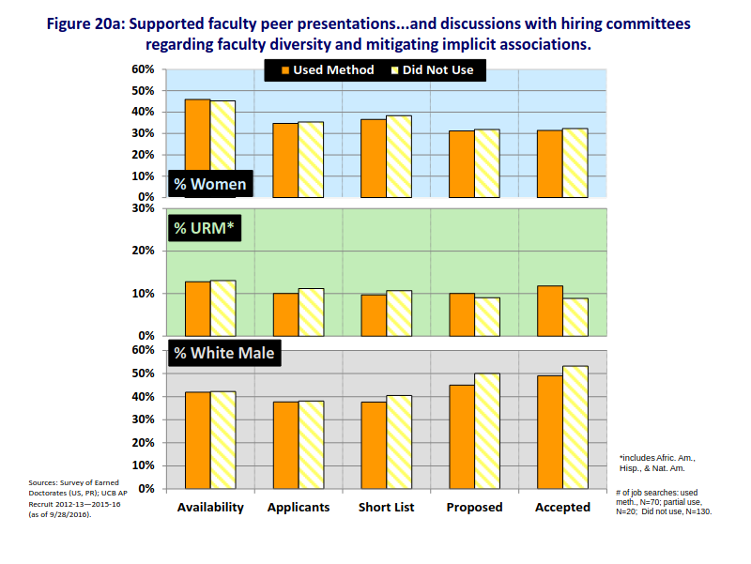
When hiring
Basic bias training with implicit-association training impact is not enough !
Move things forward

Slide 62
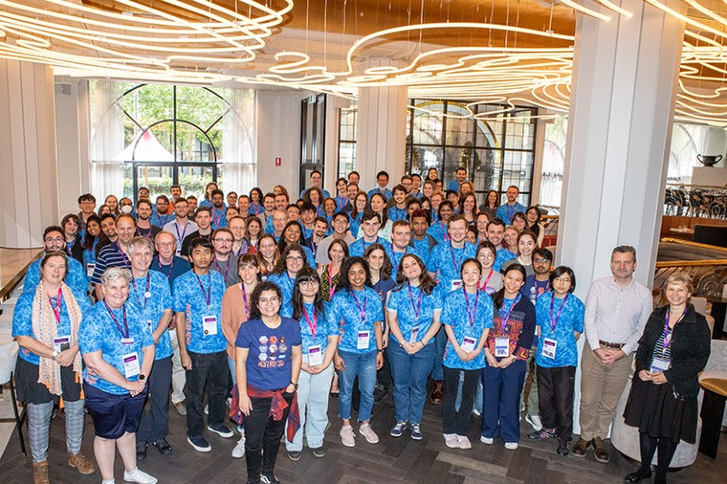
When hiring
A cascading effect :
Astro3D Australian Center
Recruitement measures:
  clear goals in terms of diversity
  diversifiction of team leaders
  2 day training on diversity for everybody, every year.
  minimal quota of 50% of women in postdoc hiring committees
  minimal quota of 50% of women on final postdoc listings
more PhD women
more leader women
more postdoc women
It is important to recruit AND keep people, women stay more in women lead teams:
“members also took cultural, LGBTQIA+, and Indigenous awareness training in subsequent annual retreats, and held monthly seminars on diversity and inclusion”
“The center’s code of conduct clearly established actions against sexism, insults, microaggressions, and behaviors that excluded other members, and the center had multiple ways of filing misconduct complaints.”
2017
38%
2022
50%
Move things forward

Slide 63
When hiring – so many things to try and explore !
agree before hand that all the data available to judge is biased
ask for CVs without dates, only experience lengths
agree before hands on criterion and use rubrics
have a jury member be responsible for highlightings whenever
a new criterion appears or disappear when evaluating a person
evaluate speech time repartition in jurys
(http://arementalkingtoomuch.com/)
for people who will be teaching, include a question on what they would do in front of a discriminating situation: « A bachelor male student does not want to do a group project with a female student, stating that women are bad at computer science, how do you answer them? »
Break the unfairness by setting up quotas
Move things forward

Slide 64
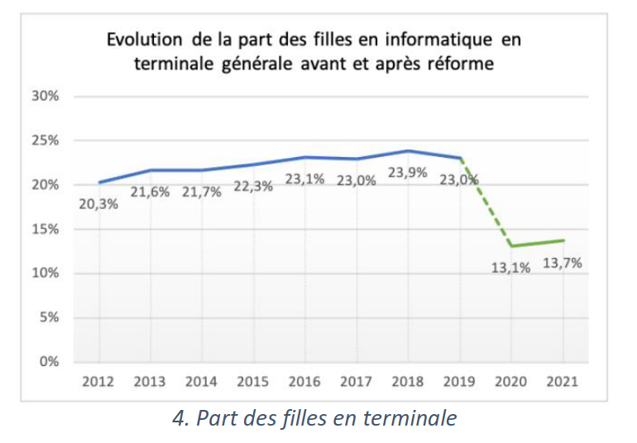
Time to conclude
It will probably worsen if we don’t act
Terrible things are here,
all around us.
But, we are researchers. So, let’s be researchers. Let’s solve this problem!
Move things forward

