Slide 1
vFlashCards Demo
CISC 4900
Brooklyn College – City University of New York

Slide 2
What is vFlashCards?
Software application based flashcards.
Virtual flash cards, if you will.

Slide 3
Why vFlashCards?
Convenience of software based flashcards for students on the go.
Paper flashcards can be cumbersome to carry.

Slide 4
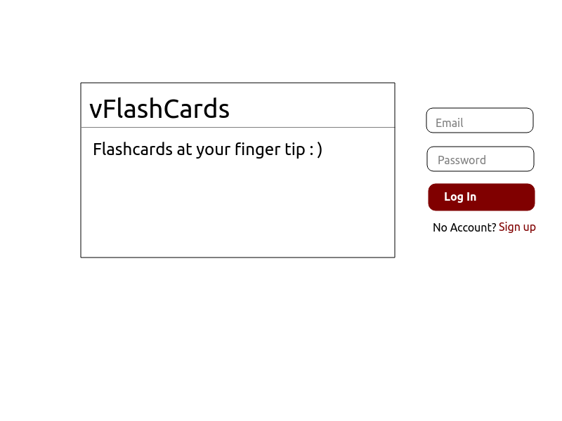
Wireframe – Home

Slide 5
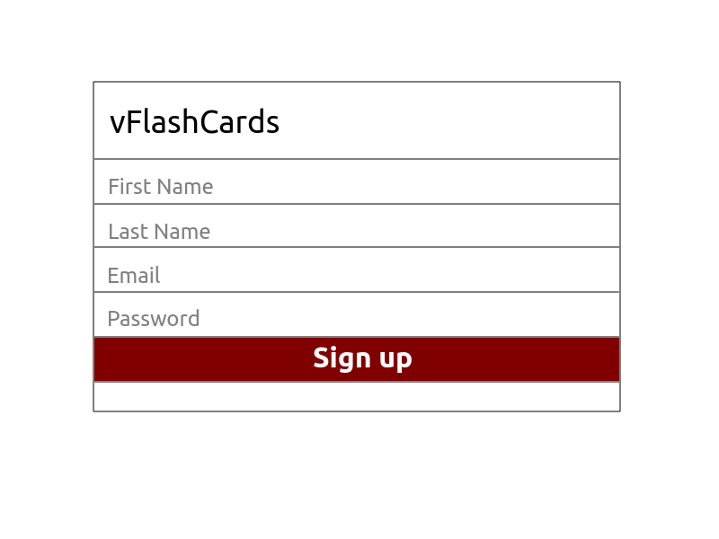
Wireframe – Sign up

Slide 6
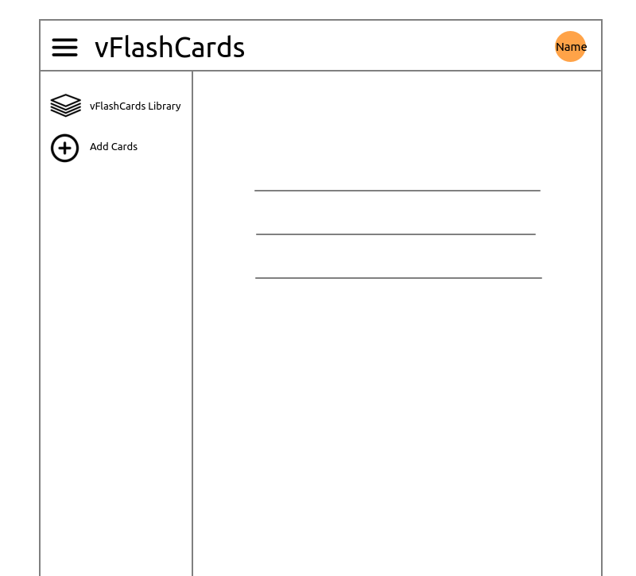
Wireframe – Login profile

Slide 7
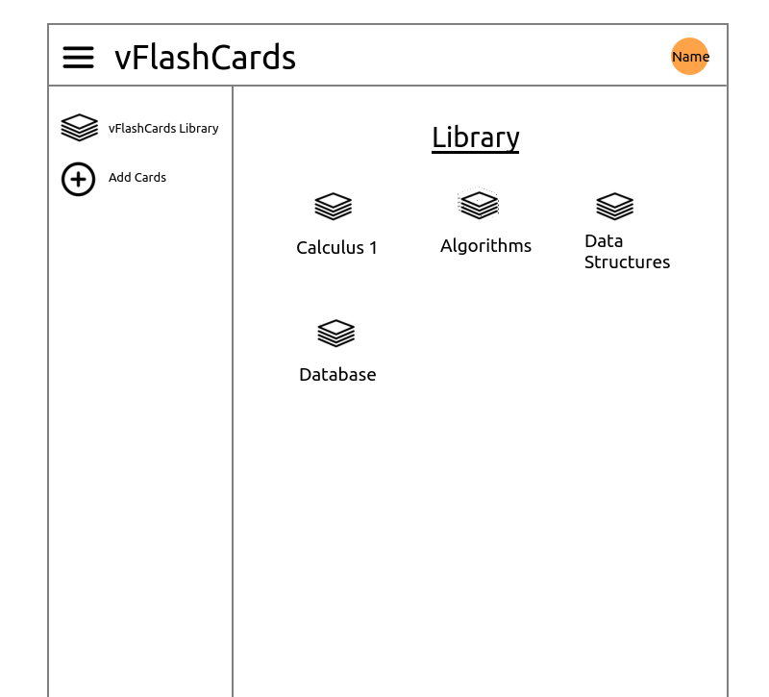
Wireframe - Library

Slide 8
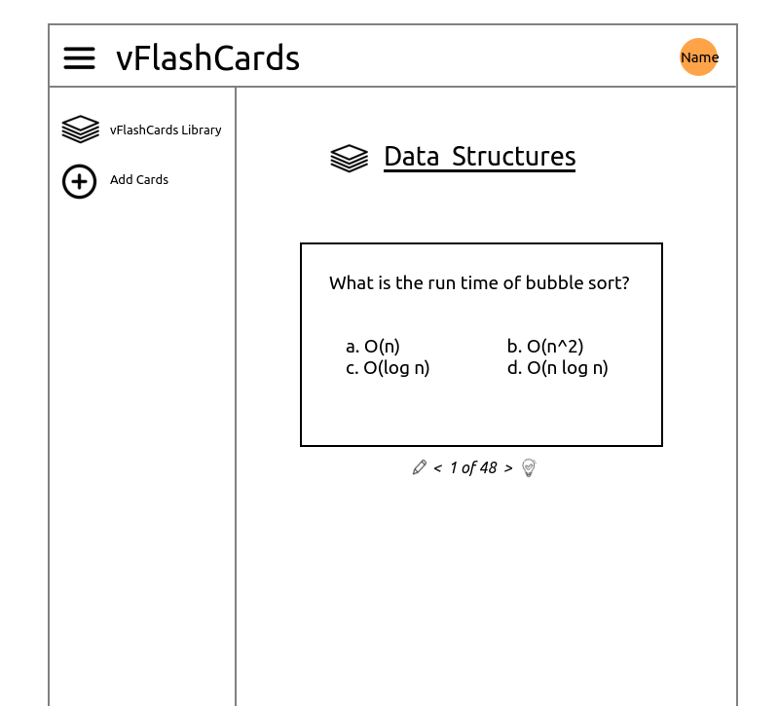
Wireframe – vFlashCards set

Slide 9
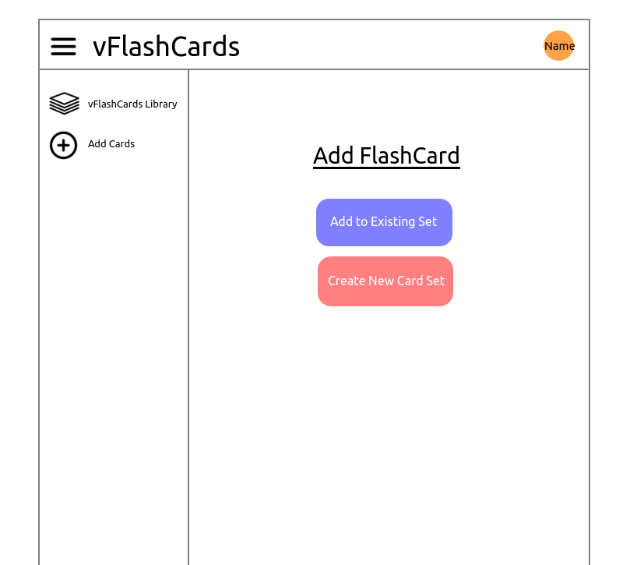
Wireframe – Add cards

Slide 10
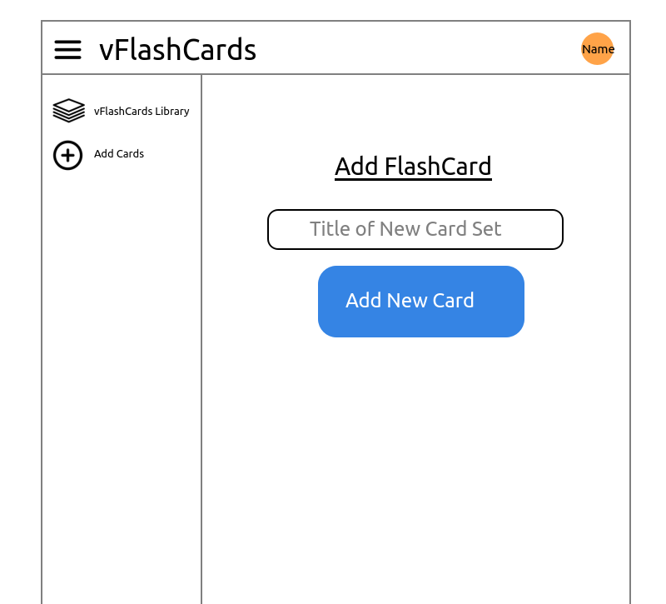
Wireframe – Add cards (cont’d)

Slide 11
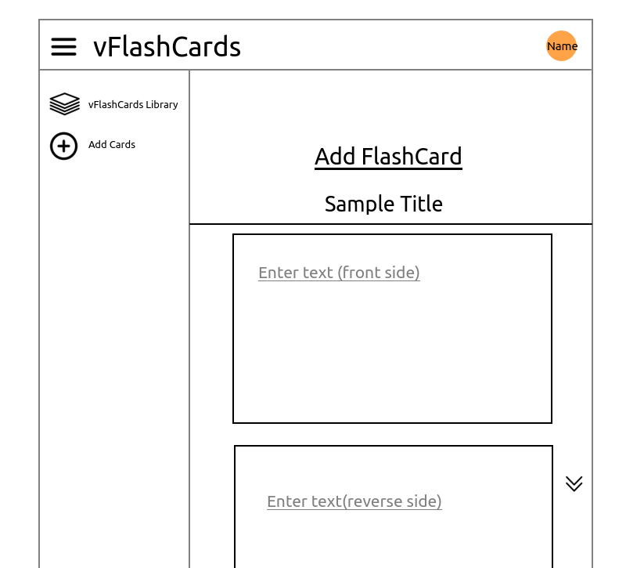
Wireframe – Add cards (cont’d)

Slide 12
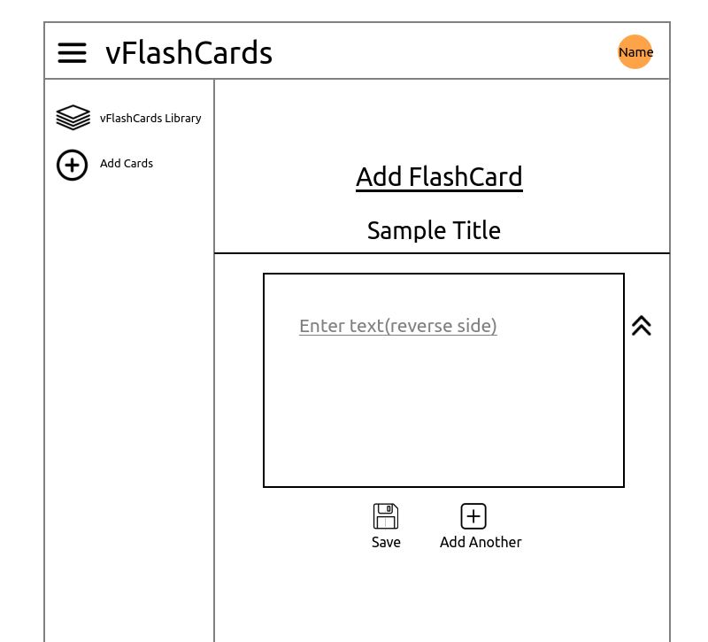
Wireframe – Add cards (cont’d)

Slide 13
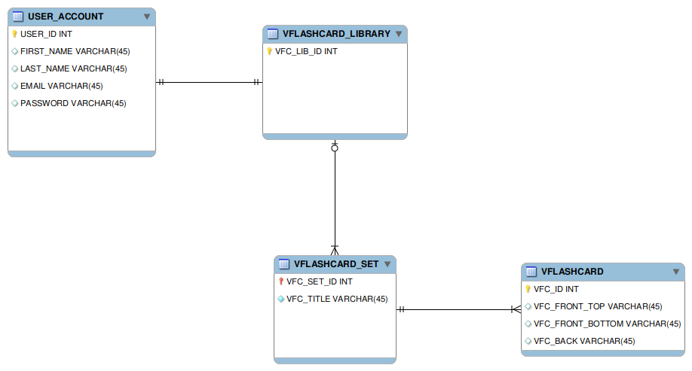
Entity Relationship Diagram

Slide 14
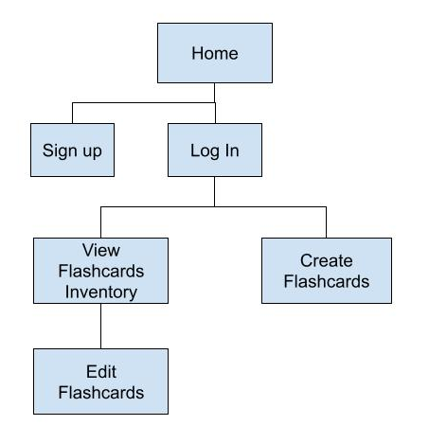
Sitemap

Slide 15
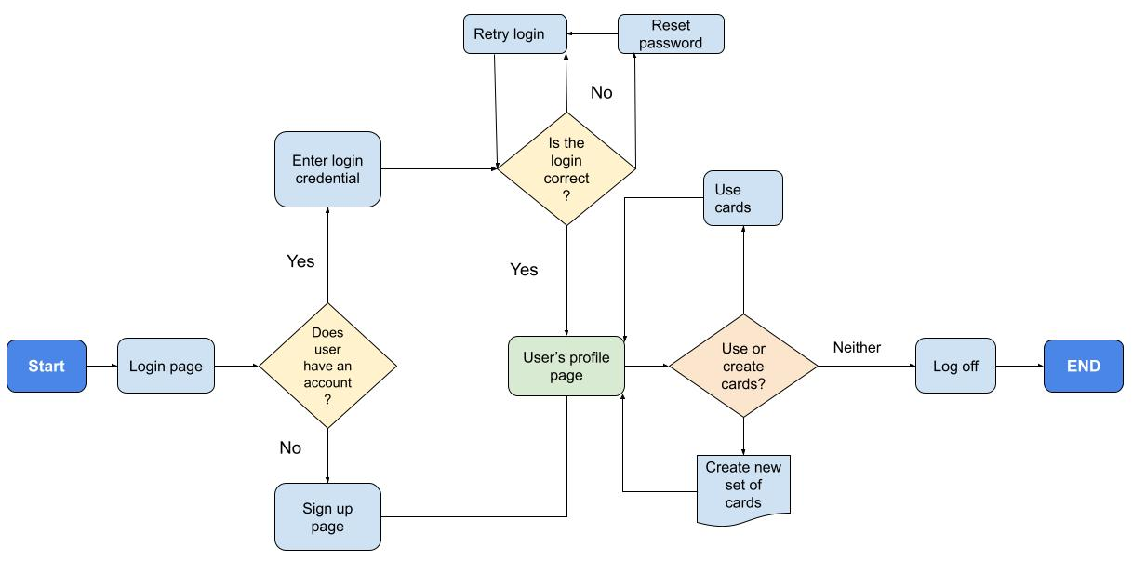
User Flow Chart

Slide 16
Tentative Schedule
Task | Description | Due Date
Research on the type of DB to use | Debate on whether to go with NoSQL or relational DB | 09/13/23
Refine the existing ERD model | Follow up during CTP office hours | 09/13/23
Refine user workflow | Refine the existing version as seen in initial design document | 09/17/23
Built out the backend | Using Express, NodeJS, | 09/30/23
Built out the frontend | Using React | 10/15/23
Deliver minimum viable product |  | 10/30/23
Incorporate vFC sharing | Allow site members to share sets from their library | 11/15/23
Incorporate Deepl | Language translation (tentative) | 11/15/23
Incorporate localization | Tentative | 11/25/23
Incorporate internationalization | Tentative | 11/25/23

Slide 17
End of Demo

