Slide 1
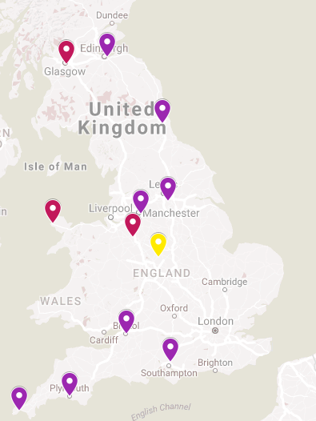
Alstom
(Polmadie, PC)
WC Trains (3)
Virgin East Coast
(Craigentinny, EC)
XC Trains (6)
Voyager Class 220, 221
Train Locations
December 2017 time table
WC= 20 trains total (17 to 19 in service)
XC= 58 trains total (52 in service)
Arriva Train Care (ATC)
(Tyne Yard, TY)
XC Trains (4)
Alstom
(Longsight, MA)
XC Trains (4)
Bombardier
(Crofton, CT)
XC Trains (4)
Bombardier (BT)
(Central Rivers, CZ)
XC Trains (16 departures, 5 stopped)
WC Trains (7-9 departures, 1-3 stopped)
Arriva Train Wales (ATW)
(Holyhead, HD)
WC Trains (3)
BartonUN = Central Rivers (for XC)
BrtnUNCmd = Central Rivers (for WC)
LongstCMD=Longsight
Elgh Dep=Eastleigh
Craig CS=Craigentinny
Tyne S.S.=Tyne Yard
CroftnDep=Crofton
LairaTRMD=Laira
Pznce TMD=Penzance
PoldieCMD = Polmadie
Crewe CS = Crewe
Holyhead=Holyhead
Arriva Train Care
(Crewe, CP)
WC Trains (4)
Arriva Train Care (ATC)
(Barton Hill, BH)
XC Trains (4)
Arriva Train Care (ATC)
(Eastleigh, EH)
XC Trains (8)
Great Western Railway (GWR)
(Penzance, PZ)
XC Trains (2)
Great Western Railway (GWR)
(Laira, LA)
XC Trains (5)

