Slide 1
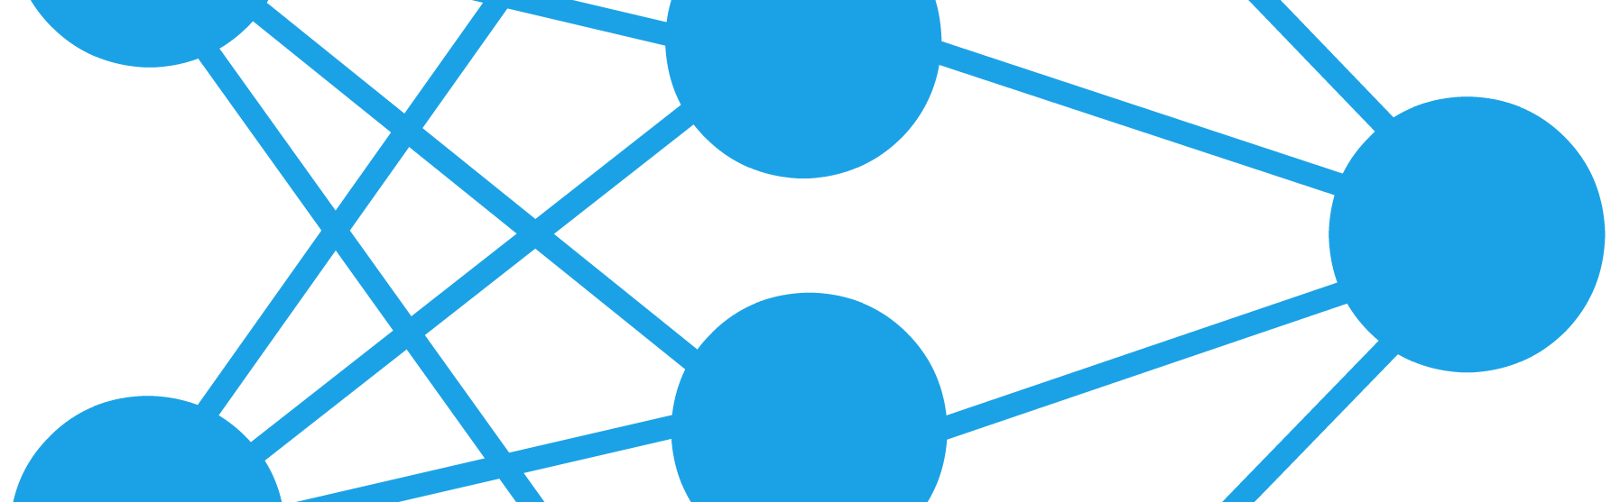
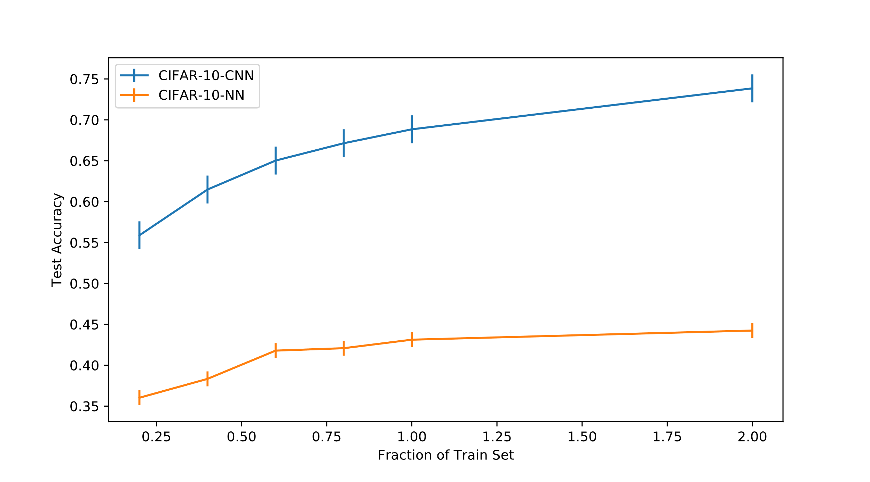
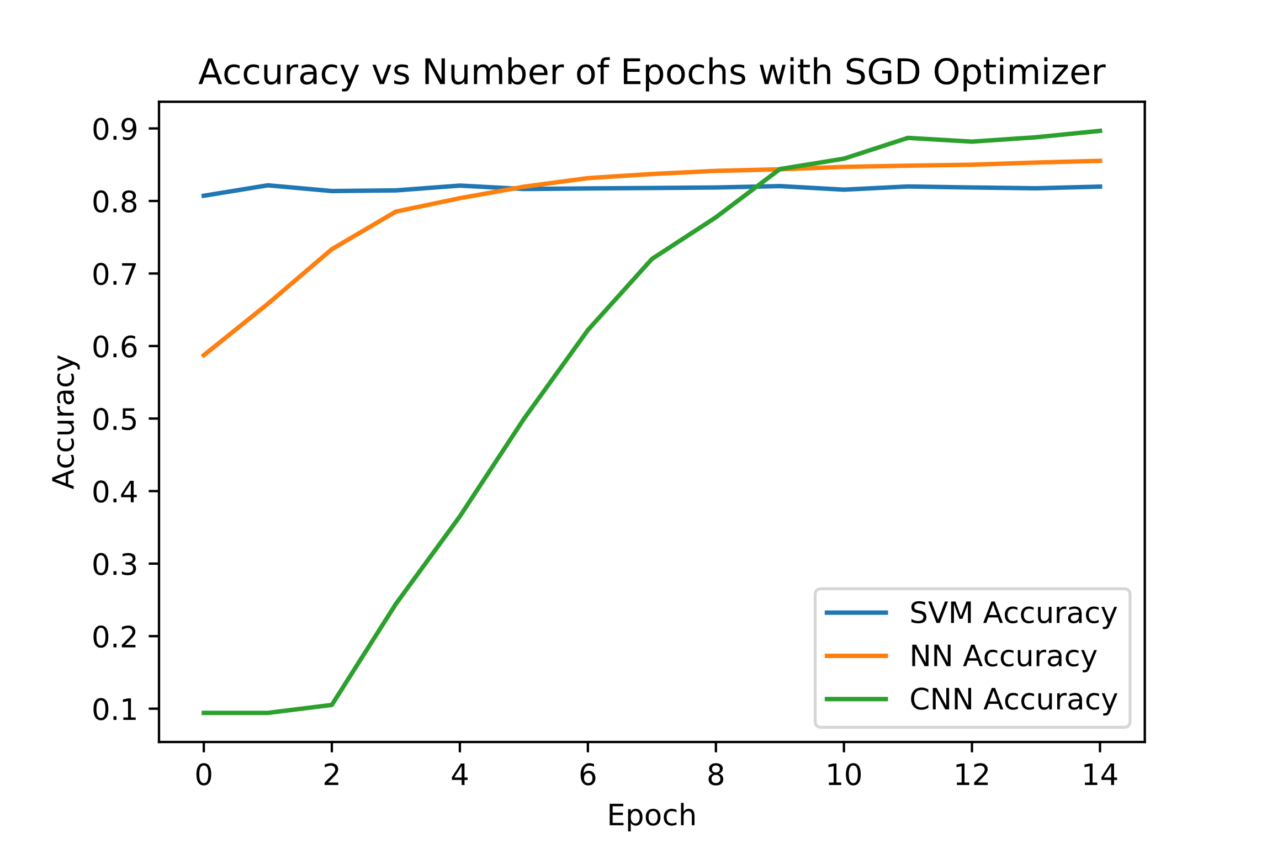
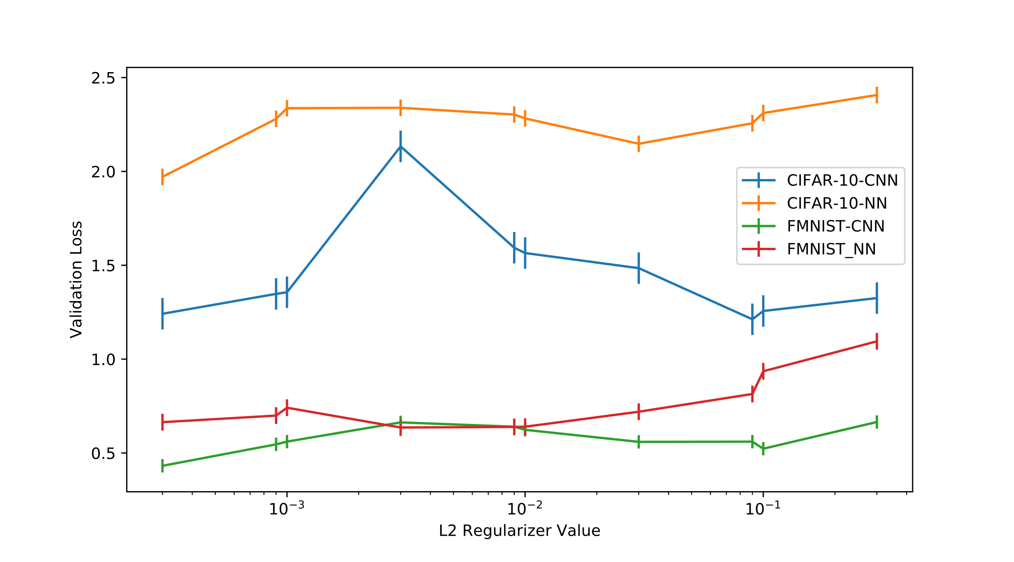
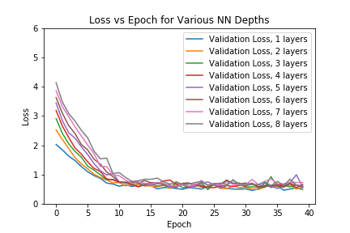
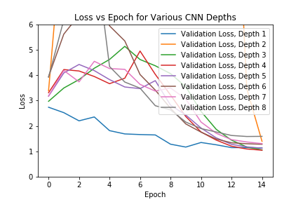

Impact of Hyperparameters on Model Performance
Alexander Peplowski | Azfar Khoja | Daniel Wang
Objectives
Procedure
Results
Evaluate:
Network Shape vs Performance
Data Availability vs Performance
Network Node Count vs Performance
Target Algorithm vs Convergence Time
Regularization vs Performance
2. Data Availability vs Performance
2. Data Availability vs Performance
Step | Description
Split Training Set | Generate smaller stratified sets sampled from CIFAR-10 and F-MNIST
Data Augmentation | Reflect images horizontally to double data set size
Run Experiment | Evaluate test set accuracy using above sets
3. Network Node Count vs Performance
3. Network Node Count vs Performance
Baseline Algorithms
Step | Description
Define Models | Generate models with equal depth and variable number of neurons
Run Experiment | Evaluate validation loss, test accuracy using CIFAR-10 and F-MNIST
Convolutional Neural Network
Neural Network
SVM
Regularization alpha = 0.01
Batch Normalization
Batch Normalization
4 Convolutional Layers:
(3x3) Kernel
32,32,64,64 Feature Maps
Two FC Layers
490 Nodes per hidden layer
Equal number of parameters as CNN baseline
3 Layers
Max Pooling x2
Gradient Descent Optimizer
Linear Kernel
4. Target Algorithm vs Convergence Time
Step | Description
Define Models | Compile baseline models with gradient descent optimizer
Run Experiment | Evaluate validation loss, test accuracy using F-MNIST with fixed epoch count
4. Target Algorithm vs Convergence Time
5. Regularization vs Performance
5. Regularization vs Performance
Data Sets
Step | Description
Define Models | Generate CNN, MLP models with variable l2 regularization values
Run Experiment | Evaluate validation loss using CIFAR-10 and F-MNIST
CIFAR-10
3 Color Channels
Fashion MNIST
10 Classes
10 Classes
32x32 Image Size
60,000 images
28x28 Image Size
Grayscale (1-Channel)
70,000 Images
Results
Conclusions
Procedure
1. Network Shape vs Performance
1.1: When controlling for number of parameters, MLP network depth has little impact on performance for the f-MNIST dataset
1.2: When controlling for number of parameters, CNN network depth is best at depth 4 for the CIFAR-10 dataset
2: Increasing data availability has a significant impact on CNN, small impact on NN. Data augmentation helps in both cases.
3:
4: SVMs with linear kernels have fast convergence, but CNNs have the best performance on the F-MNIST dataset
5: Not clear how to select a general regularizer across datasets, use hyperparameter search!
1. Network Shape vs Performance
Step | Description
Define Models | Generate models with equal parameter count for MLP and CNN depths from1 to 8
Run Experiment | Evaluate validation loss, test accuracy using CIFAR-10 for CNN and F-MNIST for MLP
Notes:
To change this poster, replace our sample content with your own. Or, if you'd rather start from a clean slate, press the New Slide button on the Home tab to insert a new page. Now enter your text and pictures in the empty placeholders. If you need more placeholders for titles, subtitles or body text, copy any of the existing placeholders, then drag the new one into place.

