Slide 1

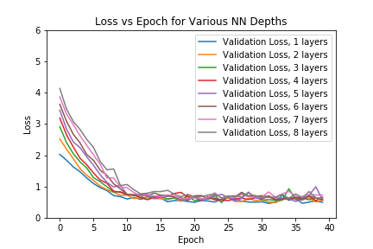
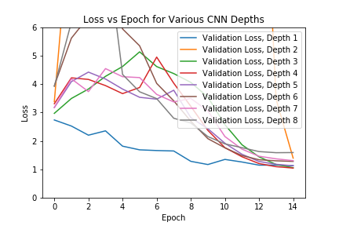

Impact of Hyperparameters on Model Performance
Your name | Teacher’s name | School
Objectives
Procedure
Results
Evaluate:
Network Shape vs Performance
Data Availability vs Performance
Network Node Count vs Performance
Target Algorithm vs Convergence Time
1. Network Shape vs Performance
2. Data Availability vs Performance
Step | Description
Define Models | Generate models with equal parameter count for MLP depths from1 to 8
Run Experiment | Evaluate validation loss, test accuracy using CIFAR-10 for CNN and F-MNIST for NN
3. Network Node Count vs Performance
2. Data Availability vs Performance
Step | Description
Split Training Set | Generate smaller stratified sets sampled from CIFAR-10 and F-MNIST
Data Augmentation | Reflect images horizontally to double data set size
Run Experiment | Evaluate test set accuracy using above sets
Baseline Algorithms Used
Convolutional Neural Network
Neural Network
SVM with Linear Kernel
Regularization alpha = 0.01
Batch Normalization
Batch Normalization
4 Convolutional Layers:
(3x3) Kernel
32,32,64,64 Feature Maps
Two FC Layers
490 Nodes per hidden layer
Equal number of parameters as CNN baseline
3 Layers
Max Pooling x2
Gradient Descent Optimizer
3. Network Node Count vs Performance
Step | Description
Define Models | Generate models with equal depth and variable number of neurons
Run Experiment | Evaluate validation loss, test accuracy using CIFAR-10 and F-MNIST
4. Target Algorithm vs Convergence Time
Conclusion
Step | Description
Define Models | Compile baseline models with gradient descent optimizer
Run Experiment | Evaluate validation loss, test accuracy using F-MNIST with fixed epoch count
Brief summary of what you discovered based on results
Indicate and explain whether or not the data supports your hypothesis
Data Sets Used
Results
CIFAR-10
3 Color Channels
Fashion MNIST
10 Classes
10 Classes
32x32 Image Size
60,000 images
28x28 Image Size
Grayscale (1-Channel)
70,000 Images
1. Network Shape vs Performance
Notes:
To change this poster, replace our sample content with your own. Or, if you'd rather start from a clean slate, press the New Slide button on the Home tab to insert a new page. Now enter your text and pictures in the empty placeholders. If you need more placeholders for titles, subtitles or body text, copy any of the existing placeholders, then drag the new one into place.

