Slide 1
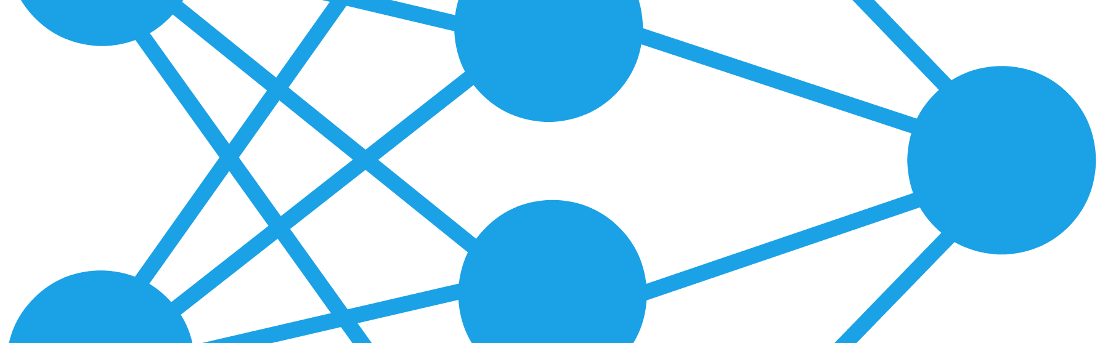
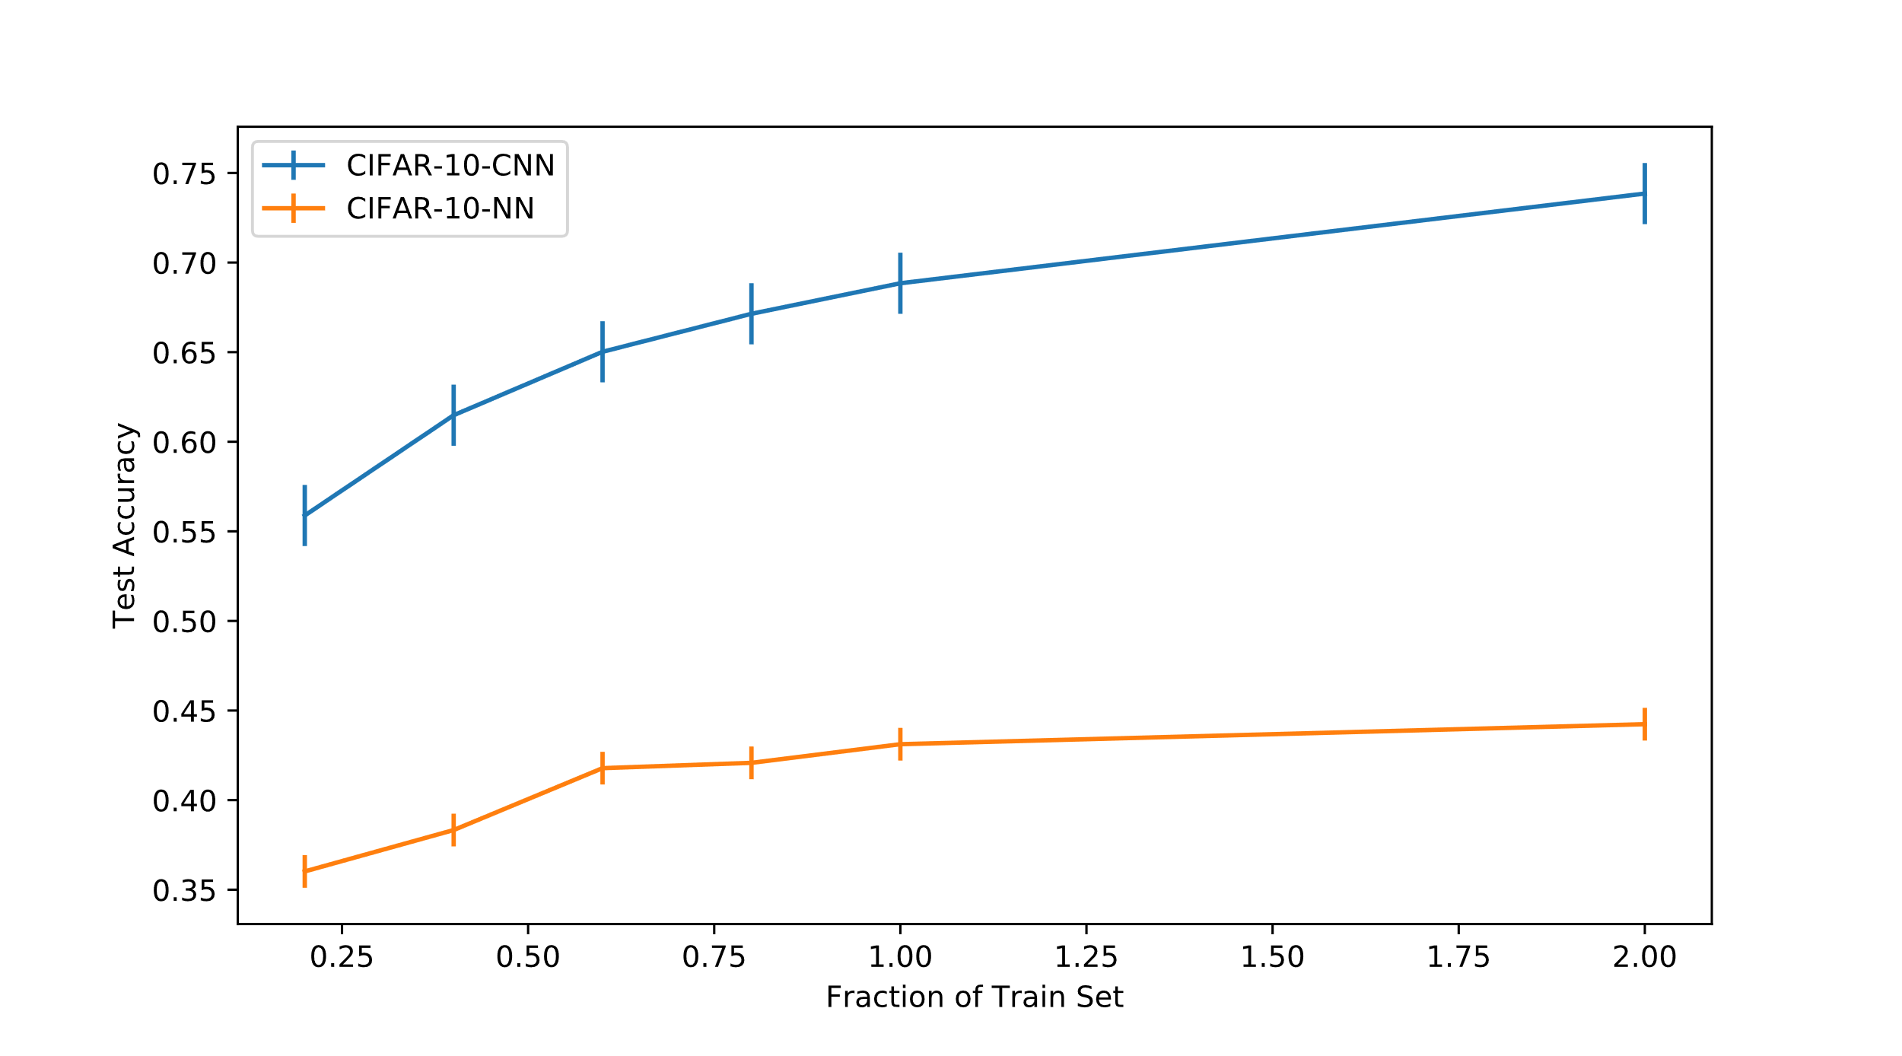
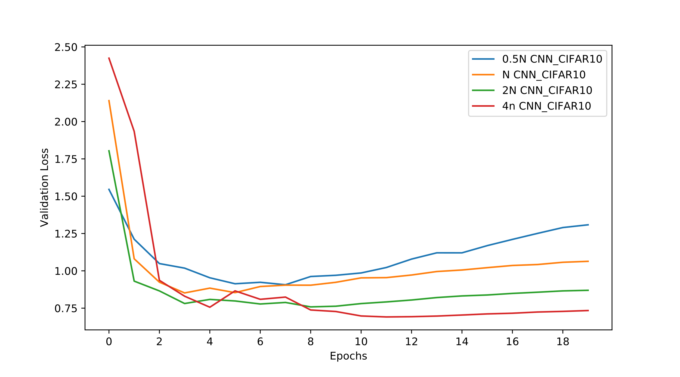
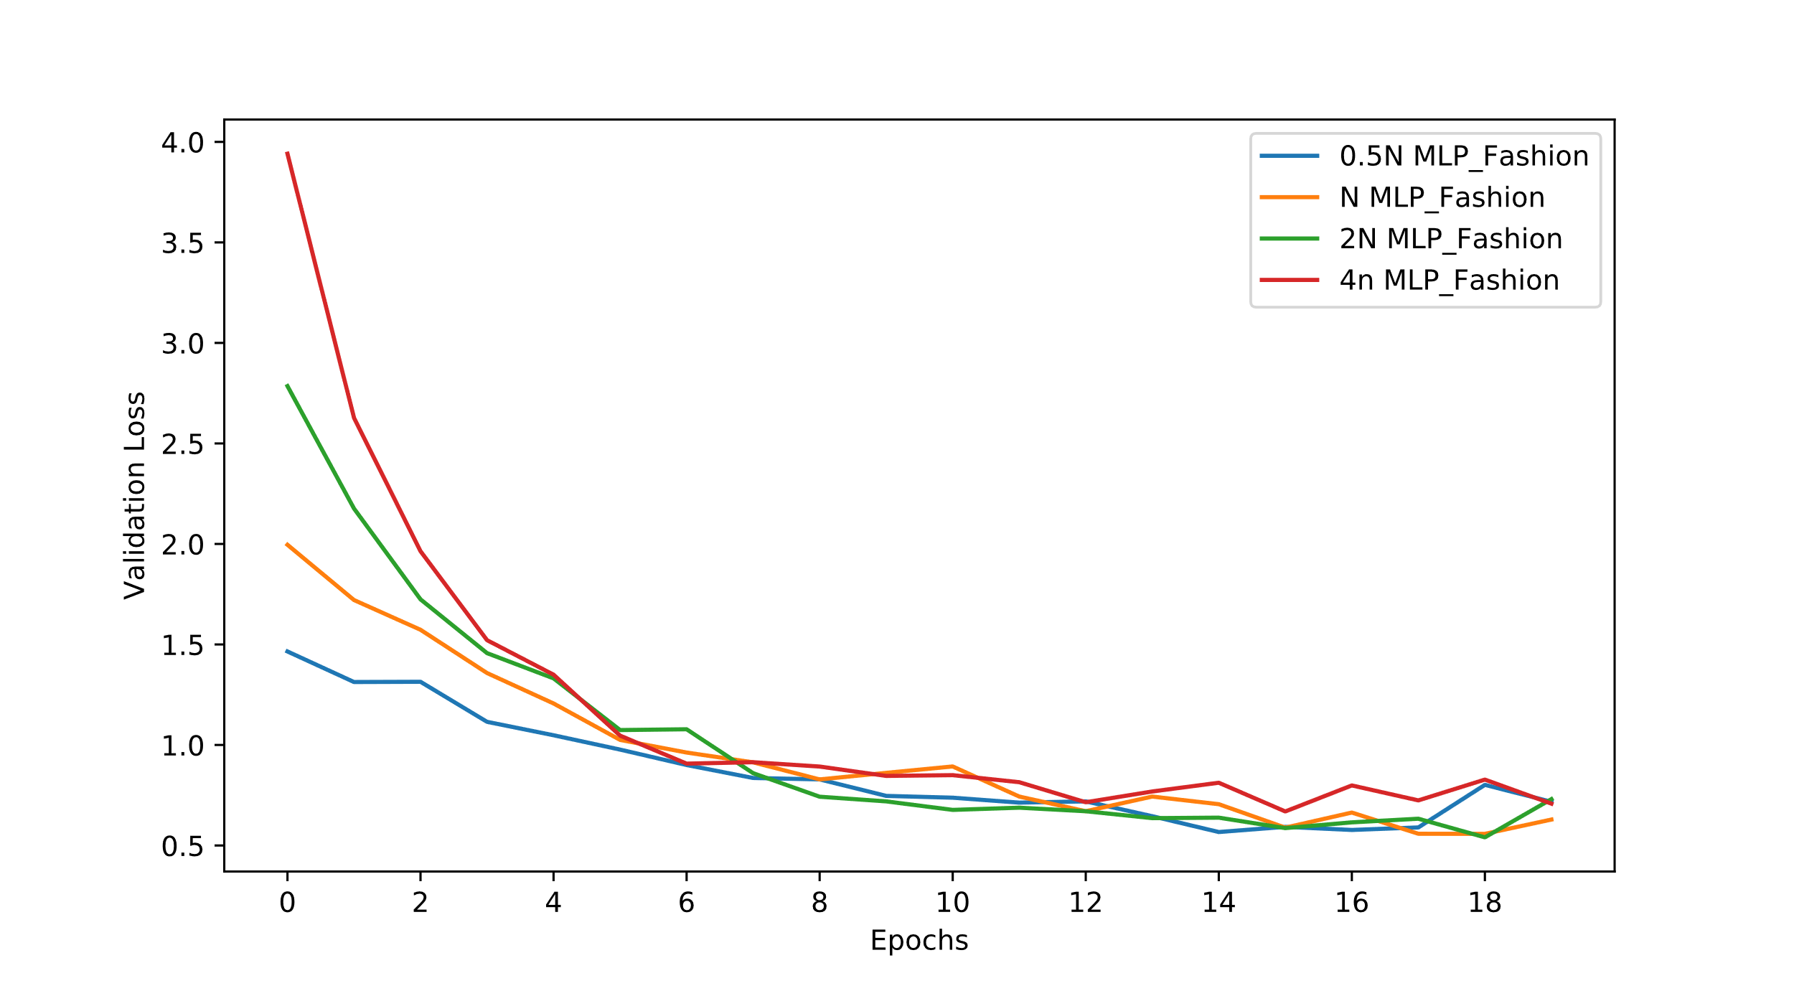
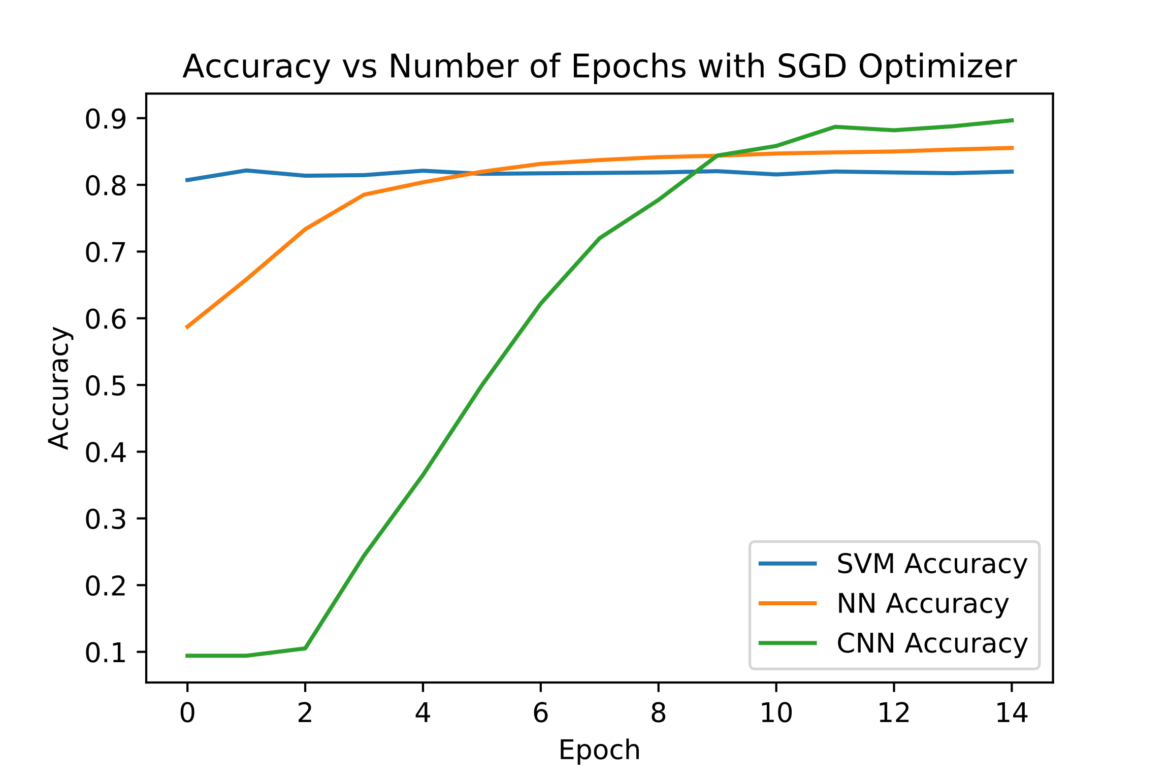
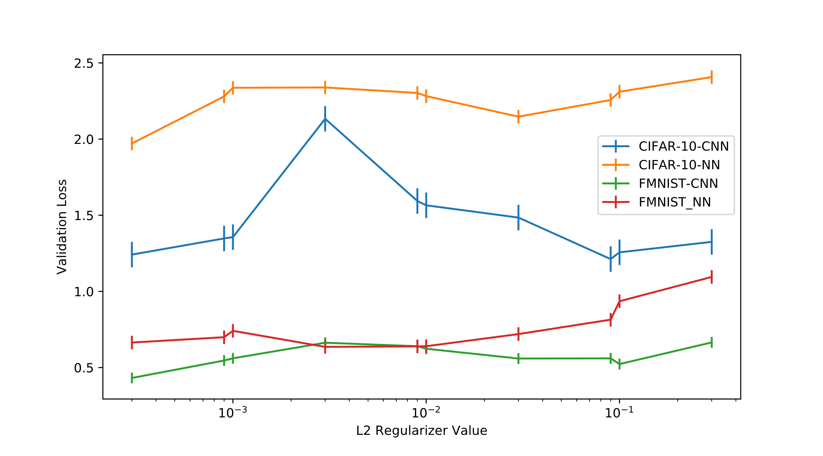
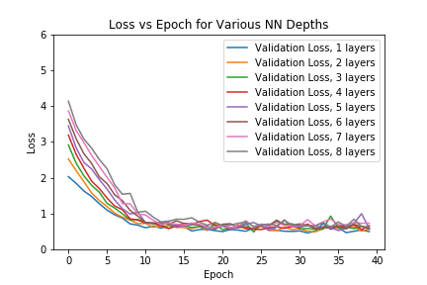
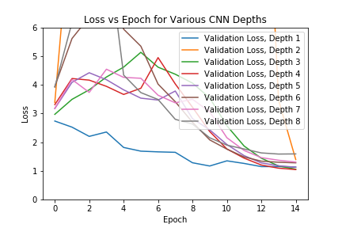

ML Model Optimization Strategies for Image Datasets
Alexander Peplowski | Azfar Khoja | Daniel Wang
Objectives
Procedure
Results
Evaluate:
Network Shape vs Performance
Data Availability vs Performance
Network Node Count vs Performance
Target Model vs Convergence Time
Regularization vs Performance
2. Data Availability vs Performance
2. Data Availability vs Performance
Step | Description
Split Training Set | Generate smaller stratified sets sampled from CIFAR-10 and F-MNIST
Data Augmentation | Reflect images horizontally to double data set size
Run Experiment | Evaluate test set accuracy using above sets
3. Network Node Count vs Performance
3. Network Node Count vs Performance
Baseline Models
Step | Description
Define Models | Generate models with equal depth and variable number of neurons
Run Experiment | Evaluate validation loss, test accuracy using CIFAR-10 and F-MNIST
Convolutional Neural Network
Multilayer Perceptron
Support Vector Machine
Regularization alpha = 0.01
Batch Normalization
Batch Normalization
4 Convolutional Layers:
(3x3) Kernel
32,32,64,64 Feature Maps
Two Dense Layers
490 Nodes per hidden layer
Equal number of parameters as CNN baseline
3 Layers
Max Pooling x2
Gradient Descent Optimizer
Linear Kernel
4. Target Model vs Convergence Time
Step | Description
Define Models | Compile baseline models with gradient descent optimizer
Run Experiment | Evaluate validation loss, test accuracy using F-MNIST with fixed epoch count
4. Target Algorithm vs Convergence Time
5. Regularization vs Performance
5. Regularization vs Performance
Data Sets
Step | Description
Define Models | Generate CNN, MLP models with variable l2 regularization values
Run Experiment | Evaluate validation loss using CIFAR-10 and F-MNIST
CIFAR-10
3 Color Channels
Fashion MNIST
10 Classes
10 Classes
32x32 Image Size
60,000 images
28x28 Image Size
Grayscale (1-Channel)
70,000 Images
Conclusions
Results
1.1: When controlling for number of parameters, MLP network depth has little impact on performance for the F-MNIST dataset
1.2: When controlling for number of parameters, CNN network depth is best at depth 4 for the CIFAR-10 dataset
2: Increasing data availability has a significant impact on CNN, small impact on MLP. Data augmentation helps in both cases.
3.1: When varying the node count, the highest capacity CNN model has the best performance and fastest training time on the CIFAR-10 dataset.
3.2: When varying the node count, the capacity of MLP models does not impact performance for the F-MNIST data set.
4: SVMs with linear kernels have fast convergence, but CNNs have the best performance on the F-MNIST dataset
5: Not clear how to select a general regularizer across datasets, use hyperparameter search!
Procedure
1. Network Shape vs Performance
1. Network Shape vs Performance
Step | Description
Define Models | Generate models with equal parameter count for MLP and CNN depths from1 to 8
Run Experiment | Evaluate validation loss, test accuracy using CIFAR-10 for CNN and F-MNIST for MLP

