Slide 1

AMERICAN UNIVERSITY OF SCIENCE & TECHNOLOGY Faculty of Engineering and Computer Science Department of Information & Communications Technology
Recipe Book Application
Mobile Phone computing infrastructure/ict370
Instructor: Dr. Bassel Dhaini
Presented by:
Ralph Achkar
Adam Moumneh
Jawad al sahili

Slide 2
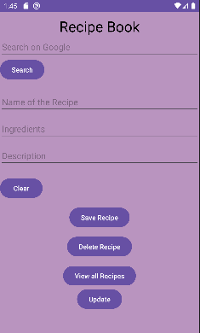
Introduction
We developed a Recipe Book application with three key text views – Name, Ingredient, and Description – to simplify recipe management. The app features a database for seamless saving, deleting, updating, and viewing of recipes. It offers a professional and efficient solution for users to organize and access their favorite recipes effortlessly. Welcome to a compact and intuitive Recipe Book application designed for culinary enthusiasts.

Slide 3
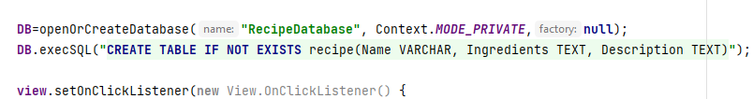
Database and table creation
Created a database called “RecipeDatabase” using openOrCreateDatabase
Created a table called “recipe” with three columns: name, ingredients and description

Slide 4
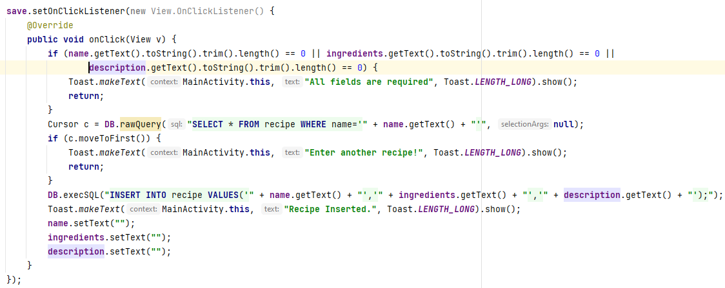
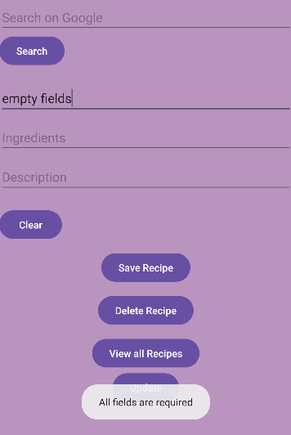
Save button
-In order to save a recipe all fields must be filled, or else it will return “All fields are required”
-Cursor c will check of the recipe is already saved in our database, if it is it will return “Enter another recipe”
-If the recipe isn’t saved yet, it will save the name, ingredients and description.

Slide 5
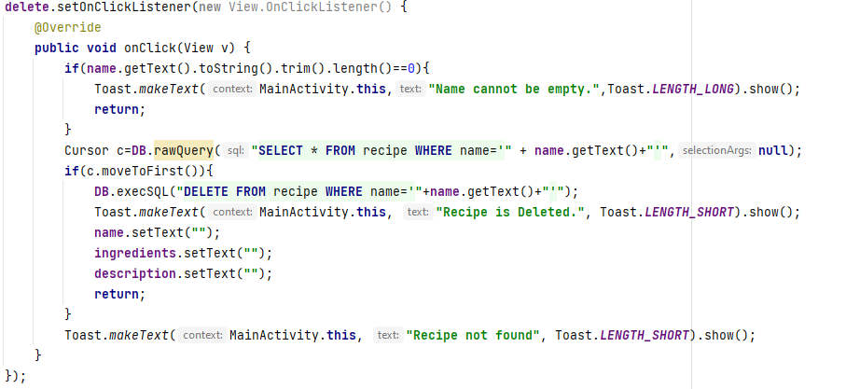
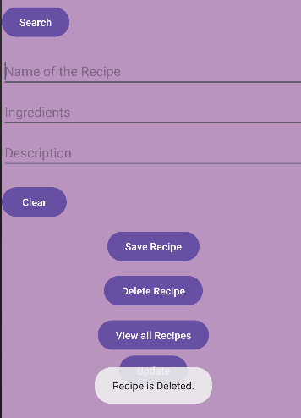
Delete button
-In order to delete a recipe, name should not be empty or else it will return “Name cannot be empty”
-Cursor c checks if the name is available in our database.
-If the name of the recipe is not saved inside our database it will return “Recipe not found”

Slide 6
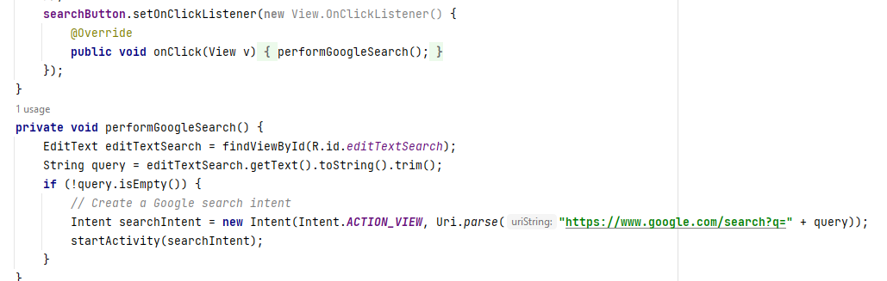
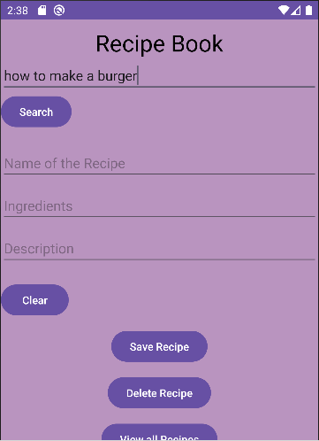
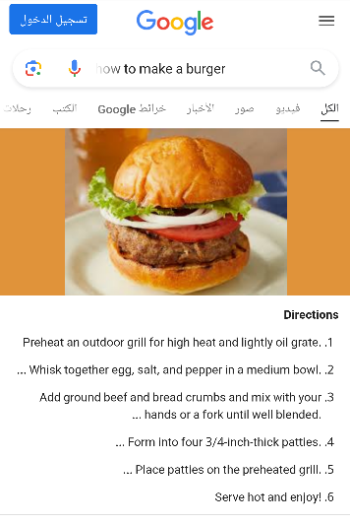
Google search

Slide 7
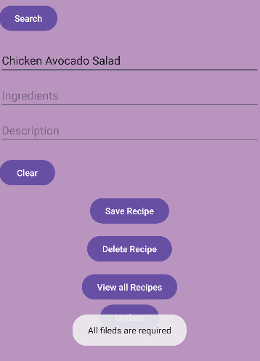
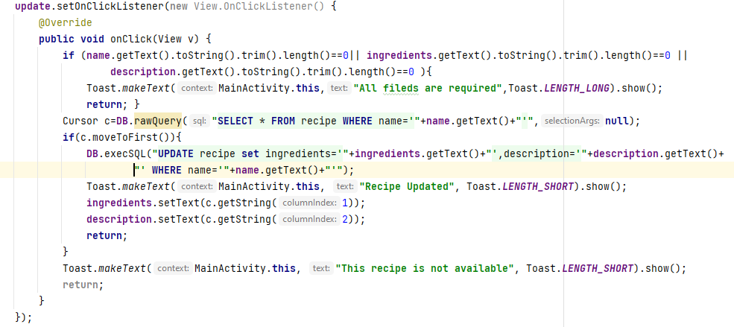
Update button
-In order to update a recipe, all three fields must be filled.
-Cursor c will check if the recipe is already saved.
-In case the recipe is not available, it will return “This recipe is not available”

Slide 8
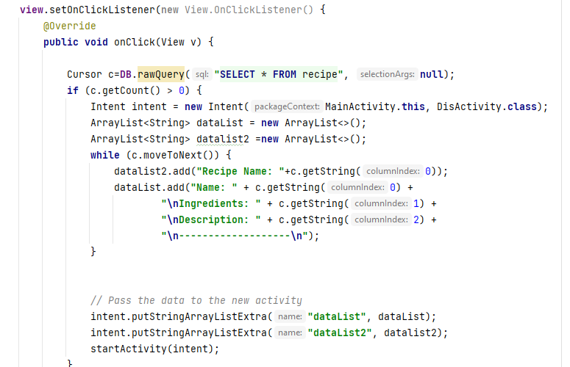
View button
MainActivity:
-Created an intent that takes us to DisActivity
-Created two arraylists
-Sent the two arraylists to the DisActivity class using intent

Slide 9
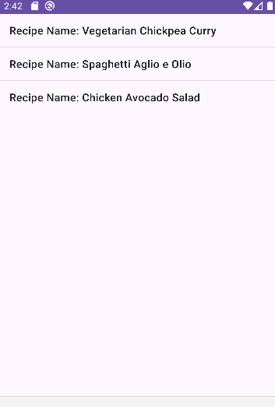
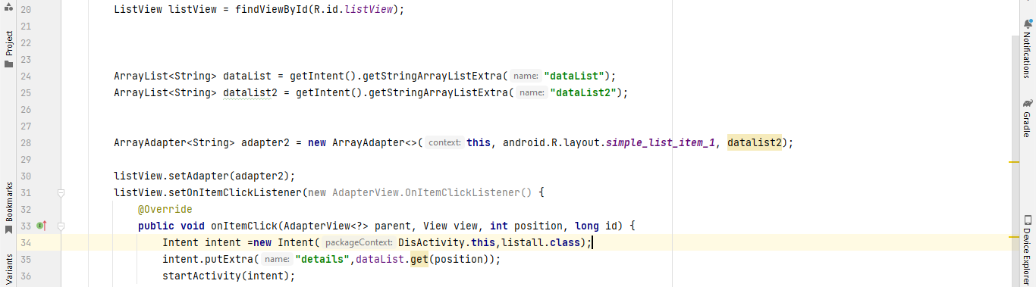
View button
DisActivity:
-We retrieved the two arraylists
-Created a new arrayadapter
-We set the adapter to the listview
-Created a new intent that takes us to listall class

Slide 10
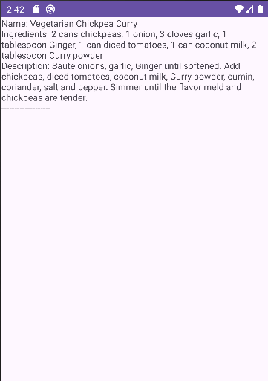
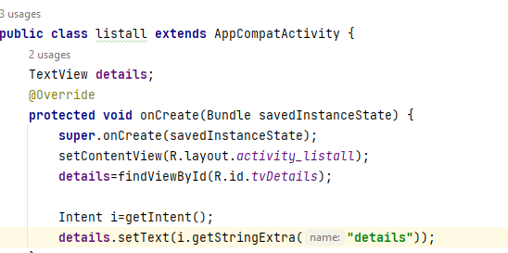
View button
Listall class:
-We get the details of the recipe

Slide 11
conclusion
In conclusion, the Recipe Book application offers a practical and user-friendly solution for individuals passionate about culinary exploration. With its minimalist design and essential features, users can seamlessly organize, save, and retrieve their favorite recipes.

