Slide 1

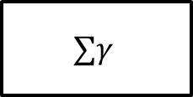
New Image
Salient Object Tracker
Lucas Kanade
Hough Transform Detector
Kalman Filter
Motion Estimate
Motion Estimate
$$∑γ$$
Final Motion Estimate
$$∑$$
Pose Estimate

