Slide 1

Training of Trainers Program for Haj 2026
10th –11th January 2026

Slide 2

Welcome to the Guests of ALLAH
In the name of Allah,
the beneficent and the merciful

Slide 3
HAJ
2026G / 1447H
Presented on 10/11 JAN 2026

Slide 4
Baggage packing tips
Check-in baggage
Hajis will be allowed 02 bags of maximum 20 kgs each.
Ensure that minimum requirements are carried out, as normally weights increase on return due purchases in Makkah / Madinah.
Carry Medication only for the duration of the Haj Yatra, as any extra medicines would be carriage in commercial quantity and liable to customs regulations.
Foodstuff too should be enough, only for the duration of the journey.
Travel as light as possible
DO NOT CARRY ANY PARCELS / GIFTS RECEIVED FROM OTHERS.
Baggage should not be tied with ropes as KSA Authorities object to the same. If baggages are tied with ropes they need to be safe wrapped.

Slide 5
Baggage packing tips
Hand baggage
Keep handbags light as they need to be carried by the pilgrim at every point. Carry an extra set of Xerox copies in accompanying guest baggage.
Dimension of 56x45x25cm / 22x18x10in
Each pilgrim should carry his own baggage.
Count and pick up the handbags at every point.

Slide 6
Phase 1 - 48 hours before departure.
Reporting at Haj House
Hajis to report to the Haj House.
Haji needs to get him self inoculated and inform Haj Committee of any medical problems at this time, as medical FIT TO FLY if needed is to be prepared before coming to Airport.
‘FIT TO FLY’ is not provided by airport doctors.
Haj should ensure that his handbags and check-in bags comply with the regulations and should ensure that all bags are packed in his presence and should not carry any baggage for others.
Check-in baggage and hand-baggage should be labelled inside and out.
Hajis should always carry an extra photocopy of all documents in his hand baggage.

Slide 7
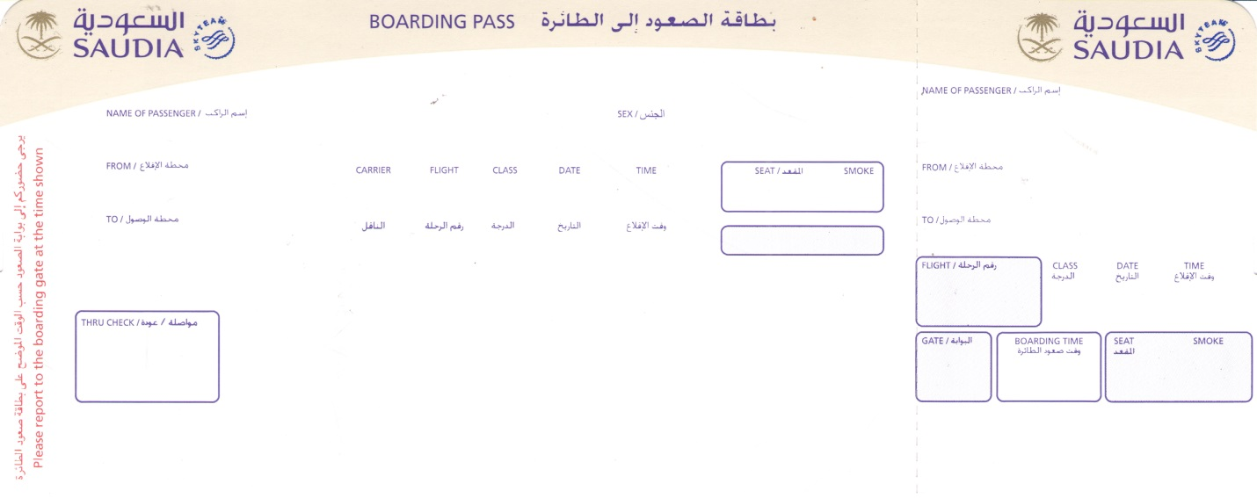

24 hours before scheduled departure.
Boarding passes will be distributed at Haj House
Indians Hajis do not need to fill any forms to be presented at the airports in India and Saudi Arabia.
From
India
From
Saudi Arabia

Slide 8
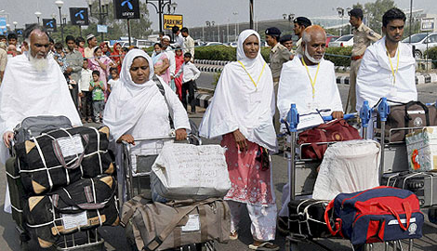
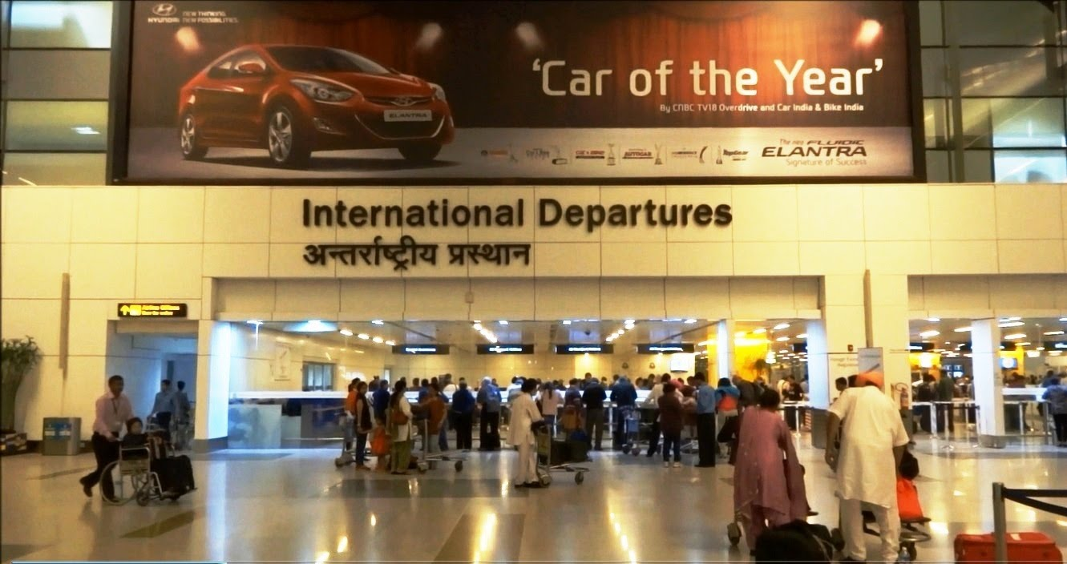
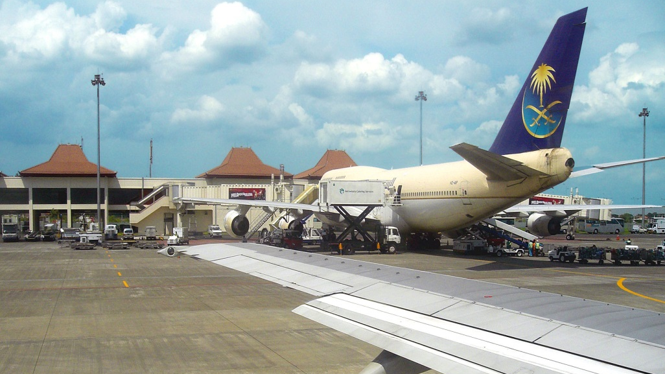
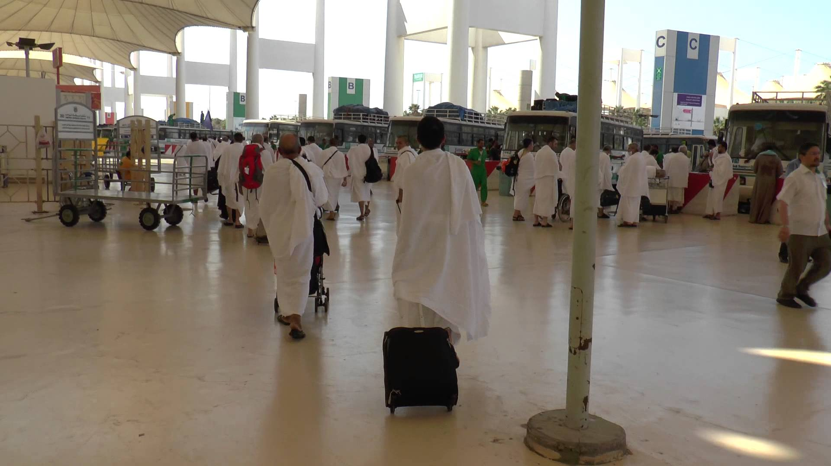
Airport Haj Familiarisation

Slide 9
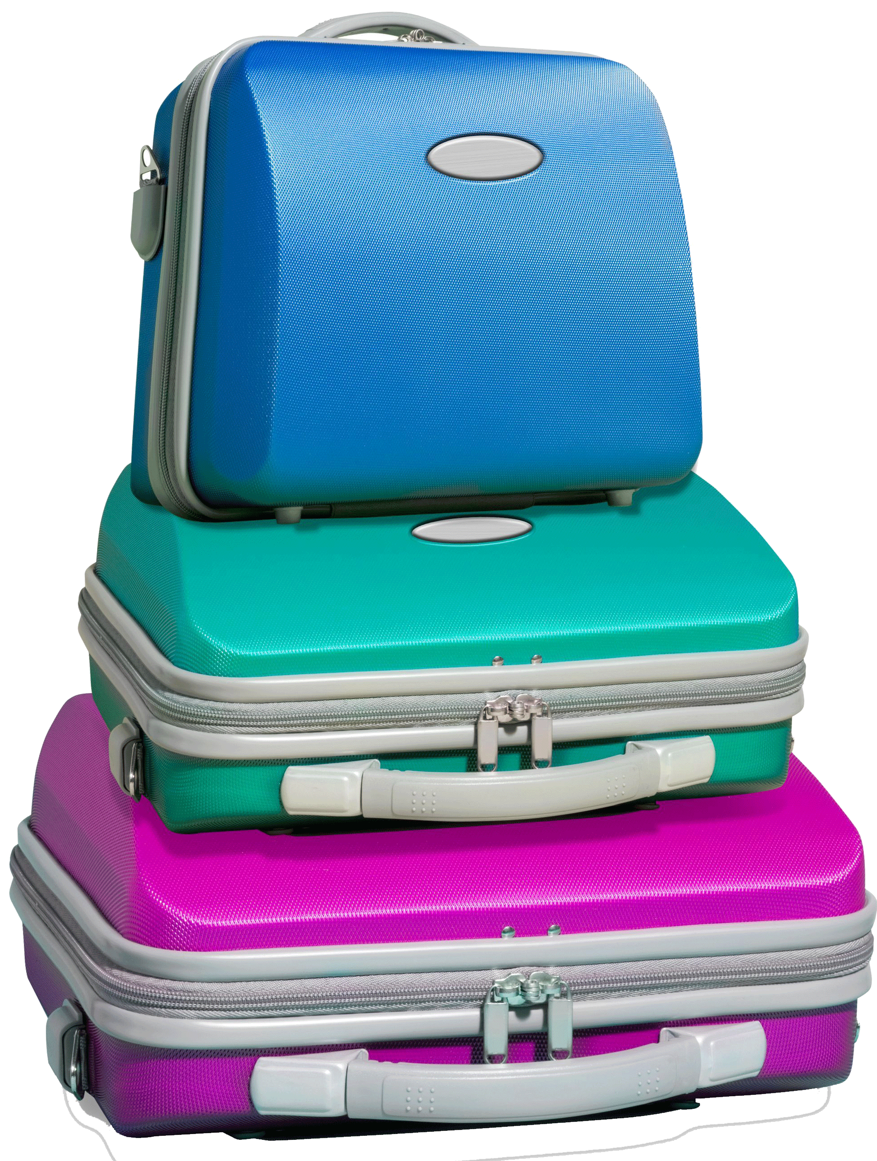
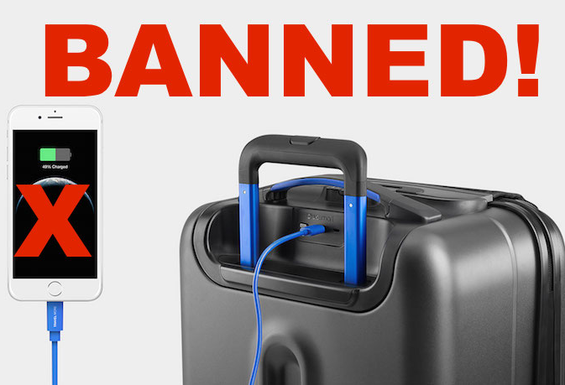
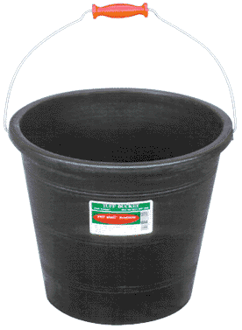
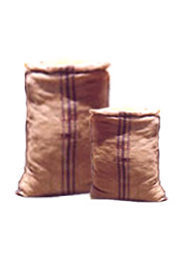
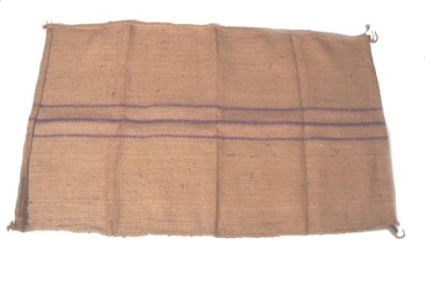
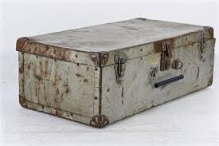
Types of baggages permitted Suitcases Airbags Trolley bags Types of baggages not permitted Buckets Mugs Drums Bedrolls / Sleeping bags Cartons / Sacks / Bori Metal suitcases / Smart Luggage
Baggage permitted / not-permitted


Slide 10
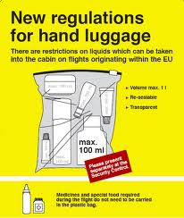

Items not permitted in hand baggage
Moisturizing lotion / Cream *
Liquids* (Strictly not above 100ml)
Small knife
Sewing Needle & Thread
Folding Umbrella
Scissors
Razors / Razor Blades
Flashlight / Torch
Pack of string / Rope
Scotch Tape / Masking tape
Masalas / Paste / Liquids / Match Box
Cigarette Lighters
Beetle nut cutter / Nail-clippers

Slide 11


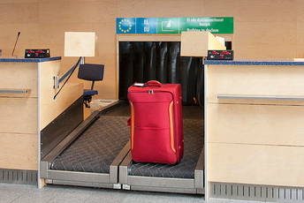
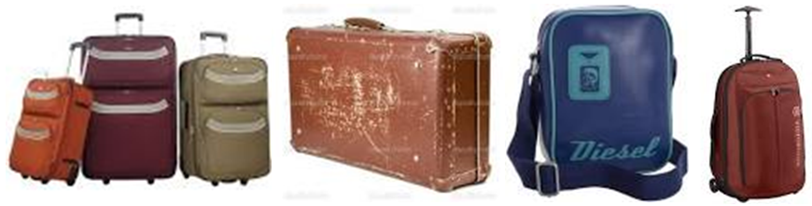
05 hours before scheduled departure.
Baggage Check-in
Hajis to present only their IND/KSA boarding pass at Saudia Counters
Hajis will be allowed 02 bags of maximum 20 kgs each.
22kgs

Slide 12
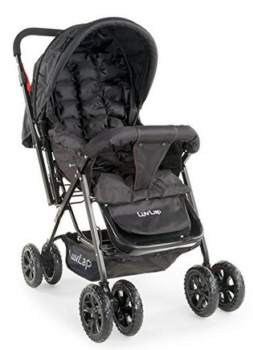
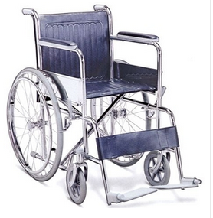
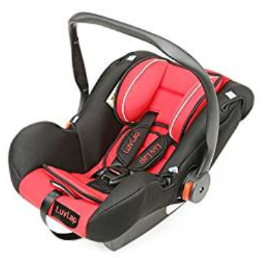
05 hours before scheduled departure.
Baggage Check-in
Personal Wheelchairs & Baby Prams need to be plastic safe wrapped.
Compulsory

Slide 13
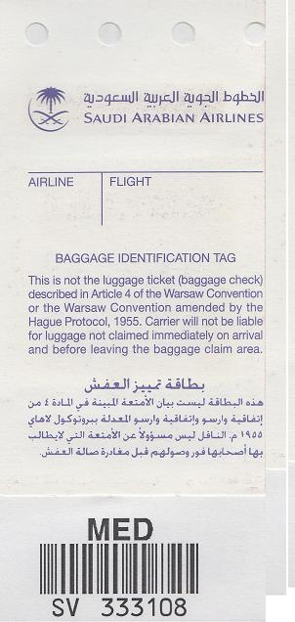

05 hours before scheduled departure.
Baggage Check-in
Passengers will be given a claim tag for every piece of baggage checked-in.
Each passenger will be permitted 01 handbag of maximum 07 kgs.
No extra pouches, sling bags, plastic bags will be permitted.
Handbag tags are not cumpulsory.
Hajis should ensure that all bags have and identification such as cover number /name / phone number and photograph.

Slide 14
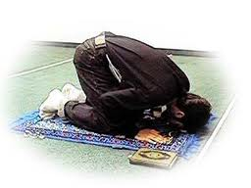

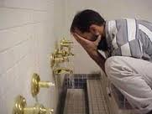
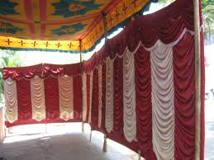
06 hours before scheduled departure.
Report at Airport – Wudu, Namaz (Salat) & Ehram
Wudu, Namaz (Salat) and Ehram facilities are available at various airports for passengers who arrive 06 hours before departure.
It would be advisable if Hajis completed their Wudu, Namaz and Ehram before arriving at the airport to avoid lines for wudu and toilets.

Slide 15
04 hours before scheduled departure.
Immigrations / Security
Hajis should now proceed for Immigrations.
Separate queues will be maintained for ladies & gents.
In security Hajis should ensure that spring balance scale / knives / blades / umbrellas / metal chairs / utensils / Zamzam are not present in handbag.
No metals / coins will be permitted on pax body.

Slide 16

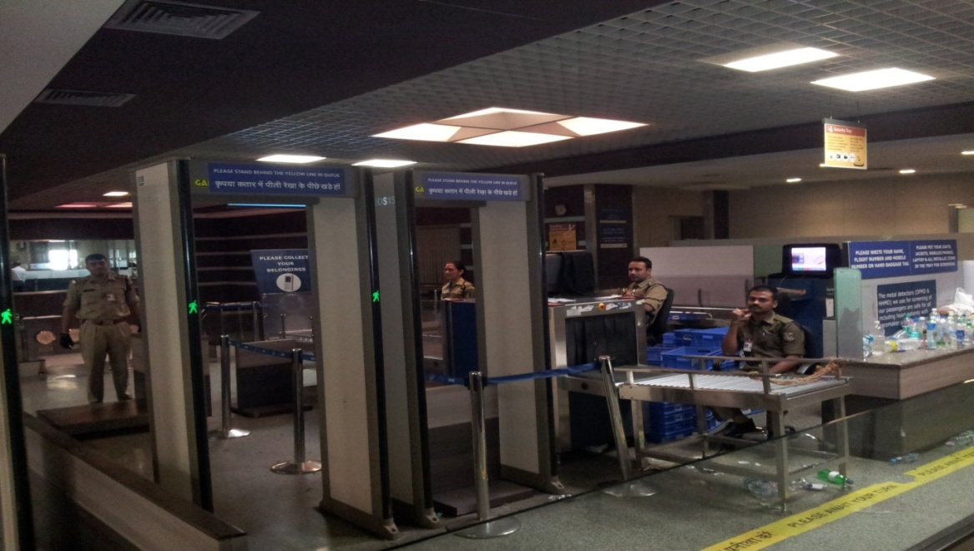
04 hours before scheduled departure.
Foreign Exchange / Security & Snack Box.
Hajis should now collect their foreign exchange and proceed for CISF Security.
Separate queues are maintained for Hajis.
After security Hajis can wait in the security holding area.

Slide 17
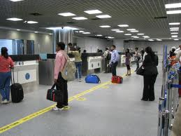
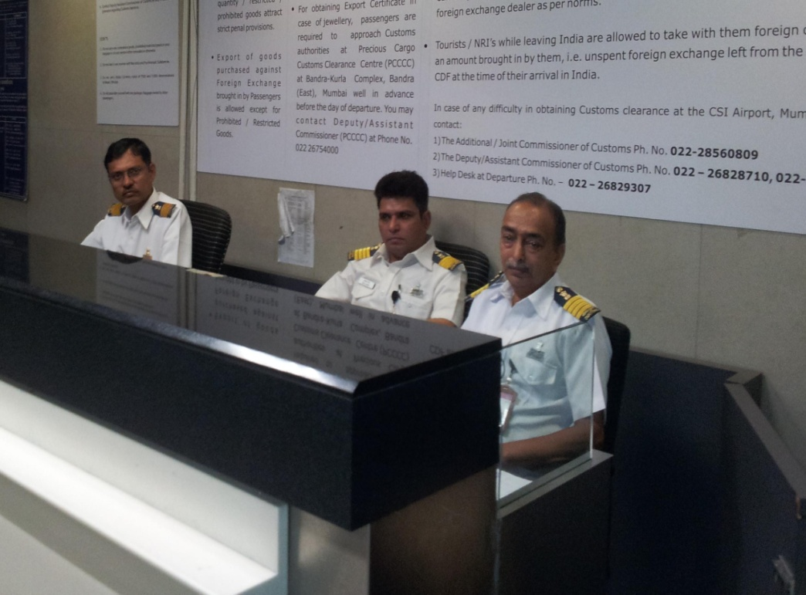
03 hours before scheduled departure.
Immigrations / Customs
Hajis should now proceed for Immigrations / Customs.
Separate queues will be maintained Hajis

Slide 18
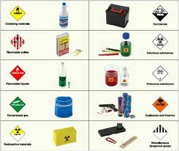
Security restricted items
Match Boxes / Cigarette Lighters
Stoves
Power Banks
Smart Luggage
Cooking Fuel
Kerosene / Coal
Oil / Oily food in large Quantities
Honey / Dry Coconut
Tobacco and Tobacco products
Goods in commercial quantities…..etc.

Slide 19
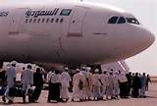
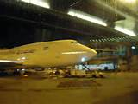
01 hours before scheduled departure.
Boarding commences
During boarding all Hajis should sit according to their seat numbers and follow instructions given by the crew.

Slide 20
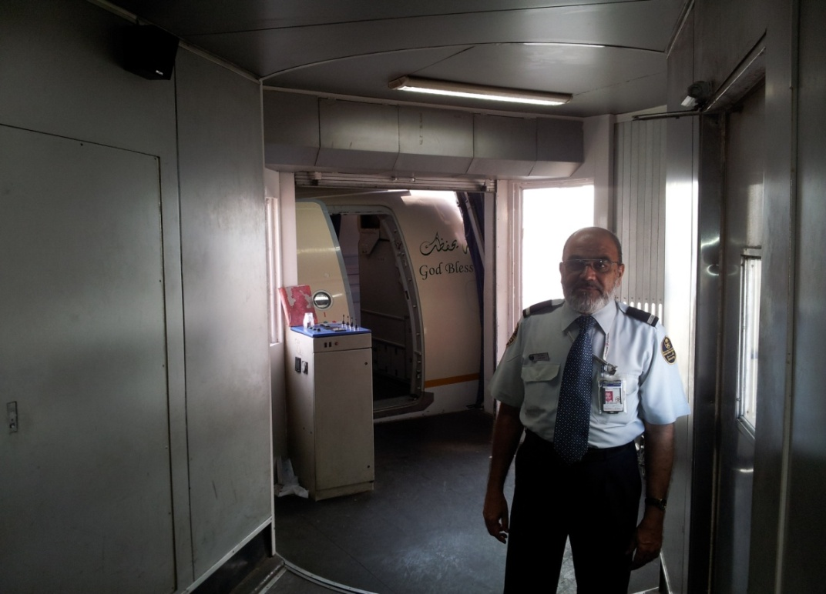
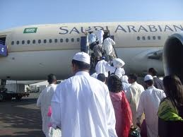
01 hour before scheduled departure.
Boarding commences
Hajis should now proceed for boarding in a single queue and follow instructions given by Airline Staff.
Passports will be re-checked at the terminal building exit.
For boarding at the aircraft door only boarding pass is needed and the same should be kept in hand till seated.

Slide 21
On Board
Customs formalities
Free baggage is only for personal items like clothes shoes etc
Hajis should ensure that High Value purchases are declared to Customs to avoid problems with Indian Customs.
Volunteers are available at all times to guide the Hajis.
Hajis need to be well aware of the customs regulations and should refrain from carrying any undeclared / dutiable goods.
Import of undeclared foreign currency is not allowed.
There is no free duty allowance for Gold / Silver purchased in KSA.
Drones / remote controlled wireless toys are not allowed.
There is no Duty-free Allowance for Infants.
Kindly follow queues to clear customs and avoid crowding.

Slide 22
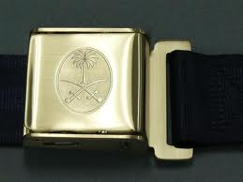
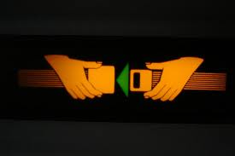
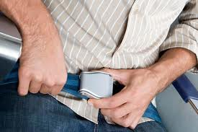
Departure Time
Put on your seat belts
Seat belts need to be kept on during take-off and landing.
سُبْحَانَ الَّذِي سَخَّرَ لَنَا هَذَا وَمَا كُنَّا لَهُ مُقْرِنِينَ . وَإِنَّا إِلَى رَبِّنَا لَمُنْقَلِبُونَ

Slide 23
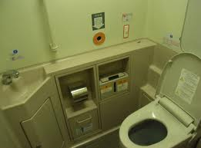

After takeoff
Avoid littering the aircraft.
Passengers using the washrooms are requested not to spill water in the lavatories due to electrical circuits below the toilet floorings.
Smoking is not permitted on any flights

Slide 24
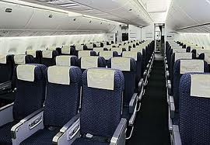
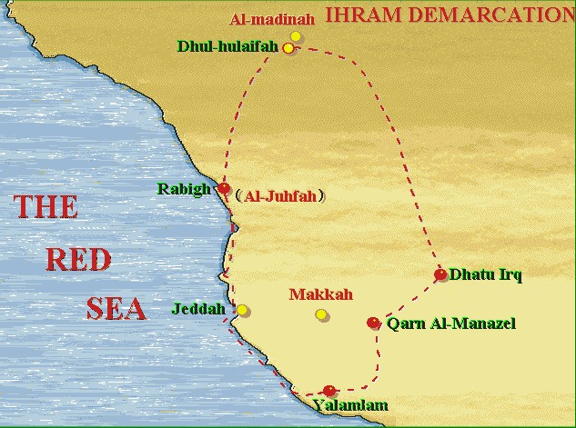
After takeoff
An announcement will be made before the Meeqat (ميقات) arrives.
Meeqat (ميقات) is the geographical boundary that a person intending Hajj or Umra may not cross without assuming Ihram for Haj or Umra.

Slide 25
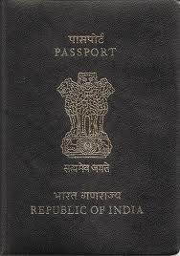
Landing in Kingdom of Saudi Arabia
After landing in Saudi Arabia, the first formality is clearing Arrival Immigrations.
Hajis should line up for Immigrations and present before the Immigration Officer his Passport.
Keep the Boarding pass in hand as the same may be re-checked by immigrations.

Slide 26
Missing baggage
Missing baggage complaint
If the baggage, which was handed over to the airline doesn’t arrive, all passengers are required to write a complaint with the airlines immediately.
The passenger will be given a complaint copy before leaving the airport.
Complaints and enquiries from volunteers / friends / relatives will not be entertained.

Slide 27

Perform Hajj and Ziyarat

Slide 28

Preparing to return to India
Every Haji will be allowed 02 pieces of check-in baggage of 20 kgs each & 01 Hang baggage of 07 kgs ONLY.
Hajis should not carry zamzam, as Zamzam will be provided in India after arrival.
While purchasing anything in Saudi Arabia, Hajis should note that everything purchased will add weight to their baggage allowance
Hajis will NOT be allowed to carry
Zamzam in check-in or Hand baggage.
Zamzam if hidden inside baggage is
removed by Saudi Security Agencies.
HIDING ZAMZAM IN BAGGAGE IS
STRICTLY PROHIBITED BY SAUDI AGENCIES
A cargo counter will be set up next to the baggage acceptance counter, to carry baggage at subsidised rates.
Only 01 handbag of 07kgs will be allowed per Haji and it is to be carried by the Haji himself.
No extra pouches, sling bags, plastic bags will be permitted.
07 kgs only

Slide 29
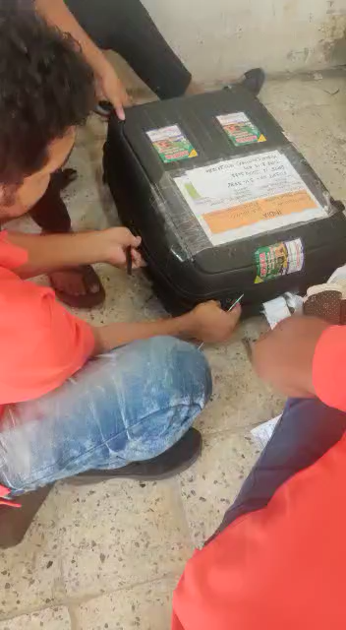
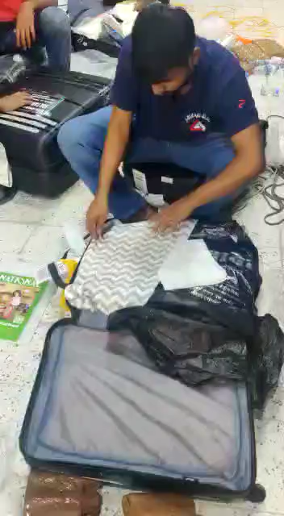
Packing Zam zam in Check in Baggage

Slide 30
18 hours before scheduled departure.
Baggage Handover
Baggage will be accepted by handling agent, below the passengers accommodation / building in the presence of Indian embassy Staff & Airline Officials.
Hajis should check-in their own baggage only & collect a claim tag from the airline for the same.
The Hajis should keep 01 extra pair of clothes in their hand baggage as they will not be able to access their check-in baggage after they are handed over to the authorities.
All boarding passes / baggages of the cover number should be given together.
Once baggage for the cover-number is accepted together, offloading of baggage is not possible.
Part check-in of baggage is not accepted and only 01 Haji from every cover number can do the check-in with all the boarding passes.
As per Saudi Haj Regulations, baggage are required to reach the airport for loading 18 hours before departure
Hand Baggage - Only 01 piece of 07kgs will be allowed per Haji

Slide 31
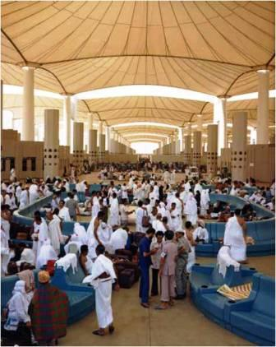
Reaching Jeddah / Madinah Airport
12 hours before scheduled departure. (JED)
06 hours before scheduled departure. (MED)
Hajis will be dropped off at the Airport Terminal by the buses and the Indian Mission Staff will guide the Hajis to the Gate.
Saudia Ground Staff shall be available and shall work in close coordination with Haj Mission Officials for Gate coordination.
Saudia Staff shall ensure that Hajis do not face any problems after security and Major Indian Language speakers shall be available at all times
Hajis will need to follow a queue system for immigrations security and boarding.

Slide 32

On Landing
Security / Immigrations.
Volunteers at Indian Airports will be available to guide the Hajis through Immigrations and Customs.
Hajis should queue at the Zamzam distribution counter to collect the complimentary
05 liters Zamzam for each Haji.

Slide 33
Items permitted in hand baggage
(Max weight 07 kgs per piece / per Haji)
Quran Majeed
Extra Ihram
Extra Slippers
Miswaak
Empty Plastic bottle for water
Musalla (Janamaz)
Book on Ehkame Haj & Duas.
Ball pen
Passport / Currency & Documents.
Tasbeeh
Topi (Cap)
Power banks / Mobile chargers

Slide 34
Important advise
Carrying Drugs to Saudi Arabia lead to death sentence
Advise Do not carry - Valuables like Jewelry Undeclared Foreign Currency Prohibited Goods or Goods in Commercial Quantity
Important Do not carry any Goods for others and ensure packing of all bags are done in presence of passengers so that
passengers can explain to authorities the contents.

Slide 35
Phase 1 - 48 hours before departure.
Change in regulations due to Covid19
Haj requirements may change due to Corona and new variants. The same shall be communicated later, if any.
Saudi Arabia may insist for 02 doses of vaccine.

Slide 36
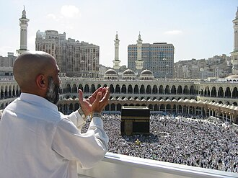
Kindly keep all of us in your duas.
Haj Mubarak

