Slide 1
CISC 3060
Introduction to Robotics
Sensor Subsystem
.

Slide 2
What is a sensor
A sensor is a device that the robot can query to measure something about itself or its environment.
Sensing is key for any but the simplest behaviors!

Slide 3
Sensors
Sensors in Animals
Proprioceptive sensing
Temperature, blood pressure, muscle contraction, chemical concentrations, etc.
Exterioceptive sensing
Touch, sound intensity & pitch, light intensity, color, near-body motion (fish), magnetic field (birds)
We use the same taxonomy in robotics!

Slide 4
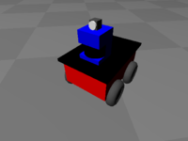
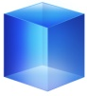

Some common robot sensors
}
Internal sensing (proprioceptive)
Wheel rotation (odometer)
Gyroscope
Accelerometer
Compass and inclinometer
External sensing (exterioceptive)
Bump sensors
IR sensors
Ultrasound sensors
Laser Ranging
Video camera
GPS
State of the robot itself
}
State of the external
environment

Slide 5
A Second Classification
Active Sensors
Ultrasound
Infra Red
Radar
Structured light (eg Microsoft Kinect)
Passive Sensors
Camera
Bump or limit sensors
Gyroscope

Slide 6
A Third Classification
Contact Sensors
Limit or bumper switch
Tactile sensor
Noncontact Sensor
Camera
Radar

Slide 7
A Fourth Classification
Analog Sensors
Potentiometer
Analog camera
Force sensor
Digital Sensor
Bump sensor
Limit sensor
Digital Camera
V
Angle
V
Open
Closed
Time

Slide 8
In Summary
A Sensor is either:
Properioceptive or Exterioceptive
Passive or Active
Contact or Noncontact
Digital or Analog

Slide 9
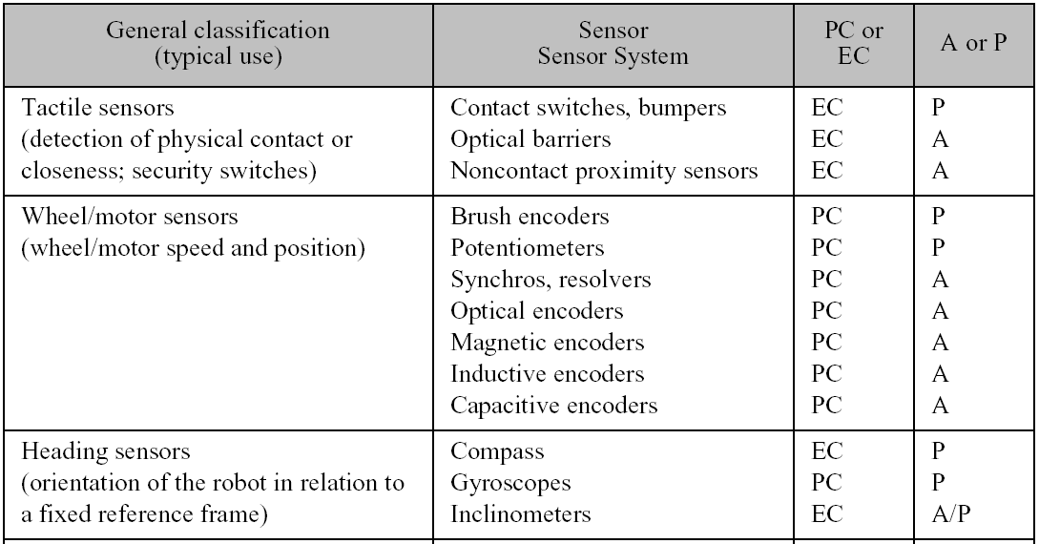
General Classification (1)

Slide 10
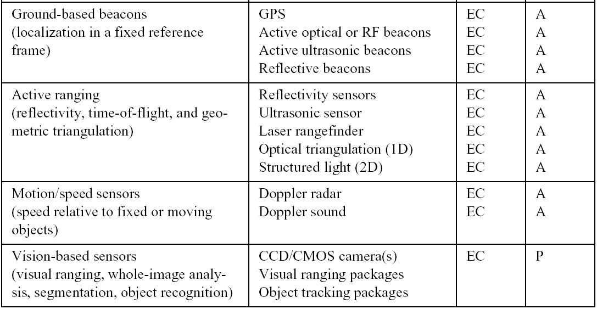
General Classification (2)

Slide 11
Real Sensors
Produce noisy output signals
Return an incomplete description
Cannot be modeled completely

Slide 12
Bump Sensors
These are ‘tactile’ or touch sensors
Typically exterioceptive, passive, contact, digital sensors.
Used to determine if the robot is in contact with the environment
Most typically a switch:
Open when there is no contact
Closed where there is contact

Slide 13
Sensing of Motor Movement
Robot actuator – typically a rotary motor
Sense how much it has ‘turned’
Why? After all when you activate the motor – won’t it move as you tell it, so if you calculate by Dead Reckoning won’t you know where the robot is?
NO! Why?
It can Slip, Stall, Race, Saturate, ……
(and animal ‘muscles’ have similar issues, which is why animals have muscle sensors…)

Slide 14
Sensing of Wheel Rotation
Two Methods:
Resolver, Tachometer – measure velocity
Potentiometer or encoder – measure position
Wheel
Resolver
or
Encoder
Axle
Motor
Encoder is far more common - used on printers,
scanners, and other peripherals as well as robots.
Absolute Encoder: Gives a Degree reading
Incremental Encoder: Rotation relative to a start
Differential Encoder: Two readings, better accuracy

Slide 15
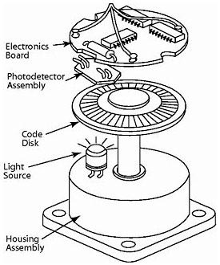

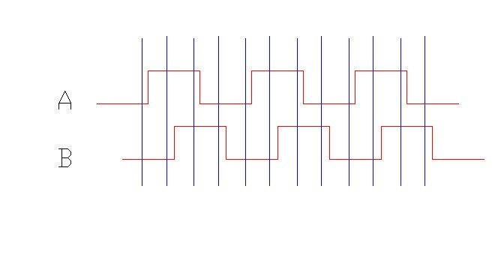
Encoder: Digital Rotation sensor
Differential digital encoder signals

Slide 16
Odometry
The use of the wheel motion information to determine the location of the robot:
Wheel encoders can be used to measure v and w and estimate where the robot is (more later….)
BUT – what about wheel slip, wheel stall when robot is against obstacle, etc?
Use Compass and Gyroscope sensors to back up Odometry!

Slide 17
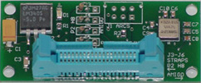
Gyroscope
Principle: The momentum of a spinning flywheel will ‘resist’ a change in orientation
Optical Gyro: Uses optical cavity and two lasers – no moving parts

Slide 18
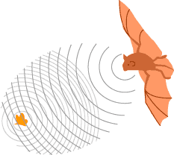
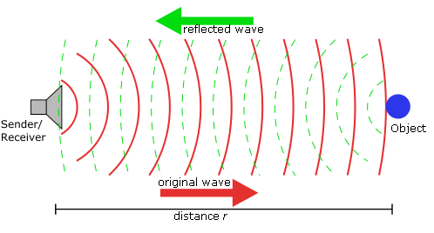
Sonars
Sonar: SOund Navigation And Ranging
Sonar is a method of finding the distance to an object by measuring the time it
takes for a pulse of sound (usually ultrasound) to make the round trip back to the
transmitter after bouncing off the object (Time of Flight Measurement - TOF).
At sea level, in air, sound travels at about 344 metres per second (1130 feet per
second). In practical terms this means 2.5 cm is covered in about 74 microseconds.

Slide 19
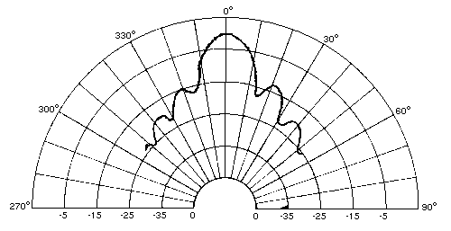
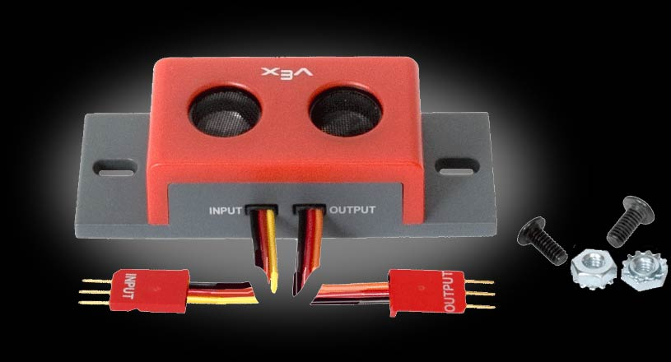
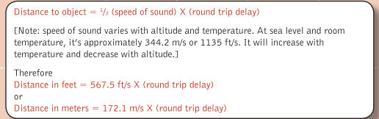
Sonar Beam and Arrays
VEX Sonars are pulsed
typically emit at frequency 40kHz
Range: 3cm to 3m
Example of Sonar:
Transducer cone aperture
of main lobe Is 15º for
Pioneer AT3 Sonar

Slide 20
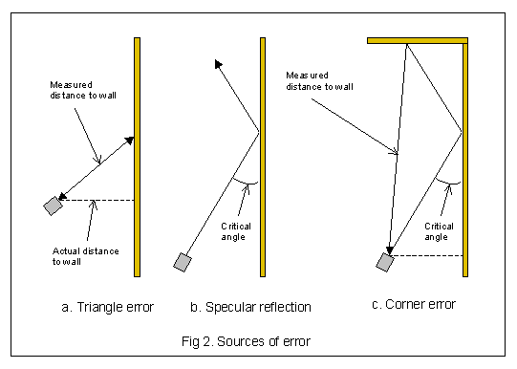
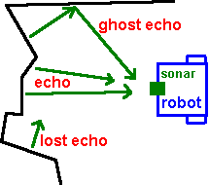
Sonar Issues
Sonar works best when the sensor is parallel to the target.

Slide 21
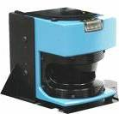
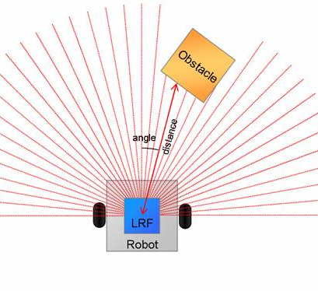
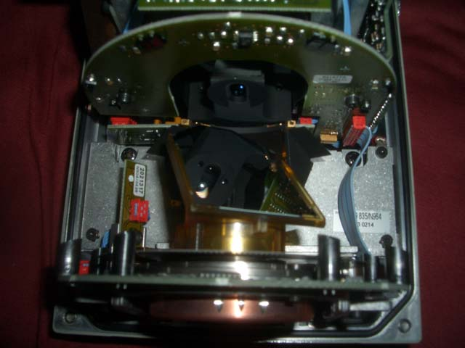
Laser Ranging
Laser is scanned in plane, reflections are used to
estimate depth
Sick LM 200
Laser rangefinder
laser
Rotating mirror
motor
Distance is estimated using a
Time-of-flight approach
Range 80m, resolution 10mm
Angular resolution 1º
encoder

Slide 22


Vision
Vision is a passive approach to sensing
In theory, provides a lot of information about the environment
In practice, can be difficult to interpret
Digital camera
Produces images of size
640 x 480 x 3 bytes
at video frame rate
1/3” Sony CCD Camera
(analog camera)
Video Frame
Grabber

Slide 23
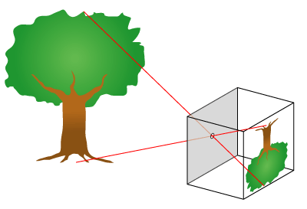
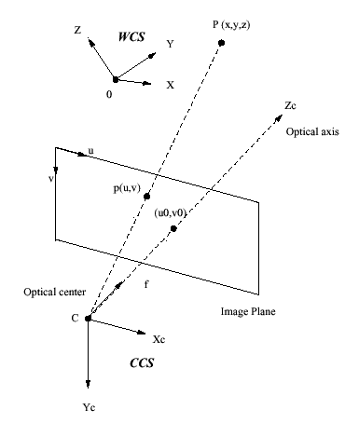
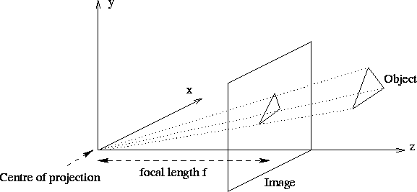
Pinhole Camera Model

Slide 24
Issues With Vision
Each point on the image (u,v) corresponds to a point in the scene (x,y,z)
But that requires mapping 2D to 3D .. which is an underconstrained mapping.
Lighting changes dramatically alter an image (but are not changes in the elements of the scene)
Objects may be occluded, hard to recognise, hard to separate from other objects, etc.

