Slide 1
Color Classifier
by Adil Naqvi & Karishma Ali

Slide 2
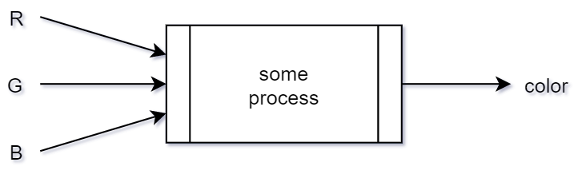
The Problem
Around 16 million colors in RGB space
Difficult to classify each RGB value manually
Need of a classifier

Slide 3
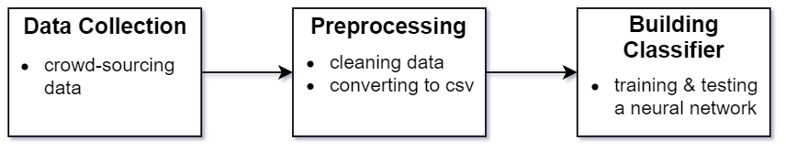
The Solution
3 steps

Slide 4
Data Collection
Crowd-sourcing data
RGB value + color label
Github (hosting) + Firebase (database)
sahnbk.github.com
5000+ responses
LiEr39Fasd951e3: {r:79, g: 238, b:82, label: “green-ish”}

Slide 5
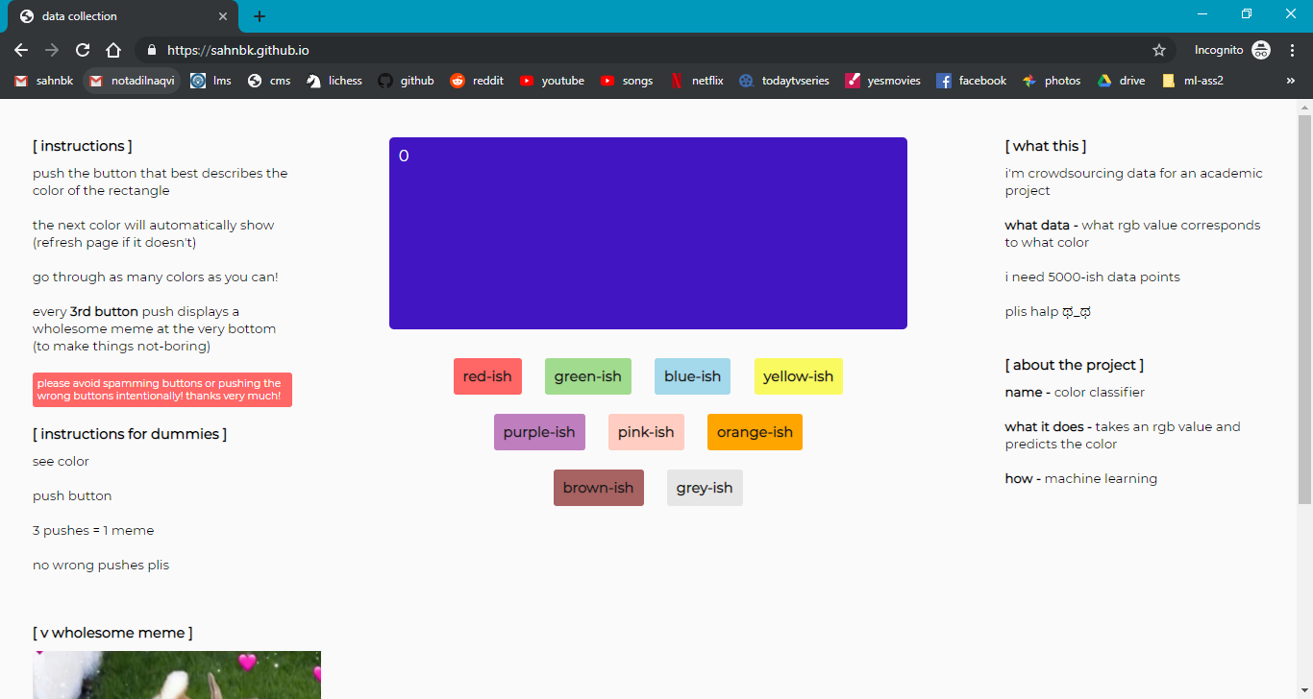

Slide 6
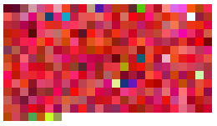
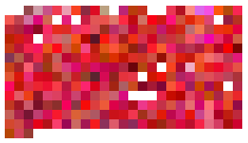
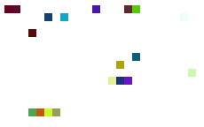
Preprocessing
Cleaning (done manually)
Approx. 4800 entries after cleaning
Converted to .csv file
(unclean red-ish entries)
(clean red-ish entries)
(incorrect red-ish entries)

Slide 7
Building a classifier
Neural network classifier

Slide 8
Results

