Slide 1
Color Classifier
by Adil Naqvi & Karishma Ali

Slide 2
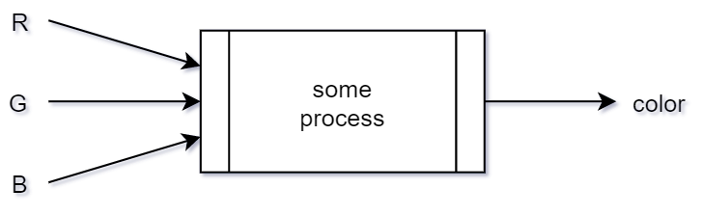
The Problem
Around 16 million colors in RGB space
Difficult to classify each RGB value manually
Need of a classifier

Slide 3
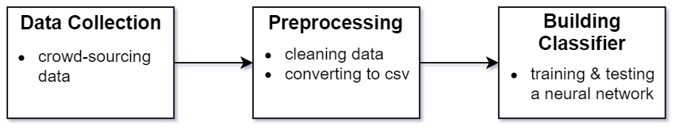
The Solution
3 steps

Slide 4
Data Collection
Crowd-sourcing data
RGB value + color label
GitHub (hosting) + Firebase (database)
sahnbk.github.com
5000+ entries
3 features
9 classes
Format of one data entry:
{r:79, g: 238, b:82, label: “green-ish”}

Slide 5
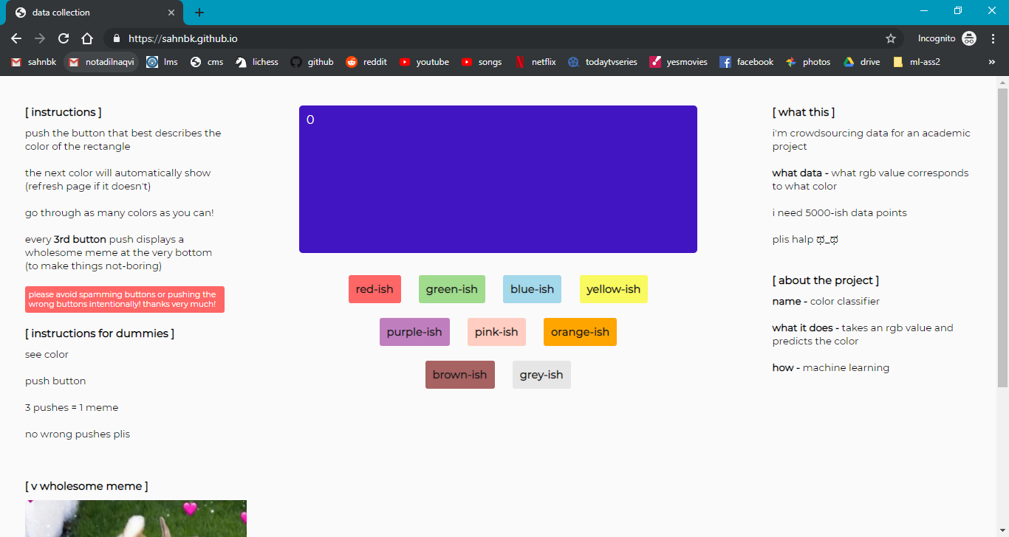

Slide 6
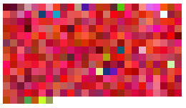
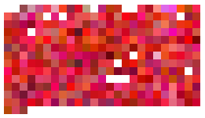
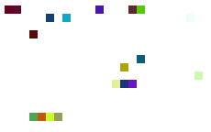
Preprocessing
Cleaning (done manually)
Approx. 4800 entries after cleaning
Converted to .csv file
(unclean red-ish entries)
(clean red-ish entries)
(incorrect red-ish entries)

Slide 7
Building a classifier
Neural network classifier (sklearn)
1 input layer (3 nodes)
1 hidden layer (6* nodes)
1 output nodes (9 nodes)
Learning rate = 0.01
Activation = sigmoid func.
*Jeff Heaton, Introduction to Neural Network in Java
*https://stats.stackexchange.com/questions/181/how-to-choose-the-number-of-hidden-layers-and-nodes-in-a-feedforward-neural-netw

Slide 8
Results
Efficiency measures
Accuracy (83.1%)
F1 scores
blue-ish = 0.88
brown-ish = 0.74
green-ish = 0.93
grey-ish = 0.68
orange-ish = 0.71
pink-ish = 0.75
purple-ish = 0.86
red-ish = 0.82
yellow-ish = 0.80

