Slide 1
Dictionary using Treaps
Adil Naqvi
Abdul Wasay Ikhlaq
Waleed Bin Khalid

Slide 2
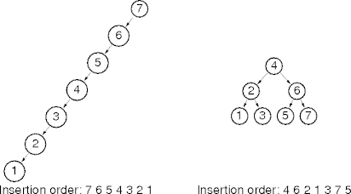
Problem with BSTs
Sorted insertion increases space complexity
Depth becomes linear instead of logarithmic
Can be highly unbalanced
Possible solutions
  Shuffle data
  (not always practical/applicable)
  Rebalance tree after every operation
  (expensive, complicates operations)
  Use treaps

Slide 3
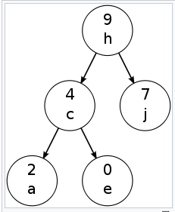
What is a treap?
Tree + Heap = Treap
NODE
Key | Priority
priority
key
Key Tree (BST)
Priority Heap (max)

Slide 4
Key & priority
Key
  User data
  Should be comparable
  Can be string, integer, vector etc.
  BST implementation for efficient traversals
Priority
  Should be an integer value
  Assigned to keys randomly
  Max/min heap for balanced tree structure
priority
key

Slide 5
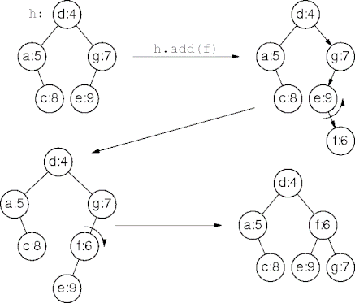
Insertion & search
Insertion
  Insert node following BST properties
  If heap order is violated, perform rotations
Search
  Same as in a BST

Slide 6
Dictionary using treaps
Requirements
  Should have insertion & search options
  Should display meaning(s) of searched words
  Should have a sizeable database
  Should be implemented using treaps

Slide 7
Approach
Understanding & implementing treaps in C++
  source code from Sanfoundry^{[1]}
  modifying code to work with strings
  worked around insertion collisions
Finding and preparing dictionary database
  data (word/class/meaning) in .csv format from Bragitoff^{[2]}
  converted into .txt file with appropriate delimiters
Linking database with our code
  used <fstream> to operate on files

Slide 8
Approach
Insertion
  get new line from .txt file as string
  separate word, class, meaning using split function^{[3]} and store as vector string (key)
  insert vector string in treap
  upon collision, add colliding key to the existing key
Searching & displaying
  take user input and call treap find function
  if a match is found, display the vector string

Slide 9
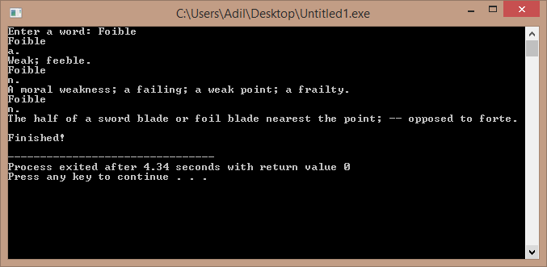
Results
Has insert & search options
50,000+ words

Slide 10
Thank you!
[1] https://www.sanfoundry.com/cpp-program-implement-treap/
[2] https://www.bragitoff.com/2016/03/english-dictionary-in-csv-format/
[3] https://stackoverflow.com/questions/14265581/parse-split-a-string-in-c-using-string-delimiter-standard-c
[4] http://faculty.cs.niu.edu/~freedman/340/340notes/340treap.htm
[5] http://bluehawk.monmouth.edu/rclayton/web-pages/s10-305-503/treaps.html

