Slide 1
Glass Classification
Adil Naqvi and Umar Rehman

Slide 2
Agenda
The Problem
Dataset
KNN
SVM
NN
Comparisons

Slide 3
The Problem
Identify types of glasses using their composition
Used in forensics and criminology

Slide 4
Dataset
Features | 9
Classes | 6
Size | 214
Format | All numeric
Source | archive.ics.uci.edu

Slide 5
Dataset(Continued)
Features
Refractive index
Na
Mg
Al
Si
K
Ca
Ba
Fe
Class | Examples
1building_windows_float_processed | 70
2building_windows_non_float_processed | 76
3vehicle_windows_float_processed | 17
5containers | 13
6tableware | 9
7Headlamps | 29

Slide 6
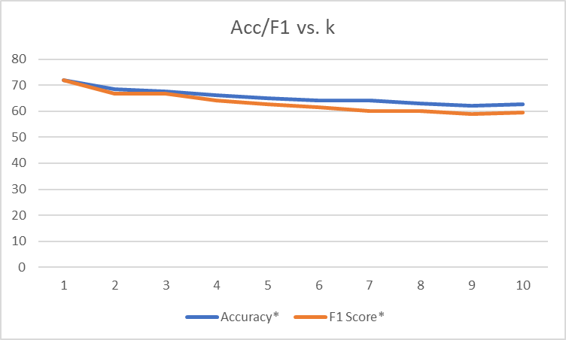
KNN
k | Accuracy* | F1 Score*
1 | 72 | 71.8
2 | 68.4 | 66.8
3 | 67.5 | 66.7
4 | 66.1 | 64.2
5 | 64.9 | 62.7
6 | 64.2 | 61.6
7 | 64.2 | 60
8 | 62.9 | 60
9 | 62.1 | 59
10 | 62.8 | 59.6
*averaged over 100 values

Slide 7
KNN
Advantages
Disadvantage
Easy to apply
Slow (lazy)
Another disadvantage of this approach is that the algorithm does not learn anything from the training data, which can result in the algorithm not generalizing well and also not being robust to noisy data
Needs greater data for higher accuracy
Selecting K uses additional computation

Slide 8
NN
1 hidden layer with 20 neurons was trained
Sigmoid Activation function was used
Learning rate= 0.025
Accuracy=81.3%
F1=80.8

Slide 9
NN
Advantages
Disadvantages
very good feature extractors
Usually very accurate
computationally expensive

Slide 10
SVM
 | original_data |  |  |  | 3_classes_dropped
 | avg acc | avg f1 | max acc | max f1 | avg acc | avg f1 | max acc | max f1
linear | 63.5 | 60.9 | 74.4 | 72 | 72.3 | 72.2 | 88.6 | 88.6
poly2 | 67.7 | 65.1 | 79.1 | 76 | 75.4 | 75.3 | 88.6 | 88.5
poly3 | 66.3 | 65.2 | 79.1 | 76.5 | 74.7 | 74.4 | 85.3 | 84.6
rbf | 69.6 | 67.8 | 81.4 | 76.9 | 79.3 | 78.7 | 91.4 | 91.5
sigmoid | 34.9 | 34.9 | 19 | 19 | 42.9 | 42.9 | 25.7 | 25.7

Slide 11
SVM
Acc and f1 was low due to less number of examples of 3 of 7 classes
Said classes made up only 18% of total data
Not enough for proper training
Removing these 3 classes from data improves acc and f1
Chose rbf kernel due to high acc, f1
Accuracy=81.3%
F1=76.8

Slide 12
SVM
Advantages
Disadvantages
Works well on problems in high dimensions and that are not linearly separable.
Can avoid overfit
On perceptual tasks (vision, speech and so on), they are massively outclassed by deep neural networks

Slide 13
Comparison
Classifier | Accuracy | F1 Score | Run Time
KNN | ~75% | ~0.75 | <2 s
SVM | ~79% | ~0.79 | <2 s
NN | ~81% | ~0.80 | <2 s

Slide 14
Thank you!

