Slide 1
Traveling Salesman Problem using Genetic Algorithm
with Mutation and Crossover
by Adil Naqvi

Slide 2
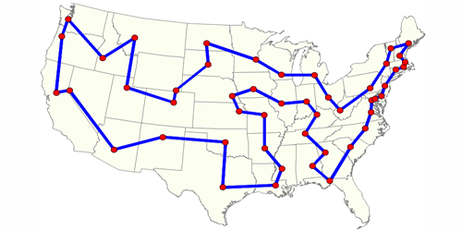
1. Traveling Salesman Problem
Randomized/predefined city locations
Visit every city
Shortest route

Slide 3
1a. Traditional TSP properties
Symmetric
Cannot visit same city more than once
Do not have to return to starting city
n! possibilities for n cities

Slide 4
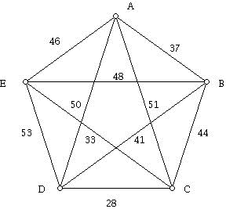
1b. Real world applications
Airline companies
Parcel companies (UPS)
Soldering, drilling
Traversing graphs (CS)

Slide 5
1c. Computing algorithms
Exact algorithms
Provide optimal solution
Brute force method
Held-Karp algorithm…
Approximate algorithms
5% away from optimal solution
Genetic algorithm
Christophides algorithm…

Slide 6
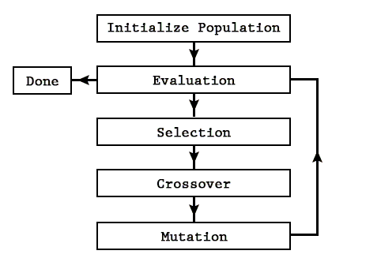
2. Genetic Algorithm

Slide 7
2a. GA terms
Generation
Population
Creature
Genes
Fitness & fitness function
Selection
Cross-over
Mutation

Slide 8
3. TSP using GA
Set of generations
Population
Creature
(Route)
Gene
(City)
Generation 5
Generation 4
Generation 3
Generation 4
Generation 2
Generation 1
Route 1
Route 2
Route 3
City B
City C
City D
City A
City C
City …
Route 4
B D A C ...
Route 5
Distance = 20 units
Fitness = 1/Distance = 0.05
(or)
Fitness = 1/Distance² = 0.0025
Route …

Slide 9
3. TSP using GA
Fitness function
fitness = 1/distance (or)
fitness = 1/distance² (or)
fitness = …
Selection
Roulette wheel selection (or)
Elitism…
Cross-over
Partially mapped cross-over (PMX) (or)
Order cross-over (OX)…
Mutation

Slide 10
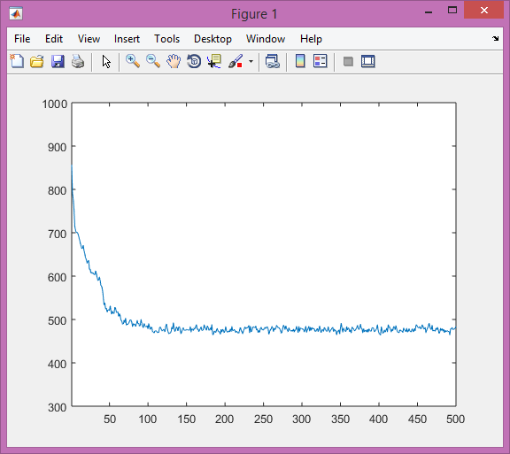
4. Results
(Mean route distance)
Min: 782.695
Max: 1167.9545
After 500 generations...
Min: 406.9916
Max: 563.7564
No. of cities: 20
No. of possible routes: 2,432,902,008,176,640,000
Pop size: 100
No. of generations: 500
Running time: 30.661 s
(rng seed: 999)

Slide 11
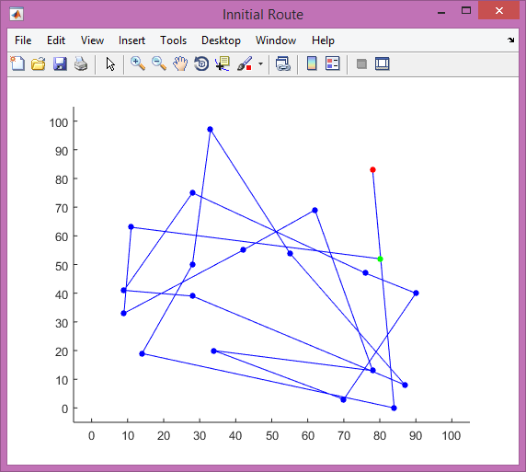
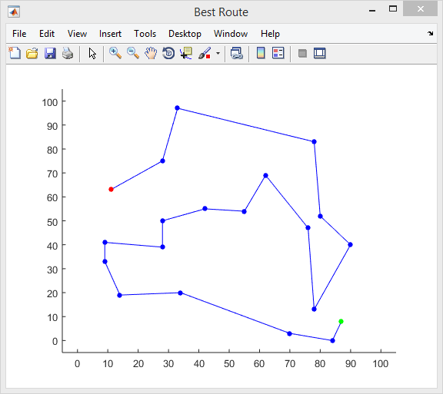
4. Results

Slide 12
Thank you!

