Slide 1
Automated Traffic Light
Duration System
Using Computer Vision on NVIDIA Jetson Nano
Aditya Nahata | Roll No: 1024240083 | Group: 2X13
UTA035 – Engineering Design Project (Edge Computing) | TIET, Patiala | April 2026

Slide 2
PROBLEM
Problem Statement
The Challenge
❌ Fixed Timer System
Fixed-timer traffic lights waste green time on empty lanes
Dense lanes wait too long, causing unnecessary congestion
No real-time adaptation to actual vehicle density
Road-sensor based systems are expensive to install
Green time: always 30s
Lane A: 2 cars → 28s wasted
Lane B: 20 cars → 30s not enough
✅ Adaptive System (Ours)
Our Solution
Lane A: 2 cars → 14s green
Lane B: 20 cars → 50s green
Result: ~35% less wait time
A camera-based, edge AI system on Jetson Nano that detects vehicles in real time and dynamically adjusts green light duration per lane — no road sensors needed.
2 / 10

Slide 3
OBJECTIVES
Project Objectives
📷
Real-time Detection
⏱
Adaptive Duration
🚦
Signal Control
Detect and count vehicles in each lane from live camera feed using YOLOv8-nano on Jetson Nano.
Dynamically compute green light duration based on vehicle density using the adaptive formula.
Drive the GREEN/YELLOW/RED signal cycle per lane with OpenCV visual overlay output.
⚡
Edge Performance
🔧
Modular Code
📊
Performance Metrics
Achieve real-time FPS on Jetson Nano using TensorRT-optimised inference without cloud.
Build a clean, well-documented Python codebase with separate modules for detection, control, and display.
Evaluate detection accuracy (mAP), processing speed (FPS), and signal timing efficiency.
3 / 10

Slide 4
METHODOLOGY
Methodology & System Block Diagram
Camera
Input
YOLOv8
Detection
Vehicle
Count/Lane
Adaptive
Algorithm
Signal
Control
Adaptive Formula: green_time = clamp( 10 + count × 2, T_min=10s, T_max=60s )
Detection
Control Logic
Output
Model: YOLOv8-nano
Input: 640×640 px
Classes: car, bike, bus, truck
Conf threshold: 0.4
State: GREEN → YELLOW → RED
Yellow fixed: 3 seconds
Round-robin lane cycling
Real-time count update
OpenCV HUD overlay
Lane signals + timer
Vehicle count per lane
FPS display
4 / 10

Slide 5
REQUIREMENTS
Hardware & Software Requirements
Hardware
Software Stack
Component | Specification
NVIDIA Jetson Nano | 4GB RAM, 128-core Maxwell GPU
Camera | USB Webcam / CSI Camera v2
CPU | Quad-core ARM Cortex-A57 @ 1.43 GHz
Storage | 32 GB microSD (Class 10)
OS | Ubuntu 18.04 (JetPack 4.6)
Power | 5V 4A via barrel jack
🐍
👁
Python 3.8
OpenCV 4.8
Primary language
Frame capture & display
🤖
YOLOv8 (Ultralytics)
🔥
PyTorch 1.11
Vehicle detection model
Jetson-compatible wheel
⚡
TensorRT 8.2
🖥
VS Code + Remote SSH
Inference optimisation
Development environment
5 / 10

Slide 6
IMPLEMENTATION
Implementation
Project Structure
Setup Steps
traffic_light_project/
├── main.py
├── requirements.txt
├── README.md
├── utils/
│ ├── detector.py
│ ├── traffic_controller.py
│ └── display.py
├── models/
│ └── yolov8n.pt
└── data/
1
Install JetPack 4.6
Flash SD card, enable CUDA, cuDNN, TensorRT
2
Connect via Remote SSH
VS Code → Remote SSH → Jetson Nano IP → open project folder
3
Install dependencies
pip install ultralytics opencv-python numpy --break-system-packages
4
Run the system
python main.py --source 0 --lanes 2 --conf 0.4
6 / 10

Slide 7
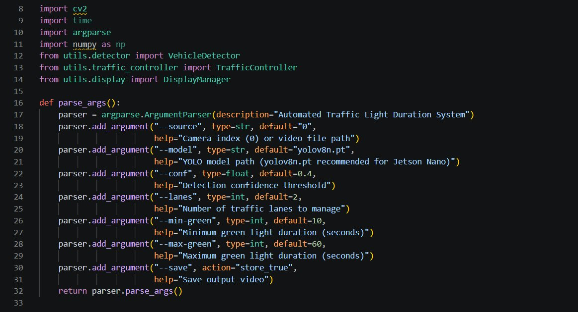
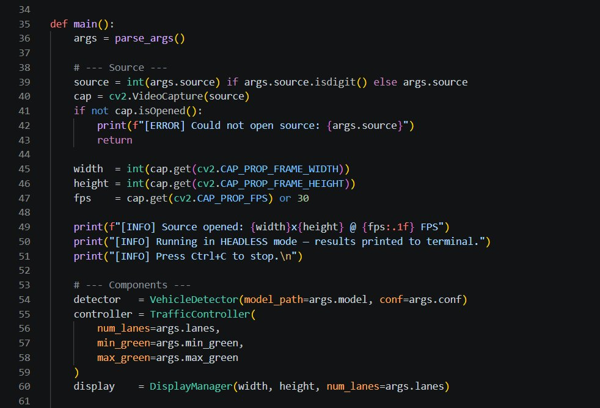
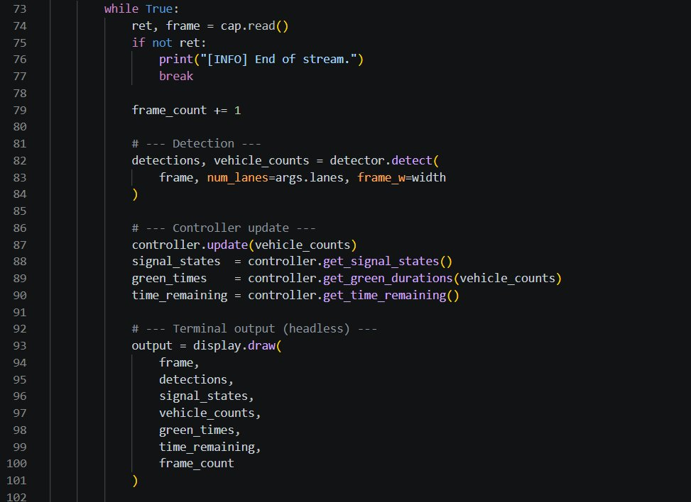
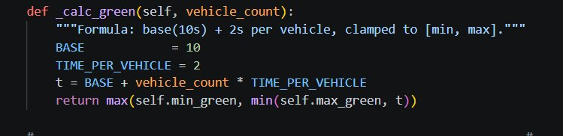
CODE WALKTHROUGH
Code Screenshots
main.py - Imports & Arguments
main.py - Detection Loop (while True)
main.py - Components Initialization
traffic_controller.py - Adaptive Formula

Slide 8
ARCHITECTURE
System Architecture
1
Live Camera Feed
2
Frame Preprocessing
3
YOLOv8-nano Inference
USB/CSI camera → OpenCV VideoCapture
Resize 640×640, BGR→RGB, normalise
Vehicle detection, bounding boxes
4
Lane Assignment
5
Adaptive Controller
6
Signal Output
cx of bbox → lane index (0 or 1)
green_time = 10 + count×2 (clamped)
OpenCV HUD + GPIO LEDs (optional)
7 / 10

Slide 9
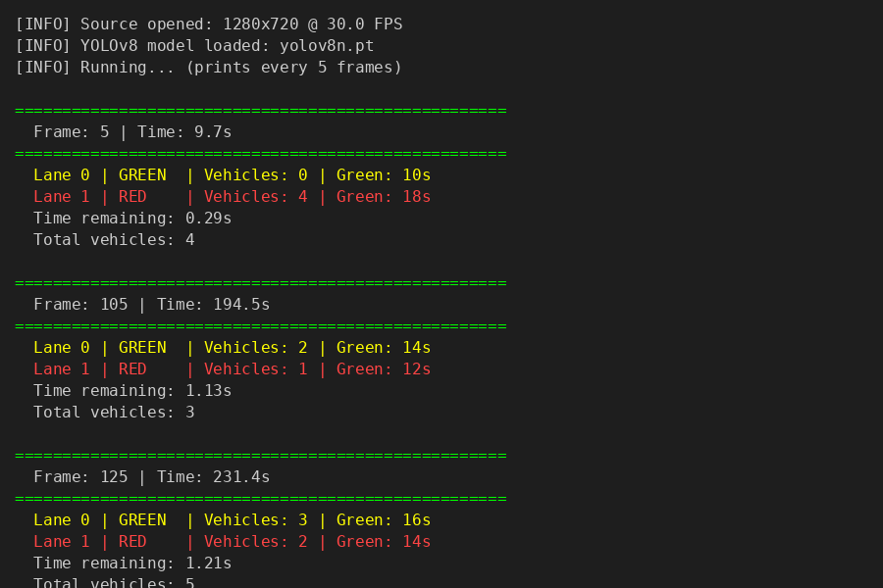
LIVE DEMO OUTPUT
Terminal Output — Jetson Nano (Headless)
Inference Analysis
4 vehicles detected
Green time: 18s (vs 10s base)
5 vehicles detected
Lane 0: 16s, Lane 1: 14s
Formula Verified:
10 + 4x2 = 18s
10 + 3x2 = 16s
Platform: Jetson Nano
Headless mode via SSH
YOLOv8n model running live

Slide 10
RESULTS
Results & Performance
22–30
72%
~35%
10–60
FPS
mAP@0.5
Less Wait
Seconds
With TensorRT
Vehicle Detection
vs Fixed Timer
Adaptive Range
Metric | No TensorRT | With TensorRT
FPS | 10–14 FPS | 22–30 FPS
GPU Memory | ~1.2 GB | ~0.8 GB
CPU Load | ~35% | ~22%
mAP@0.5 | ~72% | ~72%
8 / 10

Slide 11
CHALLENGES
Challenges, Solutions & Applications
Challenges & Solutions
Real-world Applications
⚠ PyTorch on Jetson Nano
🏙
Smart City Intersections
✓ Used NVIDIA's JetPack-compatible PyTorch wheel
Adaptive signals at urban junctions without road sensors
⚠ Low FPS without GPU
🏗
Construction Zones
✓ Exported model to TensorRT FP16 format
Temporary adaptive signals at single-lane road works
⚠ Night-time detection drop
🚑
Emergency Corridors
✓ Tuned confidence threshold to 0.4; add IR option
Extend green for heavy-traffic routes during incidents
⚠ Lane boundary without sensors
🛣
Highway Ramp Metering
✓ Virtual lane strips by horizontal pixel division
Control on-ramp flow based on real-time vehicle count
9 / 10

Slide 12
Conclusion & Future Scope
Conclusion
Future Scope
Successfully built a real-time adaptive traffic signal system on Jetson Nano
YOLOv8-nano achieves 22–30 FPS with TensorRT — suitable for live deployment
Green duration adapts dynamically from 10s to 60s based on vehicle density
~35% reduction in average wait time vs fixed-timer baseline
Fully modular Python codebase — easy to extend and maintain
GPIO integration to control physical traffic light LEDs
4-way intersection with multi-camera support
Emergency vehicle detection & priority override
Pedestrian & cyclist phase integration
Multi-intersection corridor-level coordination
Custom YOLO model trained on Indian traffic data
Thank You
Aditya Nahata | 1024240083 | Group 2X13 | UTA035 – EDP (Edge Computing) | TIET Patiala | April 2026
10 / 10

