Slide 1
Retrain or teach?
LAB MEETING
How AI learns after it's built. Does the language matter?
Part 1 It already knows more than it says
Part 2 It needs knowledge it never had
Notes:
Two situations today. Part one: the model already has the knowledge, it just doesn't say it, and we can fix that without any training. Part two: the model needs knowledge it never had, this year's news, and then we do have to train. The question is how, and whether it matters which language we train in.

Slide 2
The model often knows the answer. It just doesn't say it.
PART 1 · THE INSIGHT
+12
Even a fact seen once leaves a trace
the information is in there, weakly
+8
+5
But it gets drowned out on the way to the output
+2
higher layers mix it with everything else: vague, not wrong
+1
once
a few
dozens
~100
200+
how often the model has seen a fact → how well it answers
If the knowledge is there, we don't need to train. We need to help it out.
Notes:
How well a model answers a fact depends on how often it has seen it. The curve rises steeply with repetition, but even a fact seen once leaves a small, real trace. For rare facts the information is in there, weakly, and it gets drowned out by higher-level computation on the way to the output. If the knowledge is already there, we don't need training. We need to help it out. (Bar heights sketch the log-linear trend; exact numbers in the papers.)

Slide 3
Steer it: one addition. No training.
PART 1 · THE METHOD
everything else
v
MLP, layer 8
+ v
medical
inside one layer, each dot a sentence: the domains are separable
one vector addition · versus billions of tokens of training
Compute the “medical” direction once, add it at inference. The model says what it already knew.
Notes:
Look inside one layer, each dot is a sentence, and medical sentences sit in their own cluster. Compute the direction from everything-else to medical, once. At inference, add that vector to the activations at one layer. One addition per forward pass, no training, nothing forgotten.

Slide 4
Where you nudge matters. Facts live in the MLPs.
PART 1 · THE RESULT
+45%
FACTS · MEDICAL, LAW
MLP wins, in 3 of 3 models
+29%
+21%
BEHAVIOUR · TONE
attention wins, MLP can even hurt
residual stream
the usual spot
attention
MLP
Cheap and nothing forgotten. But it can only surface what the model has already read.
Notes:
Where you add the vector matters. Nudging the MLP layers improves factual recall by 45%, more than double the residual stream where everyone usually steers. It flips for behaviour: for tone, attention wins. So facts live in the MLPs. But steering can only surface what the model has already read. It cannot tell the model who won an election last year. For that, part two.

Slide 5
Yesterday's news isn't in there. Now it has to read.
PART 2 · NEW KNOWLEDGE
RETRAIN FROM SCRATCH
+8
trillions
of tokens, millions of dollars, every few months
+5
+4.5
CONTINUED PRETRAINING
+2
~6 billion
+1
0
tokens of fresh news, same recipe, a few days
news
random web text
new facts learned, three quizzes, eight models
It works: news teaches 2–4× more than web text. So what happens inside when we do this?
Notes:
Sometimes the knowledge genuinely isn't in there: everything after the cutoff. Retraining from scratch is trillions of tokens and millions of dollars. The alternative is continued pretraining on about six billion tokens of fresh news. In NewsCPT, news beat random web text by two to four times on every model and quiz. So it works. What happens inside when we do this?

Slide 6
Trained on English news. Asked in German. Does it know?
PART 2 · FIRST QUESTION
reads news in
same fact asked in
EN
EN
plain LLM
DE
DE
no reasoning
FR
FR
Same facts, three languages, every combination. What's your guess?
Notes:
Plain model, no chain-of-thought. It reads the news in English only. I ask about the same event in German or French. Does it keep the answer? We updated models on English, German or French news, then asked the exact same facts, about fifteen thousand, translated, in all three languages. Who thinks it transfers?

Slide 7
Knowledge mostly doesn't speak a language. ~70% carries over.
THE ANSWER
~70%
learned in English
100% = as good as asking in English
Learn it once, use it in the other two. Asking in the language it read is still a bit better.
Notes:
Yes, mostly. About 70% of the accuracy gain survives when you ask in another language, between 57 and 88% depending on direction. French to English travels better than English to French.

Slide 8
The same curve as part 1. And the repeated facts are the ones that travel.
THE DRIVER
+12
+9
asked in the training language
asked in the other two
+2
+2
mentioned a few times
mentioned 200+ times
What the news repeats, the model learns, in every language. Which newspaper matters more than which language.
Notes:
Facts mentioned a few times gain about two points; facts mentioned 200 or more times gain 10 to 14 points in the training language and 8 to 11 in the others. Each model learns its own newspaper's events best: what it read matters about twice as much as which language you ask in.

Slide 9
Old facts stay. Old skills quietly go.
THE COST
FACTS FROM BEFORE 2023
GENERAL SKILLS · 20 TESTS
+0.3
−1.2
nothing forgotten
after French-only news
+0.3 if you only test in French
Forgetting, in a new disguise. You only see it if you test beyond the training language.
Notes:
Old facts from before 2023: kept, slightly up. General skills on twenty tests in three languages: they slip. French-only loses 1.2, German 1.3, English 0.5. Test the French model only in French and it looks fine. Catastrophic forgetting in a new disguise, and the multilingual lens makes it visible.

Slide 10
Mixing helps. But can we do better without training at all?
THE OBVIOUS FIX
new facts learned
skills lost
+5.0
+3.4
+3.3
−0.3
+2.6
−0.5
Mix
EN
−1.3
−1.2
DE
FR
EN
DE
FR
Mix
Your intuition is right: mix all three. More facts, less damage.
Notes:
The obvious fix: mix all three newspapers. A balanced mix learns more facts than any single language, plus 5 points, and loses only 0.3. But can we do better, without training anything new?

Slide 11
Three models, one average. All the facts, none of the damage.
THE TRICK
★
EN
+
DE
+
FR
÷ 3 =
+5.1
+0.2
zero training · just average the weights
new facts
skills, nothing lost
Train separately, merge afterwards. The first time we get the facts without the price.
Notes:
Take the three single-language models and average their weights: add the numbers, divide by three. No training. Model soups, Wortsman et al. 2022. As many new facts as the mixture, plus 5.1, and zero skill loss. It beats every single-language model on both axes. Language-specific updates can be trained separately and merged.

Slide 12
New knowledge is a direction. Averaging keeps the shared part.
WHY IT WORKS · WORK IN PROGRESS
DE
FR
≈0.15
similarity of the three updates: nearly unrelated directions
average ★
≈65%
of one update's length: language-specific parts cancel, the shared part stays
EN
MLPs
carry 92–100% of the new facts, the same place steering found in part 1
base model
Running now: is it the shorter step or the better direction? And can we walk further along it?
Notes:
Preliminary. Each language update moves the model in a different direction; similarity only about 0.15. Averaging cancels most of each language-specific part and keeps what all three share: about 65% as far from base as a single update. Keep only the MLP changes and 92 to 100% of the new facts survive, the same place steering found. Running now: is averaging a shorter, safer step or a better direction? And can we walk further along it?

Slide 13
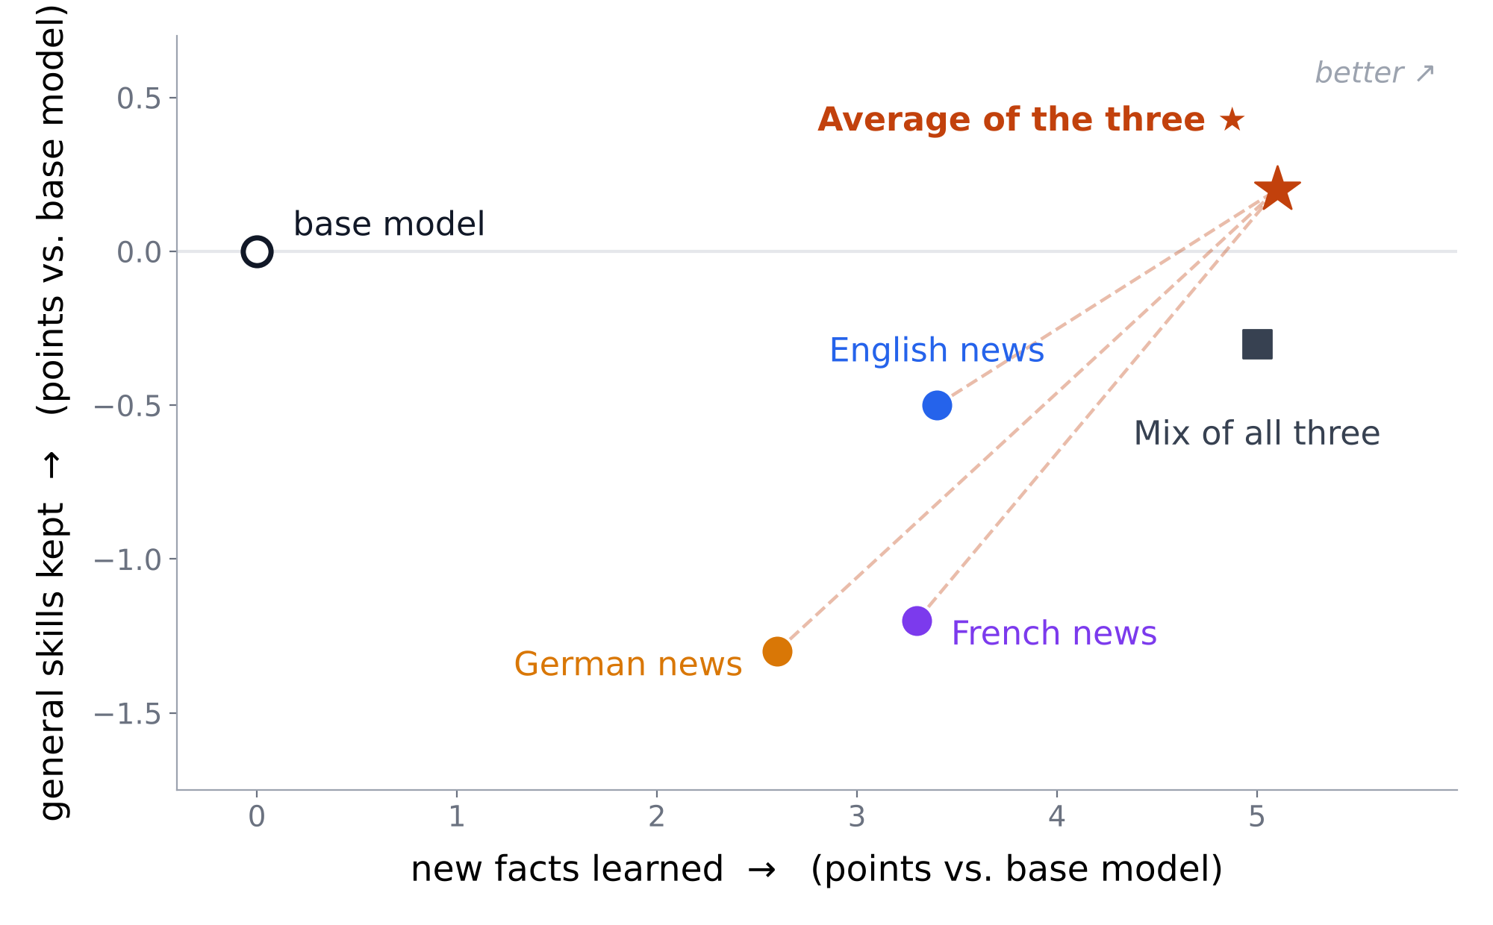
Every update learns. Only the average learns without losing.
PART 2 · IN ONE PICTURE
Right = more new facts. Up = nothing forgotten. Top right is where we want to be.
Notes:
Part two in one picture. Right means more new facts learned; up means general skills kept. Each single-language update learns but forgets. The mixture learns the most and forgets less. The average of the three single-language models, no extra training, sits top right: as many facts as the mixture and nothing lost.

Slide 14
Retraining is the brute-force option. Looking inside is the smart one.
SUMMARY
RETRAIN OR TEACH?
DOES THE LANGUAGE MATTER?
Teach.
Less than you'd think.
Steer it for what it already knows. Let it read for what's new. Average to keep what it had.
Facts cross languages. Costs hide in the others. Test in all of them, then merge.
If new knowledge is a direction we can add, average, and steer: do we ever need to retrain from scratch?
Notes:
Retrain or teach? Teach. Does the language matter? Less than you'd think. The question I'm chasing: if new knowledge is a direction we can add, average, and steer, do we ever need to retrain a model from scratch? Thanks.

