Slide 1
Retrain or teach?
MHM LAB MEETING
How AI learns after it's built. Does the language matter?
Nitin Sharma
Prof. Dr. Thomas Wolfers
Dr. Çağatay Yıldız
MHM Lab
Research Assistant
UKT Tübingen
Carl Zeiss Professor for AI in Neural Systems Imaging, FSU Jena
Cluster of Excellence ML for Science, University of Tübingen
Mental Health Mapping
Notes:
One question for today: when an AI needs to know something new, do we retrain it, or can we teach it? And a second one I spent this year on: does it matter which language it learns in? Very high level, almost no numbers, and I'll leave you with a question at the end.

Slide 2


Doctors want AI. Not on someone else's computer.
WHY THIS MATTERS · 1
86%
Big model: patient data leaves the clinic
of physicians need data-privacy assurances before they would adopt AI in practice
Small model: runs locally, still knows medicine
AMA physician survey, 2026
We need small models that run in the clinic. Can we make one understand medicine without retraining it?
Notes:
There are amazing models out there, but doctors hesitate: in the latest AMA survey, 86% of physicians need data-privacy assurances before adopting AI, because the big models run on someone else's cluster. We want a small model that runs locally and still understands medicine. Can we make a model understand a domain without retraining it?

Slide 3
Send it back to school. Expensive, and it forgets.
THE USUAL FIX
TO TEACH IT MEDICINE
AND AFTERWARDS
~48B
“Anna passed the file to Ben. Ben passed it to Clara. Who has it?”
before
after
words of training, weeks on 8 GPUs
Clara ✓
Anna ✗
Training has a cost: what it used to know. Can we avoid training altogether?
Notes:
The usual fix: train it some more. Two problems. Expensive: about 48 billion words, weeks on 8 GPUs. And it forgets: after medical training the model gets worse at simple things it could do before. Catastrophic forgetting. Can we teach instead of retrain?

Slide 4
The knowledge is already in there. It gets lost on the way out.
WAY 1 · THE HUNCH
+12
late layers: assemble the answer
+8
…
+5
early layers: look up the facts
+2
early layers: look up the facts
+1
once
a few
dozens
~100
200+
Geva et al., 2023
how often the model has seen a fact → how well it answers
Even a fact read once leaves a trace. A weak one gets overruled by the layers that write the answer.
Notes:
How well a model answers a fact depends on how often it has seen it. The curve rises steeply with repetition, but even a fact seen once leaves a small, real trace. For rare facts the information is in there, weakly, and it gets drowned out by higher-level computation on the way to the output. If the knowledge is already there, we don't need training. We need to help it out. (Bar heights sketch the log-linear trend; exact numbers in the papers.)

Slide 5
So we looked inside. Knowledge has an address.
WAY 1 · OPEN THE BOX
?
everything else
v
medical
the black box
one layer, each dot a sentence
Medical sits in its own corner. So we can point at it: one arrow, v.
Notes:
We opened the black box. Inside one layer, each dot a sentence, medical sentences sit in their own corner, cleanly separated. Knowledge has an address. So we can point at it: one arrow, v, from everything-else to medical.

Slide 6
Add the arrow while it thinks. Where you add it matters.
WAY 1 · THE NUDGE
+45%
+29%
MLP layer
+ v
+21%
the usual spot
attention
MLP
the model, layer by layer
better at medical and law facts
No training, nothing forgotten. But it can only surface what the model has already read.
Notes:
While the model answers, add that arrow to its activity at one layer. One addition, no training, nothing forgotten. And where you add it matters: at the MLP layers, the memory blocks, factual recall improves by 45%, more than double the usual spot. Facts live in the MLPs. But steering can only surface what the model has already read. For yesterday's news: Way two.

Slide 7

But what if the knowledge is genuinely new? The model finished school in 2023.
WHY THIS MATTERS · 2
Dec 2023
Read everything up to here
Never saw this
new drugs · new guidelines · yesterday's news
Steering can't surface what was never read. Now we have to train, and pay the forgetting cost.
Notes:
A language model is trained once on a giant snapshot of text, then frozen. The models we use stopped reading around the end of 2023. Everything after that it never saw. Ask it and it guesses, confidently. So: how do we keep it useful?

Slide 8
Don't rebuild it. Hand it the newspaper.
WAY 2 · THE CHEAPER WAY
FROM SCRATCH · LLAMA 3
KEEP TRAINING ON NEWS
15.6 T
6 B
words · about 30 million GPU-hours
words of fresh news · a few days on a few GPUs
Meta, 2024
2,500× less text
Same model, same recipe, new text: it learns the news. It still forgets a little. Can we minimise that?
Notes:
Rebuilding from scratch: Llama 3 took 15.6 trillion words and about 30 million GPU-hours. Instead we keep training the existing model on six billion words of fresh news, 2,500 times less text. It learns the news. It still forgets a little. Can we minimise that?

Slide 9
People open up in their own language. Do we have to train once per language?
WHY THIS MATTERS · 3
“When the emotional tone rises, multilingual clients switch to their first language.”
EN
train
DE
train again?
Dewaele & Costa, 2013 · 182 clients in psychotherapy
FR
and again?
If we must train, we'd rather train once. So: does what it learns in one language carry to the others?
Notes:
In therapy, people open up in their own language: Dewaele and Costa followed 182 multilingual clients and found they switch to their first language when the emotional tone rises. So our models must work in German and French too. Training once per language multiplies the cost. If what it learns in one language carries over, we train once. Does it?

Slide 10
It read the news in English. Ask it in German. Does it know?
WAY 2 · THE QUESTION
reads news in
same fact asked in
EN
EN
plain LLM
DE
DE
no reasoning
FR
FR
A plain model, no reasoning, same facts in three languages. What's your guess?
Notes:
Plain model, no chain-of-thought. It reads the news in English only. I ask about the same event in German or French. Does it keep the answer? We updated models on English, German or French news, then asked the exact same facts, about fifteen thousand, translated, in all three languages. Who thinks it transfers?

Slide 11
Mostly, yes. Knowledge doesn't really speak a language.
WAY 2 · THE ANSWER
~70%
what it learned in English
100% = as good as asking in English
About 70% of what it learned in English, it can answer in German or French. Asking in the language it read is still a bit better.
Notes:
Yes, mostly. About 70% of the accuracy gain survives when you ask in another language, between 57 and 88% depending on direction. French to English travels better than English to French.

Slide 12
So what did training cost us?
WAY 2 · THE COST
FACTS FROM BEFORE 2023
GENERAL SKILLS · 20 TESTS
+0.3
−1.2
nothing forgotten
looks fine in the training language, drops in the others
Old facts stay. General skills slip, mostly in the other languages. Can we take less of a hit, and transfer more?
Notes:
Old facts from before 2023: kept, slightly up. General skills on twenty tests in three languages: they slip. French-only loses 1.2, German 1.3, English 0.5. Test the French model only in French and it looks fine. Catastrophic forgetting in a new disguise, and the multilingual lens makes it visible.

Slide 13
Mix the three newspapers. Less damage, more facts.
WAY 2 · BETTER
new facts learned
skills lost
+5.0
+3.4
+3.3
−0.3
+2.6
−0.5
Mix
EN
−1.3
−1.2
DE
FR
EN
DE
FR
Mix
Mixing helps. But can we do even better?
Notes:
First idea: don't read only German, mix all three newspapers. A balanced mix learns more facts than any single language and loses much less. Can we do even better?

Slide 14
Teach three students, then average their brains.
WAY 2 · EVEN BETTER
★
EN
+
DE
+
FR
÷ 3 =
All the new facts, nothing lost, no extra training. “Model soups”, Wortsman et al. 2022: average the weights.
Notes:
Take the three single-language models and average their weights: add the numbers, divide by three. No training. Model soups, Wortsman et al. 2022. As many new facts as the mixture, plus 5.1, and zero skill loss. It beats every single-language model on both axes. Language-specific updates can be trained separately and merged.

Slide 15
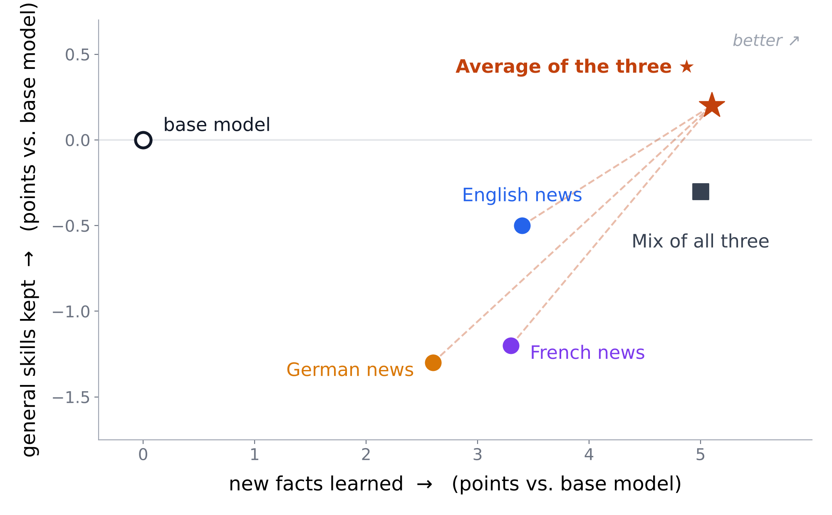
Every update learns. Only the average learns without losing.
WAY 2 · THE RESULT
Right = more new facts. Up = nothing forgotten. Top right is where we want to be.
Notes:
Part two in one picture. Right means more new facts learned; up means general skills kept. Each single-language update learns but forgets. The mixture learns the most and forgets less. The average of the three single-language models, no extra training, sits top right: as many facts as the mixture and nothing lost.

Slide 16
In the same place steering found. So do we even need to train three models?
ONGOING · WHERE DOES THE NEW KNOWLEDGE LIVE?
≈95%
the good direction
of the new facts survive if we keep only the MLP changes
MLP layers, first half
If we know where and which way, maybe we nudge the MLPs there, like steering, instead of training three models.
Notes:
Where does the new knowledge live? In the same place steering found: keep only the MLP changes and about 95% of the new facts survive, mostly in the first half of the layers. And the three language updates point in different directions; the average is the good one. So: if we know where and which way, maybe we probe the MLPs, find that direction and nudge there directly, like steering, instead of training three models.

Slide 17


Retrain or teach? Teach.
WHAT WE ACHIEVED
A LOCAL MEDICAL MODEL
GENUINELY NEW KNOWLEDGE
EVERY LANGUAGE
Steer it.
Newspaper, then average.
Train once, mostly.
One nudge at the MLPs. No training, nothing forgotten.
2,500× less text than from scratch, and the forgetting cancels out.
~70% of what it learns carries over. Test in every language.
Knowledge has an address and a direction. Next: find the direction without training at all.
Notes:
Back to the three reasons this matters. A local medical model: steer it. Genuinely new knowledge: hand it the newspaper, then average the language versions. Every language: train once, mostly, and test in every language. The thread: knowledge has an address and a direction. Next step: find the direction without training at all.

Slide 18
Thank you for your attention.
Questions?
Nitin Sharma
Prof. Dr. Thomas Wolfers
Dr. Çağatay Yıldız
MHM Lab
Research Assistant · UKT Tübingen
nitinsharma3150@gmail.com
Carl Zeiss Professor for AI in Neural Systems Imaging, FSU Jena
Cluster of Excellence ML for Science, University of Tübingen
Mental Health Mapping
Notes:
Thank you. Happy to take questions.

