Slide 1
COMP2522
Lesson 3: final, abstract

Slide 2
Lesson 3 Topics
Final Methods
Final Classes
Overriding .equals() method
Abstract methods
Abstract classes

Slide 3
Review
final Animal a;
a = new Dog();
at compile time, a is an Animal
at run time, a is a Dog
a's static type is "Animal"; its dynamic type is "Dog"

Slide 4
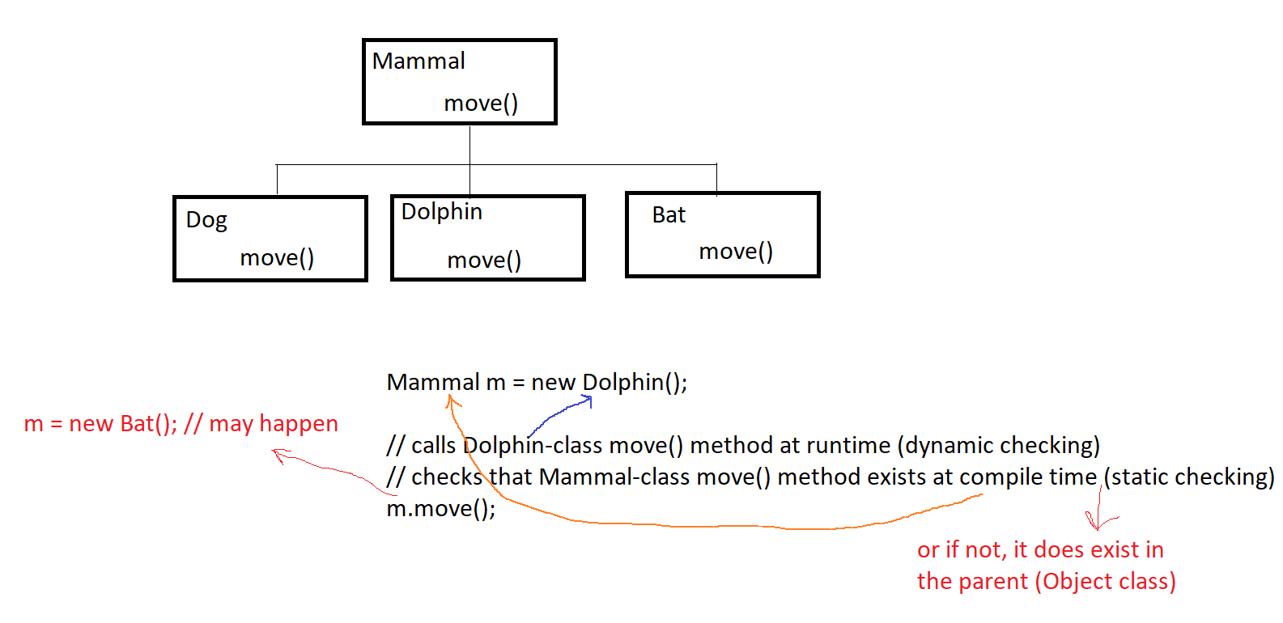
Runtime vs. Compile Time

Slide 5
Review
Polymorphism is the dynamic (runtime) lookup of methods
The three pillars of Polymorphism:
Inheritance class Dog extends Mammal
Substitution Mammal m = new Dog()
Overriding m.speak() // "woof"
Static type checks are performed by the compiler
Dynamic type checks are performed by the JRE

Slide 6
"final" Methods
Prevents subclasses from overriding that method
Often, a parent class's setter methods are declared final, to ensure that only that class can mutate its own fields, on its own terms (its own rules)
Subclasses should never be able to "directly" change a superclass field except via super() calls in the constructor
Subclass setters should likewise be made final

Slide 7
"final" Classes
Prevents subclasses from created
A final class cannot be extended

Slide 8
equals() Method
https://docs.oracle.com/en/java/javase/22/docs/api/java.base/java/lang/Object.html#equals(java.lang.Object)
When comparing objects, Java (or a developer) can call its equals() method
The Object class has an equals() method, which simply returns whether the two objects have the same address; i.e., is the parameter object actually the same object as "this"; in other words it acts the same as ==
Note: do not use == with Strings (or other objects) unless you really do want to compare addresses
It is often overridden so that we can determine what we mean by "these objects are equal":
@Override public boolean equals(final Object o) { if(o == null){ return false; // this is definitely not equal to null } if(!(o.getClass().equals(this.getClass()))){ // or instanceof return false; // these aren’t even the same class! } // now return true if and only if your criteria are satisfied }

Slide 9
hashCode() method
Whenever you override equals(), you must also override hashCode()
An object must return the same hashCode if called multiple times in running an application
The Object class has a hashCode() method, which simply returns a hash of the object’s address
It can be overridden:
@Override public int hashCode(){ // let the IDE override this for our sake }
Important Rule: equal objects must return equal hashCodes

Slide 10
Abstract methods
An abstract method has no body at all
"I won’t tell you what to do, but my children must"
public abstract void move(); // no curly braces {}
or
public abstract void move(int x, String y); // no curly braces {}

Slide 11
Abstract classes
If a class has one or more abstract methods, the class MUST be declared abstract
An abstract class cannot have objects made of it; it is just an idea
For a class to be concrete (i.e. not abstract; objects CAN be made of it), that class must implement (override) all parent (grandparent, etc…) methods which were abstract. In other words, if a parent has abstract methods, and its child doesn’t override them, the child and the parent both must be abstract classes

Slide 12
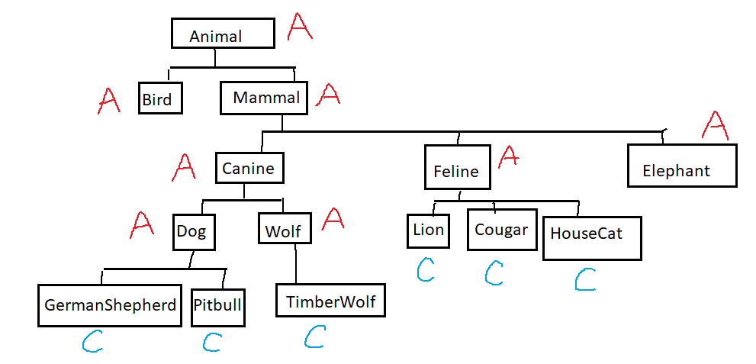
Abstract: Just an Idea (not an object)

Slide 13
Abstract
Any class that we know so far, at any time, can be made abstract
EXCEPT final classes
A final class means "no class can extend this one"
Example: try extending the java.lang.String class (you can't)
The opposite of an abstract class is a concrete class
An abstract class can contain:
- only abstract methods, e.g. public abstract void foo();
only concrete methods, e.g. public void foo(){}
a mix of abstract and concrete methods
no methods
instance variables, statics, constants
constructors

Slide 14
Abstract
If a parent class contains public abstract void foo();
…that class must be abstract
…the child class will also be abstract unless/until it implements foo(): public void foo(){}
No object can be created of any class that has any abstract methods that have not been implemented (in that class or any ancestor)

Slide 15
Abstract
We put abstract methods into a parent class so that Java has a guarantee that all subclasses definitely inherit and (eventually) implement that method
Any time you have an object, you know that all abstract parent methods must have been implemented
e.g Database class: abstract methods for open, close, connect, query….

Slide 16
Abstract
Consider an abstract parent class A that contains an abstract method foo()
Any child class of A:
must be abstract too
or
must implement (override) foo()
or
both
YOU CANNOT HAVE AN OBJECT THAT HAS AN UNDEFINED METHOD

Slide 17
Abstract
Example:
ChessPiece could be an abstract parent class
Pawn would be a concrete child class
Sport could be an abstract parent class
Ice Hockey would be a concrete child class
Weather could be an abstract class
Rain would be a concrete child class

Slide 18
Abstract Class with Static Methods
Another useful abstract class is for it to act as a container for static methods
No object is required
Let's make a static recursive method to perform multiplication
abstract class Math{
public static int recMultiply(final int a,
final int b) {
if(b == 0) {
return 0;
}
return a + recMultiply(a, b - 1);
}
}

