Slide 1
COMP2522 Lesson 8
IO, Path, Files, Scanner, Streaming

Slide 2
File Input/Output
There are many classes and techniques to work with file IO
The newest, cleanest ways involve the NIO ("new IO") and NIO2 classes
The Path interface represents a location in the file system (files or directories).
The Files class is a utility class to work with files and directories. It provides all static methods to read, write, create, delete, copy, and move files.
Path and Files are platform independent; they handle file system operations across different operating systems seamlessly.

Slide 3
Path and Files
https://docs.oracle.com/en/java/javase/22/docs/api/java.base/java/nio/file/Path.html
https://docs.oracle.com/en/java/javase/22/docs/api/java.base/java/nio/file/Files.html

Slide 4
Path
Always use Paths.get() to construct file paths instead of hardcoding paths.
Path path = Paths.get("data.txt");
// Works on all OS
Path path = Paths.get("src", "resources", "file.txt");
Path path = Paths.get("src", "resources", "data", "2024", "reports", "file.txt");
Avoid hardcoded separators: Don't use \\ or / directly; System.lineSeparator() is better, but Paths.get() can manage paths alone.

Slide 5
Creating Files (and Directories)
Creating a File:
Path path = Paths.get("newFile.txt");
Files.createFile(path); // Creates a new file
Best Practice: Check if the file exists first.
if (Files.notExists(path)) {
Files.createFile(path);
}
Creating a Directory:
Path dirPath = Paths.get("newDir");
Files.createDirectory(dirPath);

Slide 6
Nested Directories
Creating Nested Directories:
Files.createDirectories(Paths.get("dir/subdir"));
NOTE: the forward slash there is perfectly fine to use; forward slashes (/) and backward slashes (\) are automatically handled by the Paths.get() method to ensure platform independence
NOTE: if "dir" doesn't exist in the code above, this method will also create it. There is a createDirectory() (singular) method which would NOT; it would throw an exception if the parent directory doesn't exist

Slide 7
Reading All (Small) Text File Lines at Once
With files smaller than about 10MB, we can read all data into a list at once.
try {
Final List<String> lines; lines = Files.readAllLines(path);
}
catch (final IOException e)
{
e.printStackTrace();
}

Slide 8
Very Large Files, and try-with-resources
Instead of loading all lines into memory, read huge files line by line with BufferedReader.
Best Practice: Use try-with-resources to automatically close streams.
try (BufferedReader reader = Files.newBufferedReader(path)) { String line; while ((line = reader.readLine()) != null) { System.out.println(line); } } catch (final IOException e) { e.printStackTrace(); }

Slide 9
Writing/Appending Text fo a File
Writing to a File:
List<String> lines = Arrays.asList("First line", "Second line");
The next instruction overwrites the files if it exists:
Files.write(path, lines, StandardOpenOption.CREATE);
Files.writeString(path, "one string, one line", StandardOpenOption.CREATE);
Best Practice: Use StandardOpenOption to control file behavior (e.g., prevent accidental overwrite).
Files.write(path, lines, StandardOpenOption.CREATE, StandardOpenOption.APPEND);
Appending Text to an existing file:
Files.write(path, lines, StandardOpenOption.APPEND);

Slide 10
Moving Files and Directories
Moving a File:
Path source = Paths.get("file.txt");
Path target = Paths.get("newDir/file.txt");
Files.move(source, target);
Best Practice: Check if the target file already exists, handle conflicts.
Overwriting Target:
Files.move(source, target, StandardCopyOption.REPLACE_EXISTING);
Moving a Directory:
Path dirSource = Paths.get("dir");
Path dirTarget = Paths.get("newDir");
Files.move(dirSource, dirTarget);

Slide 11
Copying Files and Directories
Copying a File:
Path source = Paths.get("file.txt");
Path target = Paths.get("copy.txt");
Files.copy(source, target);
Best Practice: Use StandardCopyOption to handle overwriting and copying attributes.
Files.copy(source, target, StandardCopyOption.REPLACE_EXISTING);
Copying a Directory: Requires recursive copy (not simple with Files.copy).
Best Practice: Use a method to recursively copy directory contents (advanced topic).

Slide 12
Deleting Files and Directories
Deleting a File:
Files.delete(Paths.get("file.txt"));
Best Practice: Check if the file exists before deleting, handle exceptions (e.g., NoSuchFileException).
try {
Files.delete(path);
} catch (final NoSuchFileException e) {
System.out.println("File not found");
}
Deleting a Directory: Must be empty before deletion.
Files.delete(Paths.get("emptyDir"));

Slide 13
Reading/Writing Binary Files
import java.nio.file.*;
import java.io.IOException;
public class BinaryFileExample {
public static void main(String[] args) throws IOException {
Path path = Paths.get("binaryfile.bin");
// Data to write (a simple byte array)
byte[] dataToWrite = { 1, 2, 3, 4, 5 };
// Writing binary data
Files.write(path, dataToWrite);
// Reading binary data
byte[] dataRead = Files.readAllBytes(path);
// Output read data to verify
for (byte b : dataRead) {
System.out.print(b + " ");
}
}
}
See the next slide for a real-life application of this: copying an image from one file to another

Slide 14
copying an image from one file to another
import java.nio.file.*;
import java.io.IOException;
public class CopyImageExample {
public static void main(final String[] args) throws IOException {
// Path to the original image (source)
Path source = Paths.get("sourceImage.jpg");
// Path where the image will be copied (destination)
Path destination = Paths.get("copiedImage.jpg");
// Copy the binary image file
Files.copy(source, destination, StandardCopyOption.REPLACE_EXISTING);
// Verify by reading a few bytes from the copied file
byte[] dataRead = Files.readAllBytes(destination);
// Output the first few bytes to ensure the file was copied correctly
System.out.println("First 5 bytes of the copied file:");
for (int i = 0; i < 5; i++) {
System.out.print(dataRead[i] + " ");
}
}
}

Slide 15
Best Practices
Always use Path for file system operations (modern, flexible).
Handle large files using streams (don’t load everything into memory).
Use try-with-resources to ensure resources are closed automatically.
Use StandardOpenOption to avoid accidental overwriting.
Always check if files/directories exist before operations like move, delete, and copy.

Slide 16
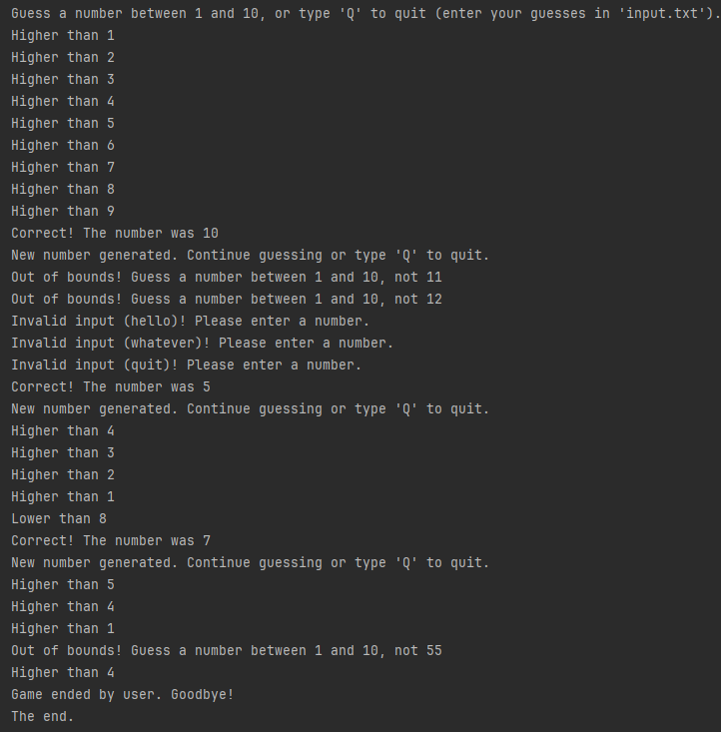
Random, File, Game
public class Game {
public static void main(final String[] args) {
final Random rand = new Random();
int target = rand.nextInt(1, 11); // Random number between 1 and 10
System.out.println("Guess between 1 and 10, or 'Q' to quit (in 'input.txt').");
try {
// Read all guesses from the file once
final List<String> lines = Files.readAllLines(Paths.get("input.txt"));
for (String input : lines) {
input = input.trim();
if (input.equalsIgnoreCase("Q")) {
System.out.println("Game ended by user. Goodbye!");
break;
}
try {
// Attempt to parse the input as an integer
int guess = Integer.parseInt(input);
if (guess < 1 || guess > 10) {
System.out.println("Out of bounds! Guess between 1 and 10, not " + guess);
} else if (guess < target) {
System.out.println("Higher than " + guess);
} else if (guess > target) {
System.out.println("Lower than " + guess);
} else {
System.out.println("Correct! The number was " + target);
target = rand.nextInt(10) + 1; // Generate a new target
System.out.println("New number generated. Guess or type 'Q' to quit.");
}
} catch (final NumberFormatException e) {
System.out.printf("Invalid input (%s)! Please enter a number." + System.lineSeparator(), input);
}
}
} catch (final IOException e) {
System.out.println("Error reading file: " + e.getMessage());
}
System.out.println("The end.");
}
}
Sample input.txt and sample output by Game
1
2
3
4
5
6
7
8
9
10
11
12
hello
whatever
quit
5
4
3
2
1
8
7
5
4
1
55
4
q
5
4

Slide 17
Random, Keyboard, Game
public class Game3 {
public static void main(final String[] args) {
final Random rand = new Random();
int target = rand.nextInt(1, 11);
System.out.println("Guess a number between 1 and 10, or type 'Q' to quit.");
// Initialize Scanner to read from the keyboard
try (Scanner scanner = new Scanner(System.in)) {
while (true) {
System.out.print("Enter your guess: ");
String input = scanner.nextLine().trim();
// Check if the user wants to quit
if (input.equalsIgnoreCase("Q")) {
System.out.println("Game ended by user. Goodbye!");
break;
}
try {
// Attempt to parse the input as an integer
int guess = Integer.parseInt(input);
if (guess < 1 || guess > 10) {
System.out.println("Out of bounds! Guess a number between 1 and 10, not " + guess);
} else if (guess < target) {
System.out.println("Higher than " + guess);
} else if (guess > target) {
System.out.println("Lower than " + guess);
} else {
System.out.println("Correct! The number was " + target);
target = rand.nextInt(1, 11); // Generate a new target
System.out.println("New number generated. Continue guessing or type 'Q' to quit.");
}
} catch (final NumberFormatException e) {
System.out.printf("Invalid input (%s)! Please enter a number." + System.lineSeparator(), input);
}
}
}
System.out.println("The end.");
}
}

