Slide 1

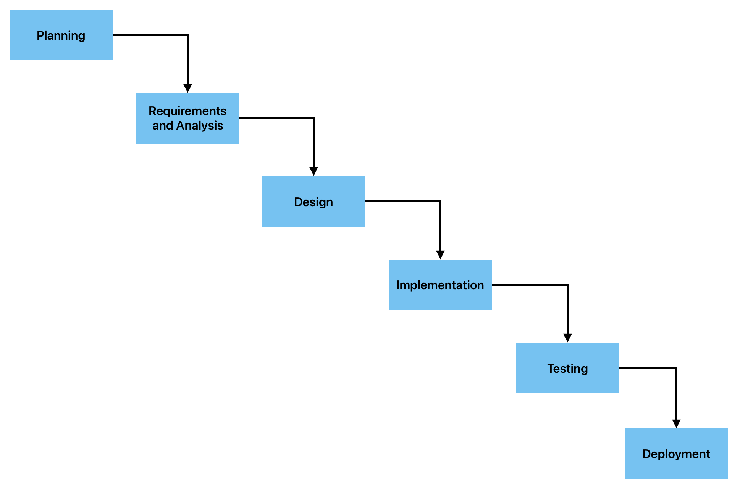
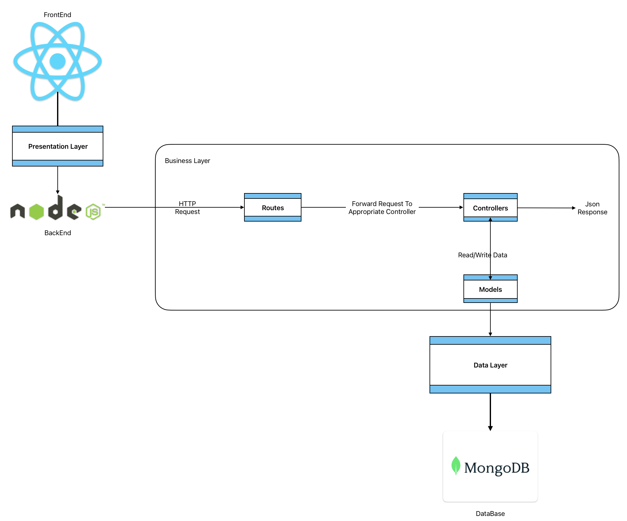

كلية تكنولوجيا المعلومات Faculty of Information Technology
FREE DISTRIBUTED RESOURCE SYSTEM (FDRS)
Supervisor: Dr. Ashraf Odeh
Anas Alseid , Wasef Jayousi , Saif Karborani
PROBLEM DESCRIPTION
ANALYSIS
Students and researchers lack access to a centralized, free platform for obtaining and sharing academic resources tailored to their specific courses and majors. Current systems present barriers such as limited access to up-to-date materials and financial costs.
Methdology
Waterfall model, detailing the sequential phases from planning to maintenance.
System Architecture
Presentation for UI, Application for business logic, Data for storage.
STATE OF THE ART
Most academic resource systems are restricted by subscriptions, access limitations, and do not facilitate a user-contributed content approach that is tailored to diverse academic fields.
PROPOSED SOLUTION
EXPECTED RESULTS
FDRS aims to develop a robust, user-friendly digital library where students can freely upload, share, and access academic resources. It will feature advanced search capabilities, user collaboration features, and a responsive design compatible across devices.
The FDRS is expected to democratize access to academic resources, enhance collaborative learning, and maintain a contemporary database responsive to the evolving needs of the academic community.
OBJECTIVES
CONCLUSION
Create an advanced search system for resource discovery.
Develop a lightweight, multi-platform compatible application.
Foster a collaborative environment through user contribution and resource sharing.
Ensure content is updated and relevant to current academic standards.
The FDRS project is anticipated to significantly improve the academic resource accessibility landscape by providing a free, user-driven platform that encourages academic collaboration and resource sharing.

