Slide 1
Understanding and Predicting Customer Churn
A case study on prescriptive analytics and end-to-end ML project lifecycle
Notes:
<a href="https://www.freepik.com/free-photos-vectors/people">People vector created by macrovector - www.freepik.com</a>

Slide 2
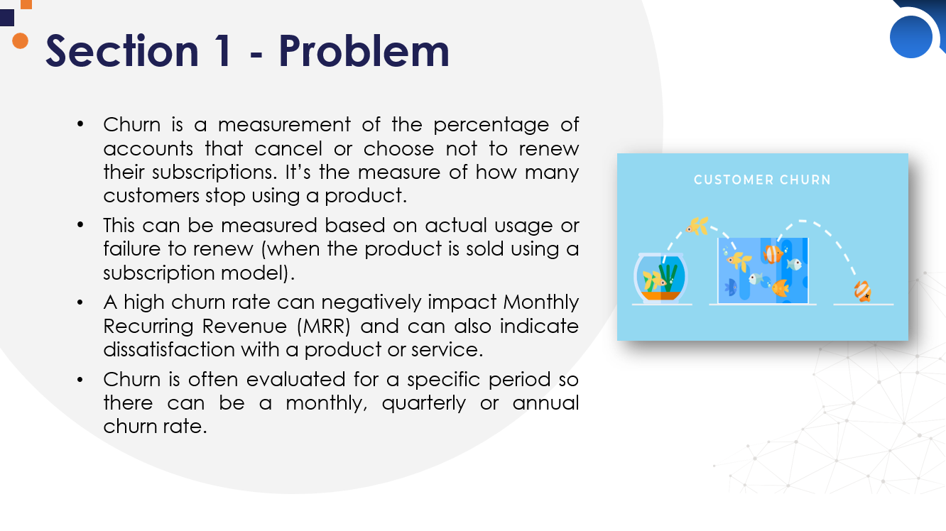
Problem
Data
TABLE OF CONTENTS
~ 20 min
Research
Production

Slide 3



Section 1 - Problem
Churn is a measurement of the percentage of accounts that cancel or choose not to renew their subscriptions. It’s the measure of how many customers stop using a product.
This can be measured based on actual usage or failure to renew (when the product is sold using a subscription model).
A high churn rate can negatively impact Monthly Recurring Revenue (MRR) and can also indicate dissatisfaction with a product or service.
Churn is often evaluated for a specific period so there can be a monthly, quarterly or annual churn rate.

Slide 4

Section 2 - Data
First half
“Theoretical” overview of the ML pipeline steps
Data Gathering
Feature engineering & selection
Model building & assessment
Second half
Practical implementation of all of the above
With code

Slide 5




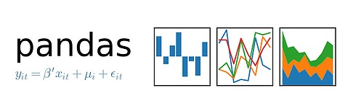
Section 3 - Research
Topics
Building the ML pipeline that covers:
Data Gathering
Feature engineering & selection
Model building & assessment

Slide 6




Section 4 - Production
First half
“Theoretical” overview of the ML pipeline steps
Data Gathering
Feature engineering & selection
Model building & assessment
Second half
Practical implementation of all of the above
With code

Slide 7


THANK YOU
Code - https://bit.ly/3yLmgm3

