Slide 1
Understanding and Predicting Customer Churn
A case study on prescriptive analytics and ML model deployment
Notes:
<a href="https://www.freepik.com/free-photos-vectors/people">People vector created by macrovector - www.freepik.com</a>

Slide 2
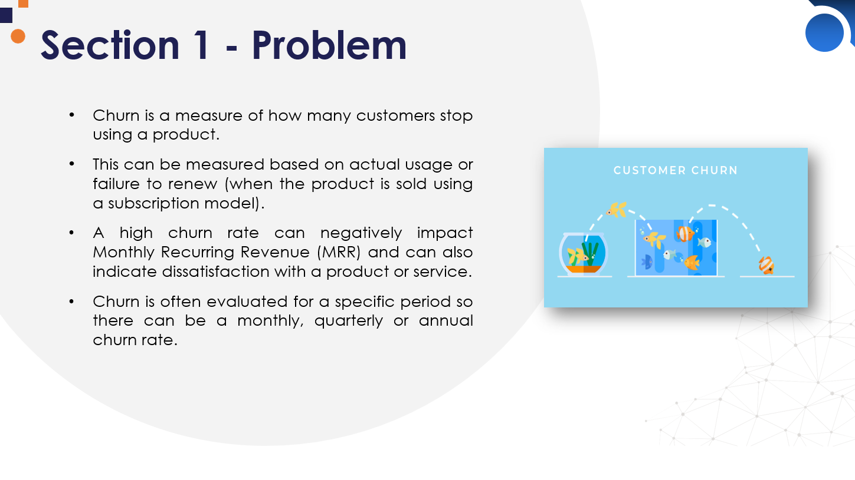
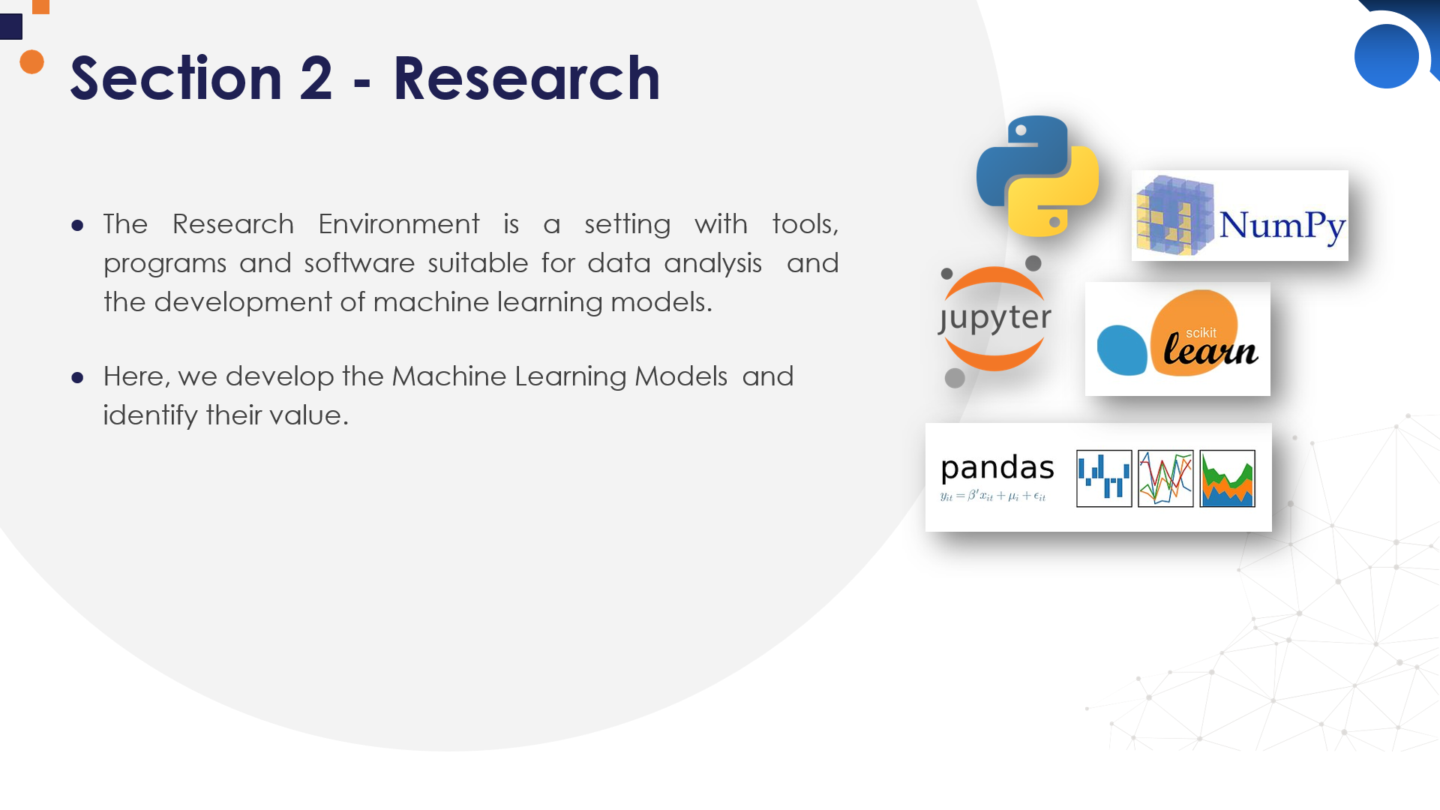
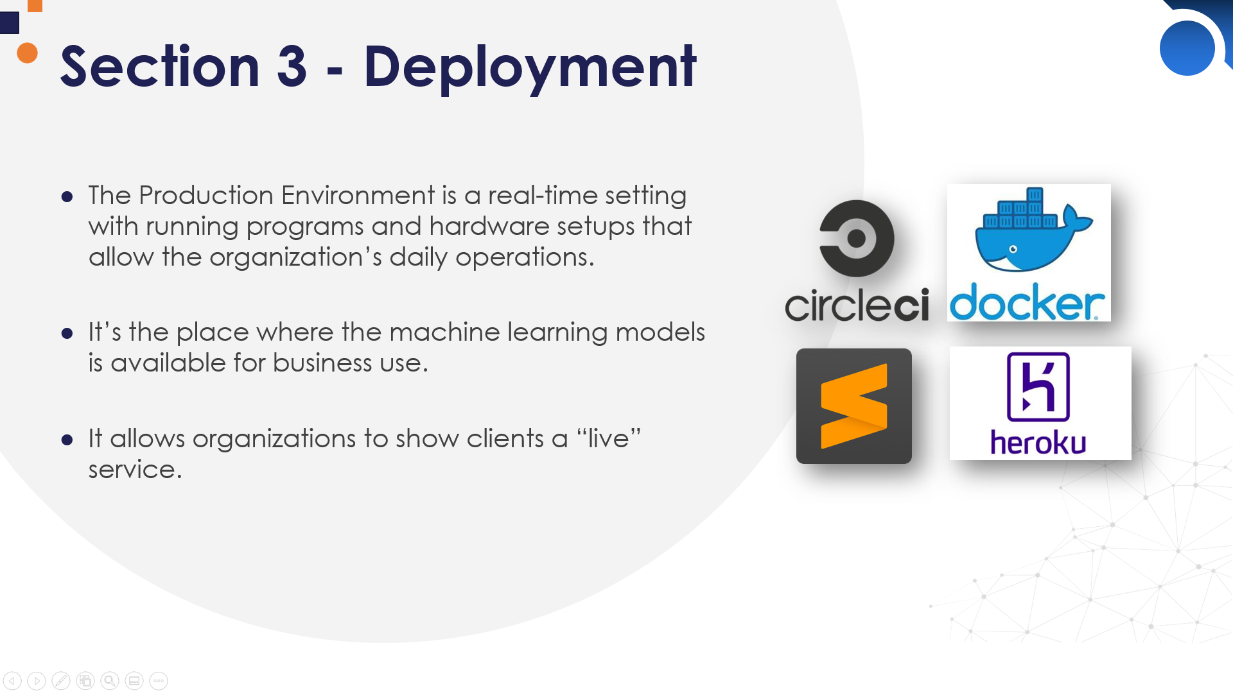
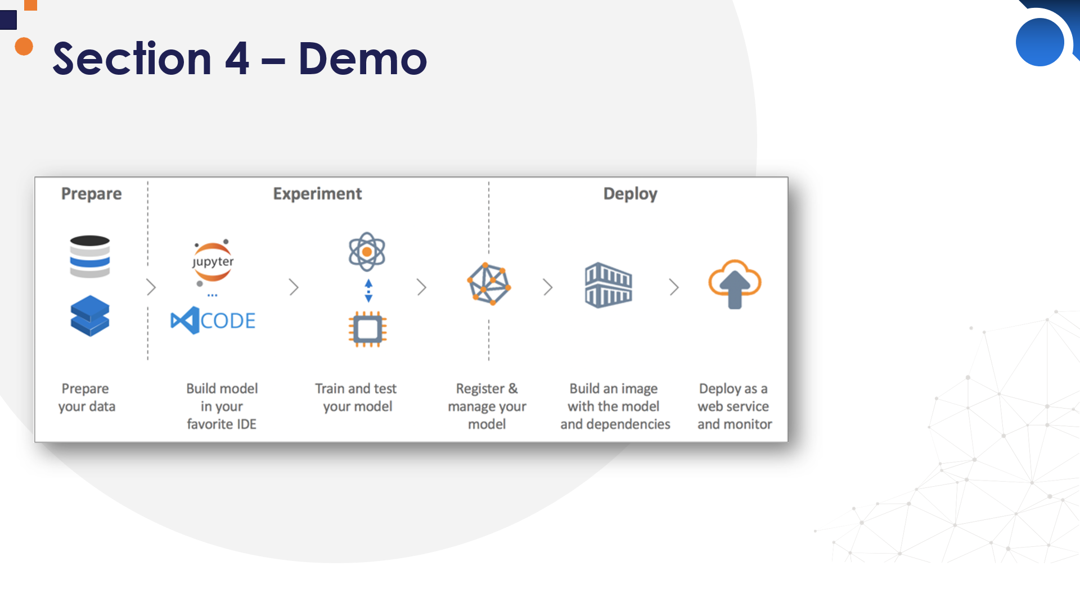
Problem
Research
TABLE OF CONTENTS
~ 20 min
Deployment
Demo

Slide 3



Section 1 - Problem
Churn is a measure of how many customers stop using a product.
This can be measured based on actual usage or failure to renew (when the product is sold using a subscription model).
Churn is often evaluated for a specific period so there can be a monthly, quarterly or annual churn rate.
A high churn rate can negatively impact Monthly Recurring Revenue (MRR) and can also indicate dissatisfaction with a product or service.

Slide 4
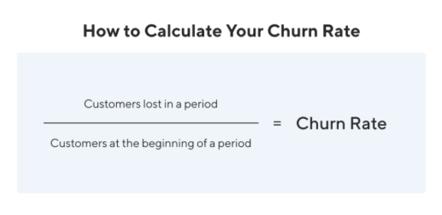
How is Churn Rate Calculated?
In its most simplistic form, the churn rate is the percentage of total customers that stop using/paying over a period.
So, if there were 7000 total customers in March and 1800 of them stopped being customers, the monthly churn rate would be 27%.

Slide 5
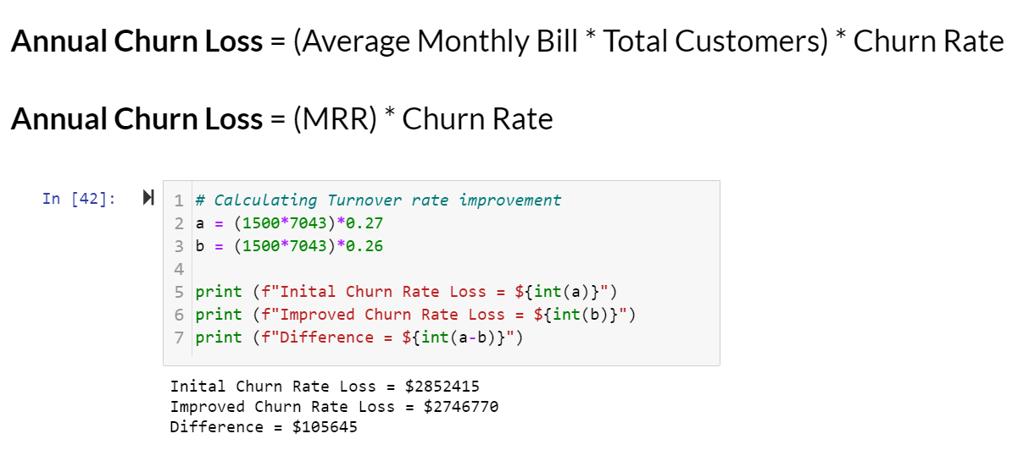
How is Churn Rate Calculated?
In its most simplistic form, the churn rate is the percentage of total customers that stop using/paying over a period.
So, if there were 7000 total customers in March and 1800 of them stopped being customers, the monthly churn rate would be 27%.

Slide 6




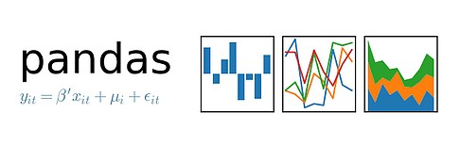
Section 2 - Research
The Research Environment is a setting with tools, programs and software suitable for data analysis and the development of machine learning models.
Here, we develop and fine-tune machine learning pipelines and identify their value.

Slide 7
Machine Learning Pipeline: Overview
Steps involved:
Data gathering
Feature engineering & selection
Model building & assessment
Creating ML pipeline
Pipeline/Model optimization

Slide 8







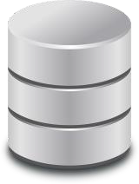

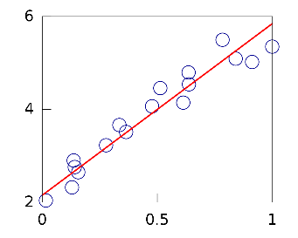





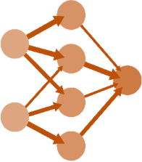

Machine Learning Pipeline
Cloud
Feature Engineering
Feature
Selection
Databases
Data Pre- processing
Variable selection
Machine Learning Model building
Model building Business uplift evaluation
Third party APIs

Slide 9
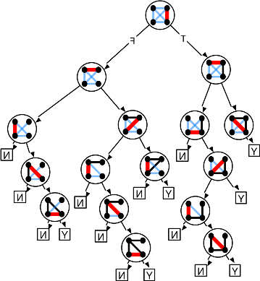



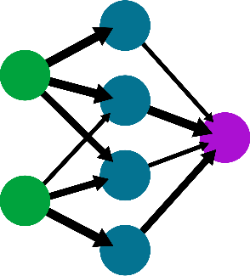













Machine Learning Pipeline
DATA
Feature
Engineering
DATA
Feature
Selection
Machine Learning Model building
Model building Business uplift evaluation
Gathering Data Sources
Data Pre- processing
Variable selection

Slide 10
Machine Learning Pipeline
DATA
Probability
Feature
Engineering
Continuous Output
DATA
Feature
Selection
Machine Learning Model building
Gathering Data Sources
Data Pre- processing
Variable selection

Slide 11
Feature selection in the pipeline
If deploying for the first time,
Plus
We don’t have to hard code the predictive features
However,
Need to deploy code to engineer all features in the dataset
Error handling and unit testing for all the code to engineering features

Slide 12
Feature selection in the pipeline
What if we re-train our model frequently?
Advantages
Can quickly retrain a model on the same input data
No need to hard-code the new set of predictive features after each re-training
Disadvantages
Lack of data versatility
No additional data can be fed through the pipeline

Slide 13
Feature selection in the pipeline
In summary,
Suitable:
Model build and refreshed on same data
Model build and refreshed on smaller datasets
Not suitable,
If model built using datasets with a high feature space
If model constantly enriched with new data sources

Slide 14




Section 3 - Deployment
The Production Environment is a real-time setting with running programs and hardware setups that allow the organization’s daily operations.
It’s the place where the machine learning models is available for business use.
It allows organizations to show clients a “live” service.

Slide 15

Purpose
Production code is designed to be deployed to end users.

Slide 16



Production Code Considerations
Testability & Maintainability
Scalability & Performance

Slide 17


Python Packages
A module is a file which contains various Python functions and global variables. It is just a file with a .py extension which has python executable code.
A package is a collection of modules.

Slide 18
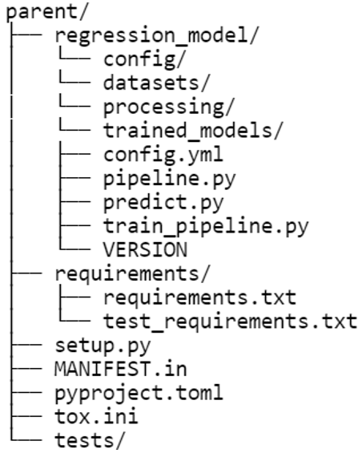

Package Structure

Slide 19
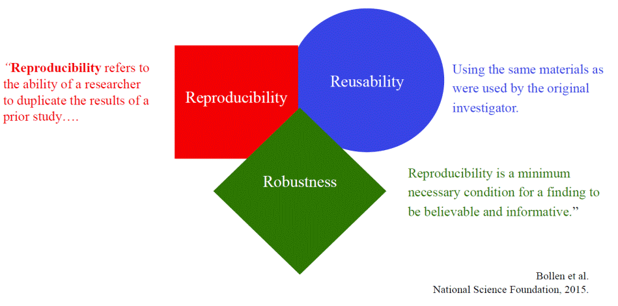
ML Code Considerations
Additional considerations specific to Machine Learning -
Reproducibility
Reusability
Robustness

Slide 20
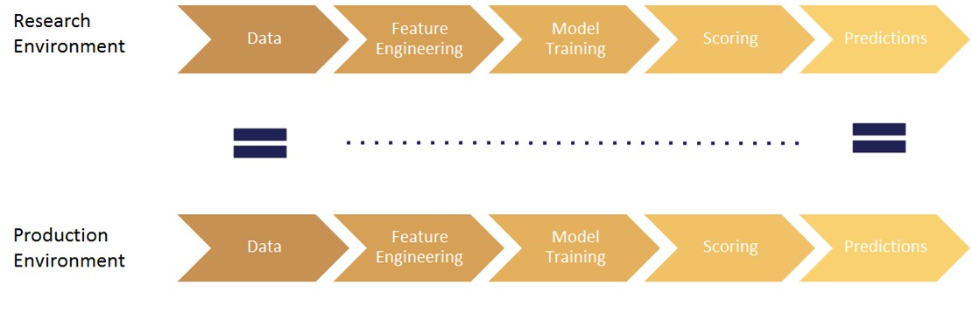
Deployment of ML Pipeline

Slide 21

ML Model Serving
Model embedded in application
Served via a dedicated service
Model published as data (streaming)
Batch prediction (offline process)

Slide 22
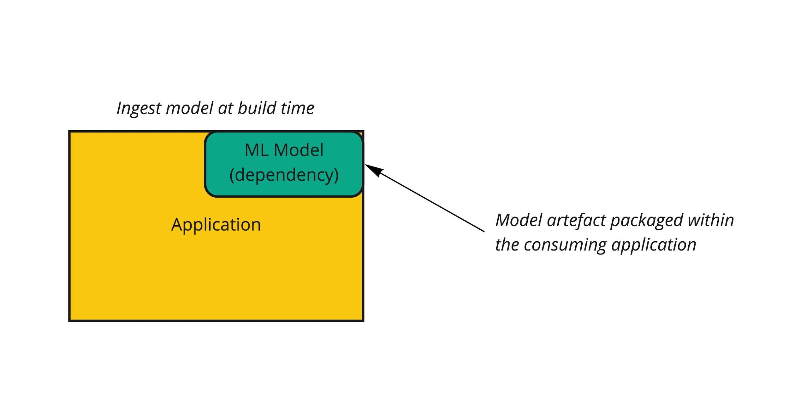
ML System Architecture
Model embedded in application

Slide 23
Web Frameworks
Provide tools to handle & automate standard tasks when building web applications -
Session management
Templating
Database Access
 | Github Stars | Github Forks | Launch Year
Flask | 55.3k | 14.3k | 2011
Django | 57.5k | 24.5k | 2006
FastAPI | 31.1k | 2.2k | 2019

Slide 24
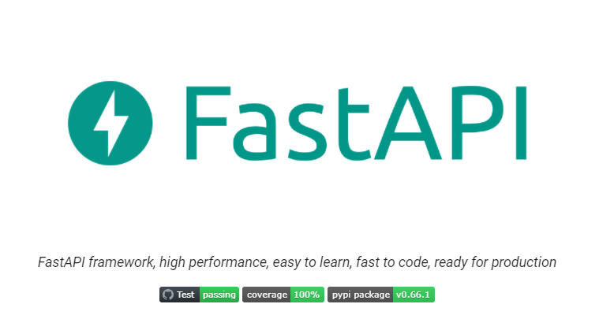
Features of FastAPI
Fast – leverages Python async capabilities
Validation with type hints and Pydantic
Automatic Documentation
Dependency Injection

Slide 25
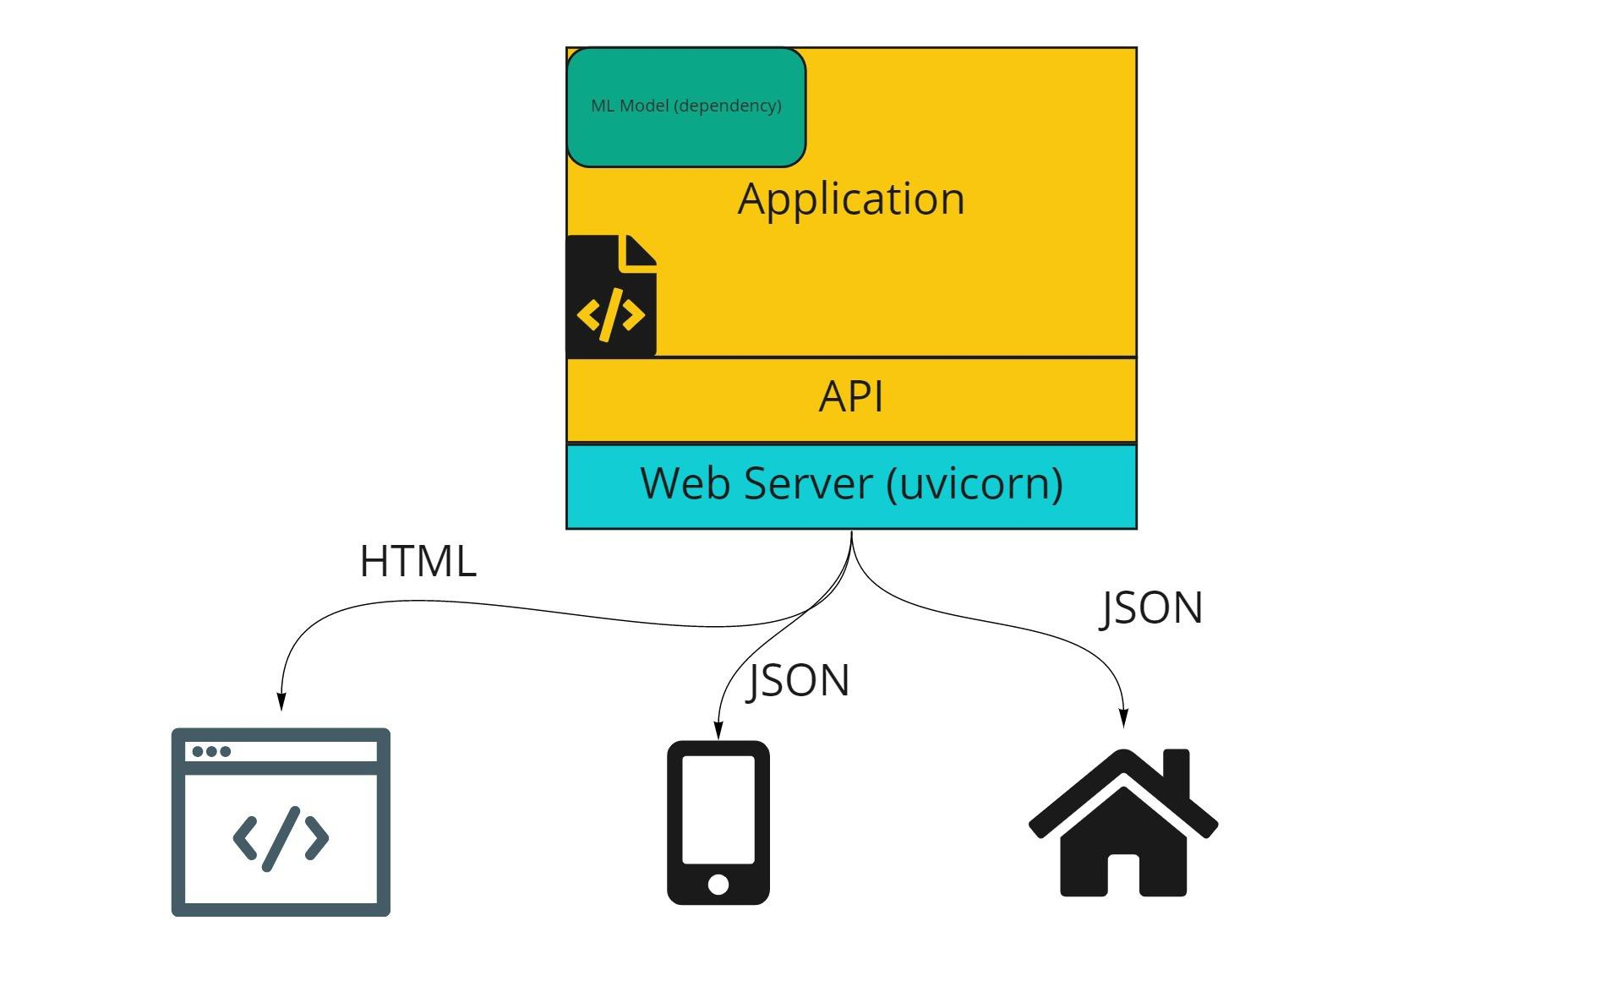
Web Server
For a production deployment, we require a web server. It deals with handling incoming requests and outgoing responses.
A server implements a “server gateway interface”. Uvicorn is an implementation of Asynchronous Server Gateway Interface (ASGI) as part of Python's asyncio library.

Slide 26
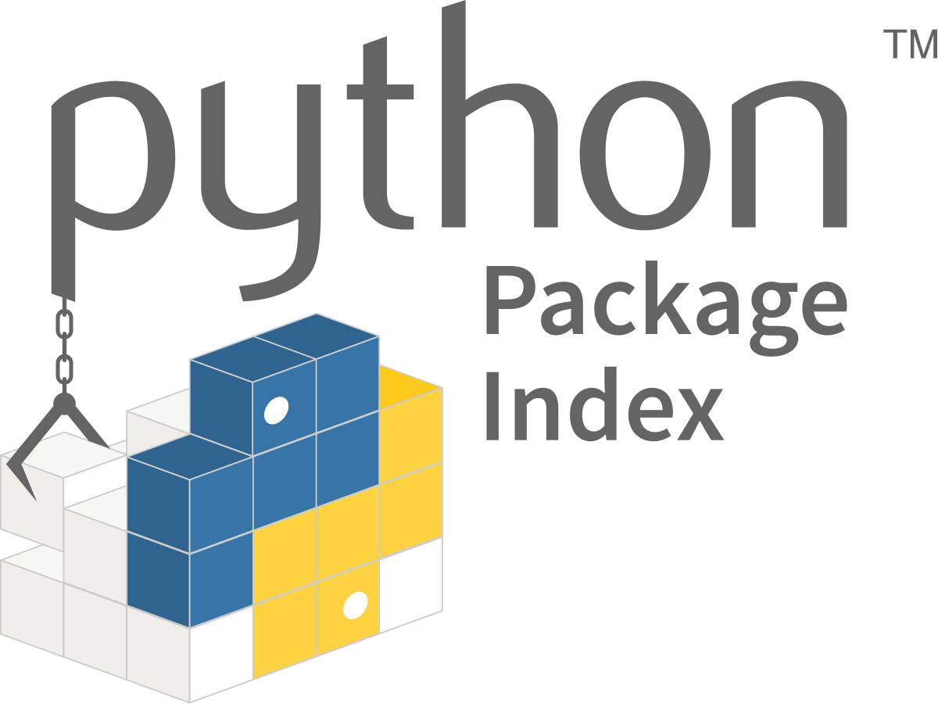

Index Servers
Repository for Package/Artifacts management

Slide 27
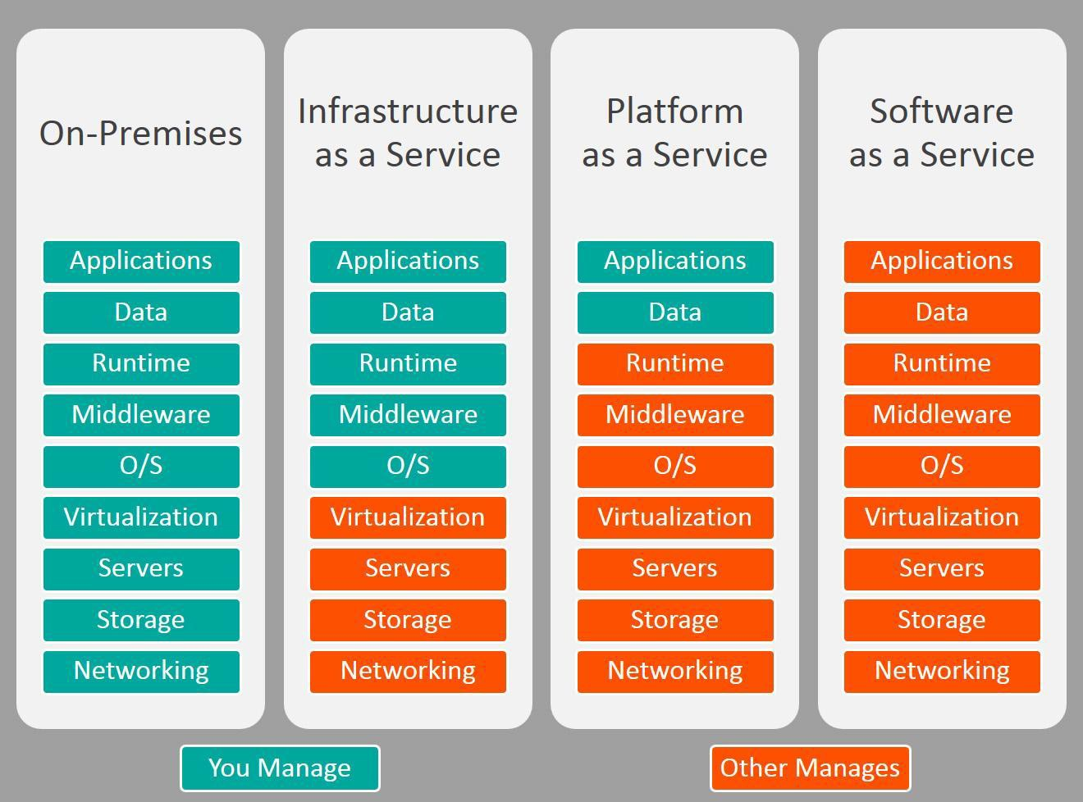
Platform as a Service (PaaS)
A cloud-based service that provides a platform allowing customers to develop, run, and manage applications without the complexity of building and maintaining the infrastructure typically associated with developing and launching an app.

Slide 28
Platform as a Service (PaaS)
AWS Sagemaker
Windows Azure
Heroku
Force.com
Google App Engine
Apache Stratos
OpenShift
PythonAnywhere

Slide 29

Features of Heroku
Heroku is very easy to use (small learning curve)
Free version available(ideal for demos)
Nice 3rd Party integration options
Works with Docker
Great documentation
Supports multiple languages

Slide 30
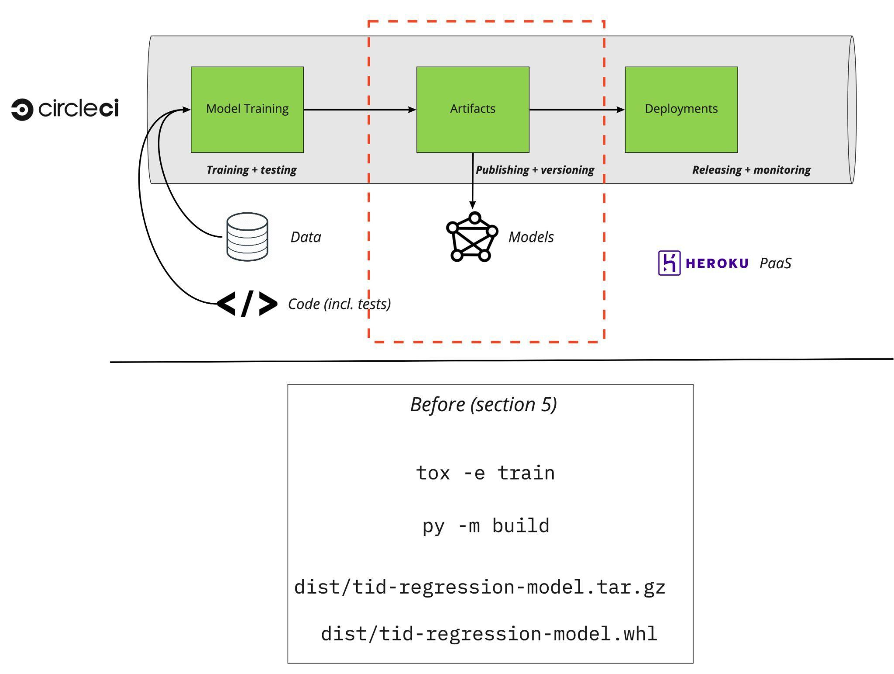


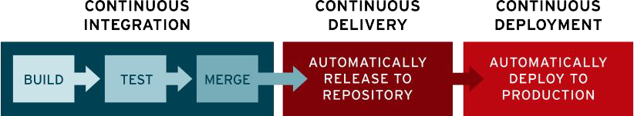
CICD
Automated model building & publishing

Slide 31
Advantages of CICD
The system is in “always releasable” state
Faster, regular release cycles
Building, testing and publishing is automated
Delivery and deployments are automated
Visibility across the company (and audit log)

Slide 32
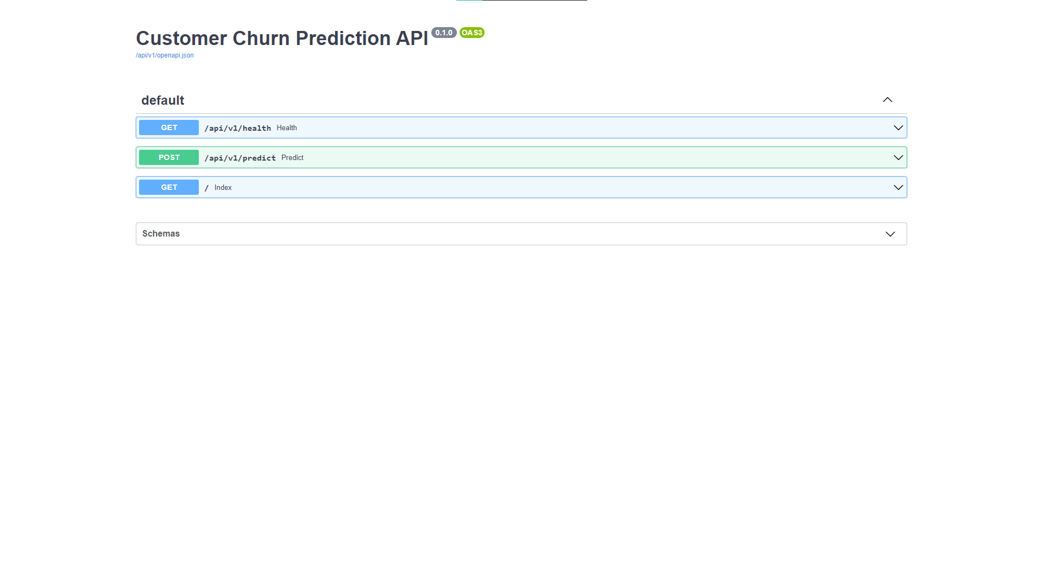
Section 4 – Demo

Slide 33


THANK YOU
Code - https://bit.ly/3yLmgm3

