Slide 1






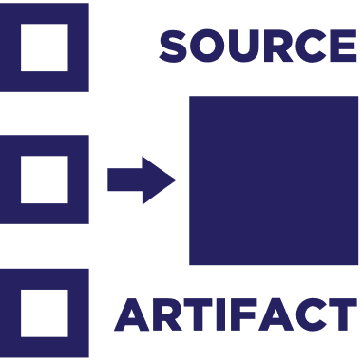
Artifact Build Environment
5
Container
SBoM
1
2
Artifact Import
3
Artifact Deployment
Index
Artifact Push
Public Registry
Index
Private Registry
Index
Image
Image
Image
4
Container Host
SBoM
SBoM
SBoM
Image
Notary v2 Scope
src
Interoperability with other projects
src
deploy
Policy Management
Source-artifact

Slide 2
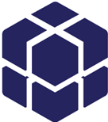




5
Registry OCI Artifact enabled OCI distribution-spec compliant
2
3
Artifact
Signature
1
4
Developer
nv2 client
ORAS client

Slide 3

OCI manifest
oci.image
{
"manifests": [
{
"mediaType": ,
"platform": {
"architecture":,
{
"config": {
"mediaType": ,
…
},
"layers": [{}]
OPTIONAL
Based on artifactType
web:a2b2
sha256:efg123
OCI index
OCI index
cncf.notary
cncf.notary
signed by:
test.contoso.com
references:
sha256:efg123
signed by:
scan.contoso.com
references:
sha256:efg123
Image Index
Image Manifest
manifest.config
Image-spec : typeOf Artifact
Helm : typeOf Artifact
Singularity : typeOf Artifact
OCI manifest
cncf.signature.pgp
web:a2b2
sha256:efg123

Slide 4
OCI manifest
oci.image
{
"manifests": [
{
"mediaType": ,
"platform": {
"architecture":,
{
"config": {
"mediaType": ,
…
},
"layers": [{}]
OPTIONAL
Based on artifactType
web:a2b2
sha256:efg123
OCI index
OCI index
cncf.notary
cncf.notary
signed by:
test.contoso.com
references:
sha256:efg123
signed by:
scan.contoso.com
references:
sha256:efg123
Image Index
Image Manifest
manifest.config
Image-spec : typeOf Artifact
Helm : typeOf Artifact
Singularity : typeOf Artifact
OCI manifest
cncf.signature.pgp
web:a2b2
sha256:efg123

Slide 5
1
Pushed Image
Artifact Type
2
OCI manifest
3
1st Signature
oci.image
2nd Signature
web:a2b2
sha256:efg123
OCI index
OCI index
references:
sha256:efg123
sha256:hgi456
references:
sha256:efg123
sha256:eia821
OCI manifest
OCI manifest
cncf.signature.pgp
cncf.signature.pgp
Artifact Type
sha256:hgi456
sha256:eia821
manifest.config object {
“digest": "sha256:efg123",
“tag": “web:a2b2"
}
manifest.config object {
“digest": "sha256:efg123",
“tag": “web:a2b2"
}

Slide 6
1
Pushed Image
Artifact Type
OCI manifest
oci.image
web:a2b2
sha256:efg123
manifest.config object {
"digest": "sha256:efg123",
"tag": "web:a2b2",
"signature": “test.contoso.com"
}
manifest.config object {
“digest": "sha256:efg123",
“tag": “web:a2b2",
"signature": “scan.contoso.com"
}
OCI manifest
OCI manifest
cncf.signature.pgp
cncf.signature.pgp
Artifact Type
2
sha256:hgi456
sha256:eia821
3
1st Signature
2nd Signature

Slide 7
OCI manifest
oci.image
{
"manifests": [
{
"mediaType": ,
"platform": {
"architecture":,
{
"config": {
"mediaType": ,
…
},
"layers": [{}]
OPTIONAL
Based on artifactType
web:a2b2
sha256:efg123
OCI index
OCI index
cncf.notary
cncf.notary
signed by:
test.contoso.com
references:
web@sha256:efg123
web@sha256:sbom
web@sha256:tuf
signed by:
scan.contoso.com
references:
web@sha256:efg123 web@sha256:results
Image Index
Image Manifest
manifest.config
Image-spec : typeOf Artifact
Helm : typeOf Artifact
Singularity : typeOf Artifact
OCI manifest
OCI manifest
OCI manifest
foo.sbom
cncf.tuf
azure.securitycenter
web@sha256:sbom
web: SBOM
web@sha256:tuf
web: TUF metadata
web@sha256:results web: Scan Results

Slide 8
1
OCI manifest
oci.image
net-monitor:v1
sha256:111m…
2
OCI index
cncf.notary.v2
net-monitor:v1-sig-acme-rockets
sha256:222m…
config:
references: sha256:111m…
signedBy: registry.wabbit-networks.com
3
OCI manifest
cncf.notary.v2
net-monitor:v1-sig-acme-rockets
sha256:333m…
config:
references: sha256:111m…
signedBy: registry.acme-rockets.com

Slide 9
1
OCI manifest
oci.image
net-monitor:v1
sha256:111m…
2
OCI index
cncf.notary.v2
net-monitor:v1-sig-wabbit-networks
sha256:222i…
config:
signedBy: registry.wabbit-networks.com
manifests:
references: sha256:111m…
3
OCI index
cncf.notary.v2
net-monitor:v1-sig-acme-rockets
sha256:333i…
config:
signedBy: registry.acme-rockets.com
manifests:
references: sha256:111m…

Slide 10
6
OCI index
1
OCI Index
cncf.notary.v2
oci.Index
net-monitor:v1-sig-wabbit-networks
sha256:222i…
config:
signedBy: registry.wabbit-networks.com
manifests:
references: sha256:111wm…
net-monitor:v1
sha256:111ma…
(multi-arch)
2
OCI index
4
OCI manifest
cncf.notary.v2
oci.image
net-monitor:v1-sig-wabbit-networks
sha256:222i…
config:
signedBy: registry.wabbit-networks.com
manifests:
references: sha256:111ma…
7
OCI index
net-monitor:v1-win
sha256:11wm…
(windows)
cncf.notary.v2
net-monitor:v1-sig-acme-rockets
sha256:333i…
config:
signedBy: registry.acme-rockets.com
manifests:
references: sha256:111wm…
3
OCI index
5
OCI manifest
cncf.notary.v2
oci.image
net-monitor:v1-sig-acme-rockets
sha256:333i…
config:
signedBy: registry.acme-rockets.com
manifests:
references: sha256:111ma…
net-monitor:v1-lin
sha256:11Lm…
(Linux)
8
OCI index
cncf.notary.v2
net-monitor:v1-sig-wabbit-networks
sha256:222i…
config:
signedBy: registry.wabbit-networks.com
manifests:
references: sha256:111Lm…
9
OCI index
cncf.notary.v2
net-monitor:v1-sig-acme-rockets
sha256:333i…
config:
signedBy: registry.acme-rockets.com
manifests:
references: sha256:111Lm…

Slide 11
1
OCI Artifact
oci.image
net-monitor:v1
sha256:111m…
2
OCI index
cncf.notary.v2
net-monitor:v1-sig-wabbit-networks
sha256:222i…
config:
signedBy: registry.wabbit-networks.com
manifests:
references: sha256:111m…
3
OCI index
cncf.notary.v2
net-monitor:v1-sig-acme-rockets
sha256:333i…
config:
signedBy: registry.acme-rockets.com
manifests:
references: sha256:111m…

Slide 12
Distribution-spec
Implemented as a Registry
push
pull
list*
Image-spec
{
"config": {
"mediaType": ,
…
},
"layers": [{}]
{
"manifests": [
{
"mediaType": ,
"platform": {
"architecture":,
Singular Artifacts w/layers blobs
Collections of Artifacts
Image Manifest
Image Index

Slide 14
1
OCI manifest
oci.image
net-monitor:v1
sha256:111m…
2
OCI index
cncf.notary.v2
net-monitor:v1-sig-wabbit-networks
sha256:222i…
manifests:
references: sha256:111m…
sha256:222m…
3
OCI manifest
cncf.notary.v2
net-monitor:v1-sig-o-wabbit-networks
sha256:222m…
config:
signedBy: registry.wabbit-networks.com
4
OCI index
cncf.notary.v2
net-monitor:v1-sig-acme-rockets
sha256:333i…
manifests:
references: sha256:111m…
sha256:333m…
5
OCI manifest
cncf.notary.v2
net-monitor:v1-sig-o-acme-rockets
sha256:333m…
config:
signedBy: registry.acme-rockets.com

Slide 15











Cloud-A
Cloud-B
ACME Rockets
Cloud Environment
Public Registry
registry.notaryv2.io
Policy Manager
Public Content
Build Environment
/debian
Key Vault
registry.acme-rockets.io
Staging
Prod
/node
/base-artifacts/debian
Functional Testing
/base-artifacts/node
/team-a/web:a1b2
Git
/prod/web:a1b2
Index
Index
Index
Build Server
Developer
Build Server
web:a1b2
debian
node
Git
Git
ACME Rockets On-prem environment
Key Vault
air-gapped network
Key Vault
Factory Floor registry
registry-factory.acme-rockets.io
Policy Manager
/team-a/web:a1b2

Slide 16
Wabbit Networks
Docker Hub
ACME Rockets
Artifact Build Environment
5
1
2
Artifact Import
3
Public Registry
Private Registry
Artifact Deployment
Index
Artifact Push
Index
Index
Index
Image
Image
Image
4
Container Host
Image
SBoM
SBoM
SBoM
Image
SBoM
src
src
src
Policy Management
src
Notary v2 Scope
deploy
Interoperability with other projects
An entity authors content
signs their content with their key
Publish to a well-known location
May get certified by the aggregator
Consume the public content into an entity's private registry
Add a verification signature, attesting to its usage in the company
Policy management enforces which keys can be used for deployment, even what registries content can be pulled from
Only after all signatures and policies are verified can the artifact be deployed

Slide 17
OCI Artifacts & Collections
OCI Weekly Call 9/30/2020

Slide 18
Wabbit Networks
Docker Hub
ACME Rockets
Artifact Build Environment
5
1
2
Artifact Import
3
Public Registry
Private Registry
Artifact Deployment
Index
Artifact Push
Index
Index
Index
Image
Image
Image
4
Container Host
Image
SBoM
SBoM
SBoM
Image
SBoM
src
src
src
Policy Management
src
Notary v2 Scope
deploy
Interoperability with other projects
An entity authors content
signs their content with their key
Publish to a well-known location
May get certified by the aggregator
Consume the public content into an entity's private registry
Add a verification signature, attesting to its usage in the company
Policy management enforces which keys can be used for deployment, even what registries content can be pulled from
Only after all signatures and policies are verified can the artifact be deployed

Slide 19





Distribution-spec
Implemented as a Registry
Artifacts-spec
Uses manifest and index* to define multiple artifacts
{
"manifests": [
{
"mediaType": ,
"platform": {
"architecture":,
{
"config": {
"mediaType": ,
…
},
"layers": [{}]
Image Index
Image Manifest
Image-spec : typeOf Artifact (Index & Manifest)
CNAB : typeOf Artifact (Index & Manifest)
Helm : typeOf Artifact (Manifest)
Singularity : typeOf Artifact (Manifest)
WASM : typeOf Artifact (Manifest)

Slide 20
Distribution Persistence Types
Individual Types
Collection Types
Container Images
Singularity Images
WASM modules
Helm Charts
Terraform
Azure Resource Manager Templates
AWS Cloud Formation Templates
Multi-arch index
CNAB
Signatures?
Artifacts that reference other artifacts Not “collections” of artifacts, but a collection of references

Slide 21

Reference Types
OCI Artifact
oci.image
OCI Artifact
wordpress:v3.1
notary.v2
3
OCI Artifact
cncf.helm
OCI Artifact
Wabbit-networks
1
wordpress:v3.1
sha256:888m…
oci.image
4
net-monitor:v1
sha256:111m…
OCI Artifact
oci.image
2
OCI Artifact
Mysql:5.7
notary.v2
docker-hub
OCI Artifact
1:1
1:many
many:1
A thing
sha256:---
OCI Artifact
OCI Artifact
notary.v2
A thing
sha256:---
Acme-rockets

Slide 22
Distribution Persistence Types
Individual Types
Reference Types
Collection Types
Container Images
Singularity Images
WASM modules
Signatures
Helm Charts
Terraform Templates
Azure Resource Manager Templates
AWS Cloud Formation Templates
Multi-arch index
CNAB

Slide 23

Collection Types
Collection Reference Types
OCI Artifact
oci.image
OCI Artifact
3
notary.v2
OCI Artifact
wordpress:v3.1
cncf.helm
OCI Artifact
Invocation image
1
wordpress:v3.1
sha256:888m…
CNAB
4
wordpress:v1
sha256:111m…
2
OCI Artifact
oci.image
Mysql:5.7
OCI Artifact
oci.image
OCI Artifact
1:1
1:many
many:1
wordpress:v3.1
A thing
sha256:---
OCI Artifact
A thing
sha256:---

Slide 24
Distribution Persistence Types
Individual Types
Reference Types
Collection Types
Container Images
Singularity Images
WASM modules
Signatures*
Helm Charts
Terraform Templates
Azure Resource Manager Templates
AWS Cloud Formation Templates
CNAB
Multi-arch index
Is a signature an Artifact, or an Attribute of an artifact?

Slide 25
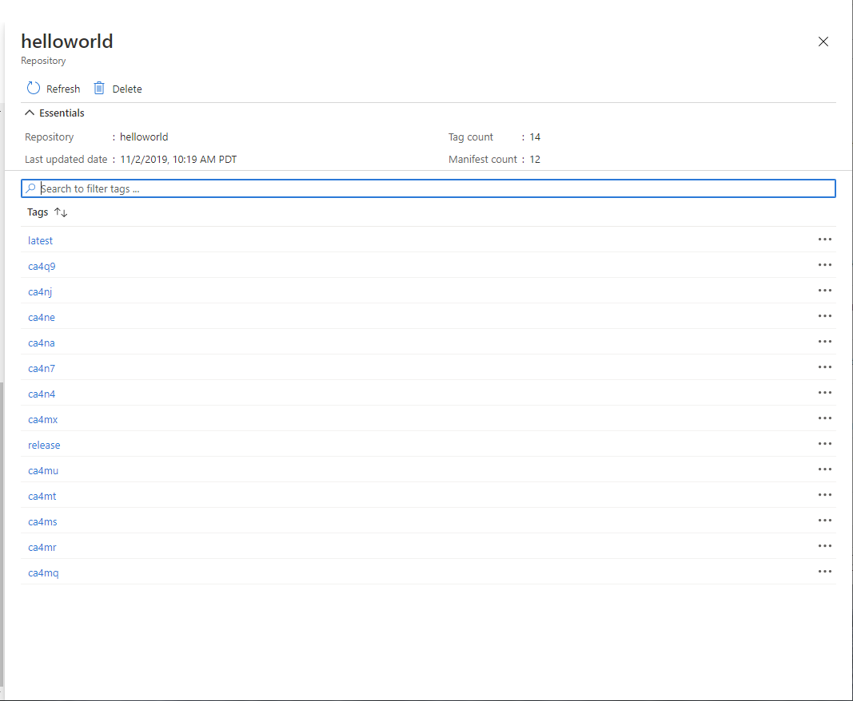
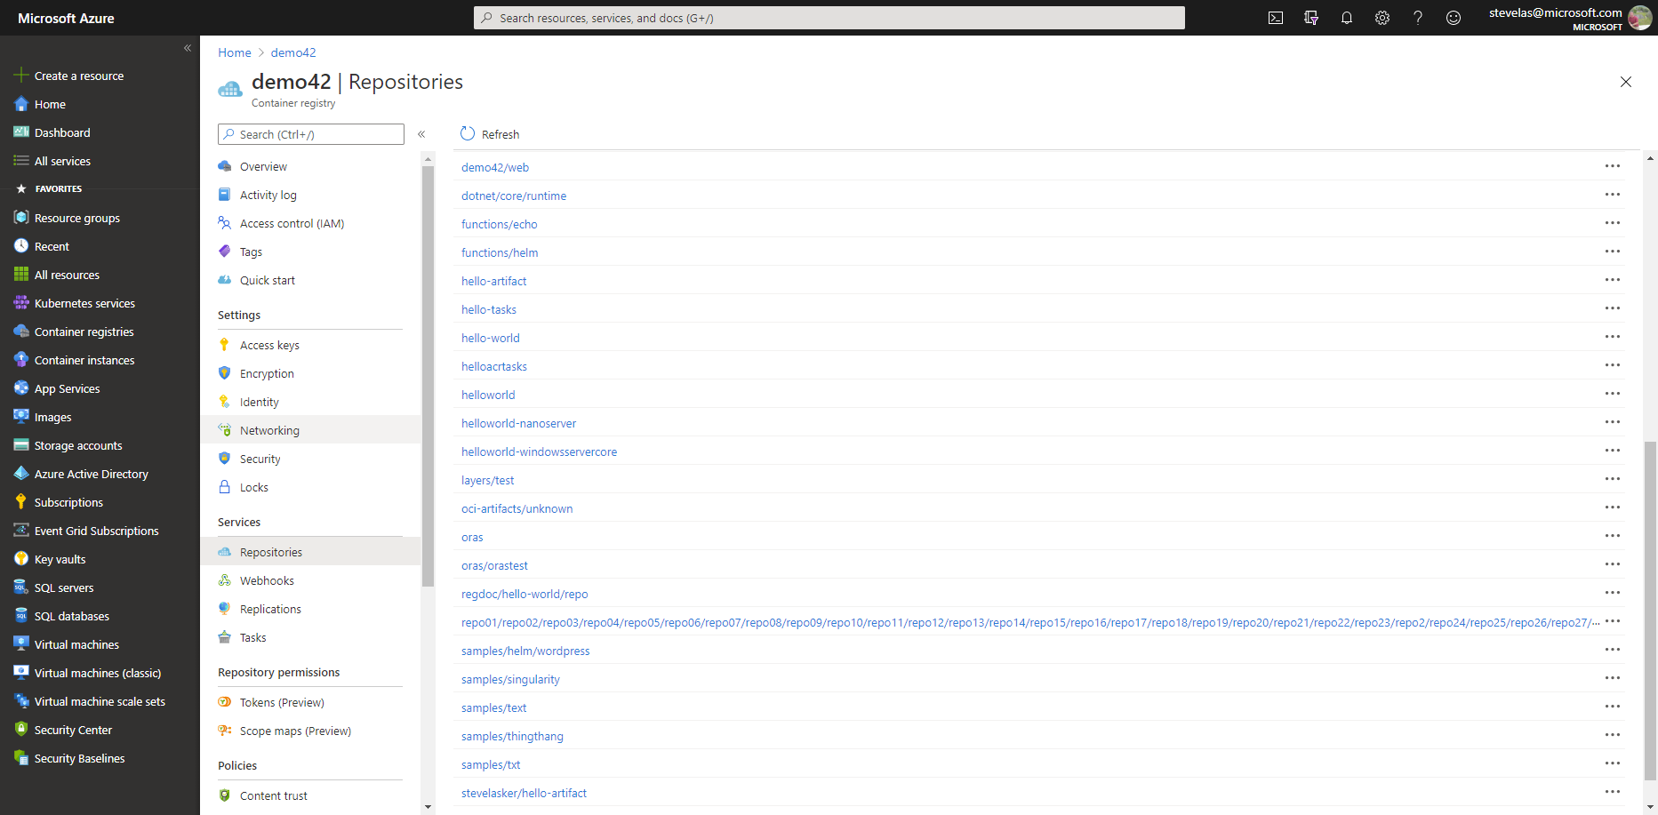

What should be seen?
latest
…
S
B
latest
o
M
ca4na
…
S
B
latest-signature
o
M
ca4nb
…
latest-signature-acme-rockets
…
ca4nc
latest-signature-wabbit-networks
…
ca4nd
ca4na
…
ca4ne
ca4na-signature
…
ca4ng
ca4na-signature-acme-rockets
…
ca4ng
ca4na-signature-wabbit-networks
…
ca4nh
ca4nb
…
ca4nj
ca4nb-signature
…
ca4nk
ca4nb-signature-acme-rockets
…
ca4nm
ca4nb-wabbit-networks

Slide 26
Distribution Persistence – Meta-data Services
Artifacts
Meta-data
Container Images
Singularity Images
WASM modules
Helm Charts
Terraform Templates
Azure Resource Manager Templates
AWS Cloud Formation Templates
CNAB
Signatures
SBoMs
Vulnerability Summaries
Hub –esque Docs/Descriptions
LastTag
TagHistory
PullCount
LastPullDate
ExpirationDate
DeployedTo

Slide 27
Distribution-spec
Implemented as a Registry
Artifacts-spec
Uses manifest and index* to define multiple artifacts
{
"manifests": [
{
"mediaType": ,
"platform": {
"architecture":,
{
"config": {
"mediaType": ,
…
},
"layers": [{}]
{
"config": {
"mediaType": ,
…
},
“blobs": [{}]
“refs": [{}]
Image Index
Image Manifest
Artifact Manifest
Image-spec : typeOf Artifact (Index & Manifest)
CNAB : typeOf Artifact (Index & Manifest)
Helm : typeOf Artifact (Manifest)
Singularity : typeOf Artifact (Manifest)
WASM : typeOf Artifact (Manifest)
S
B
o
M

