Slide 1
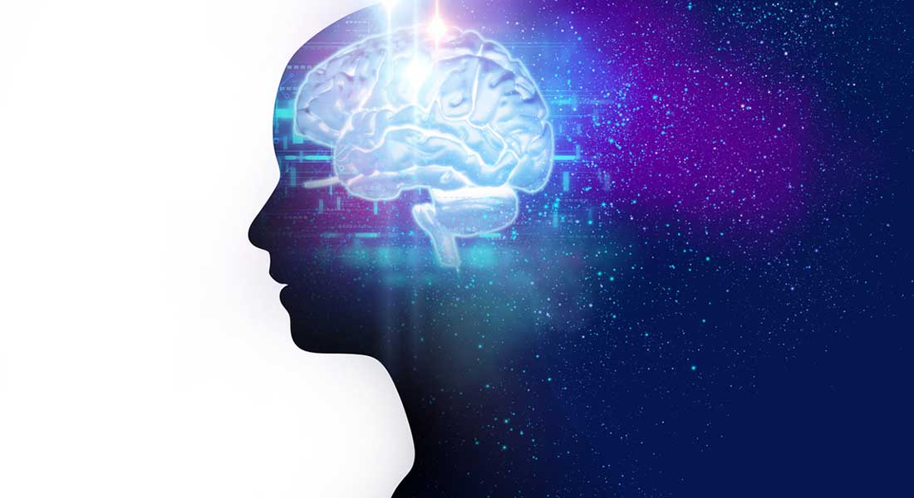
Schizophrenia
…and how to spot it online

Slide 2
What is Schizophrenia?
Schizophrenia is a chronic brain disorder
Genetically inherited but triggered by environmental factors, such as drugs and trauma
Age onset: 21–25 in males and 25–30 in females
Symptoms can include:
  Hallucinations & Delusions (Positive Symptom)
  Socialization difficulties (Negative Symptom)
  Poor Academic/Occupational Performance (Cognitive Symptom)

Slide 3
What we want to achieve
“Hallucinations started while in college. I was
constantly depressed and didn’t have many friends.”
Threshold : 50
Very likely to be schizophrenia related
Threshold : 22
Contains some schizophrenia-related
keywords

Slide 4
Part 1
Can we build a Schizophrenia model using Reddit posts ?

Slide 5
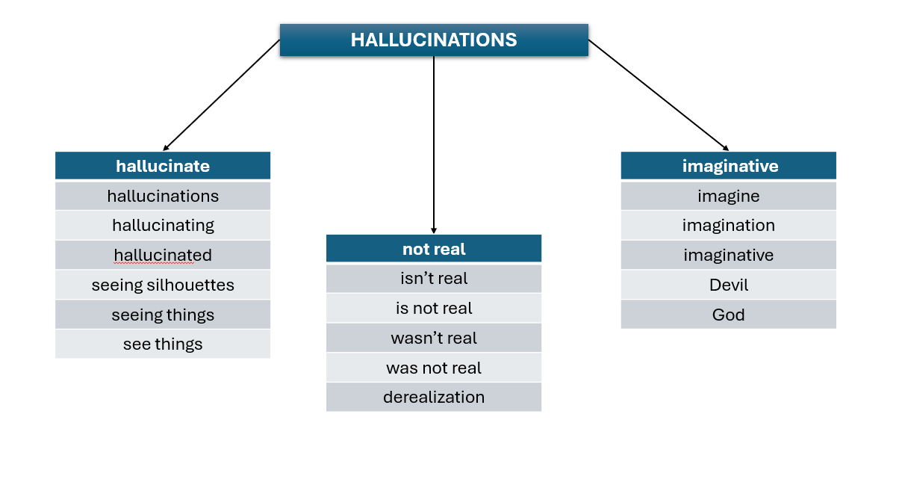
How can we spot symptoms in posts?
ANSWER: DICTIONARIES
“I feel depressed and alone all the time.”
Categories: depressed, social withdrawal
“I have heard voices since I was 15. I grew up
in an abusive household and was drinking
since I was a teen and with depression.”
Categories: hallucinations, abuse, alcohol,
depressed

Slide 6

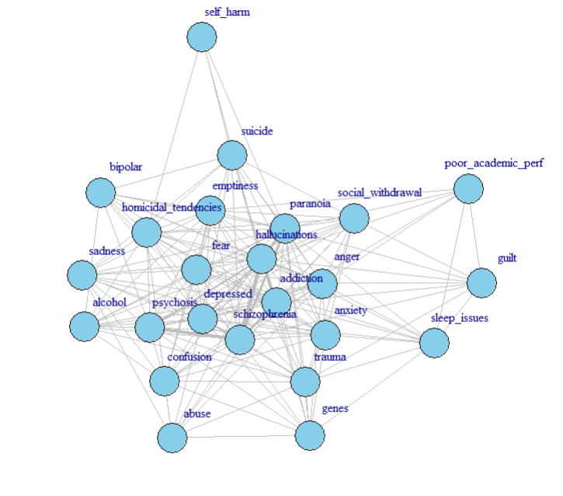
Co-occurrence of schizophrenia traits in 500 Reddit posts ~ Symptoms
Edges connect keywords that appear together in a post.
Highest co-occurrences:
  Schizophrenia, Hallucinations: 8.45%
  Schizophrenia, Psychosis : 7.04%
Global clustering: 75.77%
  how likely it is that two neighbors of a node are also neighbors with each other (generally how clustered the graph is)
Local clustering: 80.78%
  how connected the immediate neighbors of that node are (clustering coefficient of individual nodes)
Edge Density: 65.1%
Mean Distance: 1.34

Slide 7
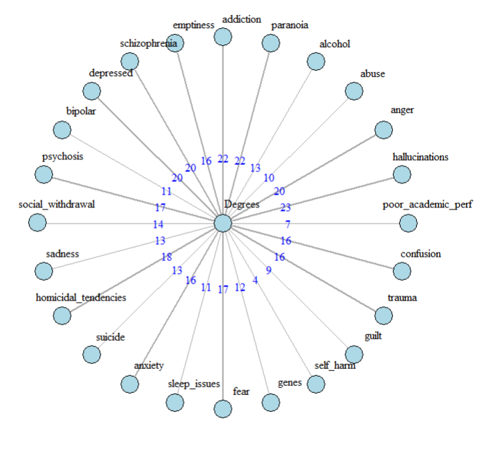
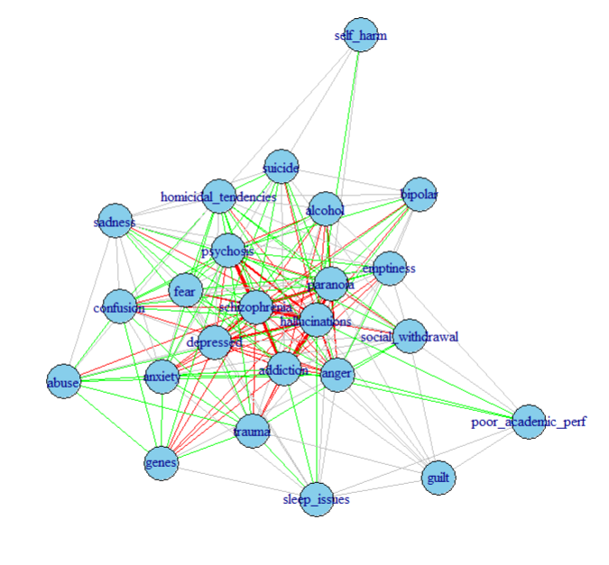
Weights and Degrees…
30.55% High
35.55% Moderate

Slide 8
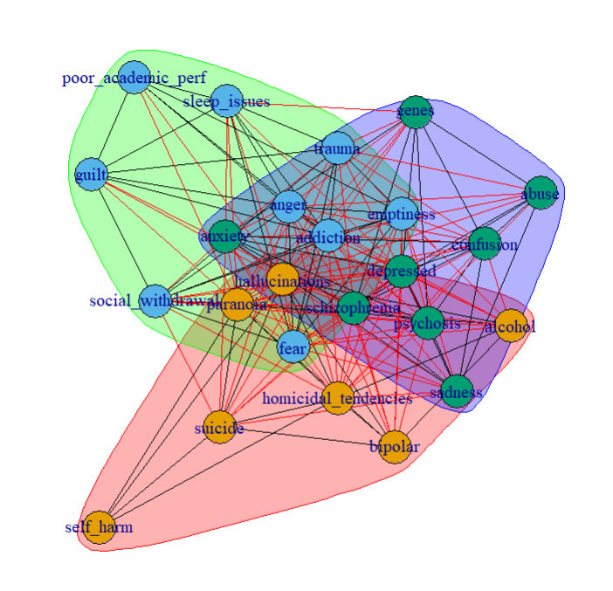
Communities
Community 1 (Mostly Positive)
  hallucinations, alcohol, paranoia, bipolar, homicidal_tendencies, suicide, self_harm
Community 2 (Mostly Negative)
  anger, addiction, emptiness, social_withdrawal, sleep_issues, fear, guilt, trauma, poor_academic_per
Community 3 (Mixture of Positive, Negative and Cognitive)
  abuse, schizophrenia, depressed, psychosis, sadness, anxiety, genes, confusion

Slide 9


What about the onset?
We need to figure out a way to retrieve the age without accidentally counting numbers that don’t correspond to it
“I have had 9 episodes so far. I was diagnosed at 20.”
result: 9, 20 (WRONG!) result: 20 (CORRECT)
answer: REGEX
When users talk about age, the number is usually followed by: s, ‘s, years old, and, but, . , comma or nothing at all
Before the number, we can find words like: at, was, a
But what about HIDDEN AGES?
“When I was a child” or “When I was in college”

Slide 10
Solution : MORE FILTERING !
“I got diagnosed when I was in college .”
“I got diagnosed when I was in 20.”
Or
“It was during my early childhood. ”
“It was during my early 10. ”
Young Adults 18-25
Kids 4-12

Slide 11

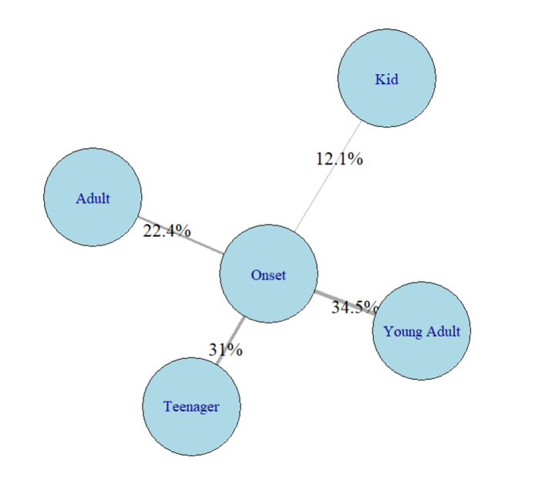






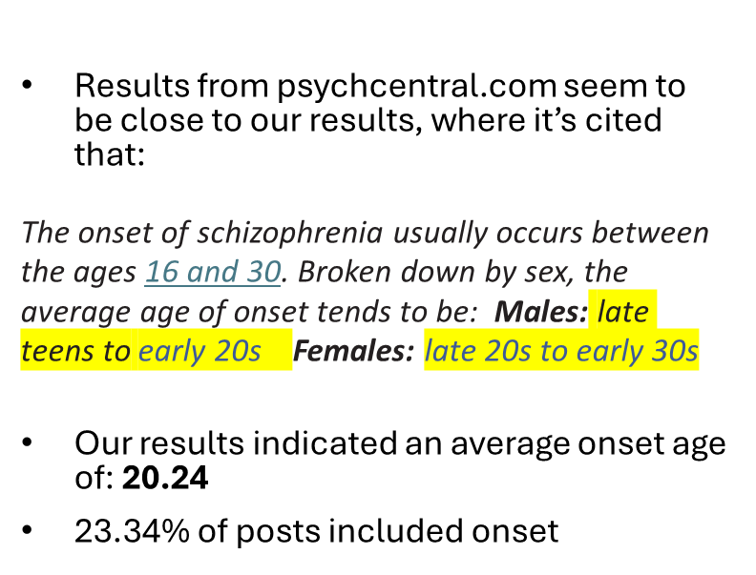

Schizophrenia onset among different age groups based on 500 Reddit Posts

Slide 12
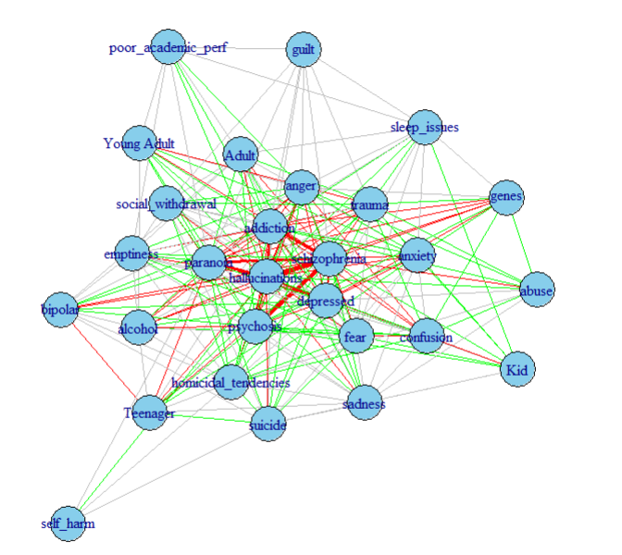

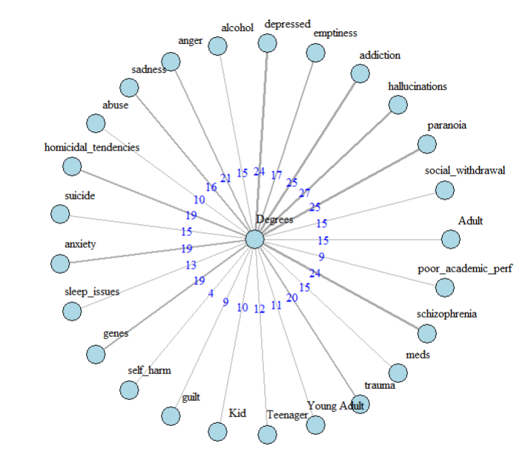
Merging traits and ages
Global clustering: 71. 09% | Edge Density: 60.3%
Local clustering: 76.91% | Mean Distance 1.39
28% High
37.28% Moderate

Slide 13
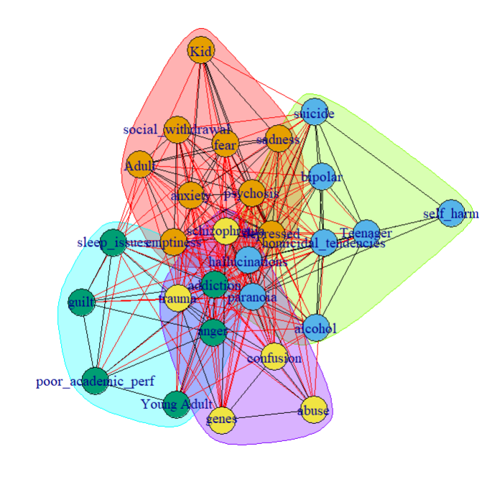
Communities
Community 1
  Adult Kid emptiness depressed psychosis social_withdrawal sadness anxiety fear
Community 2
  Teenager hallucinations alcohol paranoia bipolar homicidal_tendencies suicide self_harm
Community 3
  Young Adult anger addiction sleep_issues guilt poor_academic_perf
Community 4
  abuse schizophrenia genes trauma confusion

Slide 14
Part 2
Can we categorize the posts based on our created
model?

Slide 15
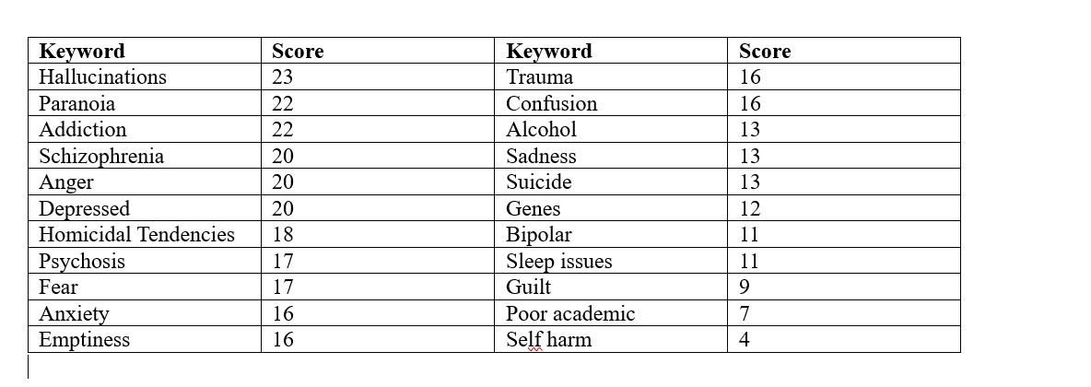


Score creation based on degrees

Slide 16
Further Score Adjustment
hallucinations + paranoia
+30 score
schizophrenia
+30 score
If absent
-10 score
If no high-degree word is present and score is
more than 50, penalty -40

Slide 17
Testing
Before adjustment, keeping degrees as the only filtering method:
False Positives: 19.5%
Τrue Positives: 52%
After adjustment, using penalties as assistance:
False Positives: ~0%
Τrue Positives: ~99.95%

Slide 18
Weaknesses and potential development
While the algorithm is capable of spotting schizophrenia-related posts:
It can’t figure out sarcasm
It can’t spot posts that don’t mention the most important keywords
It can’t spot misspellings
Potential Development:
Make it spelling insensitive
Add more mental disorders
Make it more specific about the content the post contains

Slide 19
Sources
EEG Psychiatric Disorders Dataset | Kaggle : Data with the age, IQ, sex, illness of each person. I cleared the data keeping only the healthy controls and the people with Schizophrenia.
[Serious] People that have been diagnosed with schizophrenia, what was the first time you noticed something wasn't quite right? : r/AskReddit , How did you realize you were schizophrenic? : r/schizophrenia, https://www.reddit.com/r/schizophrenia/comments/1cp37g5/what_do_you_think_caused_schizophrenia_for_you/ , What age we're y'all diagnosed? : r/schizophrenia : Which I used to create the dataset for the posts of schizophrenia
Reddit Mental Health Dataset : Which was used for the testing of the algorithm

Slide 20


