Slide 1

Schizophrenia
…and how to spot it online

Slide 2
What is Schizophrenia?
Schizophrenia is a chronic brain disorder
Genetically inherited but triggered by environmental factors, such as drugs and trauma
Age onset: 21–25 in males and 25–30 in females
Symptoms can include:
  Hallucinations & Delusions (Positive Symptom)
  Socialization difficulties (Negative Symptom)
  Poor Academic/Occupational Performance (Cognitive Symptom)

Slide 3
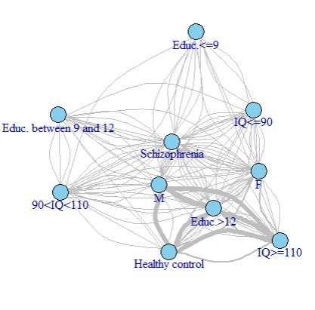
Example: Cognitive Symptom
Sample of 93 healthy individuals (58M, 35F) and 117 schizophrenic (65M, 52F).
Edges’ width represents the weight of each connection.
We have one edge for every combination of characteristics that exists in the dataset.
Education<=12 means that the person has at most graduated high school.
Interestingly, it’s found that the average IQ of healthy individuals was ~106.3 while of patients ~89.62.

Slide 4
What we want to achieve
“Hallucinations started while in college. I was
constantly depressed and didn’t have many friends.”
Threshold : 50
Very likely to be schizophrenia related
Threshold : 22
Contains some schizophrenia-related
keywords

Slide 5
Part 1
Can we build a Schizophrenia model using Reddit posts ?

Slide 6
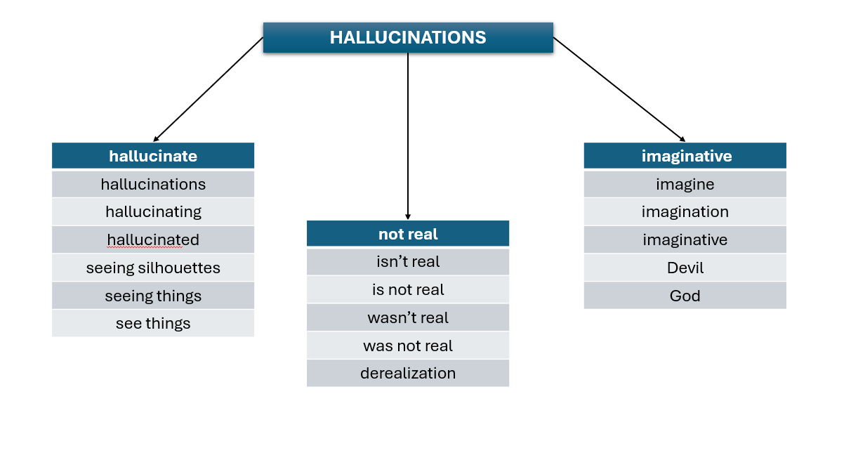
How can we spot symptoms in posts?
ANSWER: DICTIONARIES
“I feel depressed and alone all the time.”
Categories: depressed, social withdrawal
“I have heard voices since I was 15. I grew up
in an abusive household and was drinking
since I was a teen and with depression.”
Categories: hallucinations, abuse, alcohol,
depressed

Slide 7

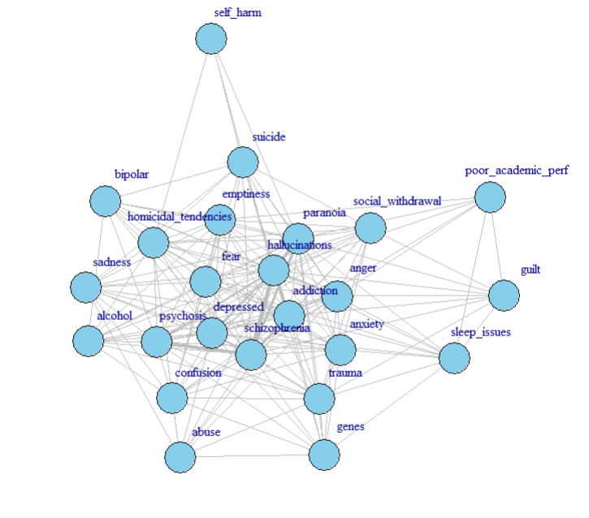
Co-occurrence of schizophrenia traits in 500 Reddit posts ~ Symptoms
Edges connect keywords that appear together in a post.
Highest co-occurrences:
  Schizophrenia, Hallucinations: 8.45%
  Schizophrenia, Psychosis : 7.04%
Global clustering: 75.77%
  how likely it is that two neighbors of a node are also neighbors with each other (generally how clustered the graph is)
Local clustering: 80.78%
  how connected the immediate neighbors of that node are (clustering coefficient of individual nodes)
Edge Density: 65.1%
Mean Distance: 1.34

Slide 8
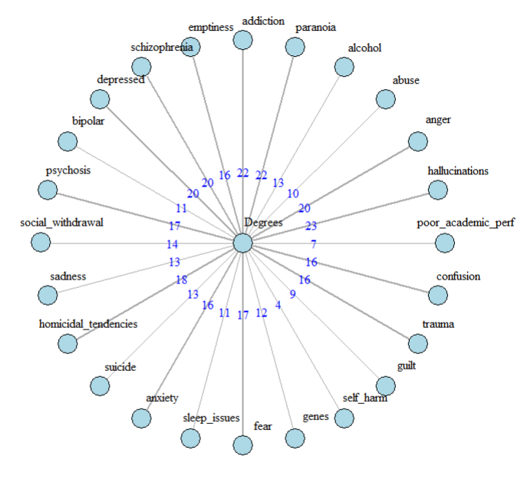
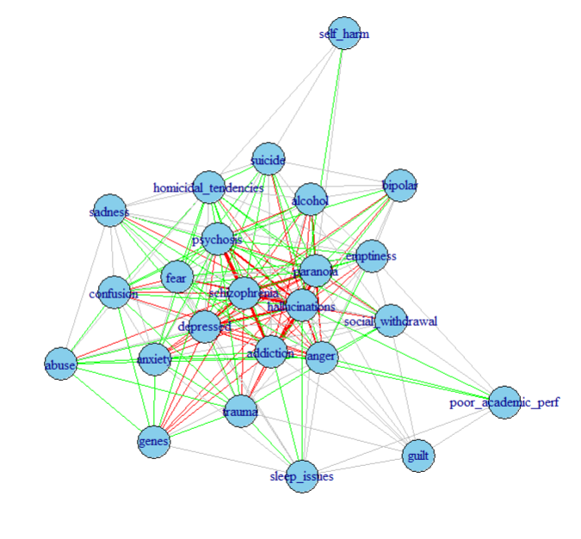
Weights and Degrees…
30.55% High
35.55% Moderate

Slide 9
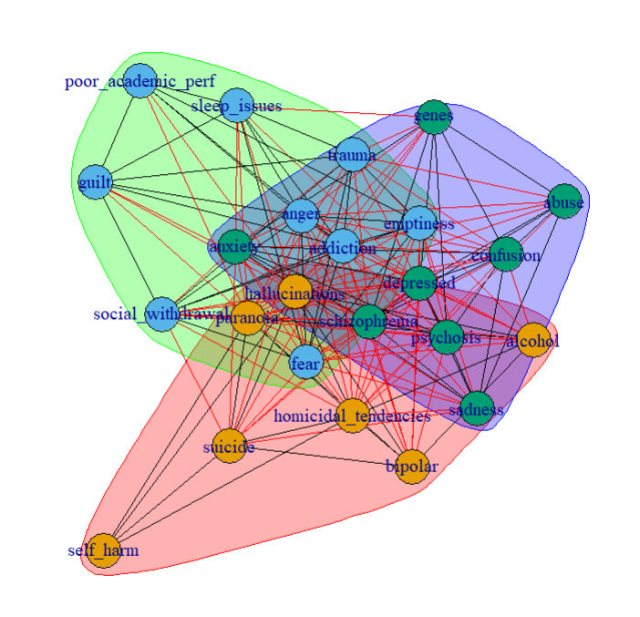
Communities
Community 1 (Mostly Positive)
  hallucinations, alcohol, paranoia, bipolar, homicidal_tendencies, suicide, self_harm
Community 2 (Mostly Negative)
  anger, addiction, emptiness, social_withdrawal, sleep_issues, fear, guilt, trauma, poor_academic_per
Community 3 (Mixture of Positive, Negative and Cognitive)
  abuse, schizophrenia, depressed, psychosis, sadness, anxiety, genes, confusion

Slide 10


What about the onset?
We need to figure out a way to retrieve the age without accidentally counting numbers that don’t correspond to it
“I have had 9 episodes so far. I was diagnosed at 20.”
result: 9, 20 (WRONG!) result: 20 (CORRECT)
answer: REGEX
When users talk about age, the number is usually followed by: s, ‘s, years old, and, but, . , comma or nothing at all
Before the number, we can find words like: at, was, a
But what about HIDDEN AGES?
“When I was a child” or “When I was in college”

Slide 11
Solution : MORE FILTERING !
“I got diagnosed when I was in college .”
“I got diagnosed when I was in 20.”
Or
“It was during my early childhood. ”
“It was during my early 10. ”
Young Adults 18-25
Kids 4-12

Slide 12

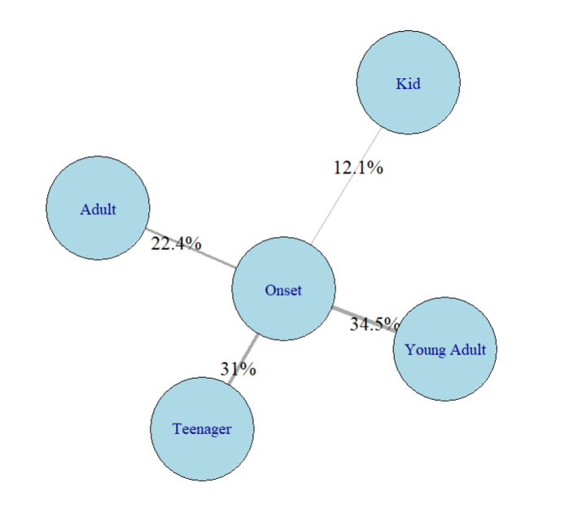






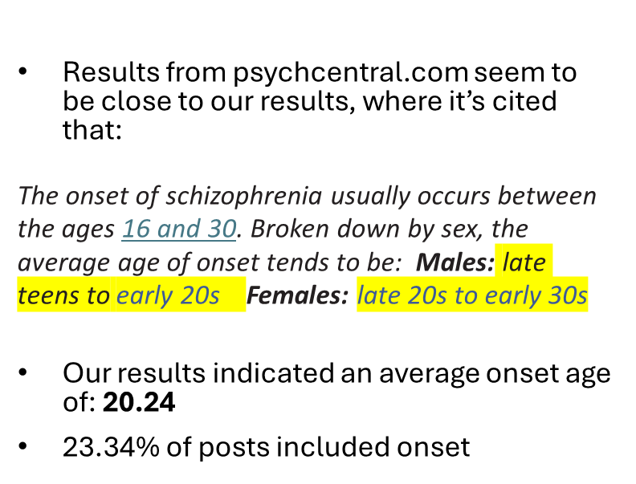

Schizophrenia onset among different age groups based on 500 Reddit Posts

Slide 13
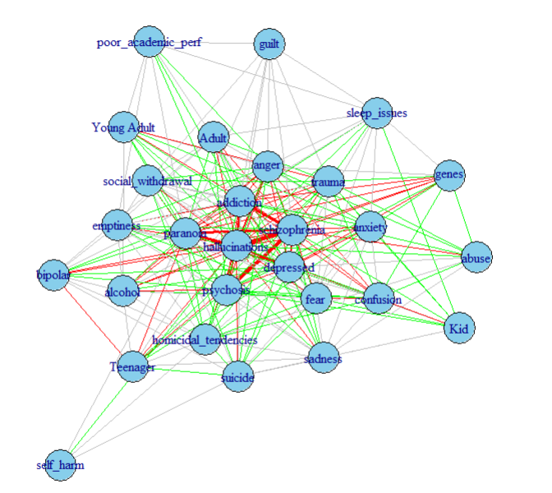

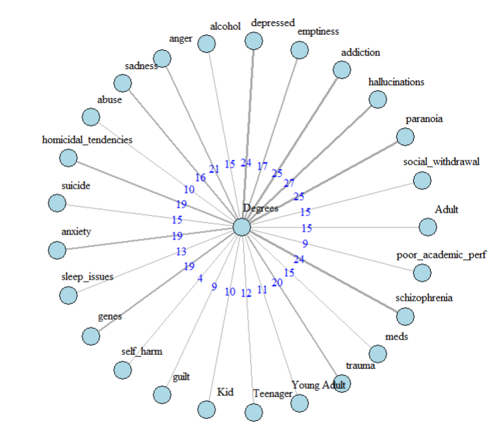
Merging traits and ages
Global clustering: 71. 09% | Edge Density: 60.3%
Local clustering: 76.91% | Mean Distance 1.39
28% High
37.28% Moderate

Slide 14
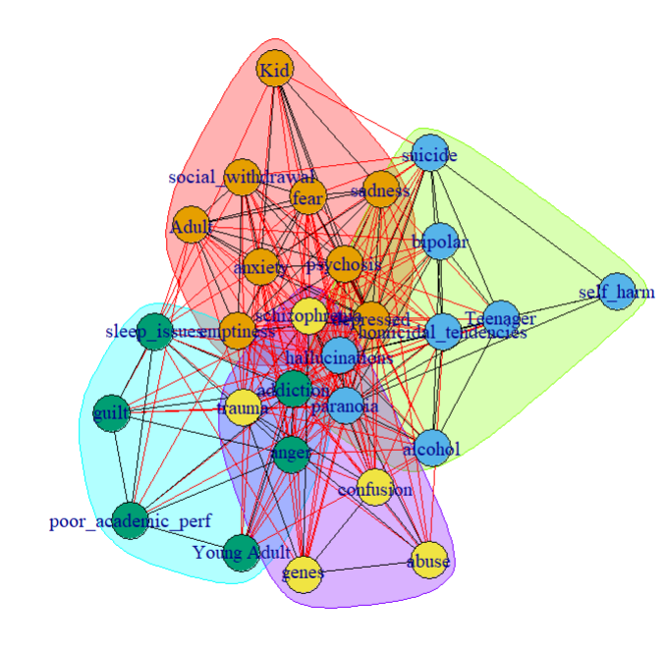
Communities
Community 1
  Adult Kid emptiness depressed psychosis social_withdrawal sadness anxiety fear
Community 2
  Teenager hallucinations alcohol paranoia bipolar homicidal_tendencies suicide self_harm
Community 3
  Young Adult anger addiction sleep_issues guilt poor_academic_perf
Community 4
  abuse schizophrenia genes trauma confusion

Slide 15
Part 2
Can we categorize the posts based on our created
model?

Slide 16
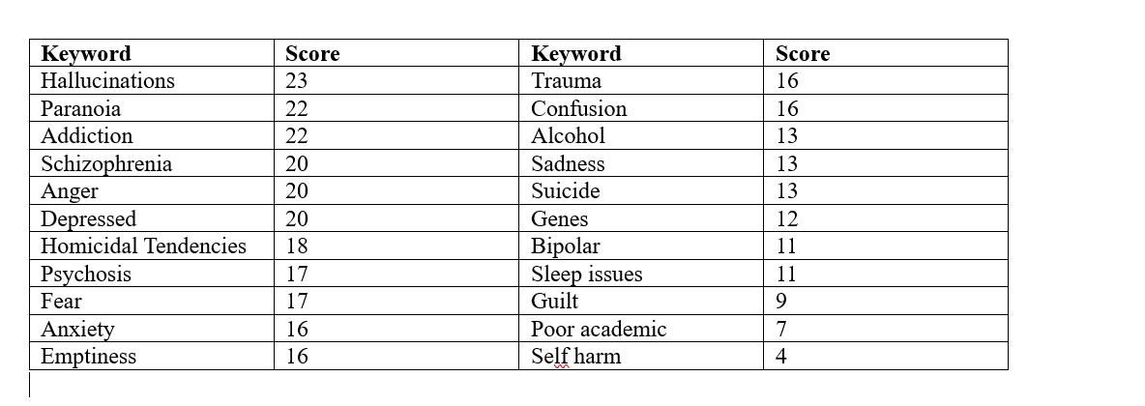


Score creation based on degrees

Slide 17
Further Score Adjustment
hallucinations + paranoia
+30 score
schizophrenia
+30 score
If absent
-10 score

Slide 18
Testing
Before adjustment with threshold 45:
False Positives: 19.5%
Τrue Positives: 52%
After adjustment with threshold 50:
False Positives: ~0%
Τrue Positives: ~99.95%

Slide 19
Weaknesses and potential development
While the algorithm is capable of spotting schizophrenia-related posts:
It can’t figure out sarcasm
It can’t spot posts that don’t mention the most important keywords
It can’t spot misspellings
Potential Development:
Make it spelling insensitive
Add more mental disorders
Make it more specific about the content the post contains

Slide 20
Sources
EEG Psychiatric Disorders Dataset | Kaggle : Data with the age, IQ, sex, illness of each person. I cleared the data keeping only the healthy controls and the people with Schizophrenia.
[Serious] People that have been diagnosed with schizophrenia, what was the first time you noticed something wasn't quite right? : r/AskReddit , How did you realize you were schizophrenic? : r/schizophrenia, https://www.reddit.com/r/schizophrenia/comments/1cp37g5/what_do_you_think_caused_schizophrenia_for_you/ , What age we're y'all diagnosed? : r/schizophrenia : Which I used to create the dataset for the posts of schizophrenia
Reddit Mental Health Dataset : Which was used for the testing of the algorithm

Slide 21


