Slide 1
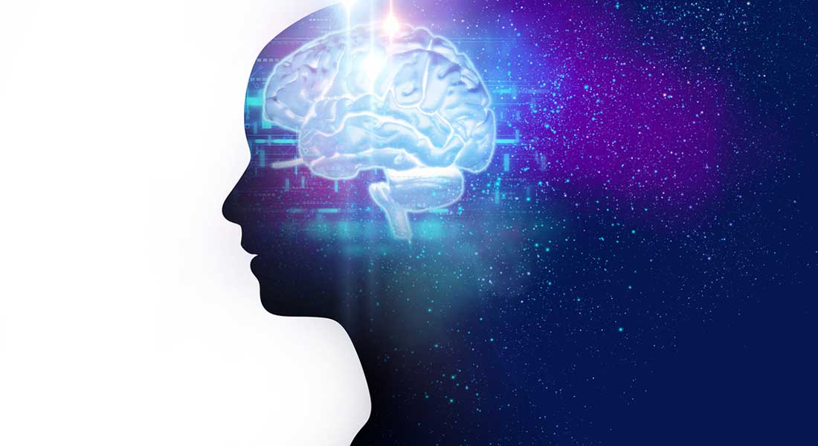
Schizophrenia
…and how to spot it online

Slide 2
What is Schizophrenia?
Schizophrenia is a chronic brain disorder
Genetically inherited but triggered by environmental factors, such as drugs and trauma
Age onset: 21–25 in males and 25–30 in females
Symptoms can include:
  Hallucinations & Delusions (Positive Symptom)
  Socialization difficulties (Negative Symptom)
  Poor Academic/Occupational Performance (Cognitive Symptom)

Slide 3
What we want to achieve
“Hallucinations started while in college. I was
constantly depressed and didn’t have many friends.”
Threshold : 50
Very likely to be schizophrenia related
Threshold : 22
Contains some schizophrenia-related
keywords

Slide 4
Part 1
Can we build a Schizophrenia model using Reddit
posts ?
Is it possible to extract scientifically accurate data from
posts alone?

Slide 5
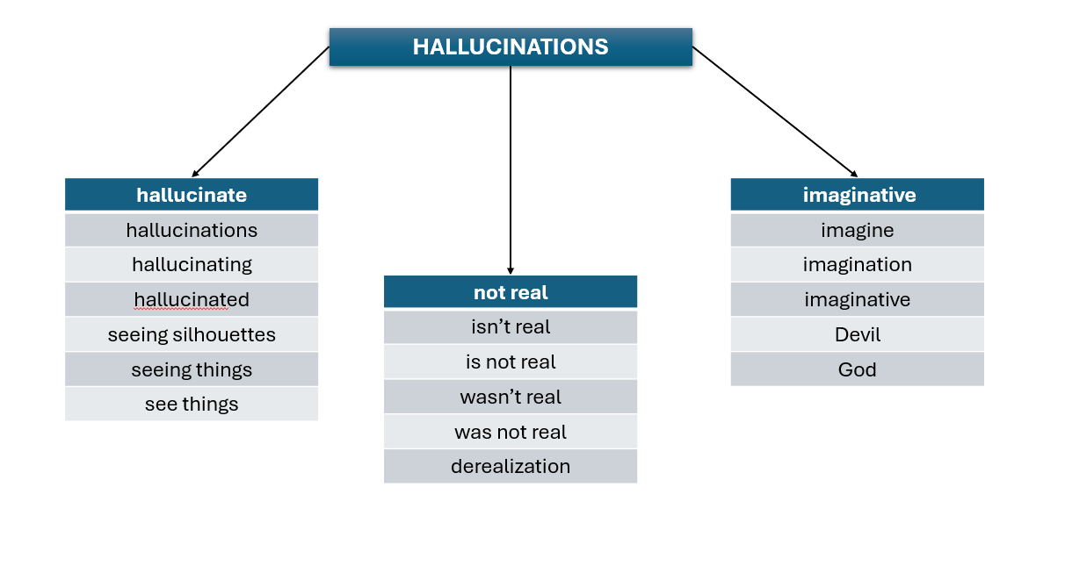
How can we spot symptoms in posts?
ANSWER: DICTIONARIES
“I feel depressed and alone all the time.”
Categories: depressed, social withdrawal
“I have heard voices since I was 15. I grew up
in an abusive household and was drinking
since I was a teen and with depression.”
Categories: hallucinations, abuse, alcohol,
depressed

Slide 6

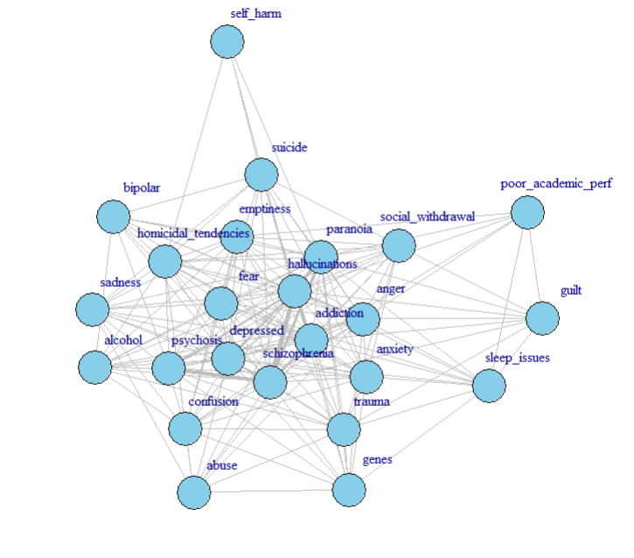
Co-occurrence of schizophrenia traits in 500 Reddit posts ~ Symptoms
Edges connect keywords that appear together in a post.
Highest co-occurrences:
  Schizophrenia, Hallucinations: 8.45%
  Schizophrenia, Psychosis : 7.04%
Global clustering: 75.77%
  how likely it is that two neighbors of a node are also neighbors with each other (generally how clustered the graph is)
Local clustering: 80.78%
  how connected the immediate neighbors of that node are (clustering coefficient of individual nodes)
Edge Density: 65.1%
Mean Distance: 1.34

Slide 7
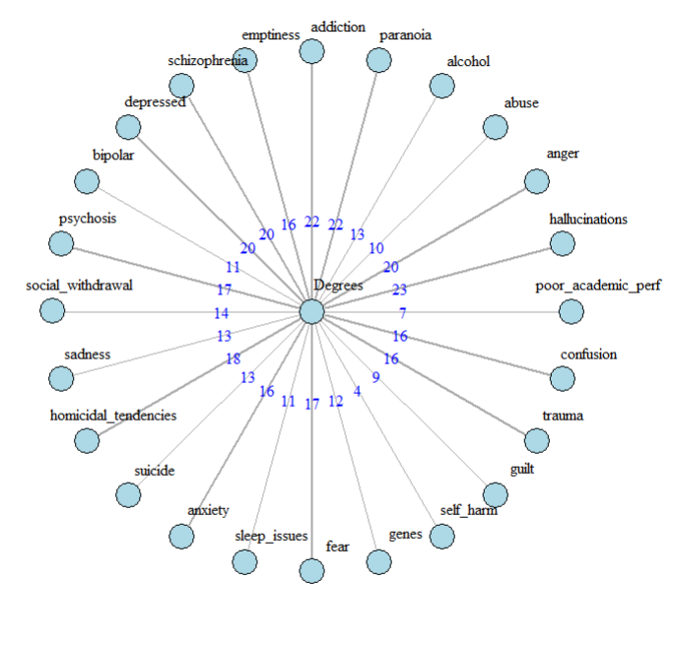
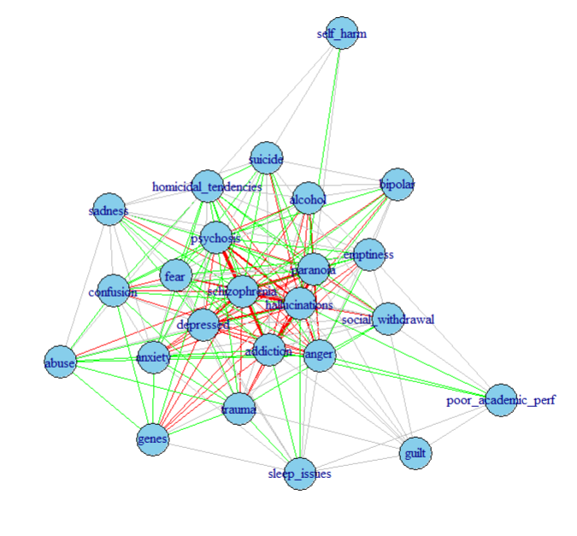
Weights and Degrees…
30.55% High
35.55% Moderate

Slide 8
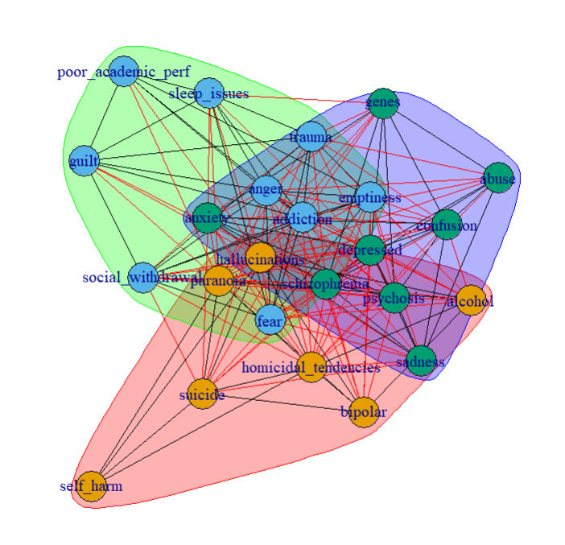
Communities
Community 1 (Mostly Positive)
  hallucinations, alcohol, paranoia, bipolar, homicidal_tendencies, suicide, self_harm
Community 2 (Mostly Negative)
  anger, addiction, emptiness, social_withdrawal, sleep_issues, fear, guilt, trauma, poor_academic_per
Community 3 (Mixture of Positive, Negative and Cognitive)
  abuse, schizophrenia, depressed, psychosis, sadness, anxiety, genes, confusion

Slide 9


What about the onset?
We need to figure out a way to retrieve the age without accidentally counting numbers that don’t correspond to it
“I have had 9 episodes so far. I was diagnosed at 20.”
result: 9, 20 (WRONG!) result: 20 (CORRECT)
answer: REGEX
When users talk about age, the number is usually followed by: s, ‘s, years old, and, but, . , comma or nothing at all
Before the number, we can find words like: at, was, a
But what about HIDDEN AGES?
“When I was a child” or “When I was in college”

Slide 10
Solution : MORE FILTERING !
“I got diagnosed when I was in college .”
“I got diagnosed when I was in 20.”
Or
“It was during my early childhood. ”
“It was during my early 10. ”
Young Adults 18-25
Kids 4-12

Slide 11

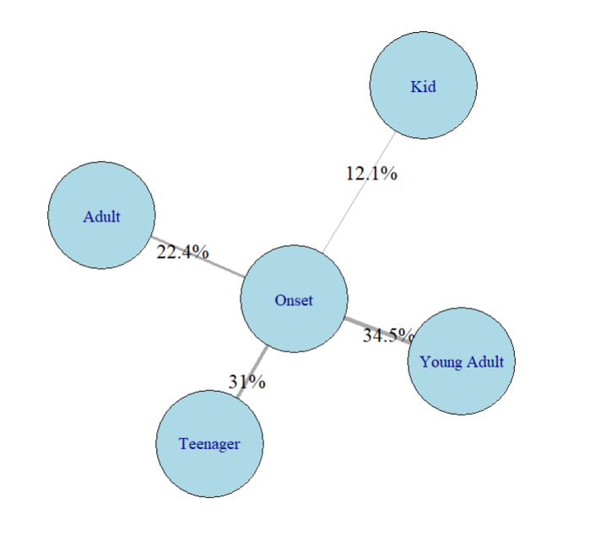






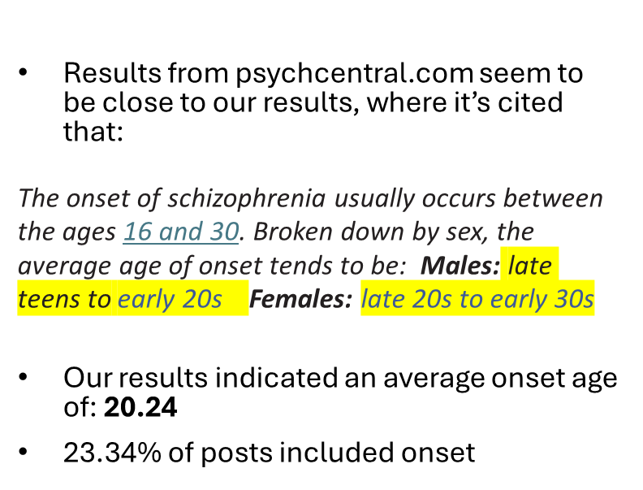

Schizophrenia onset among different age groups based on 500 Reddit Posts

Slide 12
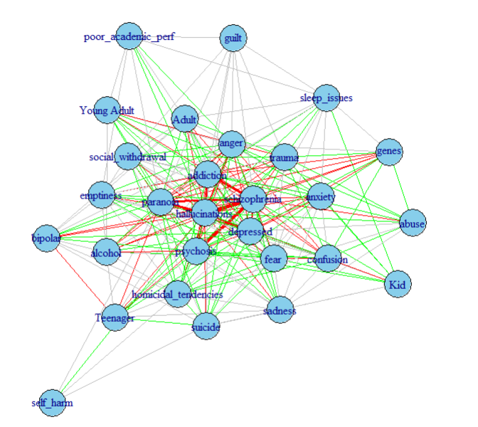

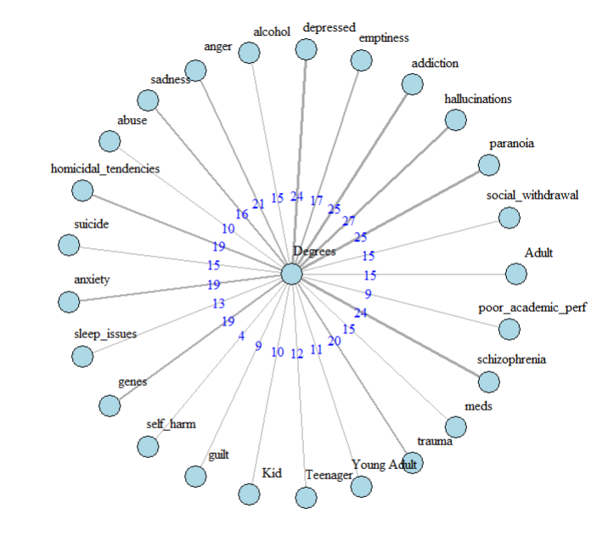
Merging traits and ages
Global clustering: 71. 09% | Edge Density: 60.3%
Local clustering: 76.91% | Mean Distance 1.39
28% High
37.28% Moderate

Slide 13
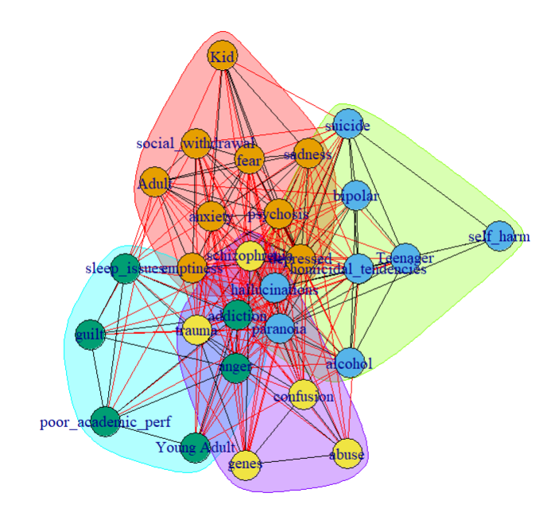
Communities
Community 1
  Adult Kid emptiness depressed psychosis social_withdrawal sadness anxiety fear
Community 2
  Teenager hallucinations alcohol paranoia bipolar homicidal_tendencies suicide self_harm
Community 3
  Young Adult anger addiction sleep_issues guilt poor_academic_perf
Community 4
  abuse schizophrenia genes trauma confusion

Slide 14
Part 2
Can we categorize the posts based on our created
model?

Slide 15
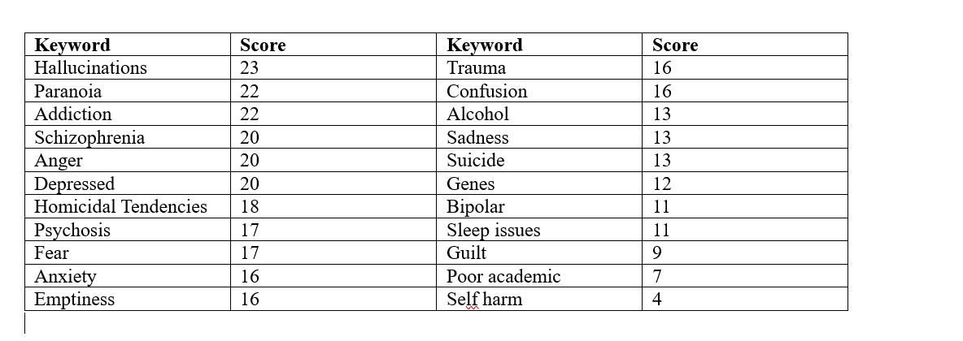


Score creation based on degrees

Slide 16
Further Score Adjustment
High degree symptoms
+30 score
Schizophrenia keyword
+30 score
If absent
-10 score
If no high-degree word is present and score is
more than 50, penalty 40

Slide 17
Testing
Before adjustment, keeping degrees as the only filtering method:
False Positives: 19.5%
Τrue Positives: 52%
After adjustment, using penalties as assistance:
False Positives: ~0%
Τrue Positives: ~99.95%

Slide 18
Conclusion
The attempt to create a schizophrenia related model based on posts alone leads to a
variety of conlusions:
Symptoms such as hallucinations and paranoia were indeed found to be severe;
however, others, like homicidal tendencies, were significantly overrepresented,
leading to inaccurate conclusions.
The onset observed in posts appeared to align with the timelines reported in scientific
studies.
Without proper score adjustments, accurately identifying schizophrenia-related posts
proved challenging, as certain symptoms were either vastly over- or underemphasized
compared to medically established findings.

Slide 19
Weaknesses and potential development
While the algorithm is capable of spotting schizophrenia-related posts:
It can’t figure out sarcasm
It can’t spot posts that don’t mention the most important keywords
It can’t spot misspellings
Potential Development:
Make it spelling insensitive
Add more mental disorders
Make it more specific about the content the post contains

Slide 20
Sources
EEG Psychiatric Disorders Dataset | Kaggle : Data with the age, IQ, sex, illness of each person. I cleared the data keeping only the healthy controls and the people with Schizophrenia.
[Serious] People that have been diagnosed with schizophrenia, what was the first time you noticed something wasn't quite right? : r/AskReddit , How did you realize you were schizophrenic? : r/schizophrenia, https://www.reddit.com/r/schizophrenia/comments/1cp37g5/what_do_you_think_caused_schizophrenia_for_you/ , What age we're y'all diagnosed? : r/schizophrenia : Which I used to create the dataset for the posts of schizophrenia
Reddit Mental Health Dataset : Which was used for the testing of the algorithm

Slide 21


