Slide 1
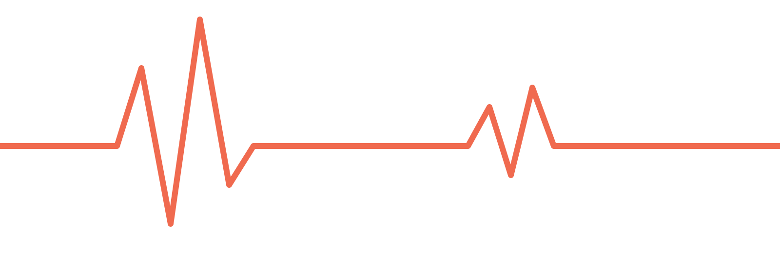
Team Uzbekistan · International Space Tournament Orbita 2026
SnailPulse
A living snail’s heartbeat, measured on the way to 24 km
Diyora Mirpulatova
Research
Begoyim Yarashova
Engineering
Nurmuhammad Buriev
Radio
Azizbek No’monjonov
Electronics and code
Ezoza Yuldosheva
Mentor
Notes:
Hello, we are Team Uzbekistan. Our project is SnailPulse: we fly a living garden snail to about 24 kilometres and measure its heartbeat during the whole flight, without hurting it. Our team: Diyora does the research, Begoyim the engineering, Nurmuhammad the radio, and I am Azizbek, I do the electronics and the code. (about 20 seconds)

Slide 2
Our three biology missions
1 · Flies with SnailPulse
2
3
Snail mucus
Earthworms
DNA
A healing material for bone, cartilage and wounds
Living tools that keep soil healthy for farming in space
Ship the recipe, not the medicine: bacteria make it on demand
A snail-mucus gel healed chronic wounds in rats and mice after one application.
Worms raise plant growth by 23% and plant phosphorus uptake by 21%.
Bacteria have made human insulin from added DNA since 1982.
One question for all three: does it still work after the stratosphere?
Notes:
We researched three biology missions: snail mucus as a healing material, earthworms to keep soil healthy for farming in space, and DNA, so bacteria can make medicines on demand. For all three we ask the same question: does it still work after the stratosphere? Mission one, the snail, is the one we fly. (about 25 seconds)

Slide 3
Why snail mucus
1–1.5%
What studies on Earth show
In chitosan scaffolds, mucus boosted bone and cartilage cell activity and fought bacteria.
Perpelek et al., 2021
of bone density lost every month by astronauts on long missions (NASA)
And any injury happens far from a hospital.
A snail-mucus gel moved chronic diabetic wounds from inflammation into repair.
Zhou et al., 2023
Does a trip to the stratosphere change the snail and its mucus?
Notes:
Why snail mucus? On long missions astronauts lose 1 to 1.5 percent of their bone density every month, and any injury happens far from a hospital. Snail mucus sticks to tissue, keeps it moist and fights bacteria. In studies it boosted bone and cartilage cells, and a mucus gel healed chronic wounds in rats and mice. But all of this was tested on Earth. So our question is: does a trip to the stratosphere change the snail and its mucus? (about 35 seconds)

Slide 4
How we test it
Flight snail
up to 24 km and back
Collect mucus
from both snails
Same tests
on both samples
Ground snail
same box, same days
Structure
Is the gel still stable?
Stickiness
Does it still stick to tissue?
Moisture
Does it still hold water?
Antibacterial
Does it still stop bacteria?
During the flight, SnailPulse records the snail’s heartbeat live, so we know what it went through.
Notes:
One snail flies, and one stays on the ground in the same kind of box. After landing we run the same four tests on both mucus samples: structure, stickiness, moisture, and whether it still stops bacteria. We don't assume the flight makes it better; we check what changes. And during the flight, SnailPulse records the heartbeat live, so we know what the snail went through. (about 30 seconds)

Slide 5
How SnailPulse works
1
2
3
4
Sensor on the shell
Our board
Flight computer
Radio to the ground
Infrared light shines in. Each heartbeat changes how much comes back.
Filters out noise and makes the tiny signal 101 times bigger.
Reads it 50 times a second, counts the beats, saves everything to SD.
Heart rate and a piece of the raw signal, every 2 seconds.
10–200
×101
2 s
beats per minute the filter lets through
signal gain
between updates on the ground
Notes:
SnailPulse works in four steps. An infrared sensor on the shell shines light in, and every heartbeat changes how much comes back. Our board filters the signal and makes it 101 times bigger. The flight computer reads it 50 times a second, counts the beats and saves everything to SD. Every two seconds the radio sends the heart rate and a piece of the raw signal to our ground station. (about 30 seconds)

Slide 6
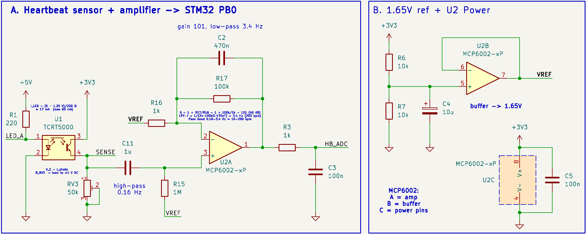
Our circuit, revision C
Sensor → filter → amplifier → flight computer. Two chips, no extra microcontroller.
Notes:
This is our circuit. A filter removes the steady part of the signal, and the amplifier boosts only heartbeats between about 10 and 200 beats per minute. A reference voltage keeps the signal in the middle of the computer's range. It is just two chips; the organisers' flight computer does the rest. (about 20 seconds)

Slide 7
Where we are today
Done
Now
Next, in Moscow
Test flight: snail survived, satellite recovered
Circuit designed and reviewed
Flight code and ground software, tested on a PC
All parts bought
Soldering the board
Bench test: a finger pulse first, then a snail
First run on the flight computer
Tune the sensor on a live snail
Cold test of the whole box
Fit into the CubeSat
Launch, 31 October
Notes:
Our test flight already worked: the snail survived, and we recovered the satellite. The circuit is designed and reviewed, the flight code and ground software are tested on a computer, and all parts are bought. Now we are soldering the board and testing it, first on a finger pulse, then on a snail. Here in Moscow we will run it on the flight computer, tune it on a live snail, cold-test it and fit it into the CubeSat before the launch on the 31st. (about 40 seconds)

Slide 8
Thank you
We’re happy to take your questions.
Notes:
Thank you. We are happy to take your questions.

