Slide 1
Accessing Wikidata Data:
Until it can be done properly
Max Klein @notconfusing
Wiki Research Hackathon
November 9 2013
(cc by-sa)

Slide 2
Natively
Wikidata is mostly standard Mediawiki except
Pages don't store Wikitext, they store JSON blobs

Slide 3
Structure of an Item
Dictionary
  {“labels”: language dicitonary
  “descriptions”: language dicitonary
  “aliases”: language dicitonary
  “claims”: list of property and values
  “sitelinks”: language dicitonary}

Slide 4
Ways to get the data
Live, from the API, using pywikibot
  Read / write
Offline, dumps, using “wda” (WikiData Analytics) parser
  https://github.com/mkroetzsch/wda
  Read only
Linked data, entities and Content negotiation
  Read only

Slide 5
Content Negotiation
Path
  wikidata.org/entity/QID.
    nt
    Rdf
    ttl

Slide 6
Content Negotiaton Example
https://www.wikidata.org/wiki/Special:EntityData/Q42046.ttl
  @prefix entity: <http://www.wikidata.org/entity/> .
  @prefix wikibase: <http://www.wikidata.org/ontology#> .
  @prefix rdfs: <http://www.w3.org/2000/01/rdf-schema#> .
  @prefix skos: <http://www.w3.org/2004/02/skos/core#> .
  @prefix schema: <http://schema.org/> .
  @prefix data: <http://www.wikidata.org/wiki/Special:EntityData/> .
  @prefix cc: <http://creativecommons.org/ns#> .
  @prefix xsd: <http://www.w3.org/2001/XMLSchema#> .
  entity:Q42046
  a wikibase:Item ;
  rdfs:label "鬣狗科"@zh, "Hienowate"@pl, "Hiena"@eu, "Hyaenidae"@es, "Hiëna"@af, "Dubuk"@ms, "Hiénafélék"@hu, "Fisi"@sw, "Hüäänlased"@et, "হায়েনা"@bn, "Hiena"@sq, "Hyaenidae"@br, "Ύαινα"@el,

Slide 7
Using Pywikibot
Almost full support of the API
  New classes in the “core” branch
    class WikibasePage(Page):
    class ItemPage(WikibasePage):
    class PropertyPage(WikibasePage):
      class Claim(PropertyPage):

Slide 8
Using Pywikibot
Classic pywikibot pagegenerators work.
  #make a generator for all the pages with a property
  en_wikipedia = pywikibot.Site('en', 'wikipedia')
  wikidata = en_wikipedia.data_repository()
  property_page = pywikibot.ItemPage(wikidata, 'Property:P21')
  pages_with_property = property_page.getReferences()

Slide 9
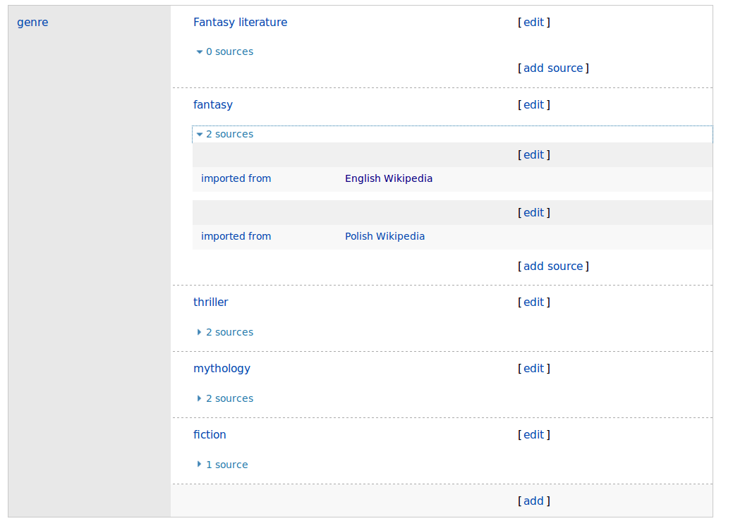
Pywikibot example
Harvesting infoboxes. In this case book, and dececting similar genres

Slide 10
Using wda
Downloads dump
  And then uses nightly incremental dumps
  About 10GB first download
Also written in python

Slide 11
Using wda
After downloading there is a parser that writes a file called kb.txt
  kb.txt stores plaintext triples
    one per line
  21 link {cdowiki:Ĭng-gáik-làng} .
  Q21 link {trwiki:İngiltere} .
  Q21 link {hewiki:אנגליה} .
  Q21 alias {en:ENG} .
  Q21 alias {min:Inggirih} .
  Q21 alias {sgs:England} .
  Q21 P31 Q1763527 .
  Q21 P47 Q22 .
  Q21 P47 Q25 .
  Q21 P36 Q84 .
  Q21 P85 Q40807 .
  Q21 P85 Q489607 .
  Q21 P85 Q182268 .
  Q21 P17 Q145 .
  Q21 P31 Q3336843 .
  Q21 P41 {Flag of England.svg} .

Slide 12
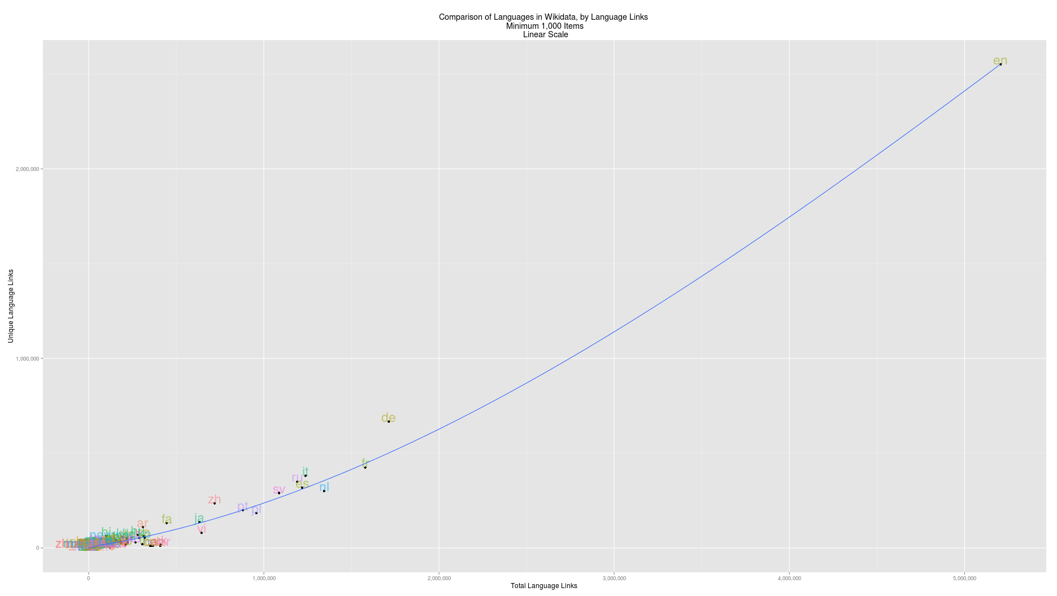
Wda example

Slide 13
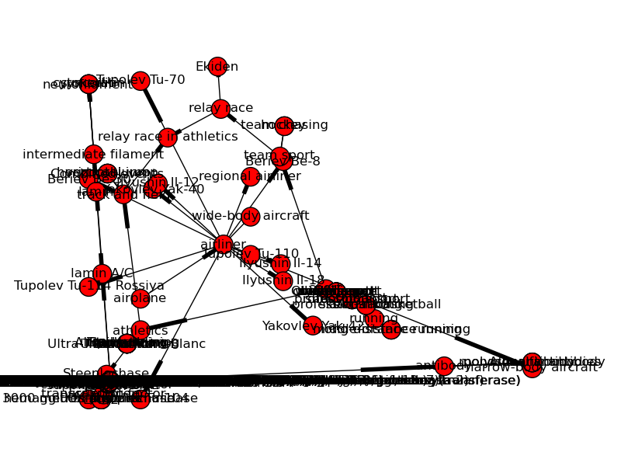
Wda example
Can somebody help with interactive graph visualization?

