Slide 1
C++

Slide 2
Location of code
https://github.com/noteonbg/cplusMay24.git
Contains a file called c++notes.txt go thru it.
Some reference pdfs
https://github.com/federico-busato/Modern-CPP-Programming.git

Slide 3
Why c++
Ability to talk with os directly
Support from various companies, most important open source
Compatible with C .

Slide 4
Versions
C++ 17 most commonly used, but it is major improvement over c++11
C++20 …picking up
C++ 23 preview release…

Slide 5
How to use c++
C plus some extra features like references, overloading, templates,
Object Orientedness

Slide 6
Two categories of applications
Applications
Can run independently, main function is present
Libraries
Cannot run independently must be used with some application.

Slide 7
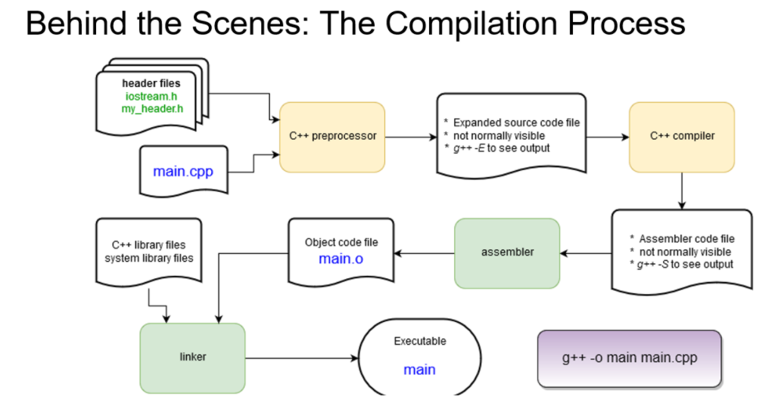

Slide 8
Basics 1
Namespace
Class
Functions
Overloading
Default arguments
Inline
Friend
Operator overloading

Slide 9
Namespace
To avoid naming collisions.
If person X has got a class called MedicalDevice and person Y has also a class called MedicalDevice then how to differentiate use the namespace to differentiate look at a37namespace.cpp

Slide 10
Class
a mechanism to create a new data type in the project.
For example we have int which is a data type, now it has got some content i=3 and some operations i = i *4 , here * can be considered as an operation
Similary class is a data type which project needs to model the domain, example MedicalDomain can contain variables like serialnumber, description and manufacterid and functions. Look at a03classexample.cpp

Slide 11
Additional information on Class
Class
Variables (content)
Functions ( operations)
Remember data type mean content + operations.
We created a class means
We created a data type.
Once we have a data type
Create a variable of the data type , typically in class it means we create the object of the class.

Slide 12
Additional information on class
Scope specifiers in the class
Private
Typically, variables will be present so that we cannot access them directly
Public
Typically, functions are present which will access the private variables.
Approach
Reach the variables thru the functions so that we don’t put junk into the variables.
Look at a03classexample.cpp

Slide 13
Functions
Basic unit of execution
Defining of function
Inside a class
Outside a class
Calling of function
Always done inside a function
Function assignment
Using function like a variable, is not equivalent to calling of function.

Slide 14
Functions
Function definition
Think who is going to call it.
It could be person
It could be system, example main function is not called by person, it is called by system..
Focus on input what does it mean
Focus on output what does it do
How does caller come to know
Function succeeded or function failed.
Key part of good design eventually.

Slide 15
Function
Calling of function
Open documentation and understand the function in terms of
What it does
What does input indicate
What does it return
How do you know failure or success.
We don’t need to know how the function does its job but what it does we should know.

Slide 16
Function overloading
Multiple functions with same name but input arguments must change
If we create ambiguity, then compiler will let us know we should resolve.
Look at a04overloading.cpp

Slide 17
Default arguments
Function input arguments is given a default value.
During function call, if input argument is given, that value is taken
If input argument is not given , default value is assumed.
Ensure no ambiguity when used with overloading ,
look at a19defaultargument.cpp file

Slide 18
Variables in c++
Basic data types int, float available.
Data type can be inferred by the compiler auto.
Class types inbuilt and programmer created ones exist.
Variables categories can be
Non pointer, non reference types
Pointer type variables
Reference type variables.

Slide 19
Non pointer type, non reference type
X i;
Here x is the data type and i is the variable name.
Example
Int I
Bool x
MedicalDevice device;
We pass it to a function or return from the function usually a copy is created.

Slide 20
Pointer type
X* y , Here *indicates it is a pointer and X is the data type and y is name of the variable.
key things
Creation of pointer.
The pointer will point to some variable.
Operate the pointer
Are we operating on the pointer
Are we operating on what the pointer points to.

Slide 21
Pointer need
To avoid making copies of variable.
Dynamic allocation
Programmer decides at runtime to allocate memory (Heap usage)
Look at a05passbypointer.cpp
Typically, pointer creation and operation done by person X and assignment done by person Y.
In C++ we use pointers most of times only for dynamic allocation.

Slide 22
Reference
X& y here & indicates reference X indicates data type , y is the variable name.
Used to create alias for a variable.
Two use a reference
We must have an existing variable.
We must assign the reference at time of creation
Look at a06passbyrefernce.cpp
There is a called R value references we will see later on

Slide 23
Array
X y[size]
Here x indicates data type and y indicates variablename.
Array
Group of things
Fixed size
Continuous memory allocation.
We can use subscript to access individual element.
Array name is pointer.
To use , we must know the name of the array and size of the array.
Look at a07array.cpp

Slide 24
Constructor
Syntax, function name in the class same as classname.
It is a function that gets implicitly called when object gets created
Can be overloaded. Which gets called depends on what we pass as input arguments during object creation
Person X is creating the class, Person Y is using the class , by constructor Person X can enforce how to create oject on person Y
look at a12constructoranddestructor.cpp

Slide 25
Destructor in the class
Function with name ~classname.
Gets called when object is removed from memory
Can only be one.
Look at a12constructoranddestructor.cpp

Slide 26
This pointer.
See functions inside class, if you see them with the word static missing this means these are non static functions.
You need an object to access non static functions
Inside the non static function
Implicit pointer gets created called this.
It will point to calling object.
This is local, outside the non static function it wont exist.
Used at method chaining, look at a10thispointer.cpp

Slide 27
Friend Functions
We have a class called X
The class X has to tell that a function f1 will be its friend.
F1 function is defined outside the class.
This function now can access all sections of the class, including private
It is called without an object
Friend function does not have access to “this” pointer. Look at a23friend.cpp

Slide 28
Operator overloading.
We have a class called X
We us say Y is an object of class X
We are using some operator with the object example y >2, now compiler will not know how to deal y, because X is a datatype created by us.
We have to teach it by writing a function
Function name will be starting with operator…

Slide 29
Operator overloading
In the function we have to tell what needs to happen when operator is used with object of our class.
Function can be written typically
Inside the class
Outside the class.
For some operators like = , (), function has to be written inside the class only..
Look at a27operatoroverloading.cpp

Slide 30
Copy constructor and overloaded assignment operator
Copy constructor is used when
We have an existing object.
A new object is being created based on the existing object.
Example passing object to a function by value.
Example f1(m1) here m1 is a MedicalDevice object and assuming f1 input argument is not a reference type, or another case is MedicalDevice m2=m1;, here m1 is existing object and m2 is new object on which the copy constructor is invoked.
Overloaded assignment operator is used when
We already have two existing objects. Example m1 and m2 are objects of Medicaldevice and we are trying to assing one with the other
M1 =m2

Slide 31
Behaviour of copy constructor
Compiler given copy constructor works well when we don’t have any dynamic allocation in our Class
Same is the case for overloaded assignment operator.
In case we have dynamic allocation, then we need to write our own copy constructor or overloaded assignment operator
Look at the examples given in the file a12constructoranddestructor.cpp
Look when the class has no dynamic allocation and when the class has got dynamic allocation.

Slide 32
Need for Inheritance
Hierarchy creation
Generalization
Runtime polymorphism.
Terminologies
Base class
Derived Class
Immediate Base class, Immediate Derived class.

Slide 33
Inheritance
Usually test it by writing “is a “ between Derived class and Base class example, if we have base class as MedicalDevice and derived class as DiagnosticDevice , check “DiagnosticDevice is a MedicalDEvice”
We usually create objects of derived class.
Derived class object can access functions of base class and derived class

Slide 34
Inheritance benefit 1
Add a feature to the base class
No need to make any changes in the derived class.
All objects of derived class now can access feature added in the base class
Look at a33inheritance.cpp

Slide 35
Inheritance benefit 2
Runtime Polymorphism.
Behaviour depending on context, example when we say copy in Windows operating system, meaning of copy will change depending on whether you are in notepad, calculator or file explorer.
Copy in notepad copies text
Copy in calculator copies result
Copy in file explorer copies file.
Implementation possible because of overriding + substitutablity

Slide 36
Overriding
Function of base class is not acceptable to derived class object
Base class owner also feels that this function needs adaptation according to different derived classes
So base class owner makes the function as virtual.
Derived class writes the same function with new definition.
Typically Derived class object will now not be able to access the base class function.

Slide 37
Substitutability
Base class pointer can be assigned with any object of the hierarchy
Base class ptr =new DerivedclassObject, possible.
Suppose we have MedicalDevice, TherupeticDevice and DiagnosticDevice, as derived classes, it is possible to assing MedicalDevice *x =new TherupeticDevice or new DiagnosticDevice

Slide 38
Runtime polymorphism is
Virtual function or overridden function call
By using base class pointer.
Which function gets called depends on which object is assigned to my base class pointer.
Look at a33inheritance.cpp

Slide 39
RTTI -- DynamicCast
During runtime polymorphism we have a base class pointer
Using this we cannot call exclusive functions of the derived class.
Need to typecast base pointer to derived class pointer.
But we don’t know what type of object base class pointer points to hence need to check.
Doing this is called RTTI, mechanism is dynamic_cast in c++
Look at a33inheritance.cpp

Slide 40
Functions in inheritance
Non virtual function
Should not be overridden
Virtual function
May be overridden
Pure virtual function
Must be overridden

Slide 41
Constructor behaviour during inheritance
Derived class object is getting created then
Call of base class constructor
Call of derived class constructor
If the base class has got some parametrized constructor we need to call it explicity in the derived class constructor.

Slide 42
Destructor behaviour
When derived class object is removed from memory
Destructor of derived class
Destructor of base class.
If your pointer is of type base class, during runtime polymorphism
Ensure base class destructor is made virtual, else derived class destructor will not get called.

Slide 43
Templates
Data type independent way of writing classes or functions.
Template function or class is created
While using them, we call it as template initialization.
Look at a39templateclass.cpp

Slide 44
Exception handling
Focus on the function.
Advantage is we have a block try, where normal flow of code executes.
We can catch block where error rectification flow happens.
Most important thing is to remember where the function where exception occurs do we know context or not.
If we know context, then we can handle the problem and solve it.
In case we don’t know context allow exception to propagate and allow the caller of the function to handle it.

Slide 45
Exception handling
Inside if some line is causing trouble an exception object is thrown
If our code is inside a try block then we can write a catch block where reference of the exception can be caught.
If we did not handle the exception, exception goes to the caller of the function where that function needs to decide what to do with the exception. Look at a40exception.cpp

Slide 46
STL – standard template library
This is a datastructure and algorithm library
We get ready made Datastructures like Vector, Map
We get ready made algorithms like copy , find…
There are lot of other options than STL to consider in c++
See whether we know basics of Datastructures and use whichever library the project prefers.

Slide 47
Datastructure basics.
Datastructure means
Group of things.
We have some operations in mind
We pick one from the library.
Key thing is to know operations which we want
Broadly you can classify it as
Linear DS ( normal notebook) – Array, Vector
Non Linear DS( indexed notebook ) – Map, Set .. Which will usable if we are planning to search or sort fequently

Slide 48
Learning Datastructures
Picking one from the library,
Knowing what operations we want.
Respecting other person design.
Datastructure will force us to define some function for searching, for example, we have to learn how to write that function only then DS will work
If we are making our class MedicalDevice into the Vector check out what all conditions it needs to meet to be inside the Vector.

Slide 49
Vector
Growable array
Iterate thru the entire array
Occasionally search in the array
Remember it is a linear datastructure.
Look at a42vector.cpp and a43vector.cpp

Slide 50
Map
Non linear Datastructure
Dictionary operations
Put key and value
Get value specifying key
Iterate thru the Map
Think of what other operations.
Look at a47mapexample.cpp

Slide 51
STL summary
Containers
List
Vector
Map
Set
Algorithms
Sort
Find
copy

Slide 52
STL
Iterators
Ability to navigate thru datastructures.
Functors
Objects that behave like functions.
Utilities
Move, pair…

Slide 53
Move constructor and Rvalue references
Int &&x =20; here x is called rvalue references.
Std::move function to move content from a temporary variable to another variable.
Look at a59moveconstructor.cpp and a59move.cpp

Slide 54
Lamda expression
Ability to pass lines of code to a function
Lambda function signature :
[capture list] (parameters) ->return type{
// Function body
}
capture list contains variables from outside the function, parameters are input and , essentially we are passing a function like a input argument.

Slide 55
C++ 11 features.
Auto
Lambda Expressions
Smart Pointers
Concurrency Support
R-value references
Changes in STL
Constexpr
nullptr

Slide 56
C++ 17 features.
Structured Bindings
Constexpr with if condition
Std::optional
Filesystem Library

Slide 57
C++ 20 features
Concepts Library apply restrictions on templates.
Ranges Library
std::vector<int> numbers = {1, 2, 3, 4};
auto even_numbers = numbers | std::views::filter([](int n) { return n % 2 == 0; });
Modules

Slide 58
Thank you
Brita Tamm
502-555-0152
brita@firstupconsultants.com
www.firstupconsultants.com

