Slide 1
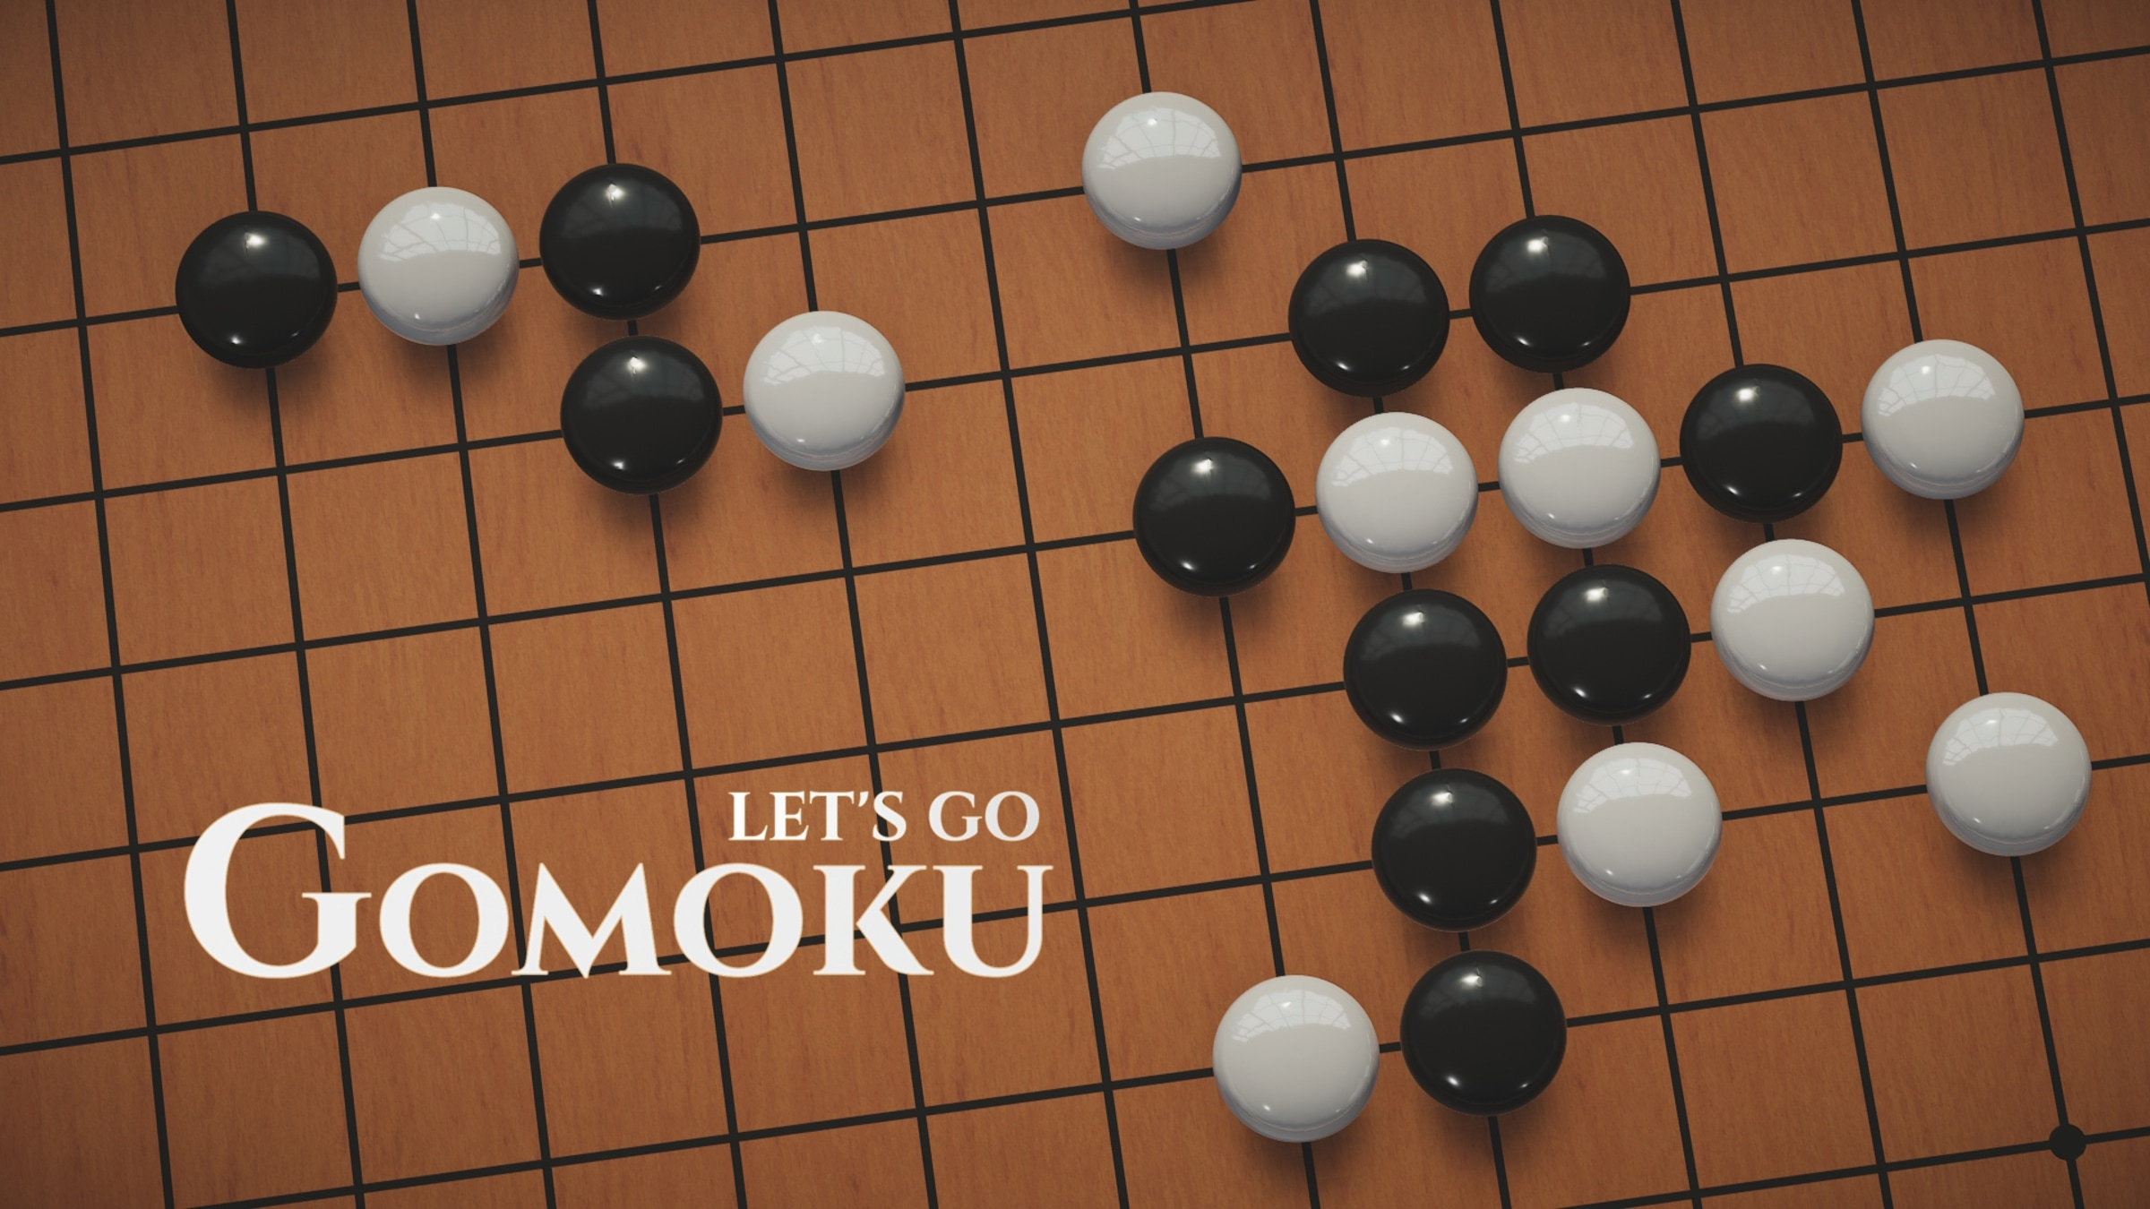
Gomoku dApp
Dylan Santiago

Slide 2
Why Algorand Block Chain?
Decentralization: With no single entity controlling the network the dApp is more resilient than regular databases.
Security: Algorands use of PPoS, Pure-Proof-of-Stake, provides less security risk to attacks. So, players would not need to worry about rules being hacked.
Immutable Data: Tamper proof records of players past games of Gomoku dApp could allow players to match with other players of similar records. (Not implemented)
Smart Contracts: The main reasons for using Algorand block chain. The complex logic required after a game has been completed can be automated super easily and fast using Smart Contracts.

Slide 3
Stateful Smart Contract Implementation
Implements game logic of Gomoku.
Smart Contract can start the game, execute a game action, and refund Algo submitted.
Smart Signatures used for withdrawing from escrow account
-Using Transaction Execution Approval Language (TEAL)

Slide 4
Setup
Using Python, PyTeal, AlgoSDK, and Streamlit.
2 Players agree to play Gomoku for Algo and submit Algo to an escrow address
Players then play a modified version of Gomoku for the Algo they both sent to the holding address.
Winner can withdraw all funds from address.
Ties are awarded equal Algo to each player.

Slide 5
What is Gomoku?
Simply put it is Chinese TicTacToe.
Originate rules dictate a 15 by 15 or 19 by 19 board size (10 by 10 for my dApp)
Goal is to score 5 in a row (4 in a row for dApp).
Players can only place pieces next to another piece.
Typically, you would start with a piece in the center, but I don’t do that for my implementation.

Slide 6
How I Implemented Gomoku
Array used for storing game pieces (10x10 matrix)
has_player_won() function runs after every move. Very tedious function that checks for every possible winning sequence (up, down, diagonal).
Hardest part is determining a winning move.
There are many many alternate rules for Gomoku, I only used these for simplicity's sake and time's sake. As we would not want a game running for more than 2 hours.

