Slide 1
Intro. To Databases
Dr. Shaheen Khatoon
Shaheen.Khatoon@xjtlu.edu.cn

Slide 2
Course Organization
1: Introduction
2: ER Modeling Concepts
3: Relational Model
6: Normalization
5: SQL
4: Relational Algebra
Book: Database Systems: Models, Design and Application 6th Edition by Ramez Elmasri and S.B. Navathe

Slide 3
Assessments
Assessment 1 (60%): Groupwork (Project)
Assessment 2(40%): Individual Coursework
Note: Refer to the module handbook for detailed assessments
Timetable
Tuesday: Online Lecture, 1300-1530
Thursday: Online Lecture:1330-1630
Friday: Project, labs, and QA: 1300-1500

Slide 4
Lab Setup
Oracle Application Express
Oracle Cloud Free Tier – https://apex.oracle.com/en/
Sign up for Always Free Oracle Cloud, provision an Autonomous Database, and create an APEX workspace. This option will be used for teaching purposes.
Download and run a preconfigured VM:
https://www.oracle.com/database/technologies/databaseappdev-vm.html
Run APEX in a preconfigured Oracle VM VirtualBox using Database Application Development Virtual Appliance. A single download gives developers a free VM with Oracle Database, Oracle REST Data Services, and APEX ready to run.
Oracle Database 18c Express Edition - Download Oracle XE and install on your laptop or desktop machine and then download and install the latest Oracle Application Express release.
Download and install: Data Modeling with Oracle SQL Developer - https://www.oracle.com/database/technologies/appdev/datamodeler.html

Slide 5
Chapter 1: Introduction to Databases
The goal of this chapter is to provide basic terms and concepts related to Databases.

Slide 6
Why to Study Databases?
Databases are an essential component of life in modern society.
We interact with databases in many daily activates, such as:-
Banking transactions: open an account, deposit, withdraw, transfer, etc.
Hotel or airline reservation.
E-commerce, buy or sell online.
Search for a book in the library.

Slide 7
Types of Databases and Database Applications
Traditional database applications
Store textual or numeric information
Sales system, Cash handling system, reservation system
Amazon.com- Example of large database application
Multimedia databases
Store images, audio clips, and video streams digitally
Geographic information systems (GIS)
Store and analyze maps, weather data, and satellite images

Slide 8
Types of Databases and Database Applications (cont'd.)
Data warehouses and online analytical processing (OLAP) systems
Extract and analyze useful business information from very large databases
Support decision making
Real-time and active database technology
Control industrial and manufacturing processes

Slide 9
What is Data?
Known facts that can be recorded and have an implicit meaning.
Made up of individual and variable:
Variables holds values of some type; integer, float, string, image, .. Etc.
Individual | Variables
Person | Height, Weight, IQ, number of siblings, Family Income
City | Population, Area, Total Income of Individuals in the city
Stock | Price of stock during each day in 2020
How this data store?
Flat files vs database

Slide 10
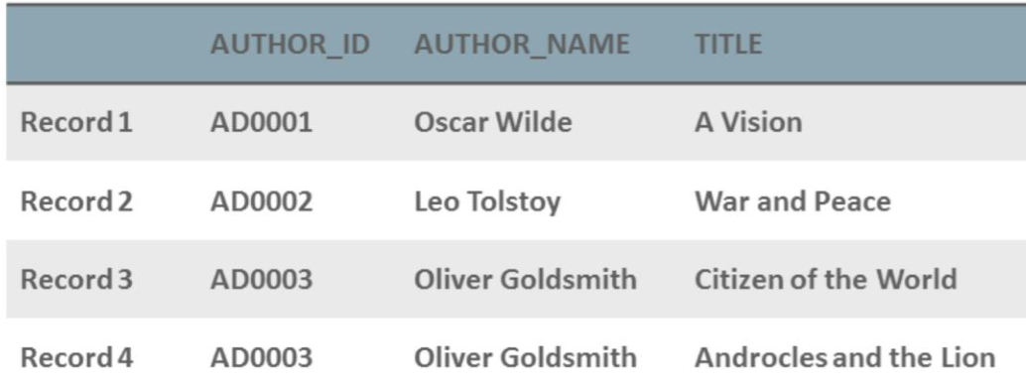
File Processing System (FPS)
FPS introduces flat files to store data
Type of database that store data in single file
Flat files are generally in plain text form, where each line hold only one record
The flat file design puts all database information in one table, or list, with fields to represent all parameters.
Example shows how the details of books and authors are stored in a single table.
Notice that both the details for the books and authors are stored in this single table, and there is a repetition of values

Slide 11
File Processing System (FPS)
Each user defines and implements the files needed for a specific software application
The application which involve data processing as a basic activity rather than computation
FPS is a collection of programs that perform services for the end users such as production of reports
This redundancy in defining and storing data results in wasted storage space and redundant efforts to maintain common up-to-date on data.

Slide 12
File Processing (FPS)
Registration System
Library System
Examination
Registration Application
Library Application
Examination Application
Registration data File
Library data File
Examination data File
Program data dependence

Slide 13
File Processing (FPS)
Registration
Reg. No
Name
Father Name
Phone
Address
Class
Library
Reg. No
Name
Father Name
Book issued
Fine
Examination
Reg. No
Name
Address
Class
Semester
Grade
Note redundant information and discuss problems

Slide 14
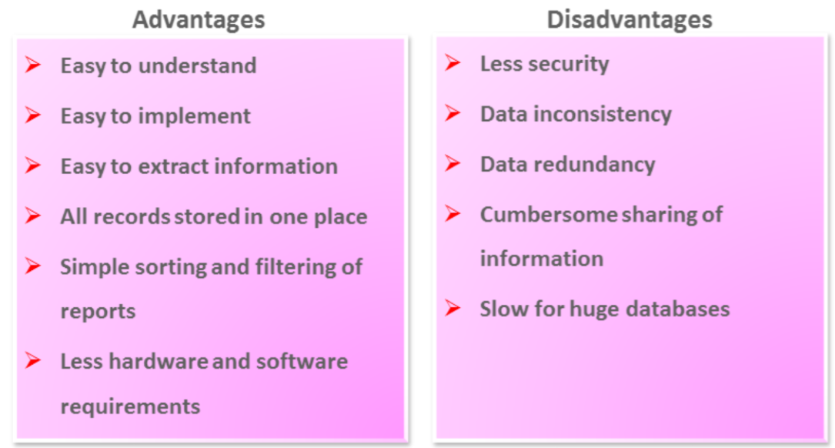
Advantages and disadvantages of flat file database
Redundancy is to store the same data in different files for no need. Redundancy caused TFPs to waste storage space, to require duplication of effort for multiple updates (waste time), and to perhaps show inconsistent data.
Inconsistency is to show different values for the same data item in different places.

Slide 15

Database Approach
View: Reg_students
Reg. No Name Father name Phone Class
View: Grade_Report
Reg. No Name Address Class Grade Semester
View: Fine_List
Reg. No Name Father_Name Book_Issued Fine
…
…
…
Registration System
Library System
Examination System
Registration Application
Library Application
Examination Application
A single repository maintain data defined once and accessed by various users
DBMS
BOOKS
Book_Issued Fine
STUDENT
Reg. No Name Father_Name Phone Address
University Student DB
CLASS
Class Grade Semester

Slide 16
Database Definition
A database is a _______collection of _________ that is stored to meet the requirement of _______of an organizations
Shared: Centralized repository, multiple users access data at the same time
logically related data: : defined on Data Model
(Relational, object, XML, hierarchical, and network)
Different users: Multiple views

Slide 17
Characteristics of the Database Approach
Main characteristics of database approach
Self-describing nature of a database system
Insulation between programs and data, and data abstraction
Support of multiple views of the data
Sharing of data and multiuser transaction processing

Slide 18
Self-Describing Nature of a Database System
Database system contains complete definition of structure and constraints
Meta-data
Describes structure of the database
DBMS catalogue store Metadata
This allows the DBMS software to work with different databases.
Database catalog used by:
DBMS software
Database users who need information about database structure

Slide 19
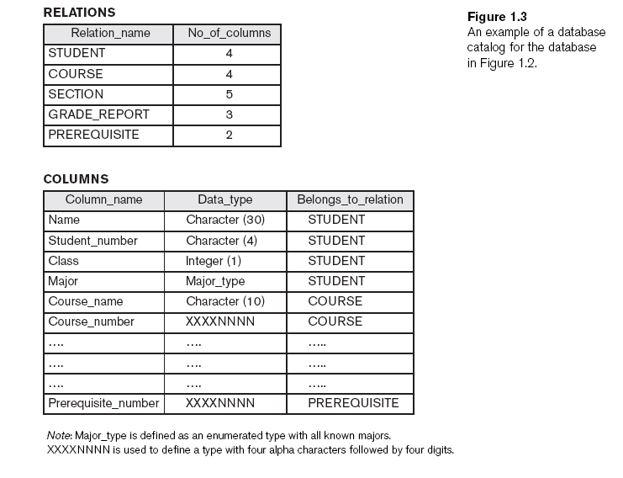

Slide 20
Insulation Between Programs and Data
Allows changing data storage structures and operations without having to change the DBMS access programs.
Program-data independence
Structure of data files is stored in DBMS catalog separately from access programs
Program-operation independence
Operations specified in two parts:
Interface includes operation name and data types of its arguments
Implementation can be changed without affecting the interface

Slide 21
Data Abstraction
Data abstraction
Allows program-data independence and program-operation independence
Conceptual representation of data
Does not include details of how data is stored or how operations are implemented
Data model
A data model is used to hide storage details and present the users with a conceptual view of the database.

Slide 22
Support of Multiple Views of the Data
View
Subset of the database
Contains virtual data derived from the database files but is not explicitly stored
Multiuser DBMS
Each user may see a different view of the database, which describes only the data of interest to that user.
Users have a variety of distinct applications
Must provide facilities for defining multiple views

Slide 23
Sharing of Data and Multiuser Transaction Processing
Allow multiple users to access the database at the same time
Concurrency control software
Ensure that several users trying to update the same data do so in a controlled manner
Result of the updates is correct
Implemented by Transaction Processing Mechanism

Slide 24
Sharing of Data and Multiuser Transaction Processing (cont'd.)
Transaction
Central to many database applications
Executing program or process that includes one or more database
Isolation property
Each transaction appears to execute in isolation from other transactions
Atomicity property
Either all the database operations in a transaction are executed or none are

Slide 25
What is a DBMS?
A Database Management System (DBMS) is a collection of programs that enables users to create and maintain a database.
A DBMS is a general purpose software system that facilitates the processes of defining, constructing, manipulating, and sharing databases among various users and applications.

Slide 26
Typical DBMS Functionality
Define a database: in terms of data types, structures and constraints
Construct or Load the Database on a secondary storage medium
Manipulating the database: querying, generating reports, insertions, deletions and modifications to its content
Concurrent Processing and Sharing by a set of users and programs – yet, keeping all data valid and consistent

Slide 27
An Example
UNIVERSITY database
Information concerning students, courses, and grades in a university environment
Data records
STUDENT
COURSE
SECTION
GRADE_REPORT
PREREQUISITE

Slide 28
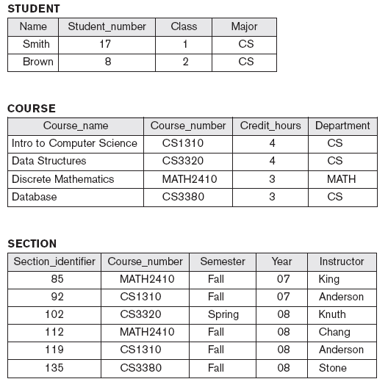
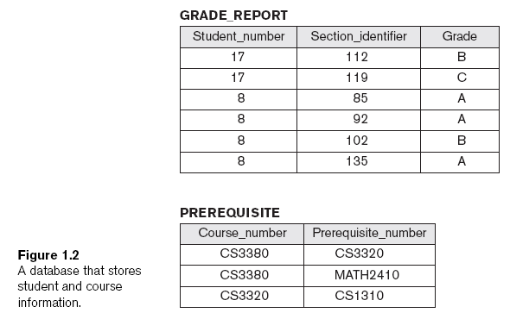

Slide 29
An Example (cont'd.)
Specify structure of records of each file by specifying data type for each data element
String of alphabetic characters
Integer
Etc.

Slide 30
An Example (cont'd.)
Construct UNIVERSITY database
Store data to represent each student, course, section, grade report, and prerequisite as a record in an appropriate file
Relationships among the records
Manipulation involves querying and updating

Slide 31
An Example (cont'd.)
Examples of queries:
Retrieve the transcript
List the names of students who took the section of the ‘Database’ course offered in fall 2008 and their grades in that section
List the prerequisites of the ‘Database’ course

Slide 32
An Example (cont'd.)
Examples of updates:
Change the class of ‘Smith’ to sophomore
Create a new section for the ‘Database’ course for this semester
Enter a grade of ‘A’ for ‘Smith’ in the ‘Database’ section of last semester

Slide 33
An Example (cont'd.)
Phases for designing a database:
Requirements specification and analysis
Conceptual design
Logical design
Physical design

Slide 34
What is an Application?
An Application program accesses the database by sending queries or requests to the DBMS.
A query causes some data to be retrieved.
A transaction may cause some data to be read and some data to be written into the database.

Slide 35
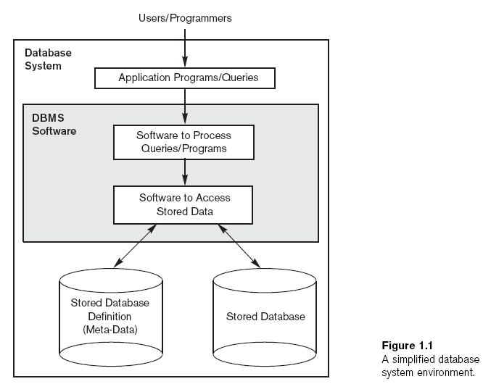

Slide 36
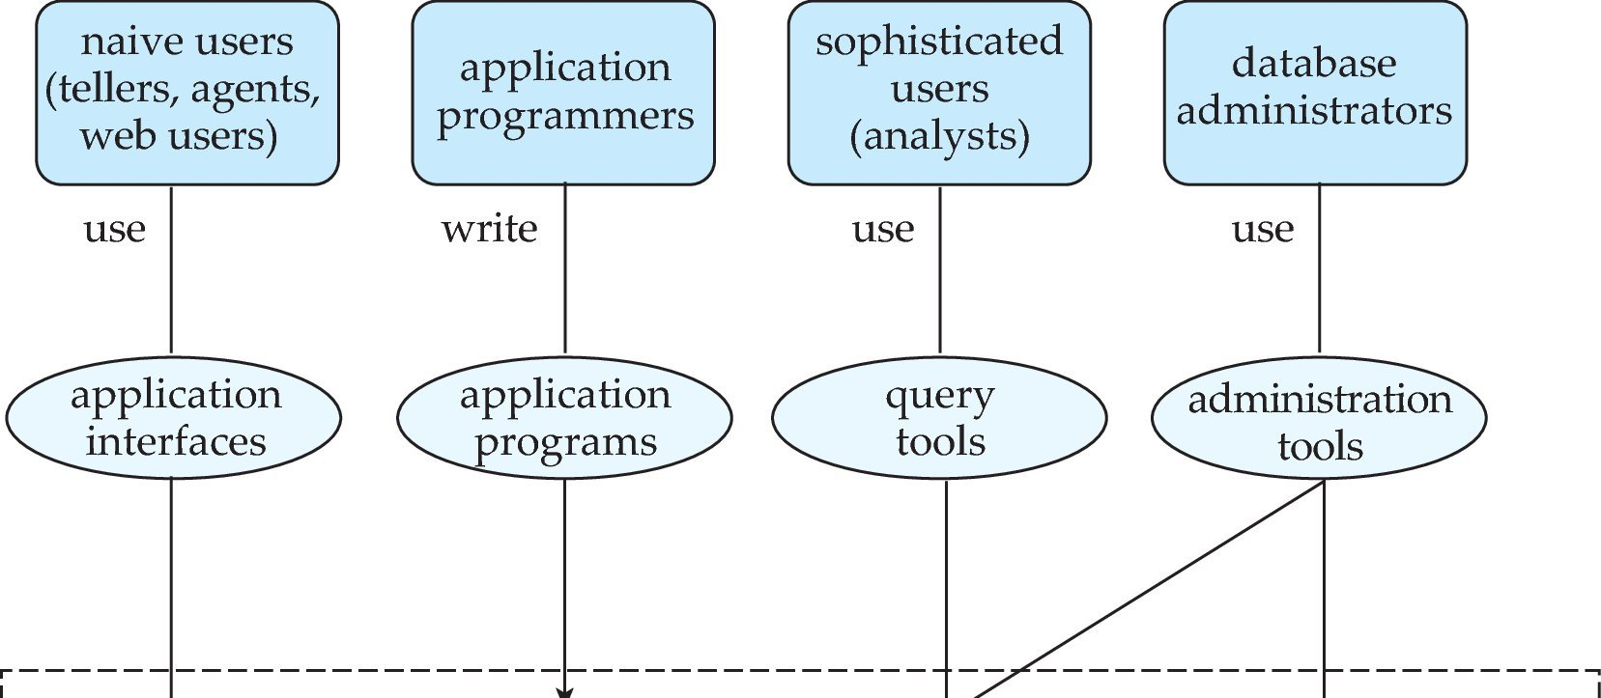
Database Users and Administrators
Database
Notes:
36

Slide 37
Actors in a large database:
1. Database Administrators:
A Database Administrator (DBA) is responsible for authorizing access to the database, coordinating and monitoring its use, and acquiring software and hardware resources as needed.
The DBA is accountable for problems such as security breaches and poor system response time.

Slide 38
Actors in a large database:
2. Database Designers:
Responsible for identifying the data to be stored in the database and for choosing appropriate structures to represent and store this data. These tasks are performed before the actual implementation of the database.

Slide 39
Actors in a large database:
3. End Users:
Are people whose job require access to the database for querying, updating, and generating reports. The database primarily exists for this use.

Slide 40
Actors in a large database:
4. System Analysts and Application Programmers (Software Engineers/ Developers)
System analysts determine the requirement of the end users. Application programmers implement these specifications as programs, then they test, debug, document, and maintain the system.
(This what you will do in this course project!)

Slide 41
Component of Database Application
Software
Interact
End users
…
Application
Program
Develop
Application
developer
What to get
DBMS
Maintain
DB
Administrator
How to get
Database
DB Designer
Design
Users
Data

Slide 42
When not to Use a DBMS:
Since a DBMS comes with an overhead costs in:-
High initial investment in hardware, software, and training
Conversion cost—already a system could be manual or FPS
Overhead for providing security, concurrency control, recovery, and integrity functions.
Therefore, TFP approach can be a better choice if:-
Simple, well-defined database applications that are not expected to change at all.
Real-time requirements for some application programs that may not be met because of a DBMS overhead.
Embedded systems with limited storage capacity such that the DBMS would not fit.
No multiple-user access is required.

Slide 43
Reading Assignment
Read following topics from textbook chapter 1: Introduction to Databases.
1.1, 1.2, 1.3, 1.4, 1.5, 1.6

Slide 44
Summary
Database
DBMS
Application Program
Database Users

Slide 45
Additional Reading
Read following topics from textbook chapter No. 1
1.6, 1.7, 1.8
Main points from these topics is given on next few slides

Slide 46
Advantages of Using the DBMS Approach
Controlling Redundancy
Redundancy is to store the same data in different files for no need. Redundancy caused TFPs to waste storage space, to require duplication of effort for multiple updates (waste time), and to perhaps show inconsistent data.
Inconsistency is to show different values for the same data item in different places.

Slide 47
Advantages of Using the DBMS Approach
Restricting Unauthorized Access
A DBMS provides a security and authorization subsystem, which the DBA uses to create accounts and to specify account restrictions. Then, the DBMS enforces these restrictions automatically.

Slide 48
Advantages of Using the DBMS Approach
Providing Storage Structures and Search Techniques for Efficient Query Processing
A DBMS uses indexes, files based on tree data structures or hash data structures that are suitably modified for disk search, to speed up disk search.

Slide 49
Advantages of Using the DBMS Approach
Providing Backup and Recovery
The backup and recovery subsystem of the DBMS allows to take backups, dated copies of the database, and to recover to a chosen backup copy in the case of hardware or software failure.

Slide 50
Advantages of Using the DBMS Approach
Enforcing Integrity Constraints
A DBMS provides capabilities for defining and enforcing integrity constraints, such as referential integrity, uniqueness, or business rules.
Examples are, When lending a book to a student, Student ID must exist in Student's table, Each Student ID must be unique, and each grade must be 0<= G <=100.

Slide 51
Advantages of Using the DBMS Approach
Reduce Application Development Time
The time needed to develop an application using the DBMS approach is 400% -600% faster than the TFPs approach requires.

Slide 52
Advantages of Using the DBMS Approach
Flexibility
DBMS allows for some changes to the structure of the database with minimum affect or without affecting the stored data and the existing application programs. However, in TFP approach any changes in the data structure requires corresponding changes in both file structure and applications programs.

Slide 53
Historical Development of Database Technology
Early Database Applications: The Hierarchical and Network Models were introduced in mid 1960’s and dominated during the seventies. A bulk of the worldwide database processing still occurs using these models.
Relational Model based Systems: The model that was originally introduced in 1970 was heavily researched and experimented with in IBM and the universities. Relational DBMS Products emerged in the 1980’s.

Slide 54
Historical Development of Database Technology
Object-oriented applications: OODBMSs were introduced in late 1980’s and early 1990’s to cater to the need of complex data processing in CAD and other applications. Their use has not taken off much.
Data on the Web and E-commerce Applications: Web contains data in HTML (Hypertext markup language) with links among pages. This has given rise to a new set of applications and E-commerce is using new standards like XML (eXtended Markup Language).

Slide 55
Extending Database Capabilities
New functionality is being added to DBMSs in the following areas:
Scientific Applications
Image Storage and Management
Audio and Video data management
Data Mining
Spatial data management
Time Series and Historical Data Management
The above gives rise to new research and development in incorporating new data types, complex data structures, new operations and storage and indexing schemes in database systems.

