Slide 1
Intro. To Databases
Dr. Shaheen Khatoon
Shaheen.Khatoon@xjtlu.edu.cn

Slide 2
Chapter 2:
Overview of Data Models and Architectures

Slide 3
Chapter 2: Outline
Database Development process
Data Models, Schemas, and Instances
Three-Schema Architecture and Data Independence
Database Languages and Interfaces
The Database System Environment
Centralized and Client/Server Architectures for DBMSs

Slide 4
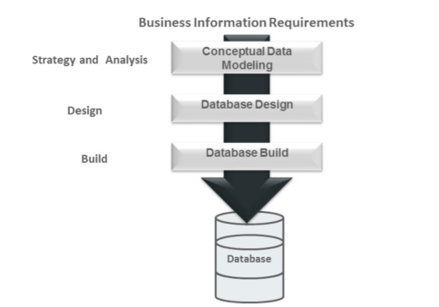
Database Development process
Data modelling is the first part of the database development process
Conceptual data modelling is the examination of a business and business data to determine the structure of business information and the rules that govern it.
Addresses the needs of a business (what is conceptually ideal), but does not address its implementation (what is physically possible).
This structure forms the basis for database design.
A conceptual model is relatively stable over long periods of time.
Physical data modelling (or database building) is concerned with implementation in a given technical software and hardware environment.
The physical implementation is highly dependent on the current state of technology and is subject to change as available technologies rapidly change.

Slide 5
Data Models
A Data Model is:
A collection of concepts that can be used to describe how the data is structured.
By structure of a database we mean the
Data types
Data relationships
Data semantics
Data constraints
It provides the means to achieve data abstraction by hiding unneeded details of data storage.
Data abstraction is suppression of details of data organization and storage, highlighting of the essential features for an improved understanding of data

Slide 6
Common types of Data Models
Flat files – single table
Hierarchical model: Tree Data Structure
Network model – Graph Data Structure
Relational model - Set of Records
Object-based data models (Object- and Object-Relational)
Semi-structured data model (XML)
Entity-Relationship data model (mainly for Relational data model )
Notes:
6

Slide 7
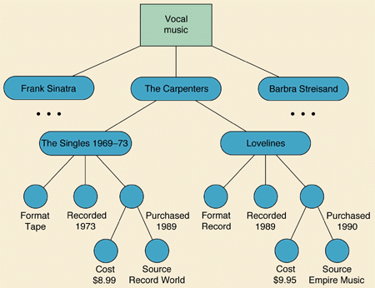
Hierarchical DB model
Tree graph→ a node to have only one parent
The main hierarchical DBMS is IBM’s IMS

Slide 8
Example
PARENT
Emp No. | First Name | Last Name | Dept Num
100 | John | Dougals | 2A
101 | Antony | Wanton | 2B
102 | Mary | Queen | 2C
103 | David | Moorey | 2D
CHILD
Serial No. | Type | User Emp No.
3009734-4 | Computer | 100
3-23-283742 | Monitor | 100
2-22-723423 | Monitor | 100
232342 | Printer | 100

Slide 9
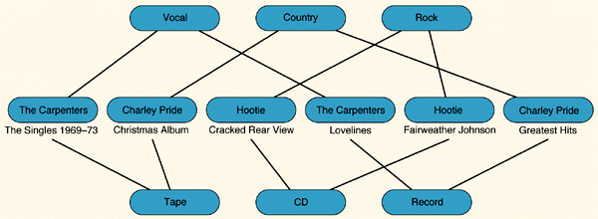
Network DB model
The network model contains logical information such as connectivity relationships among nodes and links, directions of links, and costs of nodes and links.
Facebook data is a good example of Graph
Airlines Network or other Transportation and Logistic network are also graph
Example with diagram
Relationships are explicitly modeled by the sets, which become pointers in the implementation.

Slide 10
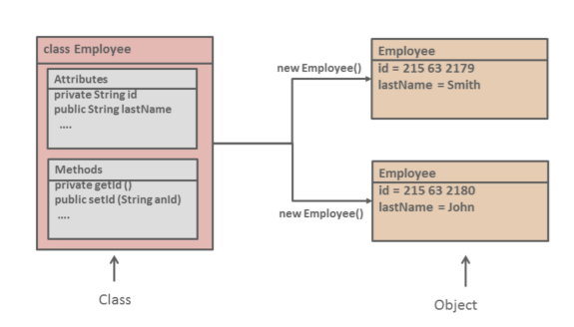
Object Oriented Model
An object-oriented data model represented using UML Class diagram and consists object-oriented concepts:
A entity is modelled as an object.
Every object has a state (the set of values for the attributes of the object) and a behavior (the set of methods that operate on the state of the object).
The values and methods in an object can be accessed or invoked outside the object only through explicit implementation.
The relationship between the objects is through sharing of access rather than through pointers or joins.
Employee class defined with two attributes:
The id attribute is the employee identifier.
The lastName attribute is the last name of the employee.
The Employee class has two methods:
getId()
setId(String anId)

Slide 11
XML Data Model
XML document captures data, instead a set of records, as a hierarchical structure, of labeled values.
<Book ISBN="ISBN-0-13-713526-2" Price="85" Edition="3rd">
<Title>A First Course in Database Systems</Title>
<Authors>
<Author>
<First_Name>Jeffrey</First_Name>
<Last_Name>Ullman</Last_Name>
</Author>
<Author>
<First_Name>Jennifer</First_Name>
<Last_Name>Widom</Last_Name>
</Author>
</Authors>
</Book>

Slide 12
Data Models Analysis
The Network and hierarchical models require the user to have knowledge of the physical data being accessed
Relational Model provides a substantial amount of data independence.
Relational systems adopt a declarative approach to database processing (that is, they specify what data is to be retrieved)
Network and hierarchical systems adopt a navigational approach (that is, they specify how the data is to be retrieved).

Slide 13
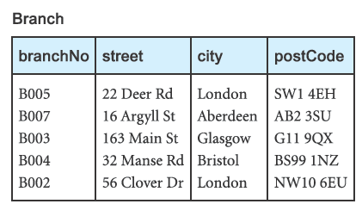
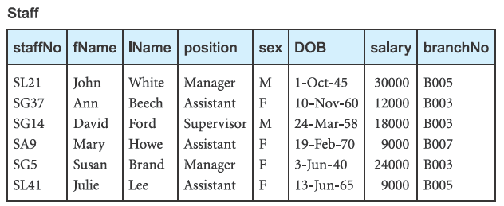
Relational Data Model
A sample instance of
a relational schema.

Slide 14
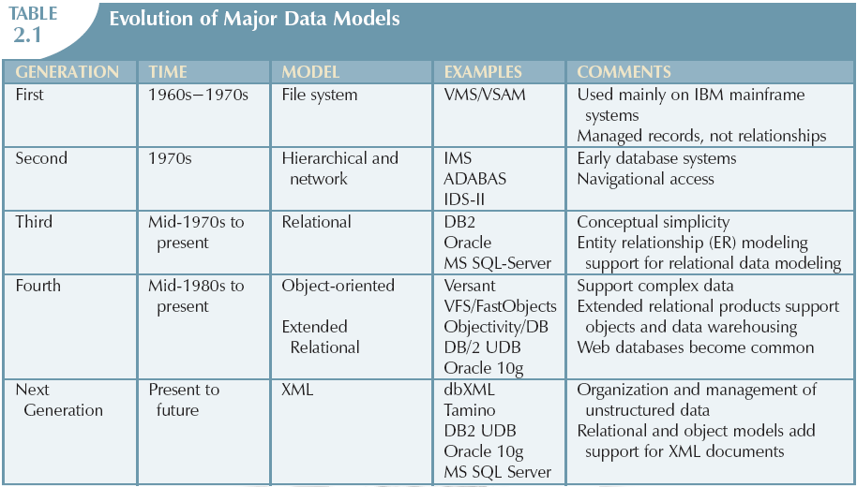
The Evolution of Data Models

Slide 15
DBMS Architecture

Slide 16
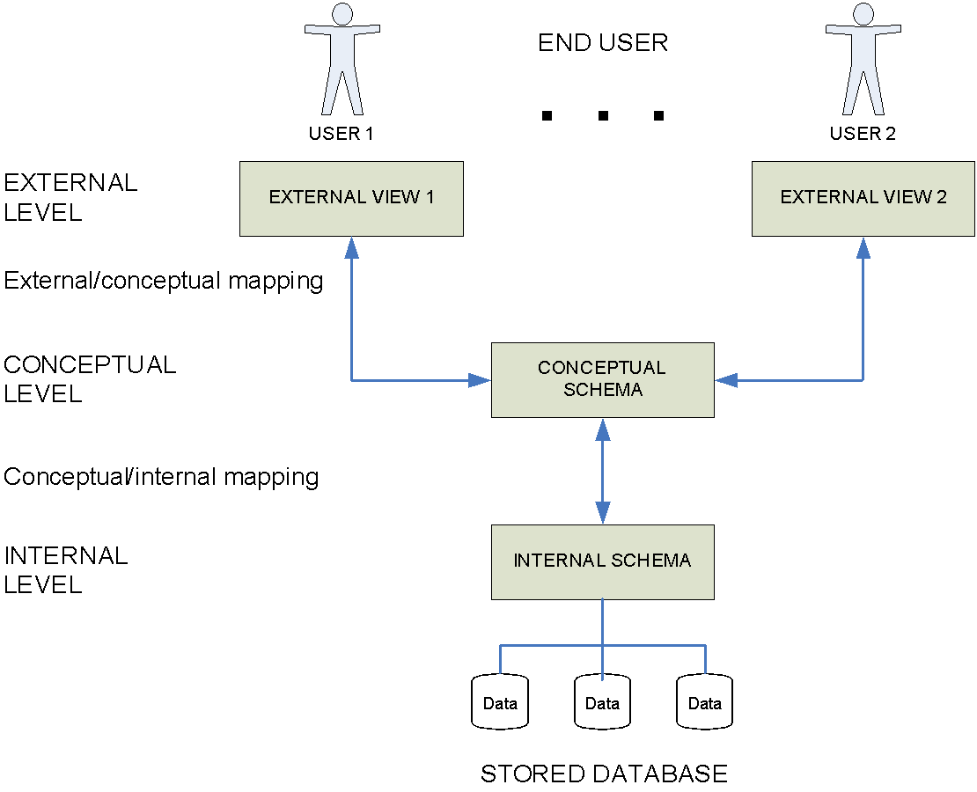
Three-Schema Architecture
External Schema: Use of Data
Conceptual Schema: Meaning of Data
Internal Schema: Storage of Data
Schema: The overall description of the database is called the database schema.
16

Slide 17
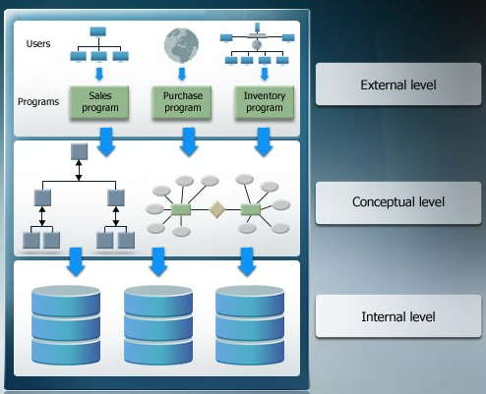
Level of three schema architecture

Slide 18
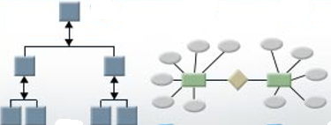
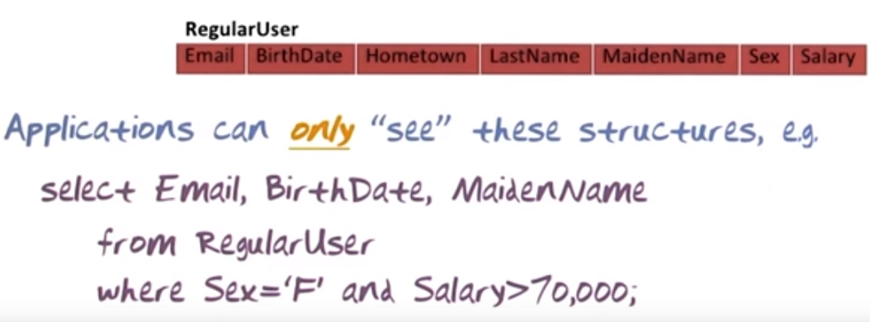
Conceptual Schema
Describes the structure of the whole database for users.
Describes logical database structure and include the abstraction of all the database entities, relationship among them, their attributes, data types, user operations and constraints
It represent the entire database and its consolidated image of the model of the real world that the database represent
Data in this schema is visible to user

Slide 19
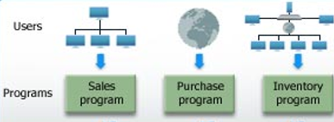
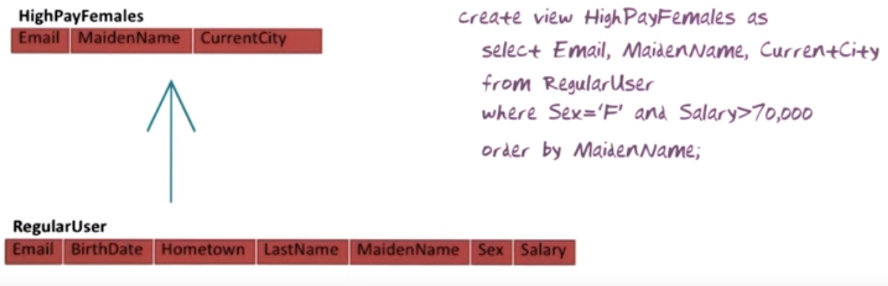
External Schema
Represent only portion of database required by user or program determined by DBA.
The remaining part is hidden from user
Describes part of the information in conceptual schema in a form convenient to particular user’s/ group’s view.

Slide 20

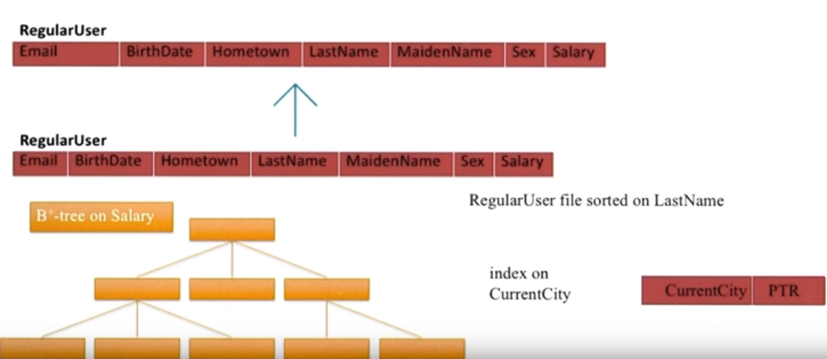
Internal Schema
Describes physical structure of database
How data will be stored, record type and access path for data
Detail of database file structure and disk location, indexing detail
Designer will decide the configuration of the storage media- database server and DBMS for database

Slide 21
Levels of Abstraction
Physical level: describes how a record is stored.
Logical level: describes data stored in database, and the relationships among the data.
type instructor = record
ID : string; name : string; dept_name : string; salary : integer;
end;
View level: application programs hide details of data types.
Views can also hide information (such as an employee’s salary) for security purposes.
Notes:
21

Slide 22


Three Schema: Example
Employee Data
First Name: Fatima Last Name: Abdullah DOB: 12th Sept. 1980
Object based Models
Workers
Name: F. Abdullah Age: 34 Y, 10 d Department: Sales
External/View Level
Ext/conceptual mapping
External Layer-Logical Data Independence
Record Based Model
Name | DOB | Dep.No
Fatima Abdullah | 12-08-1980 | 01
Ahmad Ali | 10-03-1990 | 02
… | … | …
Dep. | Dep. Name
01 | Sales
02 | Marketing
… | ….
Conceptual/logical Level
Conceptual/Int. mapping
Internal Layer-Physical Data Independence
Physical Model
Internal/Physical Level
BH | RH | Fatima Abdullah 12081980 5 D019 | RH | Ahmad Ali…
OS Layer
100011001111000011100001110000111000011100101010…

Slide 23
Mapping
DBMS transform a request specified on external schema into conceptual schema and then to internal schema for processing over stored data:
This process of transforming requests and results between levels called Inter schema Mappings
The main purpose is to achieve Data Independence

Slide 24
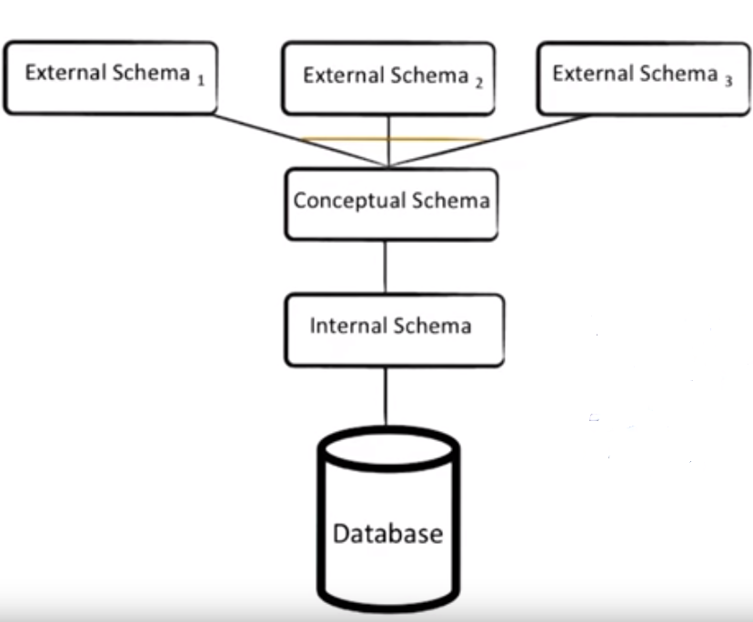
Data Independence
It is the capacity to change the schema at one level without having to change it at the next higher level
Logical data Independence:
The capacity to change the conceptual schema without having to change external schemas or application programs (expand or reduce)
Adding/deleting attribute to some relation
no need to change the programs or views that don’t require to use the new attribute
View definitions in External to conceptual mapping only need to be changed for views that use the deleted attribute

Slide 25
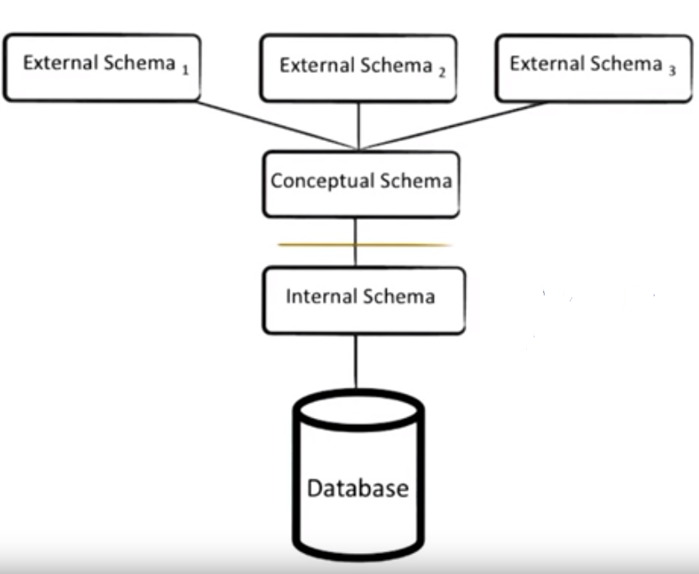
Data Independence
Physical Data independence:
The capacity to change the internal schema without having to change the conceptual schemas
Performance tuning –modification at physical level creating a new index, changing file organization etc.
If the same data as before remain in the database should not affect conceptual schema

Slide 26
Instances and Schemas
Similar to types and variables in programming languages
Schema – The schema sets up the structure of the database (Set database object).
Typically the schema is set up at the beginning, and doesn't change
Example: The database consists of information about a set of customers and accounts in a bank and the relationship between them
Analogous to type information of a variable in a program
Instance – the actual content of the database at a particular point in time
Analogous to the value of a variable
Notes:
26

Slide 27
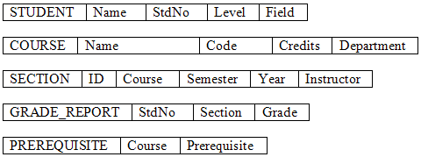
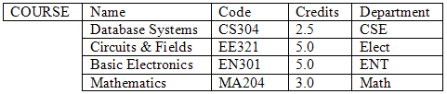

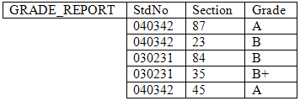
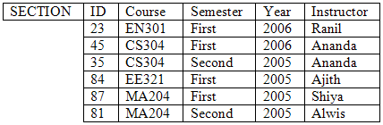

Example: University Database
DB Schema
Schema Constructs
A DB State/Instance/Extension
27

Slide 28
Schema versus DB state
Important to distinguish between DB schema and state:
When we define a new database, specify its database schema only to the DBMs
The corresponding database state is the empty state
Initial state of database when database is first Populated or loaded with initial data
Every time when a basic operation is applied we get another database state
At any point in time database has a current state
DBMS ensures that every state of database is Valid State
i.e. satisfies structure and constraints specified in schema
Schema only change when requirement change called schema evolution
E.g. we may decide another data item needed to be stored for each record

Slide 29
Reading Assignment
Textbook
2.1
2.2
Review Questions
2.1 -2.5

Slide 30
Database Languages:
Data Definition Language (DDL):
Used to define/setup a schemas or structure in particular database.
Data Manipulation Language (DML):
Use to querying and modifying the database, once the schema has been set up and data has been loaded,
Structured Query Language (SQL):
A comprehensive language that combines both DDL and DML.

Slide 31
Centralized and Client/Server Architectures for DBMSs
Centralized DBMSs Architecture
All DBMS functionality, application program execution, and user interface processing carried out on one machine

Slide 32
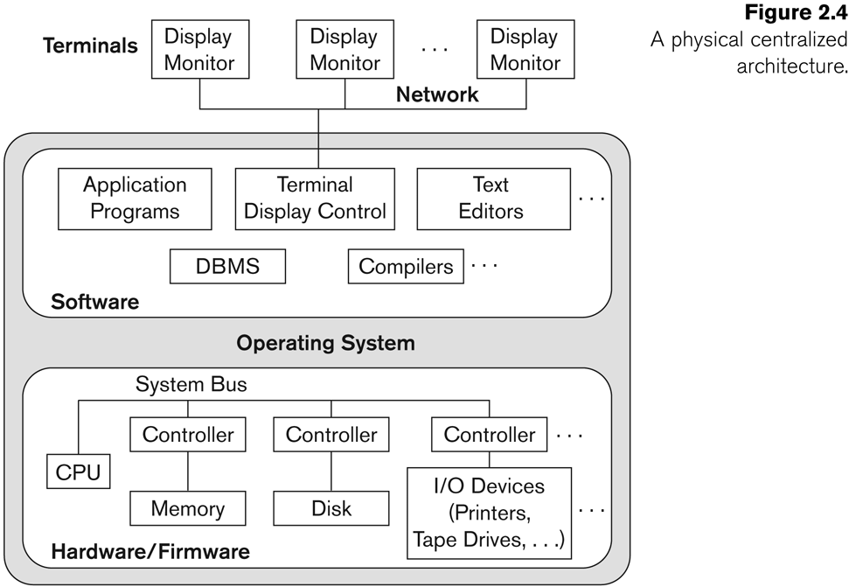
A Physical Centralized Architecture

Slide 33
Basic Client/Server Architectures
The client/server architecture was developed to deal with computer environment in which a large number of PCs, workstation, file server…
A client in this framework is typically a user machine that provides user interface capabilities and local processing
A server is a system containing both hardware and software that can provide services to the client machines.

Slide 34
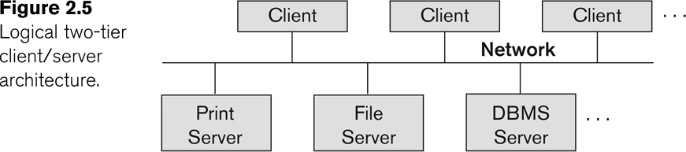
Logical two-tier client server architecture

Slide 35
Two-tier Architecture
This is called two-tire architectures because the software components are distributed over two systems: client and server
The emergence of the Web changed the roles of client and server, leading to the three-tier architecture

Slide 36
Three-tier architecture
The intermediate layer or middle layer is sometimes called the application server or Web server
Three-tier Architecture can Enhance Security:
Database server only accessible via middle tier
Clients cannot directly access database server

Slide 37
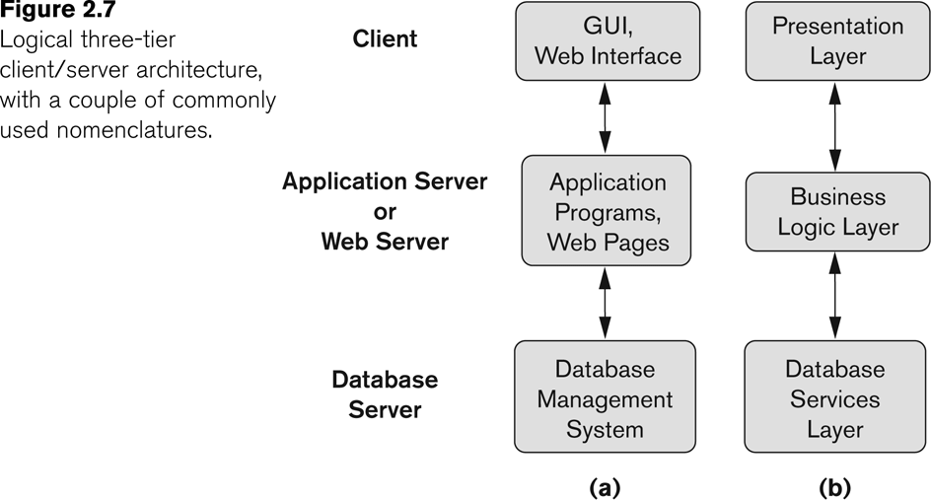
Three-tier client-server architecture

Slide 38
Three-tier architecture
The presentation layer displays information to the user
The business logic layer handles intermediate rules and constrains before data is passed up to the user or down to the DBMS
If the bottom layer is split into two layers (a web server and a database server), then it is a 4-tire architecture (possible to the n-tier)

Slide 39
Reading Assignment
Textbook
2.3
2.4
2.5
Review Questions:
2.9-2.11

Slide 40
Summary
Concepts used in database systems
Main categories of data models
Three Schema Architecture
DBMS Architectures

