Slide 1
Introduction to Databases
Dr. Shaheen Khatoon
Shaheen.Khatoon@xjtlu.edu.cn

Slide 2
Chapter 4
Basic SQL

Slide 3
Chapter 4 Outline
SQL Data Definition and Data Types
Specifying Constraints in SQL
Basic Retrieval Queries in SQL
INSERT, DELETE, and UPDATE Statements in SQL

Slide 4
Introduction to SQL
SQL: Intro
“S.Q.L.” or “sequel”
Supported by all major commercial database systems
Standardized – many new features over time
Interactive via GUI or prompt, or embedded in programs
Declarative, based on relational algebra

Slide 5
SQL: Language Breakdown
Data Definition Language (DDL)
  Create table…
  Alter table…
  Drop table…
Data Manipulation Language (DML)
  C – INSERT/Create
  R – SELECT/ Reterieve
  U – UPDATE
  D - DELETE
Other Commands
indexes, constraints, views, triggers, transactions, authorization, …
SQL: Intro

Slide 6

Basic Steps in Query Processing
1. Parsing and translation
2. Optimization
3. Evaluation

Slide 7
Basic Steps in Query Processing (Cont.)
Parsing and translation
  translate the query into its internal form using Parser. This is then translated into relational algebra. Parser perform following activities
    Verify query is syntactically correct
    verifies relations in query with matching relation in database
    Construct a parse tree (query –Tree) for representing expression using views
    Convert the parse tree into Relational Algebra
Query optimization:
  Selection of an efficient query evaluation plan is made
Evaluation
  The query-execution engine takes a query-evaluation plan, executes that plan, and returns the answers to the query.

Slide 8
Basic Steps: Optimization (Cont.)
Query Optimization: Amongst all equivalent evaluation plans choose the one with lowest cost.
  Cost is estimated using statistical information from the
  database catalog
    e.g. number of tuples in each relation, size of tuples, etc.
In upcoming course of DBMS you will learn:
  How to measure query costs
  Algorithms for evaluating relational algebra operations
  How to combine algorithms for individual operations in order to evaluate a complete expression
  Study how to optimize queries, that is, how to find an evaluation plan with lowest estimated cost

Slide 9
Data Definition Language (DDL)
Create
Alter
Drop

Slide 10
Create Table Command
Create table command is used to:
  Create a table
  Define attributes of the table with data types
  Define different constraints on attributes, like primary and foreign keys, check constraint, not null, default value etc.

Slide 11
CREATE TABLE Construct
CREATE TABLE [schema.] name
(column-1 TYPE [DEFAULT value] [constraints],
column-2 TYPE [DEFAULT value] [constraints], column-n TYPE [DEFAULT value] [constraints],
[table-constraints]);
Where:
  [schema.]: schema name followed by a dot.
  name: table name.
  column-1 to column-n: column names.
  TYPE: data type.
  [DEFAULT value]: optional default value.
  [constraints]: optional constraints, can be specified at column level or at table level.

Slide 12
Steps in Table Creation
Identify data types for attributes.
Determine default values.
Identify columns that can and cannot be null.
Identify columns that must be unique (candidate keys).
Identify primary key - foreign key mates.
Identify constraints on columns (domain specifications).
Create the table and associated indexes.
To improve access speed
Chapter 8: SQL-99: Schema Definition, Constraints, Queries, and Views
13

Slide 13
CREATE TABLE Example
CREATE TABLE EMPLOYEE
(Fname VARCHAR(15) NOT NULL,
Minit CHAR,
Lname VARCHAR(15) NOT NULL,
Ssn CHAR(9) NOT NULL,
Bdate DATE,
Address VARCHAR(30),
Sex CHAR CHECK (LOWER(SEX) IN ('m', 'f')),
Salary DECIMAL(10,2),
Super_ssn CHAR(9),
Dno INT NOT NULL,
CONSTRAINT EMPPK PRIMARY KEY (Ssn),
CONSTRAINT EMPSUPERFK FOREIGN KEY (Super_ssn) REFERENCES
EMPLOYEE (Ssn) ON DELETE SET NULL,
CONSTRAINT EMPDEPTFK FOREIGN KEY (Dno) REFERENCES
DEPARTMENT (Dnumber) ON DELETE SET NULL);
Chapter 8: SQL-99: Schema Definition, Constraints, Queries, and Views
14

Slide 14
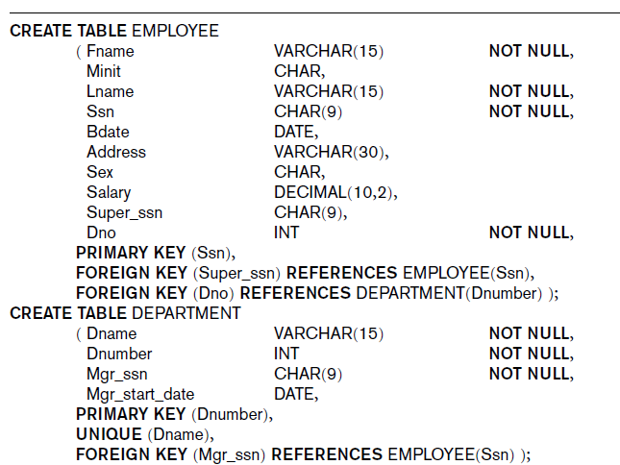
Creating tables for company database

Slide 15
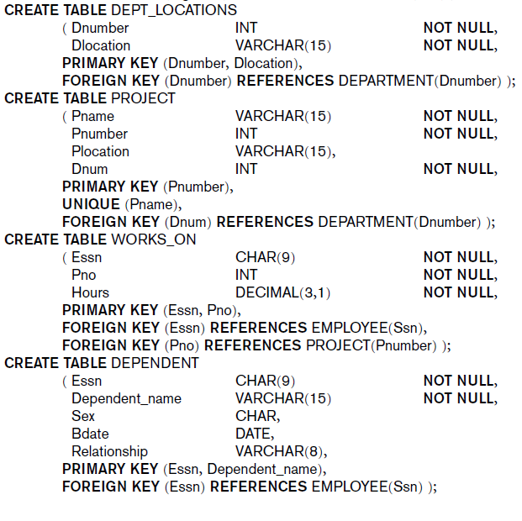

Slide 16
CREATE DOMAIN Construct
A domain can be declared, and the domain name is used with the
attribute specification.
This makes it easier to change the data type for a domain that is
used by numerous attributes in a schema, and improves schema
readability.
Examples:
  CREATE DOMAIN SSN_TYPE AS CHAR(9);
  CREATE DOMAIN D_NUM AS INT CHECK
  (D_NUM>0 AND D_NUM<21);
9

Slide 17
Constraints
There are essentially five types of constraints:
  NOT NULL constraints.
  UNIQUE value constraints.
  PRIMARY KEY constraints.
  FOREIGN KEY constraints.
  CHECK constraints.
The syntax of these constraints varies according to whether they are specified at column level or at table level.
Any constraints which apply to multiple columns must be defined as table level constraints.
Chapter 8: SQL-99: Schema Definition, Constraints, Queries, and Views
10

Slide 18
Constraints
The syntax for each of the column level constraints is:
  NOT NULL
  UNIQUE
  PRIMARY KEY
  REFERENCES table (key)
  CHECK (condition)
Chapter 8: SQL-99: Schema Definition, Constraints, Queries, and Views
11

Slide 19
Constraints
The syntax for each of the table level constraints is:
  UNIQUE (column-list)
  [CONSTRAINT name] PRIMARY KEY (column-list)
  [CONSTRAINT name] FOREIGN KEY (column-list)
  REFERENCES table (column-list)
  CHECK (condition)
An additional ON DELETE clause may be applied to a foreign key
constraint:
  ON DELETE CASCADE causes all referencing child records to be deleted whenever a parent record is deleted.
  ON DELETE SET NULL causes all referencing child records to be set to NULL whenever a parent record is deleted.
Chapter 8: SQL-99: Schema Definition, Constraints, Queries, and Views
12

Slide 20
Constraints Examples
Default value
  DEFAULT <value>
  Dnumber INT NOT NULL DEFAULT 1,
CHECK clause: following an attribute or domain definition
  Dnumber INT NOT NULL CHECK (Dnumber > 0 AND Dnumber < 21 Or
  CREATE DOMAIN D_NUM As Integer CECK (D_NUM>0 AND D_NUM<21);
PRIMARY KEY clause
  Specifies one or more attributes that make up the primary key of a relation
  Dnumber INT PRIMARY KEY;
UNIQUE clause
  Specifies alternate (secondary) keys
  Dname VARCHAR(15) UNIQUE;

Slide 21
Constraints Examples
Foreign Key: referential triggered action clause
    Options include SET NULL, CASCADE, and SET DEFAULT
      ON DELETE or UPDATE SET NULL or SET DEFAULT
    CASCADE ON DELETE :delete all the referencing tuples
      FOREIGN KEY (Dno) REFERENCES DEPARTMENT (DNumber) ON DELETE SET DEFAULT ONUPDATE CASCADE;

Slide 22
Giving Names to Constraints
Keyword CONSTRAINT
  Name a constraint
  The names of all constraints within a particular schema must be unique
  Useful for later altering
    CONSTRAINT name
Examples:
    CONSTRAINT EMPPK
    PRIMARY KEY (Ssn);
    CONSTRAINT EMPSK
    FOREIGN KEY (Dno) REFERENCES DEPARTMENT (DNumber) ON DELETE SET DEFAULT ONUPDATE CASCADE;

Slide 23
Specifying Constraints on Tuples Using CHECK
CHECK clauses at the end of a CREATE TABLE statement
  tuple-based constraints
    Apply to each tuple individually
    checked whenever a tuple is inserted or modified
  CHECK (Dept_create_date <= Mgr_start_date);

Slide 24
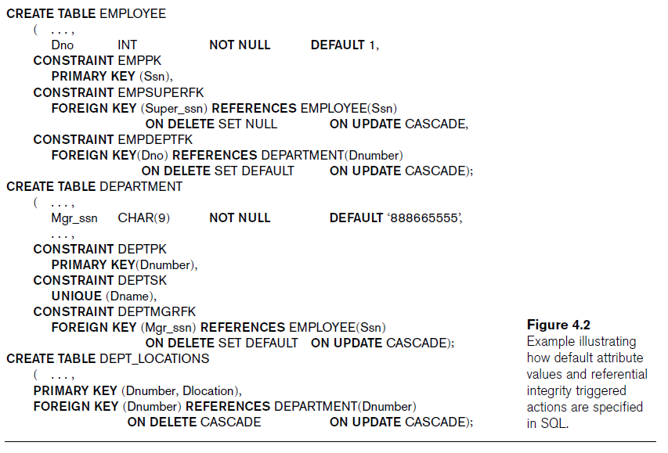
Company Tables with constraints

Slide 25
Alter Table Statement
Purpose is to make changes in the definition of a table already created through Create statement
Can add, drop attributes or constraints, activate or deactivate constraints; the format is:
ALTER TABLE table
{ [ ALTER COLUMN column_name
{ new_data_type [ ( precision [ , scale ] ) ]
[ NULL | NOT NULL ]
]
| ADD
{ [ < column_definition > ]
| column_name AS computed_column_expression
} [ ,...n ]
| DROP
{ [ CONSTRAINT ] constraint_name
| COLUMN column } [ ,...n ]
| { CHECK | NOCHECK } CONSTRAINT
{ ALL | constraint_name [ ,...n ] }
}

Slide 26
Alter Table Command
ALTER TABLE Student
add constraint fk_st_pr
foreign key (prName) references Program (prName)
ALTER TABLE program
add constraint ck_totSem
check (totSem < 9)
ALTER TABLE my_cd_collection
ADD (release_date DATE DEFAULT SYSDATE);

Slide 27
ALTER TABLE: Modifying a Column
First Create the following table:
CREATE TABLE mod_emp
(last_name VARCHAR2(20),
salary NUMBER(8,2));
Perform following modifications:
ALTER TABLE mod_emp
MODIFY (last_name VARCHAR2(10)); //Would be permitted only if columns were empty, or the largest name was 10 or less characters
ALTER TABLE mod_emp
MODIFY (last_name VARCHAR2(30));// Modification would be permitted with or without data as column width increased
ALTER TABLE mod_emp
MODIFY (salary NUMBER(8,2) DEFAULT 50);//Would be permitted with or without data as only a DEFAULT value-added

Slide 28
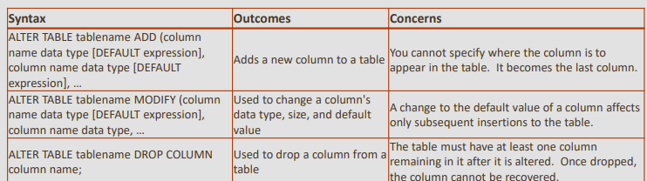
Drop a Column
ALTER TABLE my_cd_collection
DROP COLUMN release_date;
ALTER TABLE my_friends
DROP COLUMN favorite_game;

Slide 29
Removing Table
TRUNCATE TABLE table_name
    Truncate table class; You cannot roll back row removal
DROP TABLE table_name;
        Drop table class; storage is not released and you can rollback

Slide 30
Basic Retrieval Queries in SQL
Basic structure of SQL consist of three clauses:
SELECT: Correspond to the projection operation of RA
  List the attributes desired in result of query
FROM: Correspond to Cartesian-product of RA
  List the relation to be scanned in the evaluation of the expression
WHERE: Correspond to Selection of RA
  Specify Boolean condition on attribute of relation appear on FROM clause that must be true for any retrieved tuple

Slide 31
The Basic SELECT Statement
Select A₁,A₂,…,A_{n}
From R₁,R₂, …,R_{m}
Where condition
What to return
Relations
Combine, filter
Relational Algebra Expression:
∏_{a1,a2,..an} ( ⸹_{condition} (R₁,R₂, …,R_{m}) )

Slide 32

Select Examples
Retrieve the birth date and address of the employee(s) whose name is ‘John B. Smith’
SELECT Bdate, Address
FROM EMPLOYEE
WHERE Fname='John' AND Minit='B' AND Lname='Smith';

Slide 33

Query results refer to this database state

Slide 34
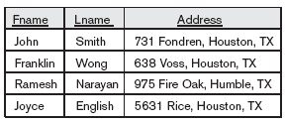
Select Examples
Retrieve the name and address of all employees who work for the ‘Research’ department.
SELECT Fname, Lname, Address
FROM EMPLOYEE, DEPARTMENT
WHERE Dname='Research' AND Dnumber=Dno;

Slide 35

Select Examples
For every project located in ‘Stafford’, list the project number, the controlling department number, and the department manager’s last name, address, and birth date.
SELECT Pnumber, Dnum, Lname, Address, Bdate
FROM PROJECT, DEPARTMENT, EMPLOYEE
WHERE Dnum=Dnumber AND mgrssn=Ssn AND
Plocation='Stafford';

Slide 36
Ambiguous Attribute Names
Same name can be used for two (or more) attributes
  As long as the attributes are in different relations
  If two tables ahs same attribute name query must qualify the attribute name with the relation name to prevent ambiguity
  For example if both Employee and department have same Dnumber and Name
SELECT Fname, EMPLOYEE.Name, Address
FROM EMPLOYEE, DEPARTMENT
WHERE DEPARTMENT.Name=‘Research’ AND
DEPARTMENT.Dnumber=EMPLOYEE.Dnumber;

Slide 37
Attribute Alias
In previous example long table name can be avioide by creating Alias of table
Another Name for Table or attribute
SELECT {*|col_name [[AS] alias] [, …n]} FROM tab_name [AS] alias}
Usually used to avoid ambiguity of attribute names in the case of queries that refer to the same relation twice.
SELECT E.Fname, E.lname, Address
FROM EMPLOYEE E, DEPARTMENT D
WHERE D.dname='Research' AND
d.dnumber=e.dno; // Oracle without as
Other: FROM EMPLOYEE AS E, DEPARTMENT AS D

Slide 38
Attribute Alias
The ambiguity of attribute names also arises in the case of queries that refer to the same relation twice.
  For each employee, retrieve the employee’s first and last name and the first and last name of his or her immediate supervisor.
      SELECT E.Fname, E.Lname, S.Fname, S.Lname
      FROM EMPLOYEE E, EMPLOYEE S
      WHERE e.superssn=s.ssn;
  It is also possible to rename the attributes within the query in SQL by giving them aliases.
      SELECT E.Fname emp_fname, E.Lname emp_lname, S.Fname sup_fname, S.Lname sup_lname
      FROM EMPLOYEE E, EMPLOYEE S
      WHERE e.superssn=s.ssn;

Slide 39
Unspecified WHERE Clause
Missing WHERE clause
  Indicates no condition on tuple selection
If more than one relation is specified in the FROM clause and there is no WHERE clause, then the CROSS PRODUCT —all possible tuple combinations—of these relations is selected.
Following query Select all combinations of EMPLOYEE Ssn and DEPARTMENT Dname
SELECT Ssn, Dname
FROM EMPLOYEE, DEPARTMENT; //execute and check the number of rows
Modify as following and compare rows
SELECT Ssn, Dname
FROM EMPLOYEE, DEPARTMENT
where dno=dnumber;

Slide 40
Use of the Asterisk
Specify an asterisk (*)
  Retrieve all the attribute values of the selected tuples
  SELECT *
  FROM EMPLOYEE, DEPARTMENT;
  SELECT *
  FROM EMPLOYEE
  WHERE Dno=5;
  SELECT *FROM EMPLOYEE, DEPARTMENT
  WHERE Dname='Research' AND Dno=Dnumber;

Slide 41
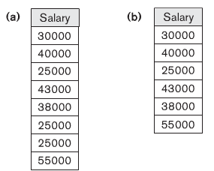
Select Distinct
SQL does not automatically eliminate duplicate tuples in query results
  Duplicate elimination is an expensive operation.
Use the keyword DISTINCT in the SELECT clause
  Only distinct tuples should remain in the result
Retrieve the salary of every employee and all distinct salary value
    SELECT ALL Salary
    FROM EMPLOYEE;
    SELECT DISTINCT Salary
    FROM EMPLOYEE;

Slide 42
Tables as Sets in SQL
Set operations
  UNION, EXCEPT (difference), INTERSECT
  Corresponding multiset operations: UNION ALL, EXCEPT ALL, INTERSECT ALL)
Make a list of all project numbers for projects that involve an employee whose last name is ‘Smith’, either as a worker or as a manager of the department that controls the project.
(SELECT DISTINCT Pnumber
FROM PROJECT, DEPARTMENT, EMPLOYEE
WHERE Dnum=Dnumber AND Mgr_ssn=Ssn
AND Lname=‘Smith’ )
  UNION
( SELECT DISTINCT Pnumber
FROM PROJECT, WORKS_ON, EMPLOYEE
WHERE Pnumber=Pno AND Essn=Ssn
AND Lname=‘Smith’ );

Slide 43
Tables as Sets in SQL
Set operations
  UNION, EXCEPT (Minus is Oracle), INTERSECT
Make a list of all project numbers for projects that involve an employee whose last name is ‘Wong’, either as a worker or as a manager of the department that controls the project.
(SELECT DISTINCT Pnumber
FROM PROJECT, DEPARTMENT, EMPLOYEE
WHERE Dnum=Dnumber AND Mgrssn=Ssn
AND Lname='Wong' )
UNION
(SELECT DISTINCT Pnumber
FROM PROJECT, WORKS_ON, EMPLOYEE
WHERE Pnumber=Pno AND Essn=Ssn
AND Lname='Wong’);
Modify the above statements using INTERSECT and MINUS
For more detail check the following link: https://docs.oracle.com/cd/B19306_01/server.102/b14200/queries004.htm

Slide 44
Substring Pattern Matching
LIKE comparison operator
  Used for string pattern matching
  % replaces an arbitrary number of zero or more characters
Retrieve all employees whose address is in Houston, Texas.
  SELECT Fname, Lname, address
  FROM EMPLOYEE
  WHERE Address LIKE '%TX%';

Slide 45
Substring Pattern Matching
  underscore (_) replaces a single character
Find all employees whos first name second character is ‘a’:
  SELECT Fname, Lname
  FROM EMPLOYEE
  WHERE Fname LIKE '_a%';

Slide 46
IS NULL
Check whether an attribute value is NULL.
Example: Retrieve the names of all employees who do not have supervisors.
  SELECT Fname, Lname, superssn
  FROM EMPLOYEE
  WHERE superssn IS NULL;

Slide 47
BETWEEN Operator
BETWEEN: Checks the value in a range
Retrieve all employees in department 5 whose salary is between $30,000 and $40,000
  SELECT *
  FROM EMPLOYEE
  WHERE (Salary BETWEEN 30000 AND 40000) AND Dno = 5;

Slide 48
IN Operator
IN: Checks in a list of values
  SELECT *
  FROM EMPLOYEE
  WHERE Salary IN (30000 ,40000) ;

Slide 49
ORDER BY clause
Sorts the rows in a particular order
SELECT select_list
FROM table_source
WHERE search_condition
ORDER BY order_expression [ ASC | DESC ]

Slide 50
ORDER BY clause
Retrieve a list of employees and the projects they are working on, ordered by department and, within each department, ordered alphabetically by last name, then first name.
SELECT D.Dname, E.Lname, E.Fname, P.Pname
FROM DEPARTMENT D, EMPLOYEE E, WORKS_ON W,
PROJECT P
WHERE D.Dnumber= E.Dno AND E.Ssn= W.Essn AND
W.Pno= P.Pnumber
ORDER BY D.Dname Desc/Asc, E.Lname, E.Fname;

Slide 51
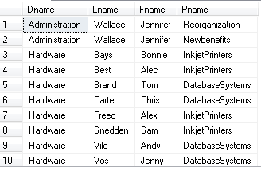
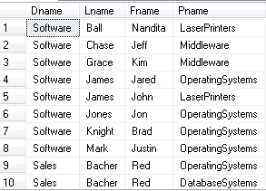
Order By Examples
ORDER BY D.Dname DESC, E.Lname ASC, E.Fname ASC
Ascending Order
Slide 1-<number>

Slide 52

Discussion and Summary of Basic SQL Retrieval Queries
A simple retrieval query in SQL can consist of up to four clauses, but only the first two—SELECT and FROM—are mandatory.

Slide 53
INSERT, DELETE, and UPDATE Statements in SQL
Three commands used to modify the database:
  INSERT, DELETE, and UPDATE

Slide 54
The INSERT Command
Add tuples to a relation.
  Specify the relation name and a list of values for the tuple.
INSERT INTO EMPLOYEE
VALUES ( 'Richard', 'K', 'Marini', '653298653', '1962-12-30', '98 Oak Forest, Katy, TX', 'M', 37000, '653298653', 4 );
A second form of the INSERT statement allows the user to specify explicit attribute names that correspond to the values provided in the INSERT command.
  INSERT INTO EMPLOYEE (Fname, Lname, Dno, Ssn)
  VALUES (‘Richard’, ‘Marini’, 4, ‘653298653’);
  Copying data from another table to a new table
  CREATE TABLE copy_departments AS (SELECT * FROM department);
  select * from copy_departments; // to verify rows

Slide 55

The DELETE Command
Removes tuples from a relation
  Includes a WHERE clause to select the tuples to be deleted

Slide 56

The UPDATE Command
Modify attribute values of one or more selected tuples
Additional SET clause in the UPDATE command
  Specifies attributes to be modified and new values

Slide 57
Update Operations, Transactions, and Dealing with Constraint Violations
Operations of the relational model can be categorized into retrievals and updates
Basic operations that change the states of relations in the database:
  Insert
  Delete
  Update (or Modify)
These operation can violate database constraint

Slide 58
The Insert Operation
Can violate any of the four types of constraints
  Domain/columns constraints can be violated if an attribute value is given that does not appear in the corresponding domain or is not of the appropriate data type.
  Key constraints can be violated if a key value in the new tuple t already exists in another tuple in the relation r(R).

Slide 59
The Insert Operation (cont…)
  Entity integrity can be violated if any part of the primary key of the new tuple t is NULL.
  Referential integrity can be violated if the value of any foreign key in t refers to a tuple that does not exist in the referenced relation
Default option is to reject the insertion

Slide 60
The Delete Operation
Can violate only referential integrity
  If tuple being deleted is referenced by foreign keys from other tuples
  Restrict
    Reject the deletion
  Cascade
    Propagate the deletion by deleting tuples that reference the tuple that is being deleted: ON DELETE CASCADE
  Set null or set default
    Modify the referencing attribute values that cause the violation: ON DELETE set NULL of set DEFAULT

Slide 61
The Update Operation
Necessary to specify a condition on attributes of relation
  Select the tuple (or tuples) to be modified
If attribute not part of a primary key nor of a foreign key
  Usually causes no problems
Updating a primary/foreign key
  Similar issues as with Insert/Delete

Slide 62
Summary
SQL
  Comprehensive language
  Data definition, queries, updates, constraint specification, and view definition
Covered in Chapter 4:
  Data definition commands for creating tables
  Commands for constraint specification
  Simple retrieval queries
  Database update commands

