Slide 1
Introduction to Databases
Relational Design Theory
(Normalization)
Dr. Shaheen Khatoon
Shaheen.Khatoon@xjtlu.edu.cn

Slide 2
Chapter 15: Basics of Functional Dependencies and Normalization for Relational Databases

Slide 3
Outline
Design “anomalies”
Formal concepts of Functional Dependencies and Normal Form
  1 NF (1st Normal Forms)
  2 NF (2nd Normal Forms)
  BCNF (Boyce-Codd Normal Form)
  3 NF (3rd Normal Forms)

Slide 4
Designing a database schema
Usually, many designs possible
Some are (much) better than others!
How do we choose?
Often use higher-level design tools (ER Model), but
  Some designers go straight to relations
  Useful to understand why tools produce certain schemas
  Very nice theory for relational database design

Slide 5
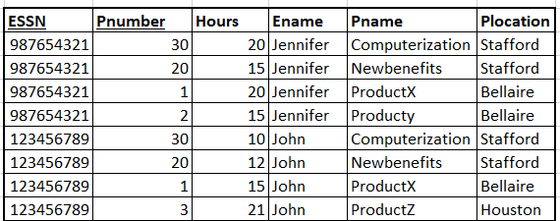
Designing a database schema
Example: Employee project information
(Essn, Ename, Pnumber, Hours, Pname, Plocation)
ESSN, Ename is repeating group for employee working on multiple projects
Pname, pnumber, Plocation are repeating for different employee working on the same project

Slide 6
Design “anomalies”
Redundancy
  duplication of data to be stored in a database
Redundant Information in Tuples and Update Anomalies
Redundant information may cause update anomalies.
Update anomalies:
  Insertion anomalies
  Deletion anomalies.
  Modification anomalies

Slide 7
Design “anomalies”
Redundant Information in Tuples and Update Anomalies
EMP_PROJ
Insertion Anomalies:
  Occurs when it is impossible to store a fact until another fact is
  known.
  Example:
    Cannot insert a project unless an employee is assigned to it.
    Cannot insert an employee unless he/she is assigned to a
    project.
SSN
PNumber
Hours
EName
PName
PLocation
8

Slide 8
Design “anomalies”
Redundant Information in Tuples and Update Anomalies
EMP_PROJ
Delete anomalies:
  Occurs when the deletion of a fact causes other facts to be
  deleted.
  Example:
    When a project is deleted, it will result in deleting all the
    employees who work on that project.
    If an employee is the sole employee on a project, deleting
    that employee would result in deleting the corresponding
    project.
SSN
PNumber
Hours
EName
PName
PLocation
9

Slide 9
Design “anomalies”
Redundant Information in Tuples and Update Anomalies
EMP_PROJ
Modification Anomalies:
  Occurs when a change in a fact causes multiple modifications to be necessary.
  Example: Changing the name of project number 15 (for example) may cause this update to be made for all employees working on that project.
SSN
PNumber
Hours
EName
PName
PLocation
10

Slide 10
Design “anomalies”
Redundant Information in Tuples and Update Anomalies
EMP_PROJ
SSN
PNumber
Hours
EName
PName
PLocation
Decompose mega relation in such a way that we don’t have any anomaly
Can reconstruct original relation without loosing information (natural join of smaller table reconstruct the original table)
SSN
EName
PNumber
PName
PLocation
SSN
PNumber
Hours
10

Slide 11
Design by Decomposition
Start with “mega” relations containing everything
Decompose into smaller, better relations with the same information.
Can do decomposition automatically
Automatic decomposition
  “Mega” relations + properties of the data
  System decomposes based on properties
  Final set of relations satisfies the Normal Form
      No anomalies, no lost information

Slide 12
Properties and Normal Forms
Atomic value (remove repeating groups) => First Normal Form (1NF)
Functional Dependencies => Second Normal Form (2NF) and Boyce-Codd normal form (BCNF)
Transitive Dependencies =>Third Normal Form (3NF)

Slide 13
1NF
In the first normal form, only single values are permitted at the intersection of each row and column; hence, there are no repeating groups.
To normalize a relation that contains a repeating group decompose the relation into smaller relations:
  remove the repeating group and form new relations
The PK of the new relation is a combination of the PK of the original relation plus an attribute from the newly created relation for unique identification.

Slide 14
Process for 1NF
In this example the repeating group is employee information, an employee can work on many projects
Also, project information since one project can be taken by many employees
Remove the repeating group

Slide 15
Process for 1NF
Decompose the mega relation into the following two tables.
  Project (Pnumber, Pname, Plocation)
  Employee (ESSN, Ename, Pnumber, hours)

Slide 16
Process for 1NF
Emp_Proj
decompose
Employee
Project
ESSN | Pnumber | Hours | Ename
987654321 | 30 | 20 | Jennifer
987654321 | 20 | 15 | Jennifer
987654321 | 1 | 20 | Jennifer
987654321 | 2 | 15 | Jennifer
123456789 | 30 | 10 | John
123456789 | 20 | 12 | John
123456789 | 1 | 15 | John
123456789 | 3 | 21 | John
Pnumber | Pname | Plocation
30 | Computerization | Stafford
20 | Newbenefits | Stafford
1 | ProductX | Bellaire
2 | Producty | Bellaire
3 | ProductZ | Houston

Slide 17
Process for 1NF
Employee is not in 1NF, since we can have many rows for the same employee for different project
Employee
ESSN | Pnumber | Hours | Ename
987654321 | 30 | 20 | Jennifer
987654321 | 20 | 15 | Jennifer
987654321 | 1 | 20 | Jennifer
987654321 | 2 | 15 | Jennifer
123456789 | 30 | 10 | John
123456789 | 20 | 12 | John
123456789 | 1 | 15 | John
123456789 | 3 | 21 | John
Emp_Proj
ESSN | Pnumber | Hours
987654321 | 30 | 20
987654321 | 20 | 15
987654321 | 1 | 20
987654321 | 2 | 15
123456789 | 30 | 10
123456789 | 20 | 12
123456789 | 1 | 15
123456789 | 3 | 21
Employee
ESSN | Ename
987654321 | Jennifer
123456789 | John

Slide 18
Process for 1NF
Emp_Proj
decompose
Employee
Project
Emp_Proj
ESSN | Pnumber | Hours
987654321 | 30 | 20
987654321 | 20 | 15
987654321 | 1 | 20
987654321 | 2 | 15
123456789 | 30 | 10
123456789 | 20 | 12
123456789 | 1 | 15
123456789 | 3 | 21
ESSN | Ename
987654321 | Jennifer
123456789 | John
Pnumber | Pname | Plocation
30 | Computerization | Stafford
20 | Newbenefits | Stafford
1 | ProductX | Bellaire
2 | Producty | Bellaire
3 | ProductZ | Houston
We decomposed the original relation into three smaller tables with no repeating group. The resultant tables are in 1NF.
We can reconstruct the resultant relations into an original mega relation without losing information.

Slide 19
Practice INF
Student_Grade_Report (StudentNo, StudentName, Major, CourseNo, CourseName, InstructorNo, InstructorName, InstructorLocation, Grade)
A student can take many courses, each course is taught by one instructor.
Student (StudentNo, StudentName, Major)
StudentCourse (StudentNo, CourseNo, CourseName, InstructorNo, InstructorName, InstructorLocation, Grade)

Slide 20
Functional Dependencies and Normalization
A functional dependency (FD) for relation R is a formula of the form A → B
  where A and B are sets of attributes of R. A is called the LHS (left hand side) and B is called the RHS (right hand side), and we say the LHS (functionally) determines the RHS, or the RHS is (functionally) dependent on the LHS.
  The meaning of the functional dependency is that for every value of A, there is a unique value of B. We say the FD holds for R if, for any instance of R, whenever two tuples agree in value for all attributes of A, they also agree in value for all attributes of B.

Slide 21
Functional Dependencies
Apply(SSN, sName, cName)
Redundancy; Update & Deletion Anomalies
Storing SSN-sName pair once for each college
Functional Dependency SSN → sName
  Same SSN always has same sName
  Should store each SSN, sName only once
Boyce-Codd Normal Form If A → B then A is a key
Decompose:
Student(SSN, sName) Apply(SSN, cName)

Slide 22
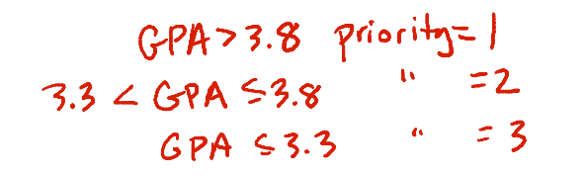
Functional Dependencies
Example:
  Student(SSN, sName, address, HScode, HSname, HScity, GPA, priority)
  Apply(SSN, cName, state, date, major)
Suppose priority is determined by GPA
Two tuples with same GPA have same priority

Slide 23




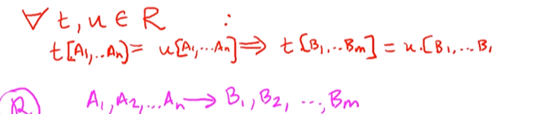
Functional Dependencies
Generalization of FDs

Slide 24
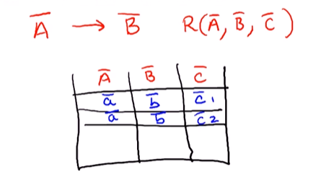
Functional Dependencies
Based on knowledge of real world which derives FDs to hold
All instances of relation must adhere

Slide 25
Functional Dependencies
Student(SSN, sName, address, HScode, HSname, HScity, GPA, priority)
SSN → sName
SSN → address
Hscode → HSname, HScity
HSname, HScity → Hscode
SSN → GPA
GPA→ priority
SSN → priority

Slide 26
Functional Dependencies
Apply(SSN, cName, state, date, major)
cName → date
SSN, cName → major
SSN → state

Slide 27
Functional Dependencies and keys
Functional dependencies generalize the notion of keys.
If a set of attributes determines the other attributes, then those attributes are a key.
The goal is to find the minimal set of FDS, such that all FDS that hold on a relation follow from the dependencies in this set

Slide 28
Inference rules for functional dependencies
A set of FDs may logically imply some other FDs.
  For instance, a → b, and b → c together imply
  a → c.
  Similarly, a → b and c → d together imply
  a,c → b,d
Given a set F of FDs, we can find all FDs implied by those in F using the following three inference rules.
(1) a → a for every attribute a
(2) If a → b, and b → c, then a → c
(3) If a → b and c → d, then a,c → b,d
Given two sets of FDs, E and F, we say E and F are equivalent, if every FD in E is implied by F, and vice versa

Slide 29
Closure properties
Given relation, FDs, set of X attributes
The closure set of X (w.r.t FDs), denoted X+ , is the set of all attributes that can be inferred to be functionally dependant on X.
For example, if F={ a → b, b → c }, then {a}+ ={a,b,c}
To find the closure set a+ , we can use the simple steps below:
  Initially a+ =a
  For each FD, if the LHS is in a+ , add the RHS to a+
  Repeat until no change to a+ is possible.

Slide 30
Closure Example
Example: R(a,b,c,d,e )
Suppose FDs contains
  a → b,
  a,b → d,
  c → e
    Initially X+= {a,c}.
      Using the first FD, we can add b to X+
      Using the second FD, we can add d to X + , and using the last FD we can add e to X+
      Thus the final closure set is X + ={a,b,c,d,e}.
    It shows {a, c} is a minimal candidate key.

Slide 31
Functional Dependencies
Student(SSN, sName, address, HScode, HSname, HScity, GPA, priority)
SSN → sName
SSN → address
Hscode → HSname, HScity
HSname, HScity → Hscode
SSN → GPA
GPA→ priority
SSN → priority
SSN→sName, address, GPA
GPA → priority
Hscode → HSname, HScity
{SSN, HScode}+ = {SSN, Hscode, sName
address, GPA, priority, HSname, Hscity}
The closure set of {SSN, HScode} contain all attributes of Student relation, it is the minimal candidate key.

Slide 32
Closure and key
Is set of attribute A is a key of R?
  Compute A+ (closure of A) determine all attributes then A is a key
How we can find all keys given a set of FDs
  Consider every subset of attributes and compute closure.
  If closure determines all attribute then the set of attributes in closure is a key

Slide 33
Relationship between FDs and keys in a relation
We are trying to find a minimal set of candidate keys using the notion of functional dependencies and closure properties
Find minimal set of FDs such that all FDS hold on the relation follow from the dependency in the set
X is a candidate key if and only if there is no proper subset (smaller subset) Y of X such that Y →Z
Given a set F of FDs that hold for table R, if R is not in 2NF (or 3NF, BCNF), we can decompose R into smaller tables so that each of the smaller tables are in 2NF (or 3NF, BCNF). This process is called normalization.

Slide 34
Decomposition Problems
Following two properties of decomposition must be considered:
  Loss less-join Property: Identify any instance (row) of original relation from the corresponding instance of the smaller relation attained after decomposition
  Dependency preservation property: Ensures that each functional dependency is represented in some individual relation resulting after decomposition.

Slide 35
Second Normal Form (2NF)
Not a member of
any candidate key
A relation is in 2NF if it is in 1NF and every nonprime attribute is fully functionally dependent on the primary key.
Remove any attributes which are dependent on part of the compound key, also called partial dependency
These attributes are put into a separate table along with that part of the compound key.
30

Slide 36
2NF: Example
R=(a,b,c,d).
FDs contains a → c and a, b → d.
The only candidate key is {a,b},
{a,b}+ = {a, b, c, d}
but there is a smaller subset a where a →c, is a partial dependency and c is a non-key attribute
Therefore, a → c violates the definition of 2NF.
We can decompose R into (a,c) and (a,b,d), which are both in 2NF.
Actually both are in BCNF, .
30

Slide 37
2NF: Example
Student(SSN, sName, address, HScode, HSname, HScity, GPA, priority)
{SSN, HScode}+ = {SSN, Hscode, sName
address, GPA, priority, HSname, Hscity}
SSN→sName, address, GPA
GPA → priority
Hscode → HSname, HScity
What if we consider{SSN, HScode} is a key?.
Check if every nonprime attribute is fully functionally dependent on the key.
  SSN→sName, address, GPA, priority
  Hscode → HSname, Hscity

Slide 38
2NF: Example
Decompose student relation into S1, and S2
Student(SSN, sName, address, HScode, HSname, HScity, GPA, priority)
S1(SSN, sName, address, Hscode, GPA, priority)//Assming students went to only one high school
S2(Hscode, HSname, Hscity) //Student = S1 Natural Join S2

Slide 39
2NF: Example
Decompose student relation into S1, S2, S3, Assuming students went to multiple high schools.
Student(SSN, sName, address, HScode, HSname, HScity, GPA, priority)
S1(SSN, sName, address, GPA, priority)
S2(Hscode, HSname, Hscity)
S3( SSN, Hscode)

Slide 40
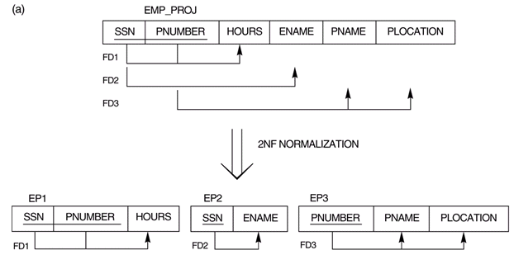
Second Normal Form: Examples
FD1: SSN, Pnumber → Hours
FD2: SSN →Ename
FD3: Pnumber →Pname, Plocation
{SSN, Pnumber}+ = {SSN, Pnumber, Ename, Hours, Pname, Plocation}
31

Slide 41
Second Normal Form: Examples (cont’d…)
{SSN, PNUMBER} → HOURS is a full FD since neither SSN → HOURS nor PNUMBER → HOURS hold
{SSN, PNUMBER} → ENAME is not a full FD (it is called a partial dependency ) since SSN → ENAME also holds
A relation schema R is in second normal form (2NF) if every non-prime attribute A in R is fully functionally dependent on a key
R can be decomposed into 2NF relations via the process of 2NF normalization

Slide 42
Third Normal Form (3 NF)
Based on the concept of transitive dependency
Transitive dependency: A→B →C
  A → C ( where A indirectly determines C)
Transitive functional dependency – if there is a set of attributes Z that are neither a primary nor candidate key and both X → Y and Y → Z holds.
32

Slide 43
Third Normal Form (3 NF)
A Relations in third normal form (3NF) if it is in 2NF and there is no transitive dependency,
  that is, no non-prime attribute is dependent on another non-prime attribute
Solution: Decompose relation with attributes which are dependent on another attribute other than the key.
32

Slide 44
3NF: Example
Decompose student relation into S1, S2, S3, Assuming students went to multiple high schools.
Student(SSN, sName, address, HScode, HSname, HScity, GPA, priority)
S1(SSN, sName, address, GPA, priority)
S2(Hscode, HSname, Hscity)
S3( SSN, Hscode)
SSN→sName, address, GPA
GPA → priority
Hscode → HSname, HScity
S2 and S3 are in 2NF and 3NF (Since there is no transitive dependency)
S1 is in 2NF but not in 3NF (there is a transitive dependency GPA → priority)

Slide 45
3NF: Example
By considering GPA → priority
  Decompose S1 into two smaller relations. The new relation will contain a set of non-key attributes
  S1(SSN, sName, address, GPA)
  S2(GPA, Priority)
  S3(Hscode, HSname, Hscity)
  S4( SSN, Hscode)
SSN→sName, address, GPA
GPA → priority
Hscode → HSname, HScity

Slide 46
BCNF
For every FD A →B , A is a key
Every determinant is a key
  S1(SSN, sName, address, GPA)
  S2(GPA, Priority)
  S3(Hscode, HSname, Hscity)
  S4( SSN, Hscode)

Slide 47
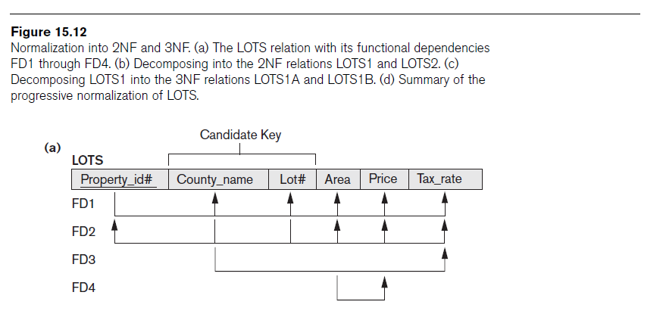
Exercise Example

Slide 48
Process of Normalization
R1 (propertyNo, countryName, Lot#, Area, Price, TaxRate)
Set of FDs
  FD1: propertyNo -> countryName, Lot#, Area, Price, TaxRate
  FD2: countryName, Lot# -> propertyNo, Area, Price, TaxRate
  FD3: countryName -> TaxRate
  FD4: Area -> Price

Slide 49
Round 1
Find all candidate keys
  Candidate keys:
  {propertyNo}, {countryName, Lot#}
  The set of key attributes are: {propertyNo, Lot#, countryName }

Slide 50
Round 2: 2NF
checking FD: propertyNo -->countryName, Lot#, Area, Price, TaxRate
checking FD: countryName, Lot# --> propertyNo, Area, Price, TaxRate
checking FD: countryName --> TaxRate
  heFD [countryName --> TaxRate] is a partial dependency, which violates definition of 2NF

Slide 51
Round 2: 2NF
R1 (propertyNo, countryName, Lot#, Area, Price, TaxRate)
Decompose R1 into R2 and R3
  R2(propertyNo, countryName, Lot#, Area, Price)
  R3(countryName, TaxRate)
  Both R2 and R3 are in second normal form

Slide 52
Round 3: 3NF
FDs
propertyNo -> countryName, Lot#, Area, Price, TaxRate
countryName, Lot# -> propertyNo, Area, Price, TaxRate
countryName -> TaxRate
Area -> Price
Check R2 and R3, if they are in 3NF?
  R2(propertyNo, countryName, Lot#, Area, Price)
  R3(countryName, TaxRate)
  In R2, FD Area -> Price, it violates the definition of 3NF, (non key attribute determines non key (Transitive dependency)

Slide 53
Round 3: 3NF
FDs
propertyNo -> countryName, Lot#, Area, Price, TaxRate
countryName, Lot# -> propertyNo, Area, Price, TaxRate
countryName -> TaxRate
Area -> Price
Decompose R2 into R4 and R5
  R2(propertyNo, countryName, Lot#, Area, Price)
  R3(countryName, TaxRate)
  R4(propertyNo,countryName, Lot#, Area)
  R5(Area, Price)

Slide 54
Round 4: BCNF
Check R3, R4 and R5, if every determinant is a key?
  R3(countryName, TaxRate)
  R4(propertyNo,countryName, Lot#, Area)
  R5(Area, Price)
  All relations already in BCNF
FDs
propertyNo -> countryName, Lot#, Area, Price, TaxRate
countryName, Lot# -> propertyNo, Area, Price, TaxRate
countryName -> TaxRate
Area -> Price

Slide 55
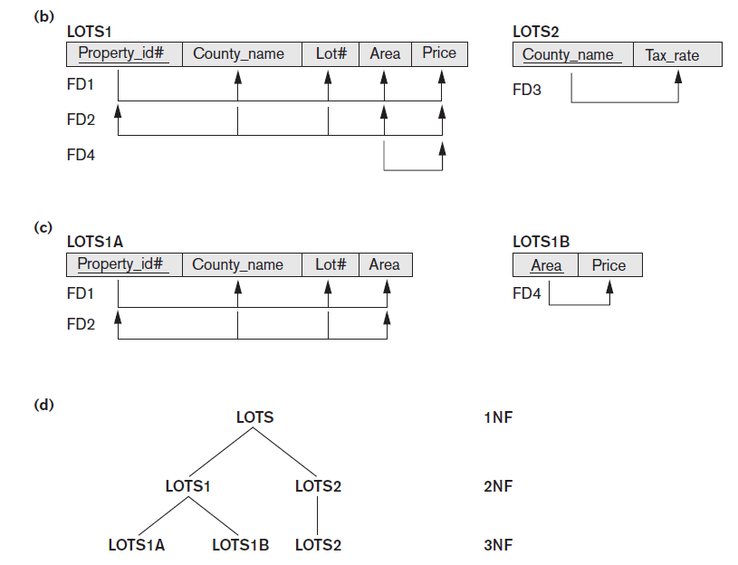

Slide 56
Advantages of Normalization
The amount of unnecessary redundant data is reduced.
Data integrity is easily maintained within the database.
The database & application design processes are much more flexible.
Security is easier to manage.
42

Slide 57
Disadvantages of Normalization
Produces lots of tables with a relatively small number of columns
Probably requires joins in order to put the information back together in the way it needs to be used
Impacts computer performance (CPU, I/O, memory).
43

Slide 58
Normalization Tool
http://www.ict.griffith.edu.au/normalization_tools/normalization/
You can use the above tool to automatically decompose a mega relation into smaller relations by providing FDs

