Slide 1
TaskBoard
How software travels from a laptop to the cloud: my DevOps capstone project
1
2
3
4
5
Write code
Test
Package
Deploy
Monitor
Notes:
Introduce the project in one sentence: TaskBoard is a simple task app, and the real goal is to show the whole journey a piece of software takes: write, test, package, deploy and monitor.

Slide 2
What I'm building, and why
WHAT
WHY
TaskBoard is a small project-management app. You create tasks, set their status and priority, and filter or search them on a dashboard.
The app is simple on purpose. The real project is everything around it.
Writing code is only half the job. Real teams must also test it, package it, deploy it, scale it and watch it.
TaskBoard is my practice run of that whole journey, done the way companies do it.
13
3
2 to 6
automated tests guard every change
services: frontend, backend, database
backend copies, auto-scaling with traffic
Notes:
WHAT: a simple task manager. WHY: to learn and show the full DevOps journey. The numbers come from the project: 13 pytest tests, three services (frontend, backend, PostgreSQL) and a backend that scales from 2 to 6 pods.

Slide 3
The tech stack in plain words
1
Build the app
2
Test and package
React - what users see
FastAPI - the brain behind it
PostgreSQL - stores the tasks
Docker - packs the app in a box
pytest - 13 automatic tests
Trivy - scans for security holes
GitHub Actions - the robot pipeline
3
Run in the cloud
4
Watch it
Terraform - builds AWS using code
Kubernetes - runs and heals the boxes
Helm - one-command installer
Ingress, HPA - routing and scaling
Prometheus - collects the numbers
Grafana - shows live dashboards
Health checks - is it alive and ready?
Notes:
Walk through the four groups left to right, top to bottom: build, test and package, run in the cloud, watch. Use the one-line meaning next to each tool; no need to go deeper.

Slide 4
Alternatives, and why I chose these
Job | Alternatives | What I chose and why
Backend | Flask, Django | FastAPI: fast, with free API docs at /docs
Database | MySQL, MongoDB | PostgreSQL: reliable, tasks fit neatly in tables
Packaging | Virtual machines | Docker: light, runs the same everywhere
Pipeline | Jenkins, GitLab CI | GitHub Actions: lives right next to my code
Cloud setup | Clicking in AWS console | Terraform: repeatable, reviewable code
Running containers | Plain Docker, ECS | Kubernetes: self-heals and auto-scales
Monitoring | AWS CloudWatch | Prometheus + Grafana: open standard, free
Notes:
The idea for every row: there are other good options, but I picked the one that is simplest to learn, widely used in industry and works well with the rest of the stack.

Slide 5
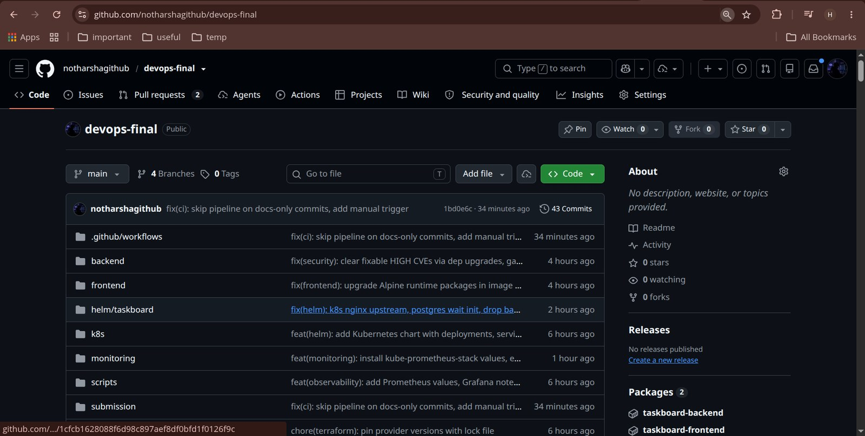
Where the code lives: GitHub
43
commits, each with a clear message such as feat or fix
2
images published to GHCR: backend and frontend
Public
Git saves every change as a checkpoint (a commit). GitHub keeps the shared copy online.
anyone can open the repository and read the code
Notes:
This is the repo on GitHub: folders for backend, frontend, helm, k8s, monitoring and the CI workflow. 43 commits with meaningful messages (feat, fix, docs) instead of vague ones like 'update'. The two packages are the Docker images pushed by the pipeline.

Slide 6
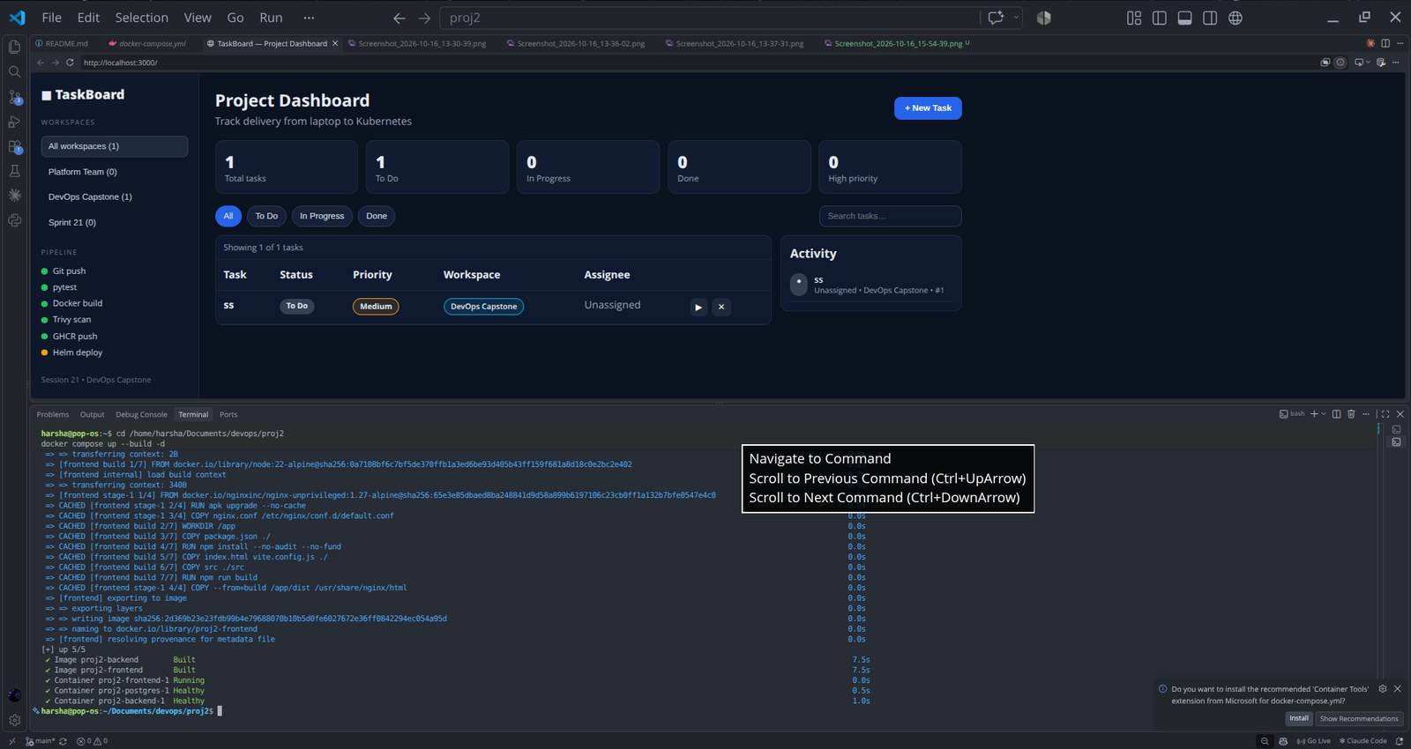
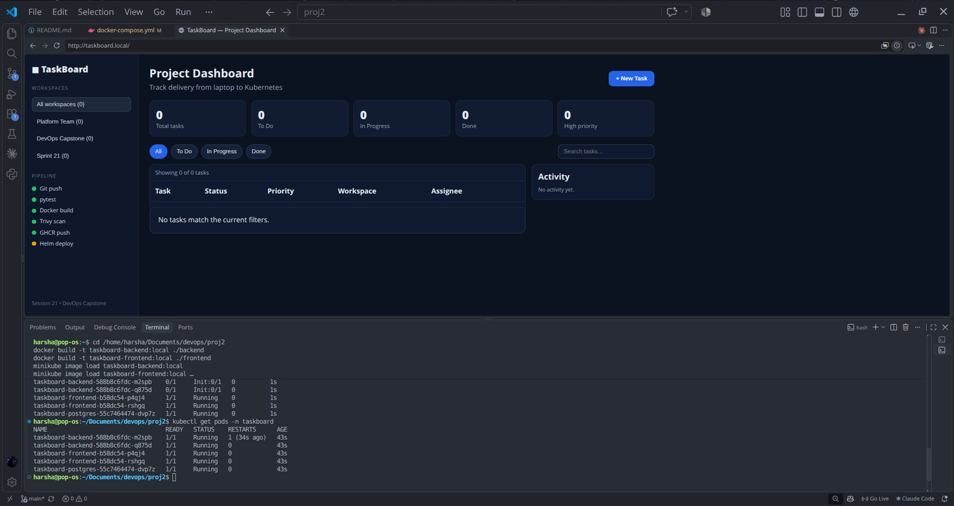
Docker and Kubernetes, simply
Docker = a shipping container
Kubernetes = the container manager
The app and everything it needs are packed into one box (an image), so it runs the same everywhere.
Here: docker compose starts all 3 services.
It keeps 2 copies of each box running, replaces any that crash, and adds more (up to 6) when traffic grows.
Here: all pods Running on minikube.
Notes:
Analogy: Docker is the shipping container, Kubernetes is the port manager who decides where containers go, replaces broken ones and adds more when it gets busy. Left screenshot: docker compose up builds and starts postgres, backend and frontend, and the app opens on localhost:3000. Right screenshot: kubectl get pods shows the backend, frontend and postgres pods Running, and the app opens through the Ingress at taskboard.local. The Terraform code in the repo builds the same on AWS EKS.

Slide 7
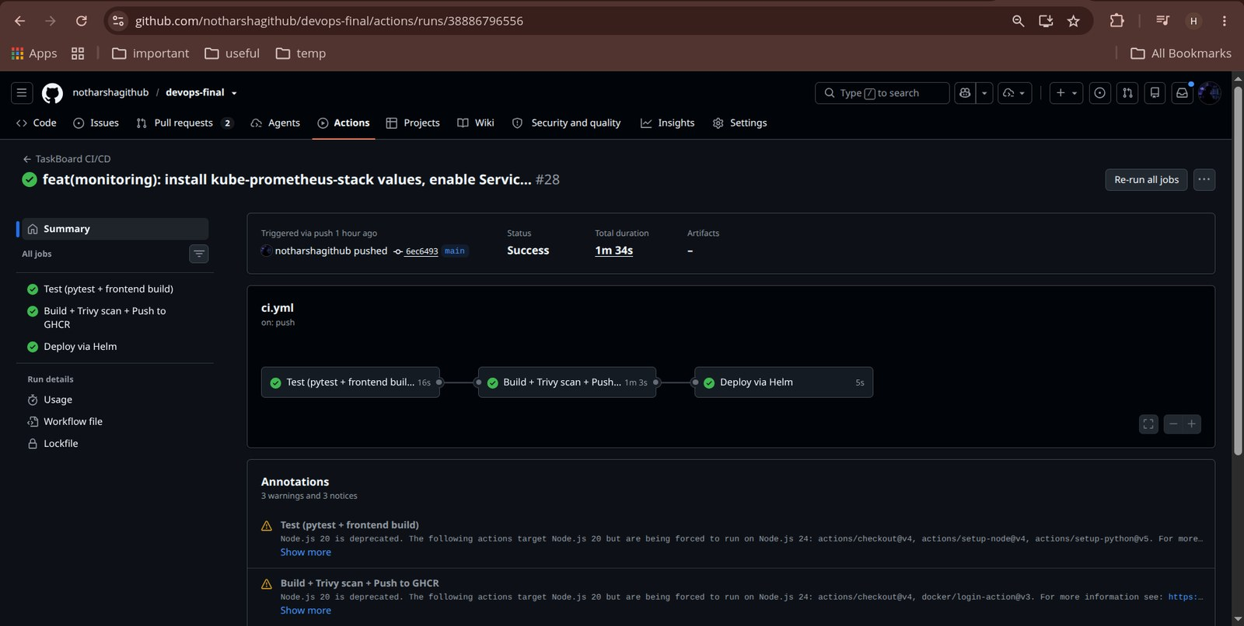
CI/CD: the automatic delivery line
1
Test
pytest runs first; red stops all
2
Build
Images tagged with commit ID
3
Scan
Trivy blocks serious issues
4
Push
Safe images go to GHCR
CI/CD means every code push is tested, packaged, scanned and deployed automatically. This real run passed all 3 jobs.
5
Deploy
Helm updates Kubernetes
Notes:
Every push to main triggers the pipeline: test, build, scan, push, deploy. If tests fail, nothing is shipped. Images are tagged with the commit ID so any running container maps back to the exact code. The screenshot is a real run (#28) where all three jobs passed in about 1m 34s.

Slide 8
Watching the app: monitoring
Is it alive?
Is it ready?
How busy is it?
/health
/ready
/metrics
A cheap check. If it fails, Kubernetes restarts the app.
Asks the database a quick question. Only ready copies get traffic.
Counts requests and timings so Prometheus can read them.
From numbers to pictures
Prometheus
collects the numbers
→
Grafana
turns them into charts
→
You
spot slow or failing parts
Notes:
Three simple endpoints give Kubernetes and Prometheus what they need: /health (alive), /ready (can serve traffic, checks the database) and /metrics (numbers). Grafana panels show requests per second, slowest endpoint (p95 latency), error rate and CPU versus number of copies.

Slide 9
Staying safe, and fixing things
6 → 0
Wrong image tag
Pod shows ImagePullBackOff. Use describe to find the bad tag, then set the right image.
fixable security issues in the first scan, after upgrading two libraries
Trivy scans every image. A serious, fixable problem stops the pipeline.
Problems with no fix yet are ignored, so one unfixable item cannot freeze every release.
Wrong Service label
Service has no endpoints. Labels match no Pods, so traffic goes nowhere. Fix the selector.
I broke things on purpose and fixed them live to learn how Kubernetes problems look.
Notes:
Security: the first Trivy scan found 6 fixable HIGH issues in python-multipart and starlette. Upgrading them took the Python findings to zero. Debian OS findings with no published fix are ignored on purpose (ignore-unfixed), which is standard practice. Troubleshooting: two practice labs, a wrong image tag and a Service whose selector matches no Pods. Reminder: run terraform destroy after the demo to avoid AWS bills.

Slide 10
Recap and live demo
What I learned
Live demo in 5 steps
1
Automate the checks
Tests and scans run on every push, so mistakes are caught early.
Create a task in the app
Push a small code change
Watch the pipeline turn green
Show every pod Running in Kubernetes
Break a Service, then fix it live
2
Package once, run anywhere
Docker makes the app behave the same on every machine.
3
Run it, then watch it
Kubernetes keeps it alive and monitoring shows when something is wrong.
Notes:
Close with the three lessons. Then run the short live demo: create a task, push a small change, watch the Actions pipeline go green, show kubectl get pods with everything Running, and finish by breaking a Service selector and fixing it live. After the demo, run terraform destroy if you built the AWS infrastructure, to avoid bills.

