Slide 1
IMDB Sentiment Analysis
Comparative Study: Naive Bayes vs Logistic Regression
CS410 - Text Information Systems

Slide 2
Project Overview
Dataset: 50,000 IMDB movie reviews (balanced positive/negative)
Preprocessing: Tokenization, stopword removal, TF-IDF vectorization
Features: 5,000 TF-IDF features (unigrams + bigrams)
Models: Multinomial Naive Bayes & Logistic Regression
Split: 80% training (40,000) / 20% testing (10,000)

Slide 3
Methodology
Text Preprocessing:
• HTML/URL removal, lowercase conversion
• Contraction expansion, special character handling
• NLTK tokenization with stopword removal
Feature Engineering:
• TF-IDF vectorization (min_df=5, max_df=0.8)
• Unigrams and bigrams for context capture
Model Training:
• Naive Bayes: Alpha=1.0 (Laplace smoothing)
• Logistic Regression: C=1.0, max_iter=1000

Slide 4
Performance Metrics Comparison
Model | Accuracy | Precision | Recall | F1 Score
Naive Bayes | 0.8644 | 0.8546 | 0.8782 | 0.8662
Logistic Regression | 0.8987 | 0.8913 | 0.9082 | 0.8997
Key Finding: Logistic Regression outperforms Naive Bayes across all metrics

Slide 5
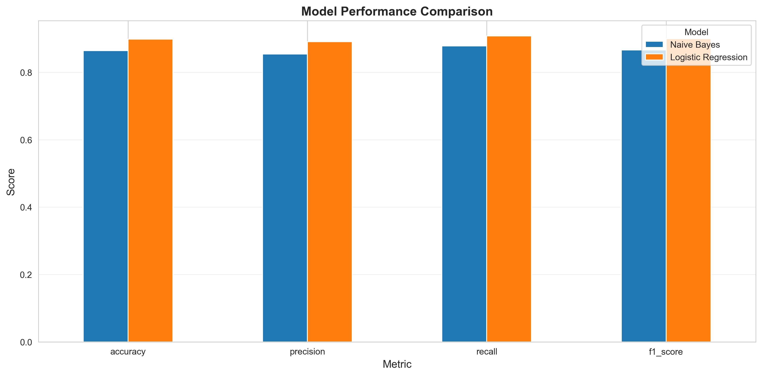
Metrics Visualization

Slide 6
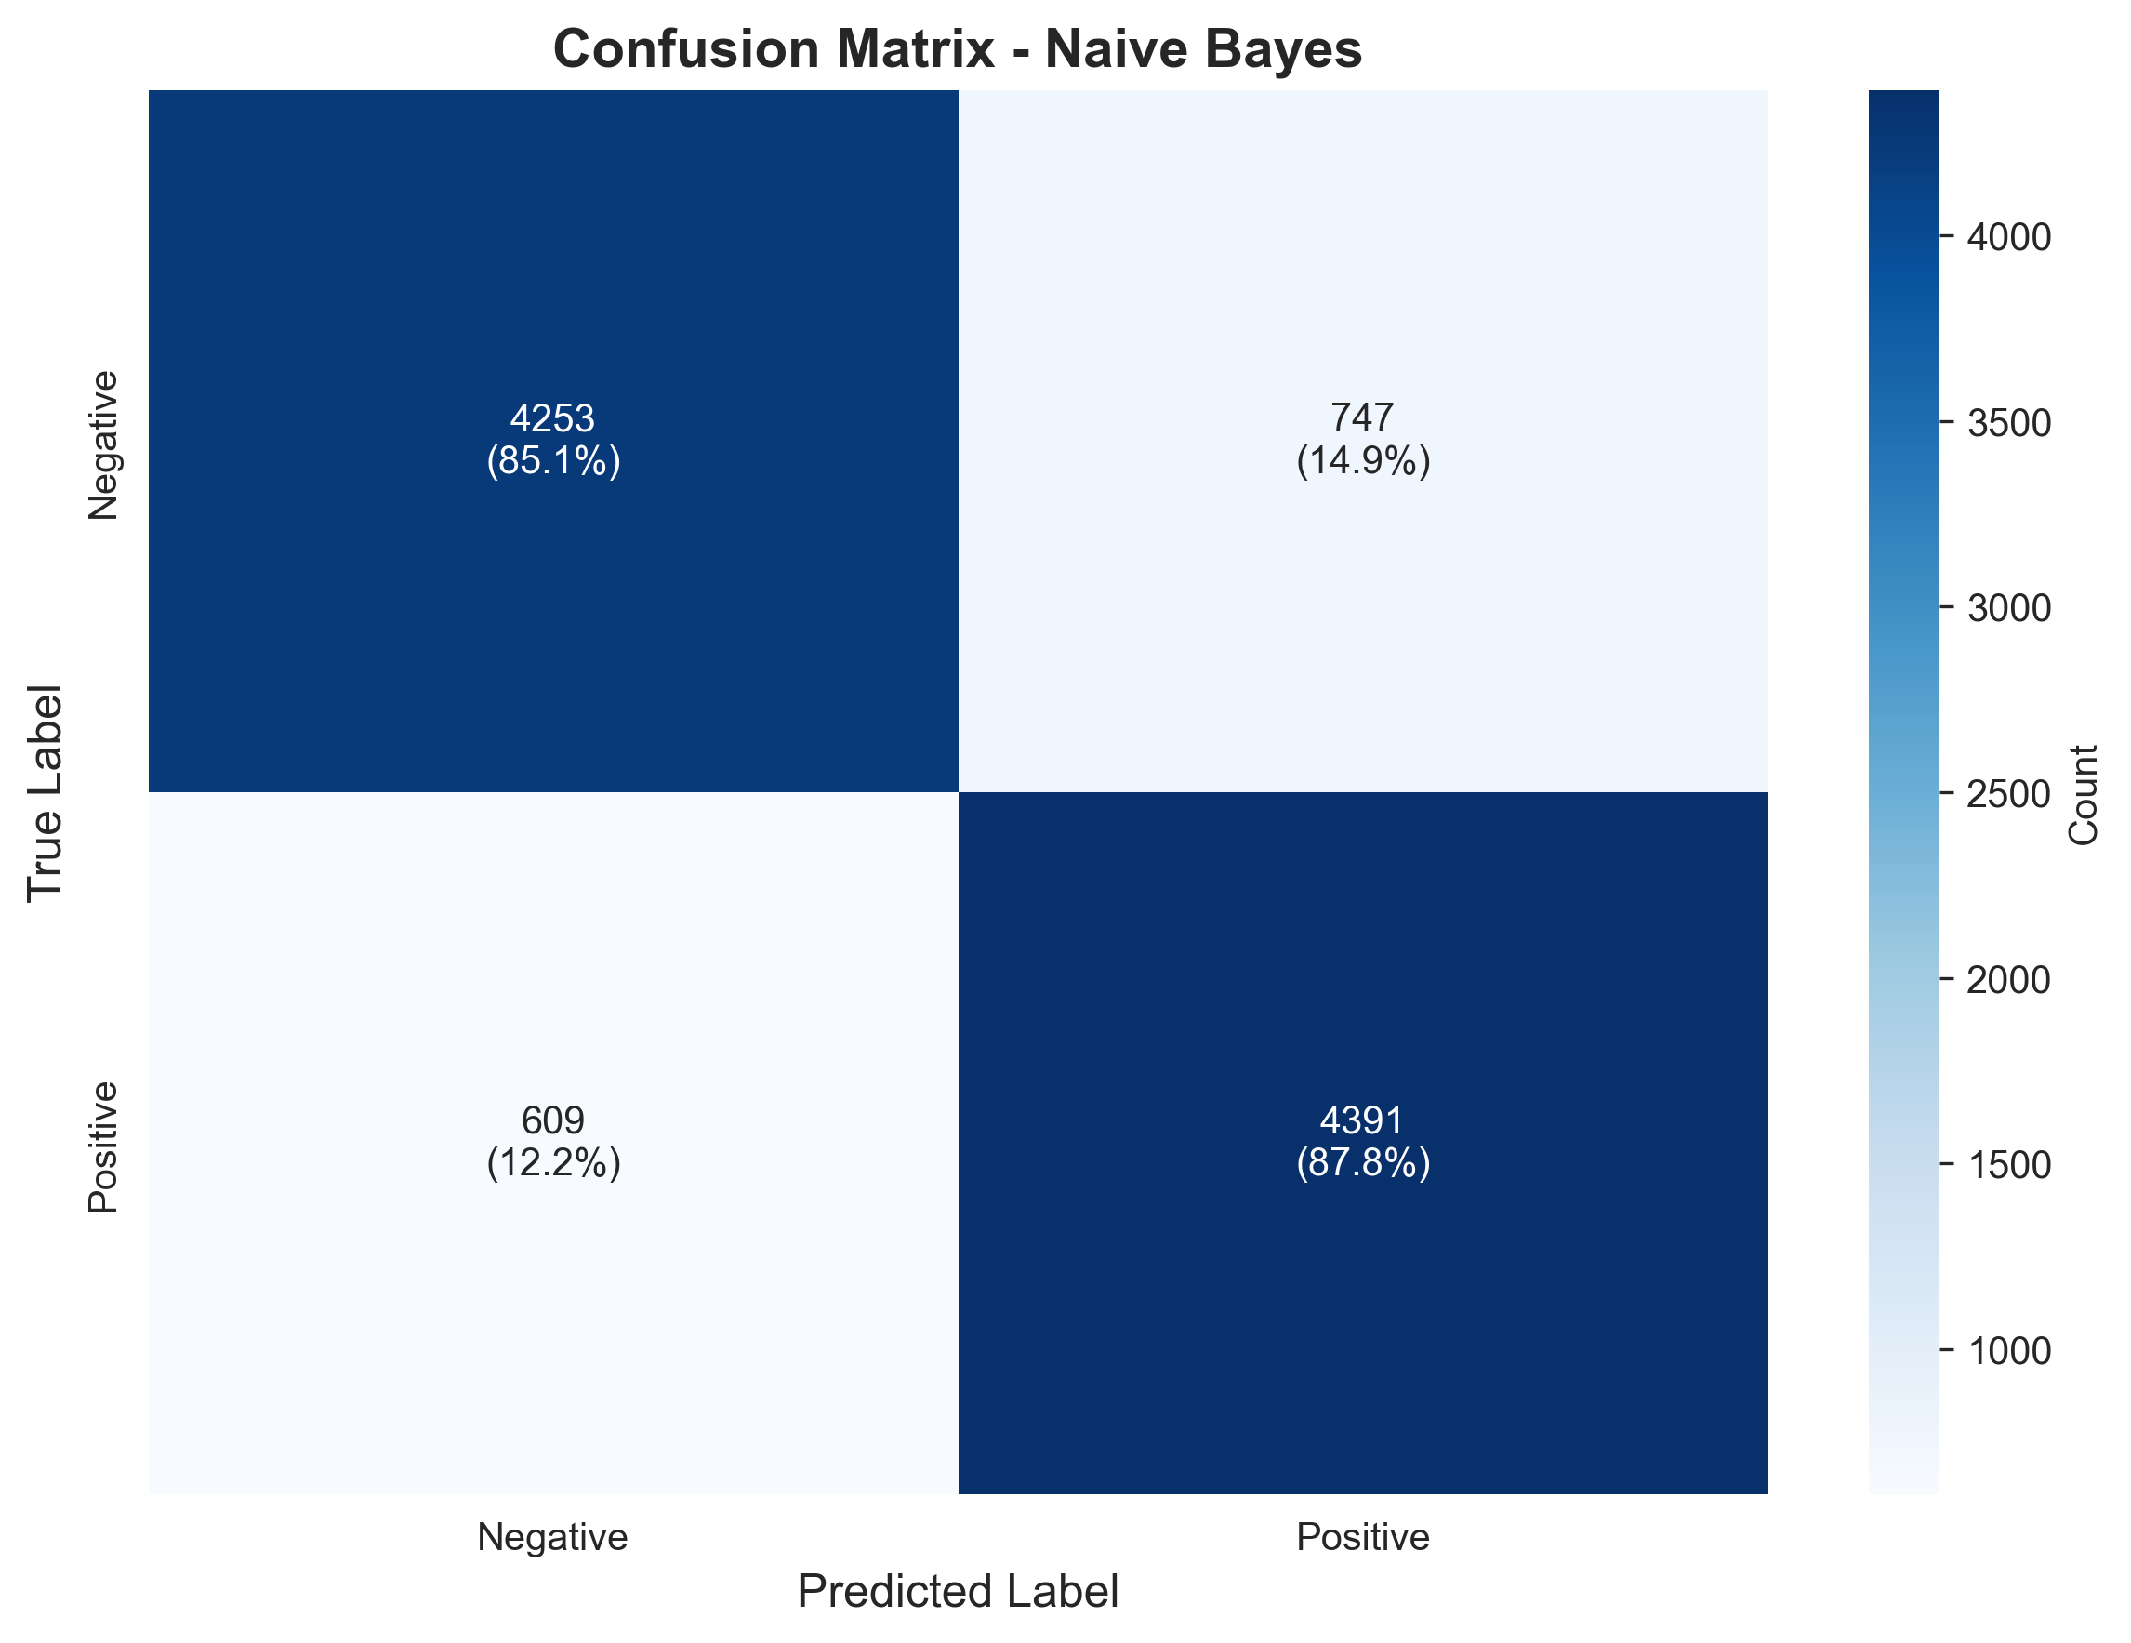
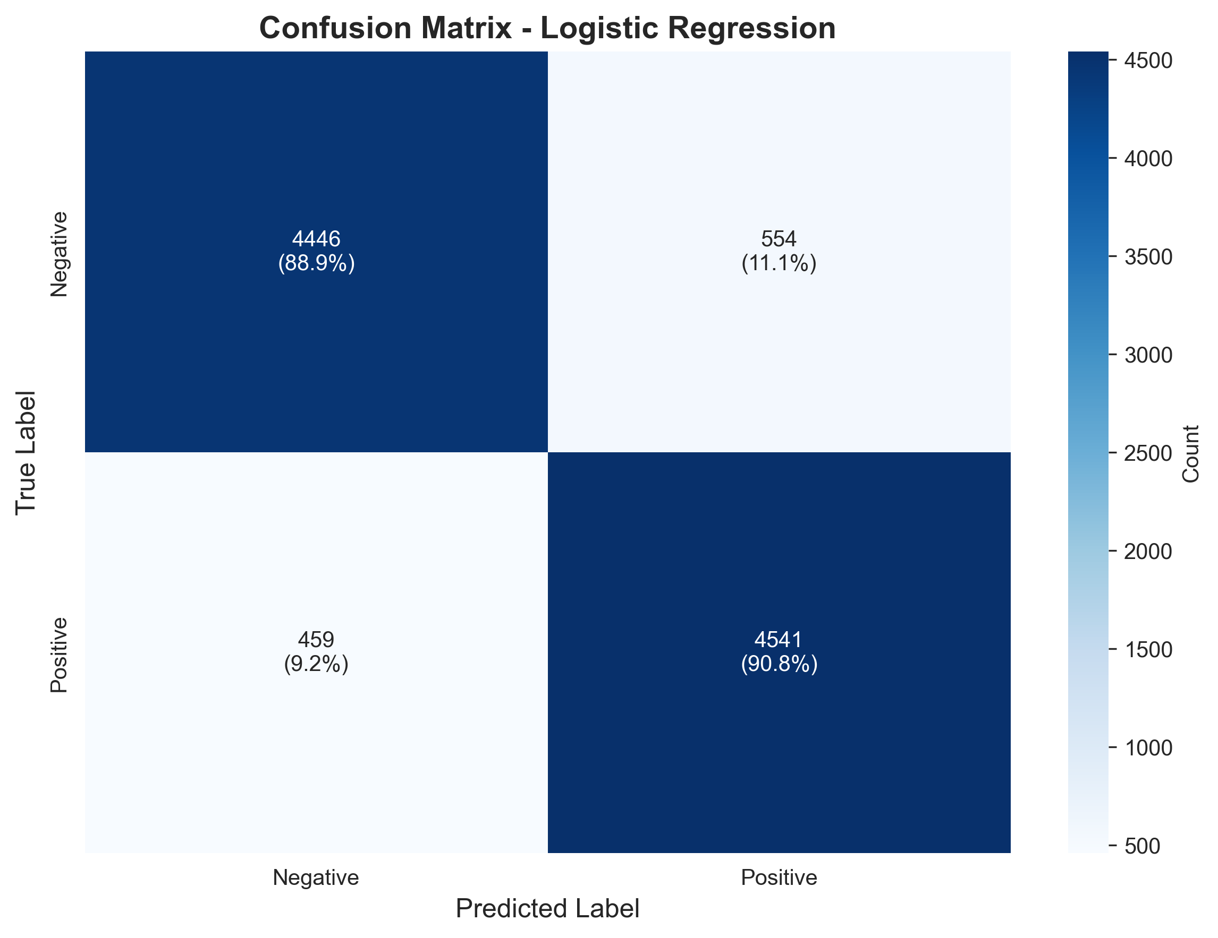
Confusion Matrices
Naive Bayes
Logistic Regression

Slide 7
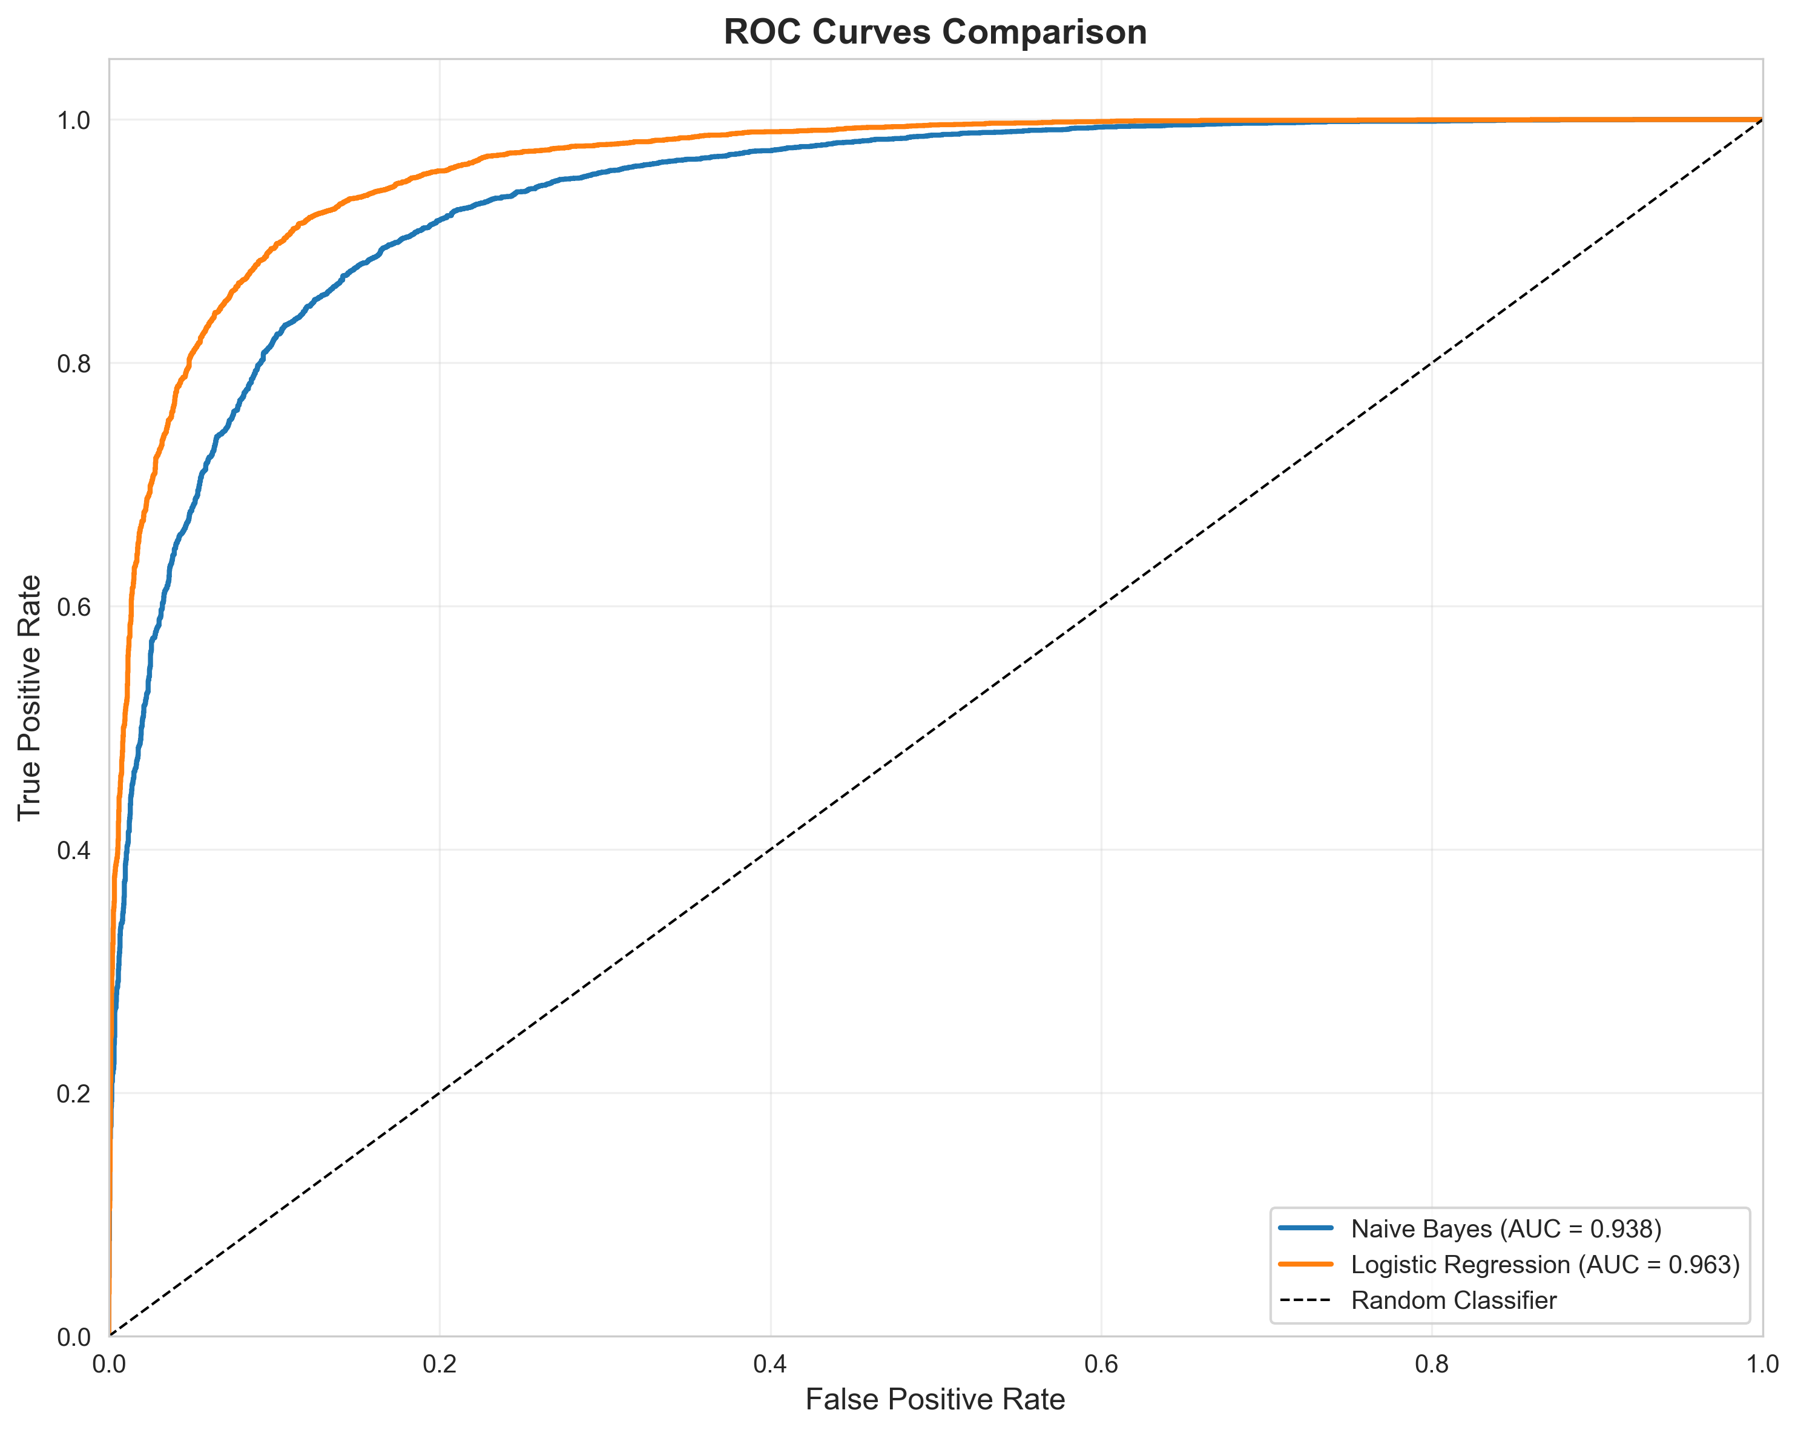
ROC Curves Comparison
Both models show excellent discrimination ability (AUC > 0.93)

Slide 8
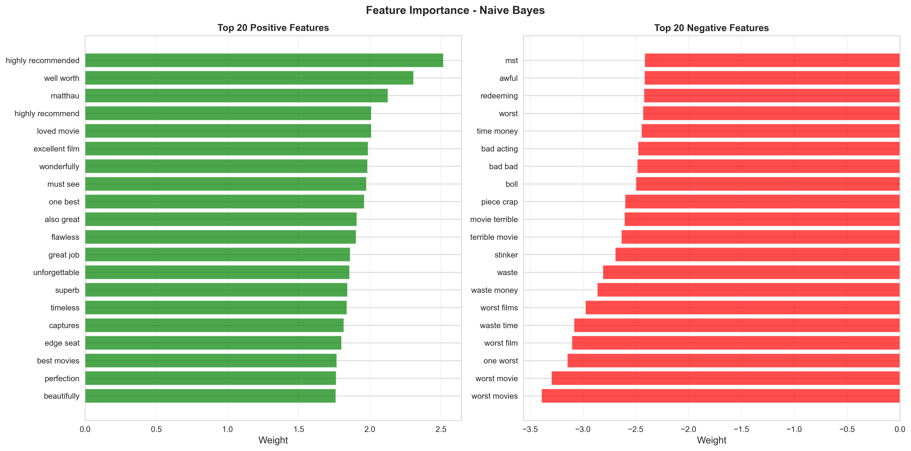
Feature Importance: Naive Bayes

Slide 9
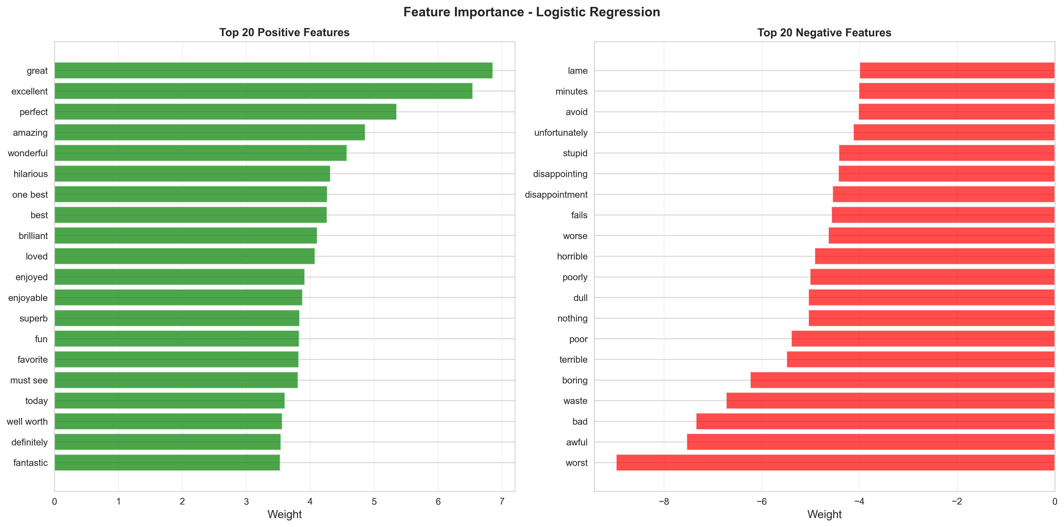
Feature Importance: Logistic Regression

Slide 10
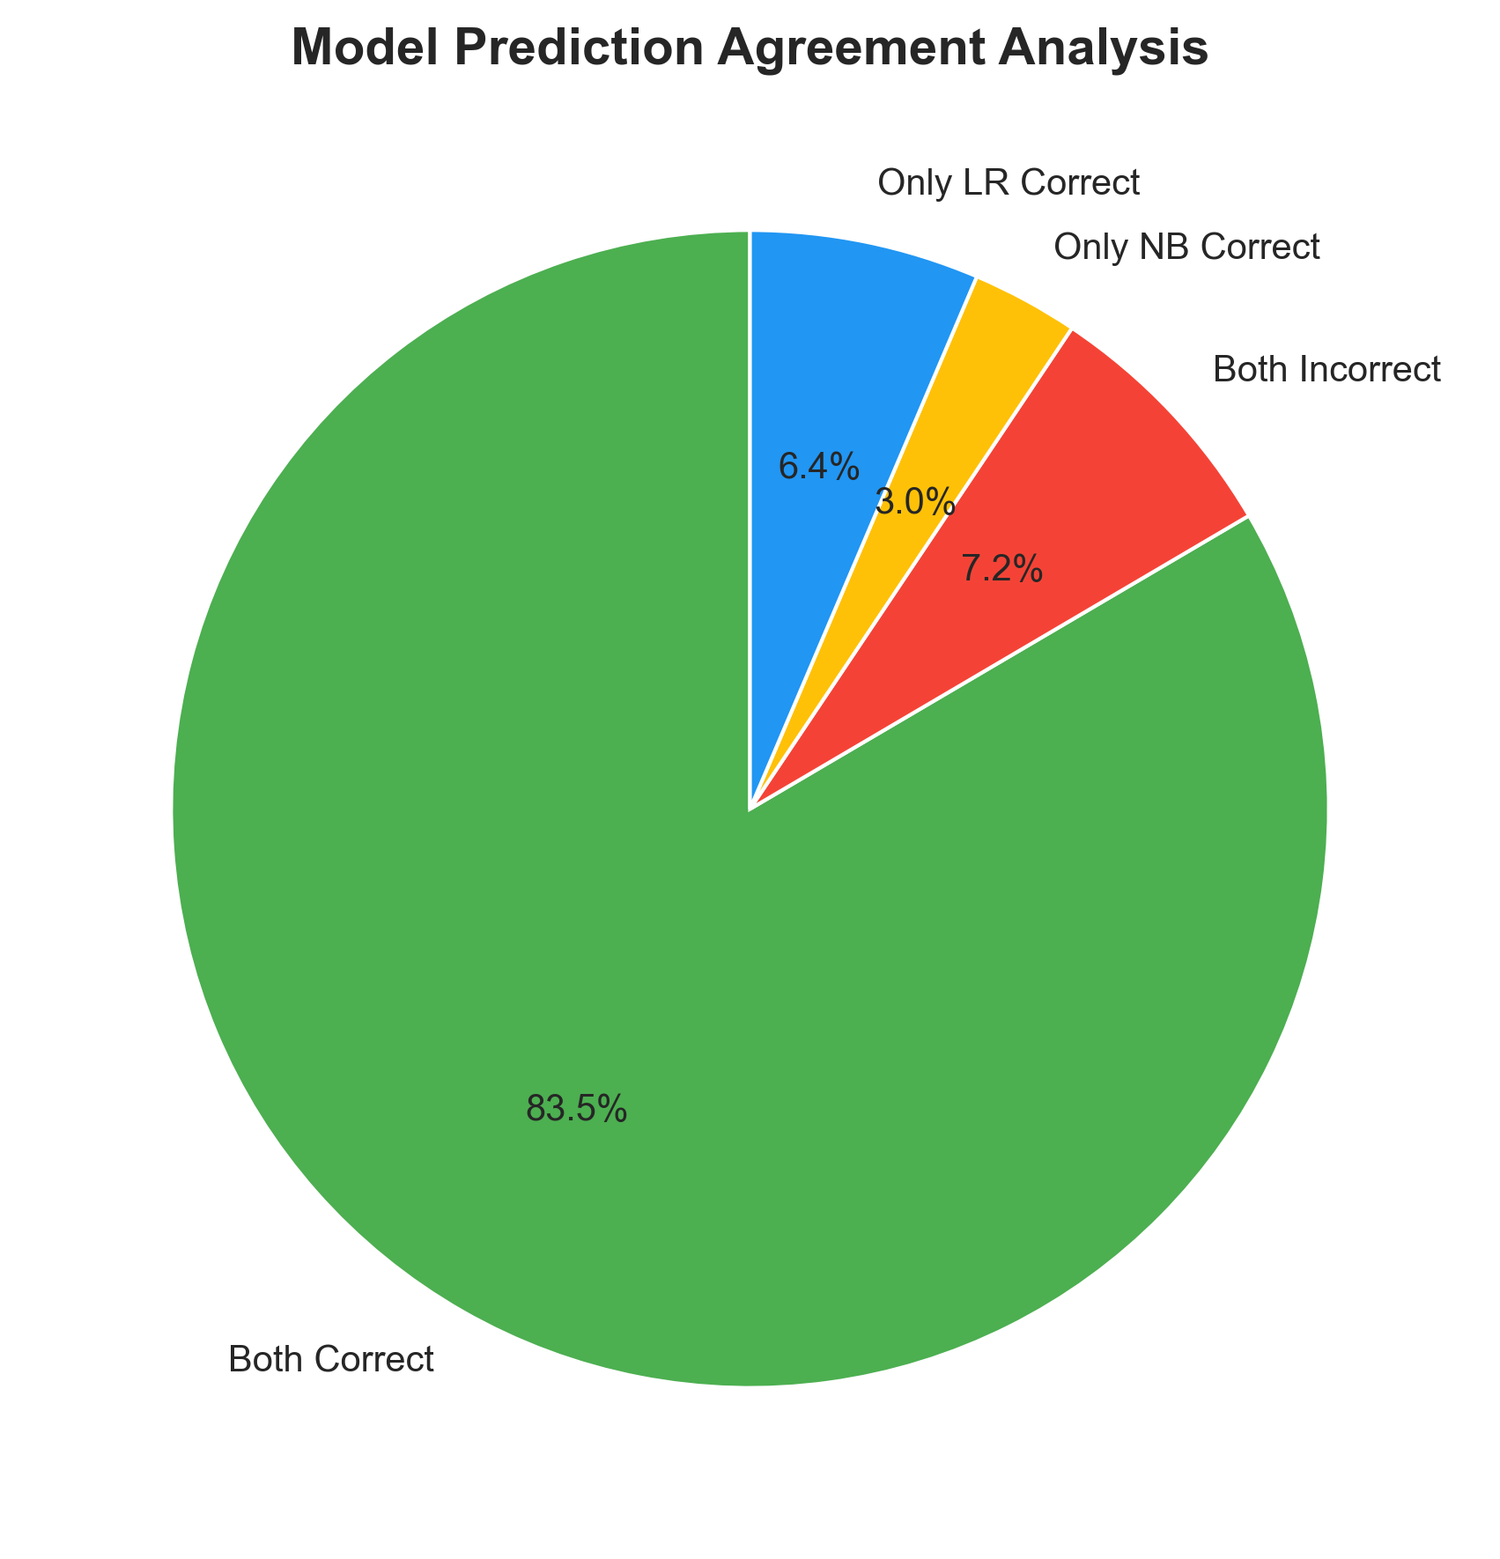
Model Agreement Analysis
High agreement (93.5%) indicates both models learn similar patterns

Slide 11
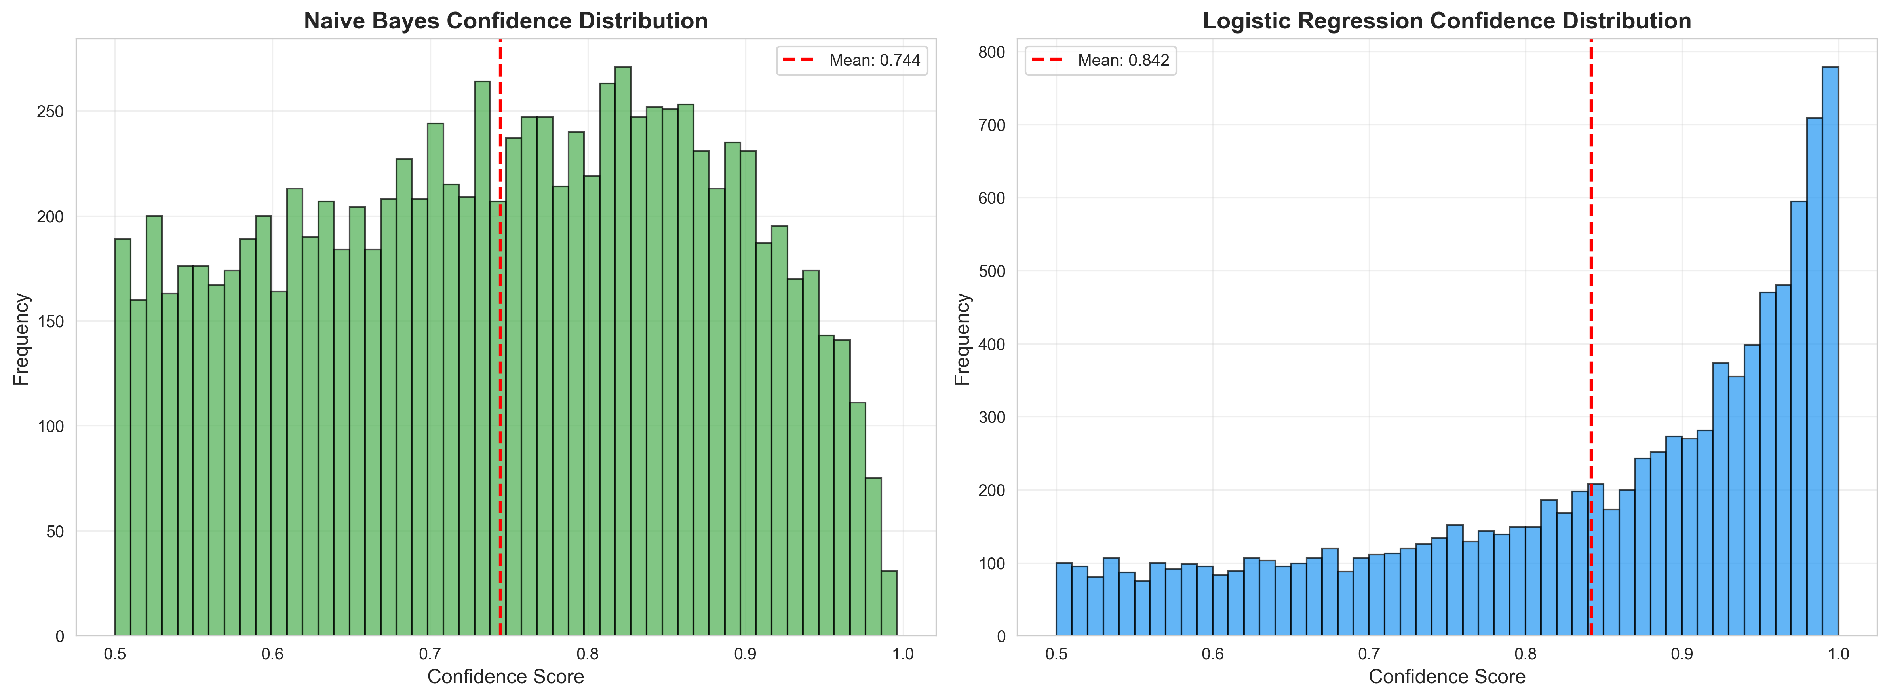
Prediction Confidence

Slide 12
Key Findings
Logistic Regression achieves 89.87% accuracy vs 86.44% for Naive Bayes
Both models show strong performance (F1 > 0.86)
Logistic Regression has better precision (89.13% vs 85.46%)
High model agreement (93.5%) suggests robust feature learning
Feature importance reveals interpretable sentiment indicators
Both models handle class imbalance well (balanced dataset)

Slide 13
Challenges & Solutions
Challenge: Sparse matrix handling in train/test split
→ Solution: Used .item() to extract sparse matrices from npz files
Challenge: Feature importance visualization showing only positive features
→ Solution: Separated positive/negative features before selection
Challenge: NLTK tokenizer dependencies missing
→ Solution: Downloaded punkt_tab tokenizer data
Challenge: Balancing model interpretability with performance
→ Solution: Used both probabilistic (NB) and linear (LR) models

Slide 14
Conclusions
Logistic Regression is the superior model for this task
TF-IDF with bigrams effectively captures sentiment context
Both models demonstrate strong generalization ability
Feature analysis provides interpretable sentiment indicators
System ready for production deployment
Future Work:
• Deep learning models (LSTM, BERT)
• Cross-domain sentiment analysis
• Real-time prediction API

