Slide 1
Call C++ from Go by SWIG

Slide 2
Some Go Basic concepts
Workspace: a directory hierarchy with three directories: src, pkg, bin
GOPATH: environment variable specifies the location of your workspace
An example directory layout:
export GOPATH=/home/usr/gocode
/home/user/gocode/
src/
foo/
bar/
x.go (package source)
y_test.go (test source)
quux/
z.go (command source)
bin/
quux (command executable)
pkg/
linux_amd64/
foo/
bar.a (package object)

Slide 3
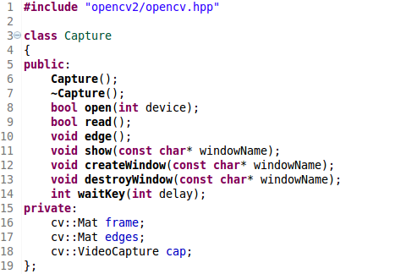
Go call C++ example: capture.h

Slide 4
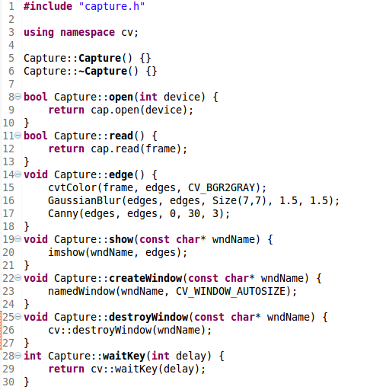
Go call C++ example: capture.cpp

Slide 5
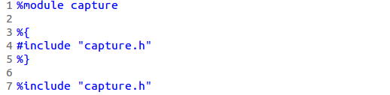
Go call C++ example: capture.swigcxx

Slide 6
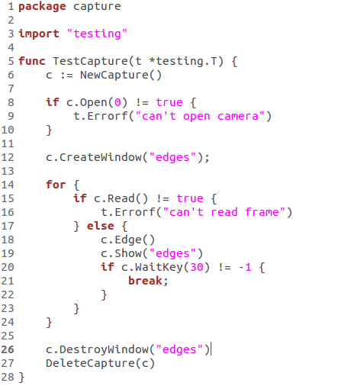
Go call C++ example: capture_test.go

Slide 7
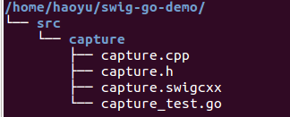
Go call C++ example: put all together
1. Prepare a workspace like the following
2. Set the GOPATH to point to the workspace
3. Change CXX to add opencv compile/link flags
4. Compile, link and run the test in package capture

Slide 8
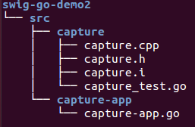


Another example: manully run swig cmd
1. Prepare a workspace like the following
2. Set GOPATH, CGO_CPPFLAGS, CGO_LDFLAGS
3. Run swig cmd, install & run capture-app
4. Run the test (capture_test.go) in package capture

Slide 9
Primitive type mapping from C++ to Go
C++ Type | Go Type
bool | bool
char | byte
signed char | int8
unsigned char | byte
short | int16
unsigned short | uint16
int | int
unsigned int | uint
long | int64
unsigned long | uint64
long long | int64
unsigned long long | unit64
float | float32
double | float64
char* / char[] | string

Slide 10
C++ classes represented in Go
C++ Usage | Go Usage
class Capture; | interface Capture
Capture c = new Capture(); | Capture c = NewCapture()
c->open(0); | c.Open(0)
c->read(); | c.Read()
c->edge(); | c.Edge()
c->createWindow(“edges”); | c.CreateWindow(“edges”)
c->show(“edges”); | c.Show(“edges”)
c->waitKey(30); | c.WaitKey(30)
c->destroyWindow(“edges”); | c.DestroyWindow(“edges”)
delete c; | DeleteCapture(c)

