Slide 1
Frameworks

Slide 2
Dependency Injection (DI)
Spring and Google Guice are two powerful dependency injection frameworks
Dependency Injection means passing dependencies in as parameters. Good candidates are databases, web requests or any external state. Bad candidates are ‘value’ objects

Slide 3
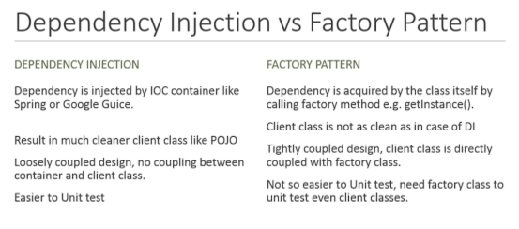
DI Vs Factory Pattern

Slide 4
Guice
Bindings in Guice. To create bindings, extend AbstractModule and override its configure() method
Call bind() to specify each binding
bind(TransactionLog.class).to(DatabaseTransactionLog.class); → BillingModule class
These methods are type checked so the compiler can report errors if you use the wrong types
Once you've created your modules, pass them as arguments to Guice.createInjector() to build an injector
Injector injector = Guice.createInjector(new BillingModule());
BillingService billingService = injector.getInstance(BillingService.class);
Use modules to create linked bindings, instance bindings, @Provides methods, provider bindings, constructor bindings and untargetted bindings
More bindings – built-in bindings and just-in-time bindings

Slide 5
Advantages of Guice over Spring DI
Spring lives in XML hell whereas Guice doesn’t require XML configuration
Guice eliminates the reliance on String identifiers i.e. Spring XML is its heavy dependence on String identifiers
Guice prefers constructor injection over setter injection. Spring prefers constructor injection
Guice hates null and refuses to inject null into any object. Exceptional cases are handled using @Nullable
Replacing Spring verbosity with Guice compactness
Guice fully supports Generics and Annotations
Guice has first class error handling
Guice is very fast
By default, Guice injects a new and separate instance of an object for each dependency. Spring provides singleton by default

Slide 6
Disadvantages of Guice
Requires the creation of Module classes (i.e. class which extends AbstractModule) to register injection bindings. These classes must have knowledge of whole systems, and are closely tied to many other classes, somehow weakening the compartmentalization

Slide 7
Do It Yourself (DIY-DI)
DI frameworks inherently carry two disadvantages:
Project code becomes tightly coupled to the framework’s syntax
Most frameworks perform a lot of magic behind the scenes
Steps for DIY-DI:
Create an application scope class
Write a top-level application helper
Create an injector class
Write a trivial main method

Slide 8
Value Vs Service Object
Value Object | Service Object
Hold state | Perform work
Are easy to create in tests | Are harder to fake in tests

Slide 9
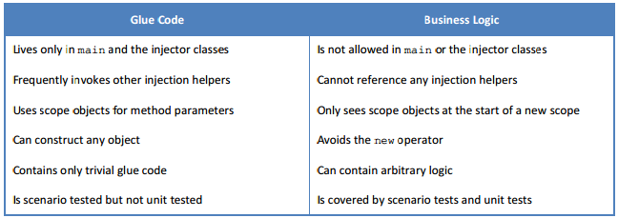
DIY-DI– Get Infected
Decouple glue code and business logic
Differentiate between value objects and service objects
Use constructor injection
Write trivial constructors
Law of Demeter - Objects should ask directly for the dependencies they need, and not acquire unnecessary dependencies

Slide 10
DIY-DI– Anti-Patterns
Mock Objects - Too many mock objects, or mock objects that return other mock objects, should be a code smell. Ideally a unit test won’t use any mocks or stubs or fakes or dummies.
Context objects and service locators - The context object pattern uses a single object that holds many different configuration variables. The service locator pattern uses a single object that is capable of producing many different types of service objects. Using either of these two patterns makes unit tests hard to write
Singletons - Avoid implementing singleton objects with private constructors. Any object that tries to enforce its own lifetime becomes difficult to test. The preferred solution is to leave the constructor public. Then the injection helpers can enforce the requirement that all callers receive the same instance.

Slide 11
Play Vs Lift – Web App Framework
Feature | Play | Lift
Programming Language | Java (any JVM scripting language Scala) | Scala
Template Language | Groovy, Japid, Velocity etc. | HTML5
Scripting Language Support | CoffeeScript, Ruby | JavaScript
Cloud Platform Support | Heroku, Amazon EC2, CloudBee, OpenShift etc. | Heroku, Amazon EC2
WebSocket Support | Yes | No

Slide 12
References
http://www.theserverside.com/feature/Spring-vs-Guice-The-Clash-of-the-IOC-Containers
https://dzone.com/articles/thibaultdelor
https://www.quora.com/How-does-dependency-injection-work-in-Spring
http://arquillian.org/
http://javarevisited.blogspot.co.uk/2015/06/difference-between-dependency-injection.html
http://vschart.com/compare/play-framework/vs/lift-web-framework
https://github.com/google/guice/wiki/Bindings
http://blacksheep.parry.org/archives/category/technology/software-development
https://docs.google.com/presentation/d/1Z51Szm2nNot12UvZMtaYuThVZ0Ie_f84uMIF6kpuWRE/present?slide=id.i609
http://blacksheep.parry.org/wp-content/uploads/2010/03/DIY-DI.pdf
http://www.javiertordable.com/guice-dependency-injection/

