Slide 1
java8

Slide 2
Java 8 – Functional Programming
Lambda Expressions (Anonymous Functions)
Default methods in interfaces (like traits in Scala)
Stream operations on collections

Slide 3
Java 8 – Five Important Features
Lambda Expressions
Parallel Operations – With the addition of Lambda expressions to arrays operations, Java introduced a key concept into the language of internal iteration
ConcurrentMap<Person.Sex, List<Person>> byGender =
roster.parallelStream().collect(Collectors.groupingByConcurrent(Person::getGender));
Java + JavaScript. New JavaScript engine in JVM = Nashorn. This introduces invokeDynamic to provide JVM-level speed to JavaScript execution right there with the likes of V8 and SpiderMonkey
New Date / Time APIs – Joda API library resolved the inefficiencies of Java APIs (i.e. before Java 8). Java 8 hasn’t taken Joda as its base for new Date / Time API due to some of the design inefficiencies in Joda API. Java 8 has implemented the new Date / Time API from scratch
Concurrent Accumulators - Enable you to very efficiently increase / decrease the value of a counter in a thread safe manner

Slide 4
Java 8 – Time API
The main API for dates, times, instants, and durations
The classes defined here represent the principle date-time concepts, including instants, durations, dates, times, time-zones and periods. They are based on the ISO calendar system, which is the de facto world calendar following the proleptic Gregorian rules
All the classes are immutable and thread-safe

Slide 5
Java 8 – Partial Function
Partial function is a function that returns function instead of a result

Slide 6
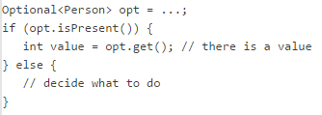

Java 8 – final class Optional
This is the design choice made most often. For instance, a call to map.get(key) returns null when the key is not present in the map. This is how the maps in the Collections Framework work, even if this behavior sounds doubtful. In fact, this method cannot be used to tell whether a given key is present in a map or not. Indeed, if this key has been associated with a null value (this is certainly not something you should do!), the call to map.get(key) will also return null
The right way to determine whether a key is present in a map is to call the following code:
map.containsKey(key);
Optional is a final class with a private constructor. In order to build an optional, we need to use one of the two factory methods provided
Optional.of() - As an argument, it takes an object that should not be null. If we pass a null object to this method, we will get a NullPointerException. This method can be used to wrap any non‐null object in an optional
Optional.ofNullable() - This method also takes an object as an argument, the difference being that this object can be null. But do not expect to get a null wrapped in an optional: if you pass a null object to this method, you will get an empty optional

Slide 7
Anonymous Inner Class - Disadvantages
Class name ends with ClassName$1 rather than ClassName
The compiler generates a new class file for each anonymous inner class which impacts the start up performance of the application as each class has to be loaded by JVM separately
When you instantiate the anonymous inner class, it would occupy additional memory space
You can examine the bytecode generated for any class file using the command
javap -c -v ClassName
Translating lambda expressions to anonymous inner classes would limit possible future optimisations (e.g. caching) as they would be tied to the anonymous inner class bytecode generation mechanism. So, lambda expressions are not converted to anonymous inner class

Slide 8
Lambdas And InvokeDynamic
The new invokedynamic bytecode instruction introduced with Java 7 gave them a mechanism to achieve this in an efficient way. The translation of a lambda expression to bytecode is performed in two steps:
generate an invokedynamic call site (called lambda factory), which when invoked returns an instance of the Functional Interface to which the lambda is being converted;
convert the body of the lambda expression into a method that will be invoked through the invokedynamic instruction
Lambda expression is non-capturing: The lambda doesn’t access any variables defined outside its body
Lambda expression is non-capturing: The lambda accesses variables defined outside its body

Slide 9
Fail Fast and Fail Safe Iterator
Concurrent Modification:-
When one or more thread is iterating over the collection, in between, one thread changes the structure of the collection is known as Concurrent Modification.
Fail fast Iterator:-
Fail fast iterator while iterating through the collection , instantly throws Concurrent Modification Exception if there is structural modification of the collection . Thus, in the face of concurrent modification, the iterator fails quickly and cleanly, rather than risking arbitrary, non-deterministic behavior at an undetermined time in the future. Fail-fast iterator can throw ConcurrentModificationException in two scenarios :
Single Threaded Environment:- After the creation of the iterator , structure is modified at any time by any method other than iterator's own remove method. Multiple Threaded Environment:- If one thread is modifying the structure of the collection while other thread is iterating over it.

Slide 10
Fail Safe Iterator
Fail Safe Iterator makes copy of the internal data structure (object array) and iterates over the copied data structure. Any structural modification done to the iterator affects the copied data structure. So , original data structure remains structurally unchanged. Hence , no ConcurrentModificationException throws by the fail safe iterator. Two issues associated with Fail Safe Iterator are : 1. Overhead of maintaining the copied data structure i.e. memory. 2. Fail safe iterator does not guarantee that the data being read is the data currently in the original data structure.

Slide 11
Multi-core processor – Parallel Stream
A parallel stream is a stream that splits its elements into multiple chunks, processing each chunk with a different thread. Thus, you can automatically partition the workload of a given operation on all the cores of your multicore processor and keep all of them equally busy
It is observed that parallel stream on LinkedList and Stream.iterate seem to produce Poor performance
Parallel streams internally use the default ForkJoinPool which by default has as many threads as you have processors, as returned by Runtime.getRuntime().availableProcessors().
You can change the number of threads using the below code:-
System.setProperty("java.util.concurrent.ForkJoinPool.common.parallelism", "12");

Slide 12
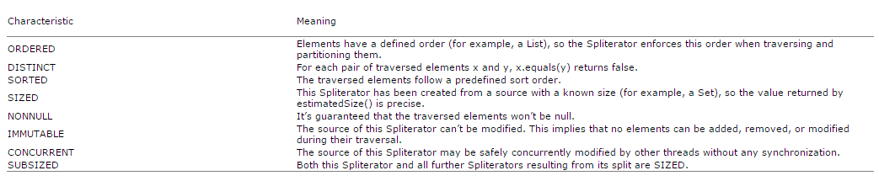
Split Iterator
Like Iterators, Spliterators are used to traverse the elements of a source, but they’re also designed to do this in parallel. Java 8 already provides a default Spliterator implementation for all the data structures included in its Collections Framework
The framework keeps invoking the method trySplit on a Spliterator until it returns null to signal that the data structure that it’s processing is no longer divisible
This splitting process can also be influenced by the characteristics of the Spliterator itself, which are declared via the characteristics method

Slide 13
Monad
Monad is a wrapper
Optional is the only monad in Java 8
Think of monads as an object that wraps a value and allows us to apply a set of transformations on that value and get it back out with all the transformations applied
Optional is used to avoid Null Pointer Exception in Java

Slide 14
How to make a class immutable
Define the class as final
Define all the instance variables in the class as private final and don’t create setter method for it
If you have collections like List, then you need to make the list of object as immutable

Slide 15
Flatmap() – Eagerly Loaded
Laziness-seeking. Many stream operations, such as filtering, mapping, or duplicate removal, can be implemented lazily, exposing opportunities for optimization. For example, "find the first String with three consecutive vowels" need not examine all the input strings. Stream operations are divided into intermediate (Stream-producing) operations and terminal (value- or side-effect-producing) operations. Intermediate operations are always lazy.
However, the flatMap() is eagerly loaded. You can experience the result if you have flatMap() in the middle
So, better filter them first. And map later.

Slide 16
Flatmap() vs Map()
The map() method wraps the underlying sequence in a Stream instance, whereas the flatMap() method allows avoiding nested Stream<Stream<R>> structure.
The map() method works well with Optional – if the function returns the exact type we need. However, in more complex cases we might be given a function that returns an Optional too. In such cases using map() would lead to a nested structure, as the map() implementation does an additional wrapping internally.
flatMap() - "flatten" a two-level Optional into one

Slide 17
Inheritance Vs Composition
Inheritance:-
IS-A relationship
Code reuse
Composition:-
HAS-A relationship
Easy to change the behaviour on the fly with dependency injection / Setters
Decorator pattern is an example where you can use composition over inheritance and add responsibilities to add objects dynamically

Slide 18
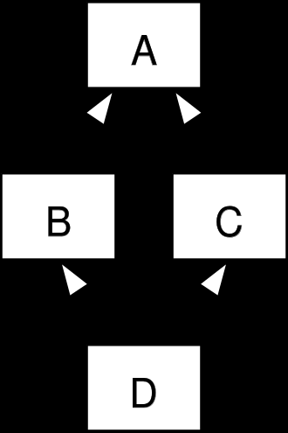
Diamond Problem in Inheritance
The "diamond problem" (sometimes referred to as the "deadly diamond of death") is an ambiguity that arises when two classes B and C inherit from A, and class D inherits from both B and C. If there is a method in A that B and C have overridden, and D does not override it, then which version of the method does D inherit: that of B, or that of C?

Slide 19
Functional Interface
Any interface with a SAM(Single Abstract Method) is a functional interface, and its implementation may be treated as lambda expressions
Functional interface cannot have default method as it has some implementation

Slide 20
Vert.X
Vert.X framework can be used for building non-blocking web applications

Slide 21
References
https://dzone.com/articles/java-8-%CE%BBe-vs-scalapart-i
http://kukuruku.co/hub/scala/java-8-vs-scala-the-difference-in-approaches-and-mutual-innovations
https://dzone.com/articles/10-features-java-8-you-havent
http://blog.takipi.com/5-features-in-java-8-that-will-change-how-you-code/
https://www.goodreads.com/author/quotes/73409.Brian_Goetz
http://winterbe.com/posts/2015/04/30/java8-concurrency-tutorial-synchronized-locks-examples/
https://docs.oracle.com/javase/8/docs/api/java/time/package-summary.html
https://community.oracle.com/docs/DOC-920950
https://community.oracle.com/docs/DOC-918126 - Concurrency
https://community.oracle.com/docs/DOC-991686 - Optional class
http://javahungry.blogspot.com/2014/04/fail-fast-iterator-vs-fail-safe-iterator-difference-with-example-in-java.html

