Slide 1
Angular

Slide 2
Angular
AngularJS | Angular
Dependency injection tokens are always strings | Tokens can have different types. They are often classes. They may also be strings.
There is exactly one injector. Even in multi-module applications, everything is poured into one big namespace. | There is a tree hierarchy of injectors, with a root injector and an additional injector for each component.

Slide 3
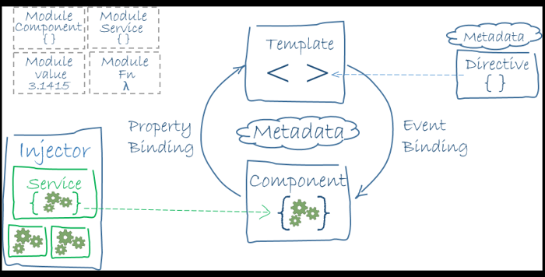
Angular Architecture

Slide 4
NgModule class - Decorator
Angular apps are modular and Angular has its own modularity system called NgModules
Every Angular app has at least one NgModule class, the root module, conventionally named AppModule
@NgModule takes a metadata object that describes how to compile a component's template and how to create an injector at runtime
Angular libraries are NgModules, such as FormsModule, HttpClientModule, and RouterModule. Many third-party libraries are available as NgModules such as Material Design, Ionic, and AngularFire2
Modules add services to the application
Modules can be loaded eagerly when the application starts or lazy loaded asynchronously by the router
Frequently used NgModules – BrowserModule, HttpClientModule, CommonModule, FormsModule, ReactiveFormsModule, RouterModule

Slide 5
RxJS
RxJS is a library for composing asynchronous and callback-based code in a functional, reactive style. Many Angular APIs, including HttpClient, produce and consume RxJS Observables.

Slide 6
Passing values between components
Service should be used to pass values from one component to another which is not in the same hierarchy
Receiving component:-
ngOnInit() {
this.myService.currentMessage.subscribe(message => this.message = message);
}
Sending component:-
sendMessage(message: type_of_the_message) {
this.messageSource.next(message);
}

Slide 7
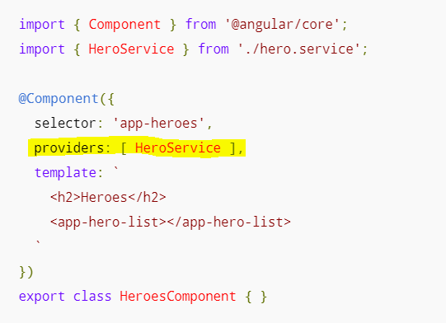
Injecting Services
Services can be injected in component or module
Service scope and lifetime
Component level – limited scope
Module level – App level scope
Angular module providers (@NgModule.providers) are registered with the application's root injector. Angular can inject the corresponding services in any class it creates.

Slide 8
Injecting Services
You're likely to inject the UserService in many places throughout the app and will want to inject the same service instance every time. Providing the UserService with an Angular module is a good choice
@provider – should be used to get the service in component

Slide 9
Directives
Directives are instructions which tell angular to do something
Allows you to attach Behaviour to element in the DOM

Slide 10
Pipes
Pipes are basically filter or formatter which helps to focus format or transform raw data and display to the user
Pipes transform displayed values in the template
Example:- Changing name to uppercase
Changing date to readable format

Slide 11
Forms
Different types of forms:-
Template driven forms
Reactive forms
Dynamic forms

Slide 12
Observables
Subject - a subscriber will only get published values that were emitted after the subscription
BehaviourSubject - The last values is cached. An subscriber will get the latest value upon initial subscription. The semantics for this subject is to represent a value that changes over time. For example a logged in user. The initial user might be an anonymous user. But once a user logs in, then the new value is the authenticated user state
ReplaySubject – No initial value. It can cache up to a specified number of emissions. Any subscribers will get all the cached values upon subscription

Slide 13
References
https://angular.io/guide/upgrade
https://stackoverflow.com/questions/48763221/angular-pass-parameter-to-another-component

