Slide 1
SCALA Features (All credit goes to Big data university. This is just my personal notes for remembering the concept.)

Slide 2
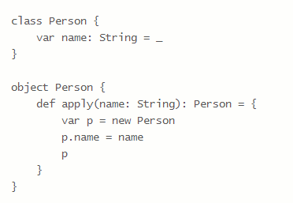
Scala – Class
The Scala object can be created without using the new operator as well
There are two ways to do this:-
Create a companion object for your class, and define an apply method in the companion object with the desired constructor signature.
Define your class as a “case class.”
Creating a companion object with an “apply” method

Slide 3
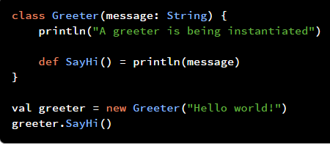
Scala – Class (Continues …)
Parameters can be passed to the Scala class
Any statements that needs to be executed while creating the object can be coded inside the class body
Unit is the equivalent of void in Java

Slide 4
Scala – Companion Objects
If a Singleton object and a class share the same name and are located in the same source file, they are called companions
A companion class can access private fields and methods inside of its companion object
Example:-
object Hello {
private val defaultMessage = “Hello!”
}
class Hello (message : String = Hello.defaultMessage) {
println (message)
}

Slide 5
Scala – Default Values for Parameters
The important usage of default parameter is that you can avoid method overloading by having default values for parameters

Slide 6
Scala – Case Classes & Objects
Case Class:-
Generates JVM-specific convenience methods
Makes every class parameter a field (field means – it is basically an instance field)
Immutable by default
Performs value-based equivalent by default (rather than checking the object instances to determine whether they are equal)
Case Object:-
If a case class is an instance-based representation of a data type, a case object is a representation of a data type of which there can only be a single instance
If you try to create a case class with no parameters, it is stateless and should be a case object

Slide 7
Scala – Apply and UnApply
case class Time(hours : Int = 0, minutes: Int = 0)
val time = Time (9, 0)
In the above example, new keyword is not used to create an object
Scala compiler creates the companion object and apply method inside companion object which is a factory for that time instance. So, the apply method will call the constructor and creates the new instance of the time class based on the parameters available.
Unapply deconstructs a Case class i.e. when you call the Unapply method passing the objects, you will get the values that are inside of the object

Slide 8
Synthetic Methods – Case Class
equals(), hashCode(), copy() and toString() – Scala compiler generates the synthetic methods
Scala provides value-based equivalence, allowing you to compare whether two different instances of a class have the same state. So, Scala is called data centric language.
hashCode() – required for any class that you might want to put into a hashed collection, such as a HashMap or HashSet
copy () – Not required by JVM. However, when the value of the field is changed, the copy() method is used to create the new instance of the class with the changed values

Slide 9
Array Vs List – Sequence Collections
Array | List
Values are stored continuously | Values are scattered
Good performance | Poor performance
Fixed size | No size limitation
Not very flexible in terms of size | Very flexible in size

Slide 10
Vectors, Sets – Sequence Collections
Vectors:-
A linked list of 32 element arrays
2.15 billion possible elements
Indexed by hashing
Good performance
Constant time performance for all operations. The operation takes effectively constant time, but this might depend on some assumptions such as maximum length of a vector or distribution of hash keys.
Sets:-
No duplicates permitted
Order is not guaranteed
The apply method on an instance checks to see if the set contains a value

Slide 11
Option
Algebraic Data Types (ADTs):-
A distinct set of possible types
Example : Days in a week, True/False
Option:-
Not a collection, but a container
Some – Representation of the value
None – Representation of the absence of a value
Allows us to avoid null on the JVM

Slide 12
Tuples and Maps
Tuples:-
A loose aggregation of values into a single container
Can have up to 22 values in Scala
Can be accessed using a 1-based accessor for each value
Example:-
val tuple = (1, “a”, 2, “b”);
tuple._3 → will give you Int = 2
Map:-
A grouping of data by key to value, which are tuple “entries”
Common implementations – HashMap, TreeMap

Slide 13
Higher Order Functions
A function which takes another function
Typically, describes the “how” for work to be done in a container
The function passed to it describes the “what” that should be done to elements in the container
Example:-
res0.map(number => number + 1)
flatMap
filter
foreach
reduce
product
exists
find
groupby
takeWhile and dropWhile

Slide 14
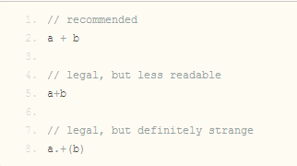
Infix Notations
The method can be called without using the Dot operator
Scala has a special punctuation-free syntax for invoking methods that take one argument. Many Scala programmers use this notation for symbolic-named methods:
Example:-

Slide 15
Local Type Inference
Scala has a built-in type inference mechanism which allows the programmer to omit certain type annotations. It is, for instance, often not necessary in Scala to specify the type of a variable, since the compiler can deduce the type from the initialization expression of the variable. Also return types of methods can often be omitted since they correspond to the type of the body, which gets inferred by the compiler.

Slide 16
Traits
Traits are used:-
When they are extended by unrelated classes
Require dependency injection
Traits – enables multiple inheritance
Traits – can’t be instantiated
Traits – A class can have multiple Traits

Slide 17
Monad
Monad is a wrapper
Monads in Scala are used to wrap objects and provide two important operations –
Identity through “unit” in Scala
Bind through “flatMap” in Scala

Slide 18
References
https://courses.bigdatauniversity.com/
http://alvinalexander.com/scala/how-to-create-scala-object-instances-without-new-apply-case-class
http://joelabrahamsson.com/learning-scala-part-four-classes-and-constructors/
https://www.dezyre.com/article/scala-interview-questions-and-answers-for-spark-developers/302

